Slide 1
Matlab Image Processing
MATLAB图像处理
Fresh business general template
Applicable to enterprise introduction, summary report, sales marketing, chart data
组员：王昊飞 汪会 韩仲明 秦楷
汇报人：优品PPT

Slide 2
Image processing toolbox
introduction
Image processing toolbox is composed of a series of functions that support image processing operations, such as geometric operations, linear filtering and filter design, image transformation, image analysis and image enhancement, mathematical morphology processing and other image processing operations,including:
Image Acquisition Toolbox（图像采集工具箱）
Image Processing Toolbox（图像处理工具箱）
Signal Processing Toolbox（信号处理工具箱）
Wavelet Toolbox （小波分析工具箱）
Statistics Toolbox （统计工具箱）
bioinformatics Toolbox（生物信息学工具箱）
A B

Slide 3
introduction
The image processing box toolkit supports four image types :
Index Images 索引色图像
Intensity Images 灰度图像
Binary Images 二值图像
RGB Images 真彩色图像

Slide 4
Indexed Images
An index image is an image in which the pixel value is subscript to the RGB palette.
An indexed image consist of a data matrix,x,and a colormap matrix map.
The palette is a color image matrix with three columns and several rows. Each row of the matrix represents one color, and a specific color is formed by three double precision Numbers that respectively represent the intensity of red, green and blue colors.
The image data is uint 8 or double precision.
Matlab palette color intensity is the floating point number in [0,1], 0 represents the darkest,1 represents the brightest.

Slide 5
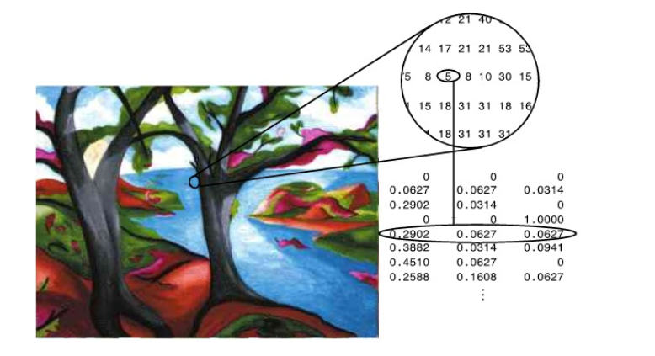
Pixel Value Are Indices to a Colormap in Indexed Images

Slide 6
The data format of Indexed Image
double precision class:Double （each pixel takes 8 bytes） | The integer class: Uint 8 (each pixel takes 1 bytes)
The array size: m×n image element value:[1,p] palette matrix: p×3 | The array size: m×n image element value:[1,p-1] palette matrix: p×3

Slide 7
Double an uint 8 of Indexed Images
1 | 2
3 | 4
image data
0 | 1
2 | 3
double
uint 8
The palette
0 | 0 | 0
0.0627 | 0.0627 | 0.0627
0 | 0 | 1
0.2902 | 0.627 | 0.627
0.3820 | 0.3578 | 1

Slide 8
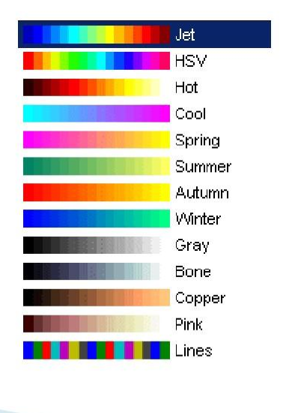
Matlab provides predefined color tables

Slide 9
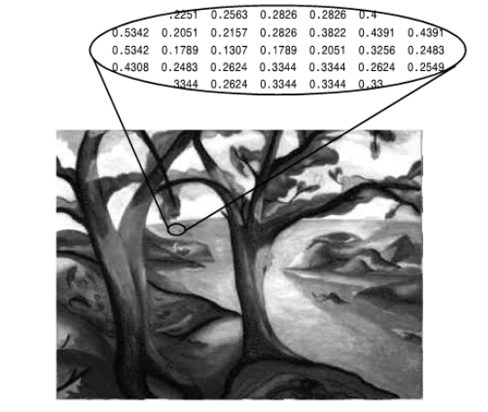
Intensity Images
MATLAB stores an intensity image as a single matrix .The matrix can be of class double,uint8.
MATLAB uses a colormap to display them.
The figure below depicts an intensity image of class
double.
Pixel Value in an Intensity Image Define Gray Levels

Slide 10
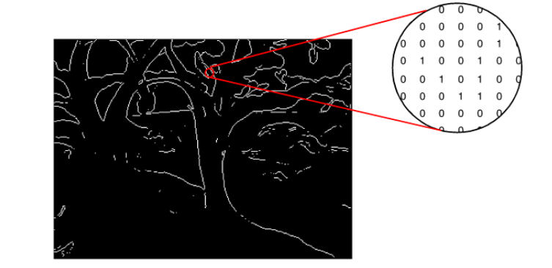
Binary Images
In a binary image ,each pixel assumes one of only two discrete values.Essentially,these two values correspond to on and off. A binary image is stored as a logical array of 0‘s(off pixels) and 1’s(on pixels) .
The figure below depicts a binary image.
Pixel Value in a Binay Image Have Two Possible Values:0 or 1

Slide 11
RGB Images
An RGB image ,sometims refered to as a truecolor image,is stored in MATLAB as an m-by-n-by-3 data array that defines R(red),G(green),anB(blue) color components for each individual pixel.If you read the pixel values at (100,50)in the image,you can view the triples(100,50,1:3).
RGB images can be stored with double precision, and the brightness value range is [0,1].
The common storage method is unsigned integer storage,and the brightness value range is [0,255].

Slide 12
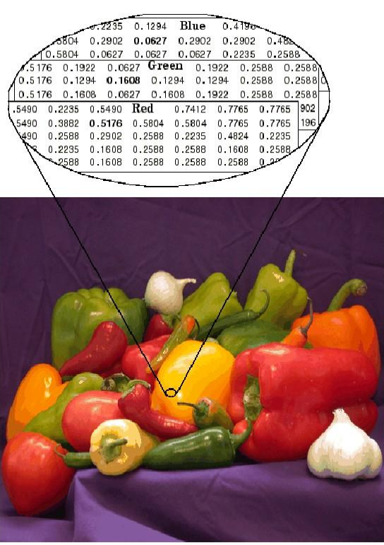
添加标题
请在此添加文字说明，编辑文字。
添加标题
请在此添加文字说明，编辑文字。
The Color Planes of an RGB Image

Slide 13
The data format of RGB Image
double precision class:Double （each pixel takes 8 bytes） | The integer class: Uint 8 (each pixel takes 1 bytes)
The array size: m×n×3 (:,:,1) — red component (:,:,2) — green component (:,:,3) — blue component Pixel values:[0,1] | The array size: m×n×3 (:,:,1) — red component (:,:,2) — green component (:,:,3) — blue component Pixel values:[0,255]

Slide 14
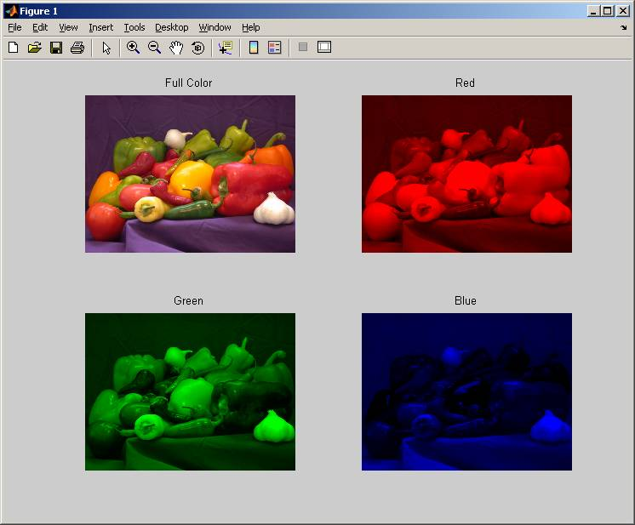
Composition of three component images
添加标题
请在此添加文字说明，编辑文字。
添加标题
请在此添加文字说明，编辑文字。

Slide 15
Thanks for watching

