Slide 1

Interactive Seller Engagement Initiative
Evoke. Engage. Empower
Team 18 : TechWiz

Slide 2
3

Slide 3
By implementing our Employee Engagement Initiative we can increase the visibility by creating interactive touchpoints that motivates seller to improve their product content.

Slide 4
Loss of Revenue and Sellers due to poor Product Content
Good product content guides and convinces a customer to buy
BUT
95% Seller Product Listing
75%
Bad Product Content
Cause
Effect 01
Effect 02
Effect 03
Effect 04
Effect 05
Poor Product Content
Poor Search Index
Poor Page Visits
Poor Conversion Rate
Opportunity Loss:
Seller Commission Revenue
Cancellation Marketplace Subscription

Slide 5
Product Demo
-

Slide 6
Ultimate Dashboard Vision
-

Slide 7
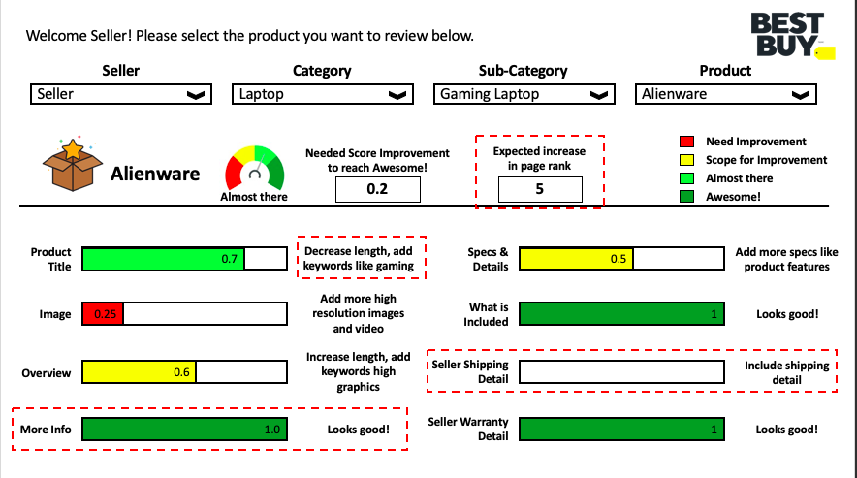

Slide 8
Limitations
1. Revenue Data was not available
2. Sales Data was not available
3. No of Visits Data was not available
4. Product Descriptions like Warranty details and More Information were not present in the Product Information
-

