Slide 1
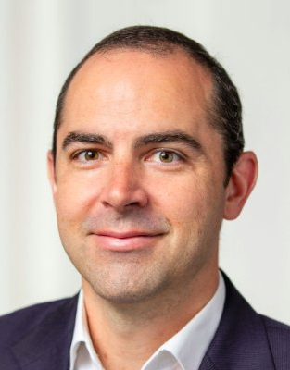
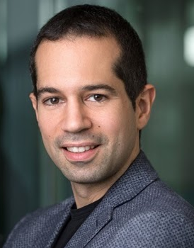
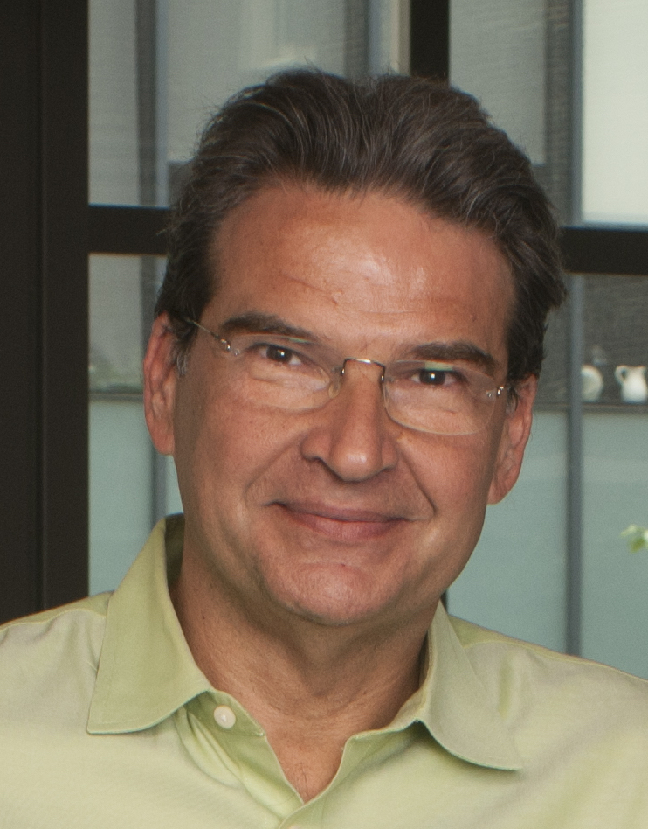
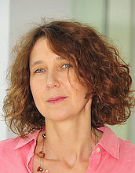
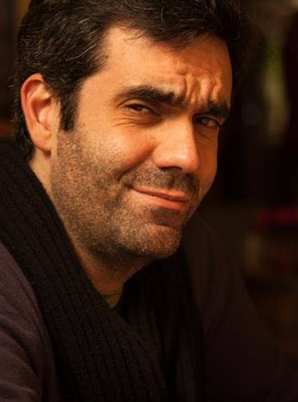
Guillermo Gallego Davide Scaramuzza Kostas Daniilidis Cornelia Fermüller Davide Migliore
TU Berlin & ECDF University of Zurich University of Pennsylvania University of Maryland Prophesee
Guillermo Gallego Davide Scaramuzza Kostas Daniilidis Cornelia Fermüller Davide Migliore
TU Berlin & ECDF University of Zurich University of Pennsylvania University of Maryland Prophesee

Slide 2
Guillermo Gallego Davide Scaramuzza Kostas Daniilidis Cornelia Fermüller Davide Migliore
TU Berlin & ECDF University of Zurich University of Pennsylvania University of Maryland Prophesee
Guillermo Gallego Davide Scaramuzza Kostas Daniilidis Cornelia Fermüller Davide Migliore
TU Berlin & ECDF University of Zurich University of Pennsylvania University of Maryland Prophesee

Slide 3
Guillermo Gallego Davide Scaramuzza Kostas Daniilidis Cornelia Fermüller Davide Migliore
TU Berlin & ECDF University of Zurich University of Pennsylvania University of Maryland Prophesee

Slide 4
Guillermo Gallego Davide Scaramuzza Kostas Daniilidis Cornelia Fermüller Davide Migliore
TU Berlin & ECDF University of Zurich University of Pennsylvania University of Maryland Prophesee

Slide 5
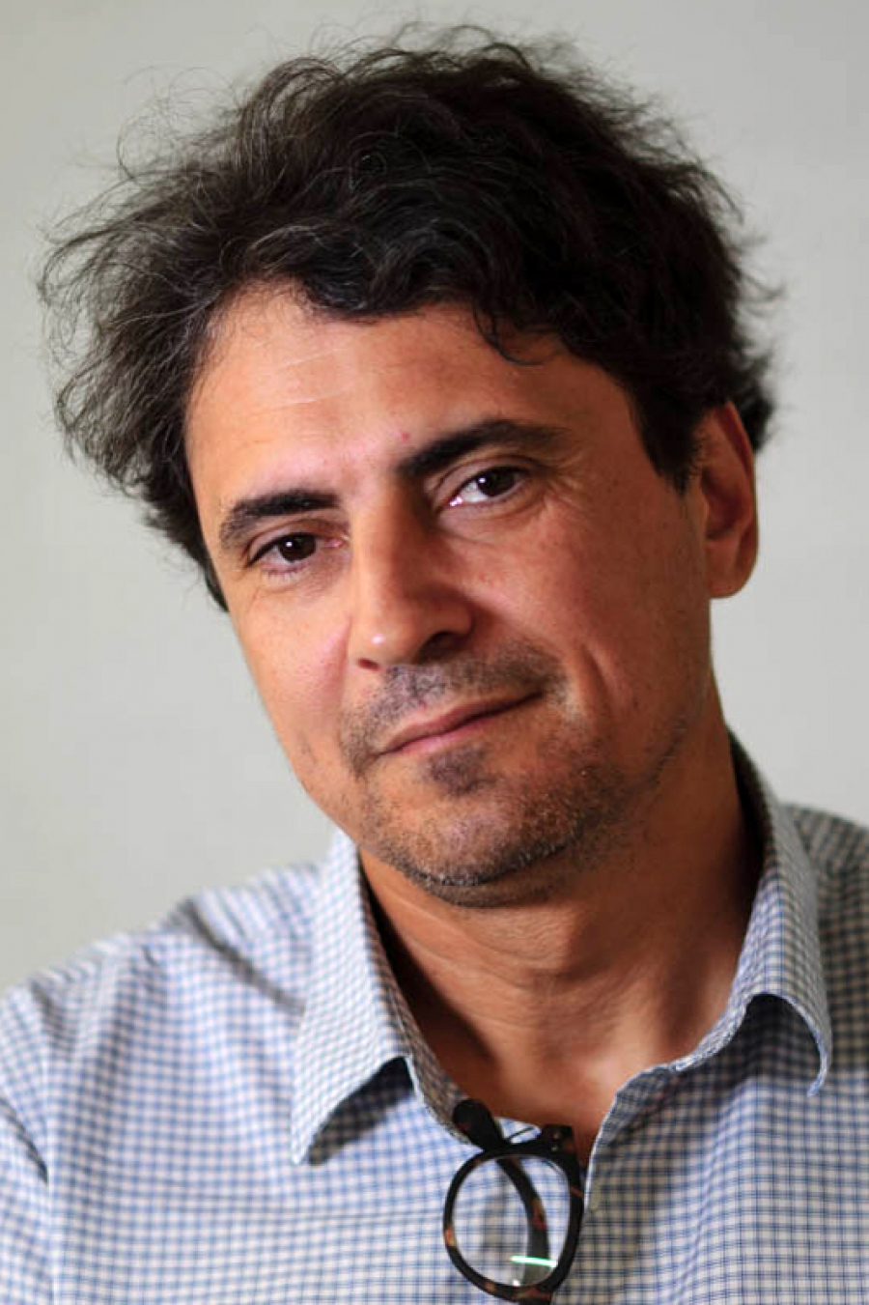
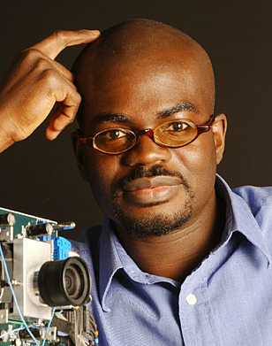
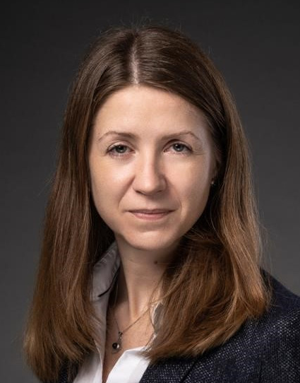
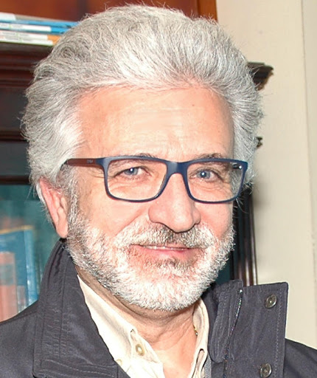
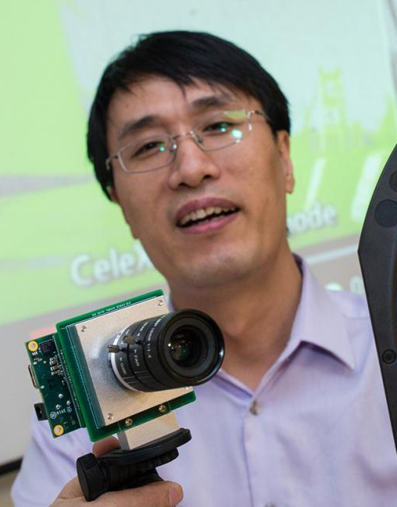
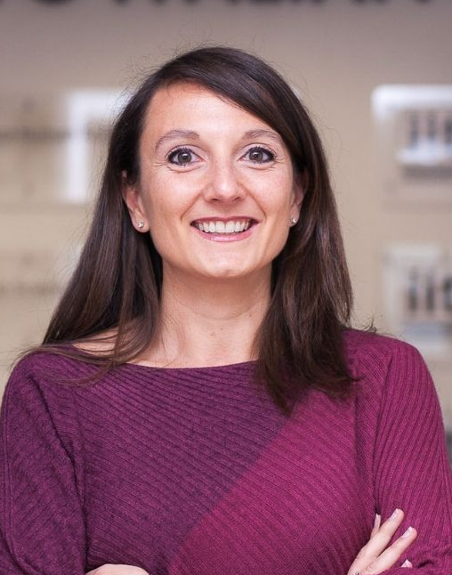
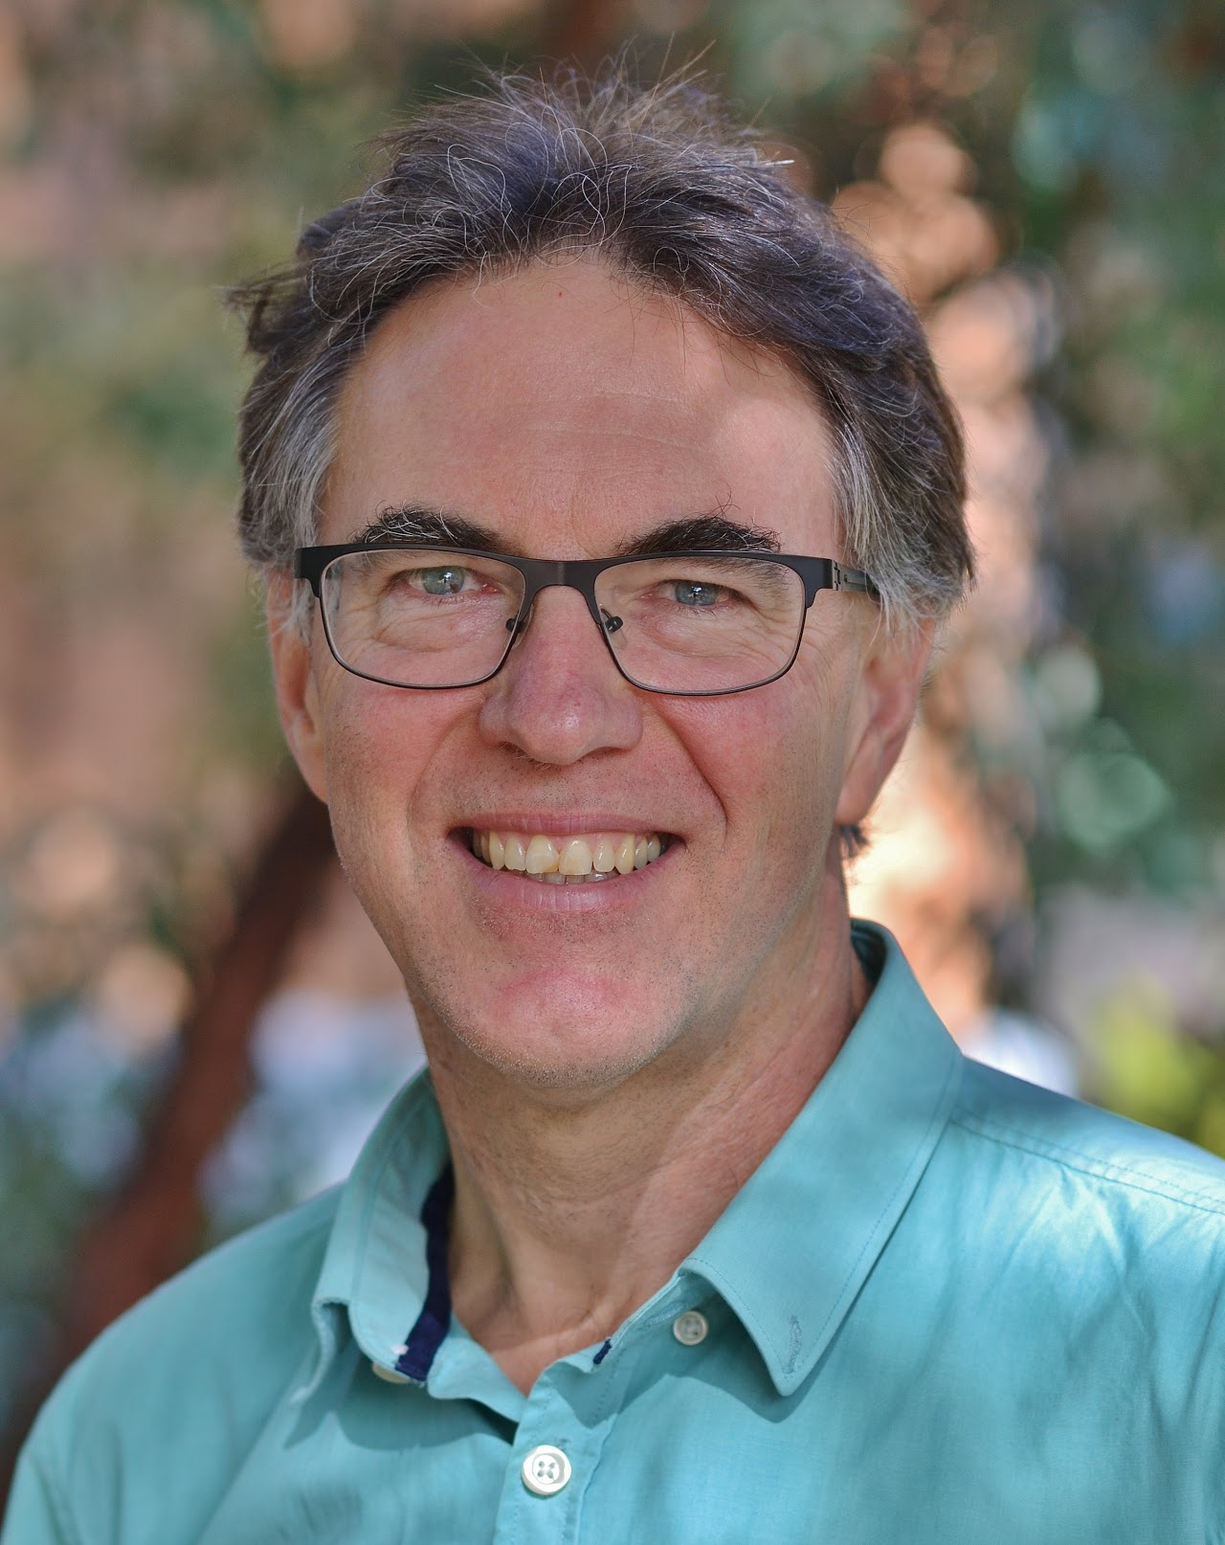
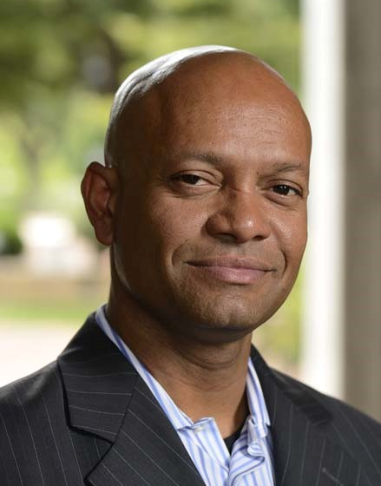
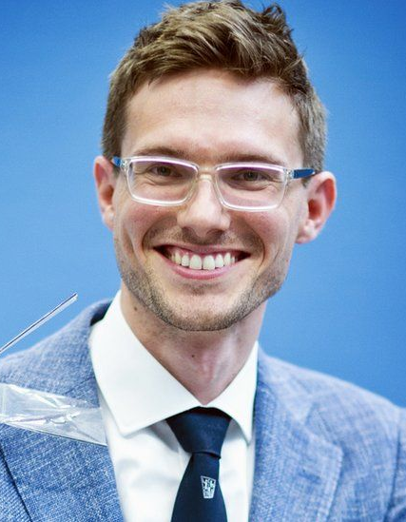
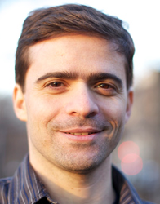
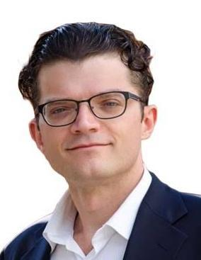
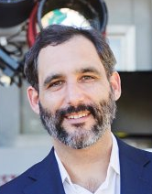
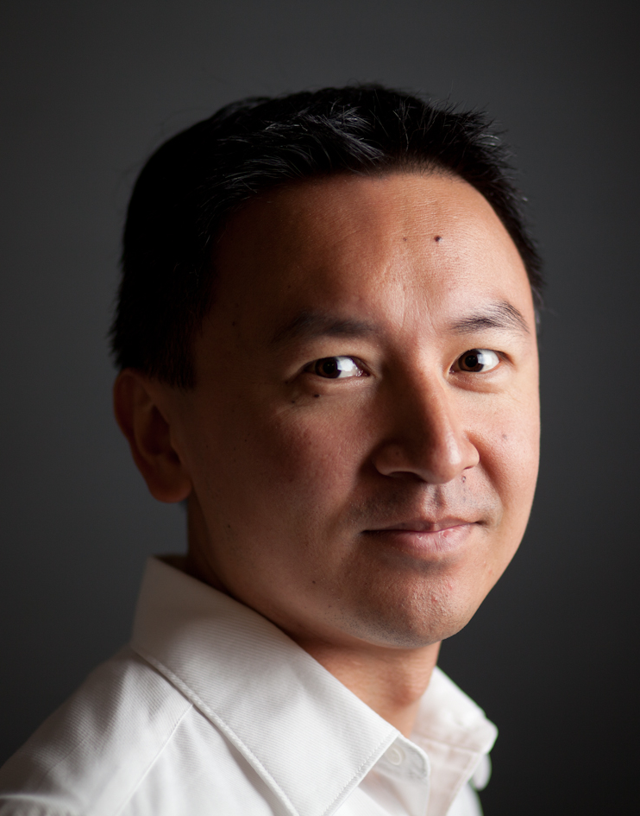
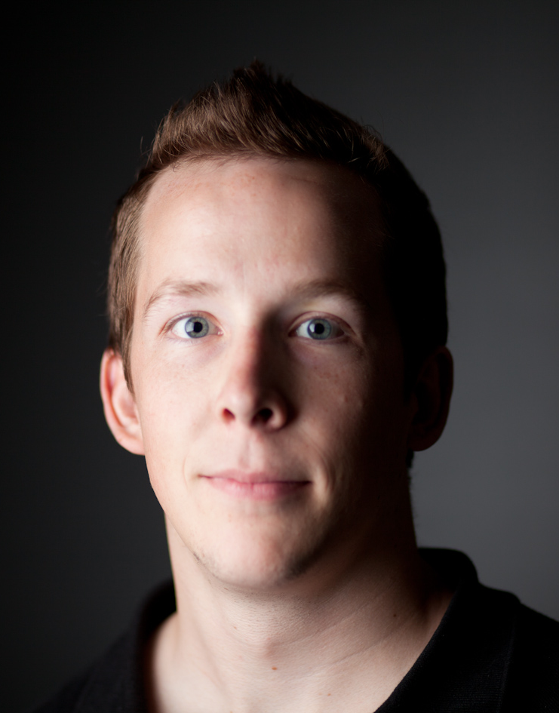
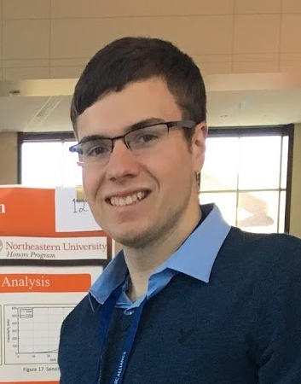
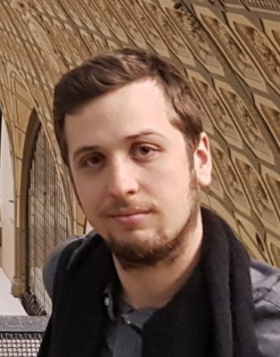
Ryad Benosman Kwabena Boahen Yulia Sandamirskaya Bernabé Linares-Barranco
U. Pittsburgh, CMU, Sorbonne Stanford Univ. Intel Labs IMSE-CNM, CSIC, U. Seville
Shoushun Chen Chiara Bartolozzi Robert Mahony Ralph Etienne-Cummings
Will Semiconductor Istituto Italiano di Tecnologia Australian National Univ. Johns Hopkins Univ.
Guido de Croon Oliver Cossairt Luca Verre Gregory Cohen
TU Delft Northwestern University Prophesee Western Sydney Univ.
Kynan Eng Christian Brändli Anthony Bisulco Ignacio Alzugaray
iniVation AG Sony AVS Samsun AI-NY ETH Zurich

Slide 6
Ryad Benosman Kwabena Boahen Yulia Sandamirskaya Bernabé Linares-Barranco
U. Pittsburgh, CMU, Sorbonne Stanford Univ. Intel Labs IMSE-CNM, CSIC, U. Seville
Shoushun Chen Chiara Bartolozzi Robert Mahony Ralph Etienne-Cummings
Will Semiconductor Istituto Italiano di Tecnologia Australian National Univ. Johns Hopkins Univ.
Guido de Croon Oliver Cossairt Luca Verre Gregory Cohen
TU Delft Northwestern University Prophesee Western Sydney Univ.
Kynan Eng Christian Brändli Anthony Bisulco Ignacio Alzugaray
iniVation AG Sony AVS Samsun AI-NY ETH Zurich

