Slide 1

بسم الله الرحمن الرحيم
Fundamentals of Data Networks
Chapter 1: Introduction

Slide 2
Chapter 1: Introduction
1.1 Data Communications
1.2 Networks
1.3 The Internet
1.4 Protocols and Standards

Slide 3
Introduction
Data communications and networking
  Change the way we do business and the way we live
  Business decisions have to be made more quickly
  Decision depends on immediate access to accurate information
  Business today rely on computer networks and internetworks
  Before get hooked up, we need to know:
    How networks operate
    What types of technologies are available
    Which design best fills which set of needs

Slide 4
Introduction
  Development of the PC changes a lot in business, industry, science and education.
  Similar revolution is occurring in data communication and networking
    Technologies advances are making it possible for communications links to carry more and faster signals
    Services are evolving to allow the use of this expanded capacity
    For example telephone services extended to have:
      Conference calling
      Call waiting
      Voice mail
      Caller ID

Slide 5

1.1 Data Communications
  Communication:
    Means sharing information
      Local (face to face) or remote (over distance)
    Telecommunication
      Telephone, telegraph and television
      Means communication at a distance
      Tele is Greek for far

Slide 6
Data Communications
  Data:
    Refers to information
      Presented in any form
      Agreed upon by the parties ( creating & using)
  Data communication : is the exchange of data between two devices via some form of transmission medium (wire cable).

Slide 7
Data Communications
  Communication system made up of a combination of hardware and software
  Effectiveness of data communication system depends on:
    Delivery : The system must deliver data to correct destination. Data received by the indented user only
    Accuracy: The system must deliver data accurately (no change).
      Data changed & uncorrected is unusable

Slide 8
Data Communications
    Timeliness: The system must deliver data in timely manner
      Data arrived late are useless
      In the same order (video and audio) & without delay (Real time transmission)
    Jitter: Variation in the packet arrival time (uneven quality in the video is the result)

Slide 9
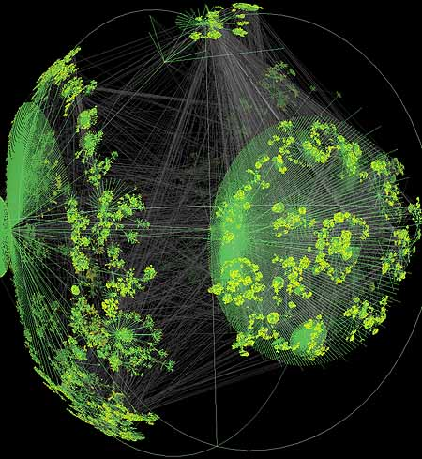
Data Communications

Slide 10

Components
  A data communication system is made up of five components

Slide 11
Components
  Message: the information (data) to be communicated
    Consist of text, numbers, pictures, audio, or video
  Sender: the device that sends the data message
    Computer, workstation, telephone handset, video camera, …
  Receiver: the device that receives the message
    Computer, workstation, telephone handset, television, ….

Slide 12
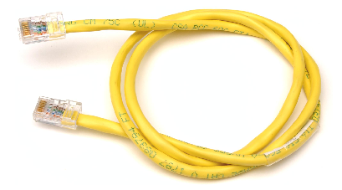


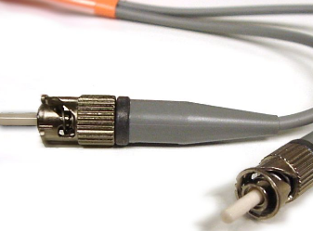
Components
  Medium: The physical path by which a message travels from sender to receiver
    twisted pair, coaxial cable, fiber-optic, radio waves

Slide 13
Components
  Protocol: a set of rules that govern data communications
    An agreement between the communicating devices
    Devices may be connected but not communicating (no protocol)
    Arabic speaker with Japanese speaker

Slide 14
Data Representation
Text
Numbers
Images
Audio
Video

Slide 15
Data Representation
Text:
  Sequence of bits (0s or 1s)
  Different sets of patterns to represent text symbols (each set is called: code)
  ASCII: 7 bits (128 symbols)
  common coding system today is:
  Unicode uses: 32 bits to represent a symbol or character in any language
Unicode
(4,294,967,296)

Slide 16
Data Representation
Numbers:
  Represented by bit patterns
  The number is directly converted to a binary number

Slide 17
Data Representation
Images:
  Represented by bit patterns
  A matrix of
  Resolution: size of the pixels
  High resolution: more memory is needed
  Each pixel is assigned a bit pattern
    1-bit pattern (black and white dots image)
    2-bit pattern (4 levels of gray)
    RGB (color images)
pixels

Slide 18
Data Representation
Audio:
  Continuous not discrete
  Change to digital signal
Video:
  Recording or broadcasting of a picture or movie
  Change to digital signal

Slide 19
Data Flow
Communication between two devices can be:
  Simplex
  Half-Duplex
  Full-Duplex

Slide 20
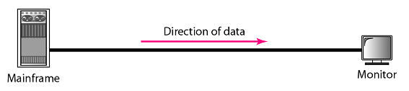
Data Flow
Simplex (one way street)
  The communication is unidirectional
  Only one device on a link can transmit; the other can only receive
  Use the entire capacity of the channel to send data
  Example: Keyboards, Monitors
Data

Slide 21

Data Flow
Half-Duplex (one-lane with two-directional traffic)
  Each station can both transmit and receive, but not at the same time
  When one device is sending, the other can only receive, and vice versa
  The entire capacity of a channel is taken over by the transmitting device
  Example: Walkie-talkies
Data
Data

Slide 22

Data Flow
Full-Duplex (Duplex) (two-way street)
  Both stations can transmit and receive at same time
  Signals going in either direction sharing the capacity of the link
  Sharing can occur in two ways:
    Link has two physically separate transmission paths
      One for sending and the other for receiving
    The capacity of the channel is divided between signals travelling in both directions
  Example: Telephone network
Data
Data

Slide 23

Exercise
What mode of data flow the following exhibits shows?
Answer: Full-Duplex
Data
Data

Slide 24
Networks
  Network : A set of devices (nodes) connected by communication links
    Node : computer, printer, …
    Distributed Processing :
      Most networks used it
      Task is divided among multiple computers instead of one single large computer

Slide 25
Networks
Network Criteria
    Network must meet a certain number of criteria
    The most important of the network criterions are:
      Performance
      Reliability
      Security

Slide 26
Networks
Performance
  Transit time: A mount of time required for a message to travel from one device to another
  Response time: Elapsed time between an inquiry and a response

Slide 27
Networks
Performance
  Performance depends on :
    1- Number of users: large number slow response time.
    2- Type of transmission medium: fiber-optic cabling faster than others cables.
    3- Capabilities of the connected hardware: affect both the speed and capacity of transmission.
    4- Efficiency of the software: process data at the sender and receiver and intermediate affects network performance.

Slide 28
Networks
Performance
  Performance is evaluated by two contradictory networking metrics:
    Throughput (high): a measure of how fast we can actually send data through a network
    Delay (low)

Slide 29
Networks
Reliability
  Reliability is measured by:
    Frequency of failure
    Recovery time of a network after a failure
    Network’s robustness in a catastrophe: protect by good back up network system

Slide 30
Networks
Security
  Protecting data from unauthorized access
  Protecting data from damage and development
  Implementing policies and procedures for recovery from breaches and data losses (Recovery plan)

Slide 31
Networks
Physical Structures:
  Type of connection
    Network: Two or more devices connected through links
    Link: Communication pathway that transfers data from one device two another
    Two devices must be connected in some way to the same link at the same time. Two possible types:
      Point-to-Point
      Multipoint

Slide 32

Networks
Point-to-Point
  Dedicated link between two devices
  Entire capacity of the link is reserved for transmission between those two devices
  Use an actual length of wire or cable

Slide 33
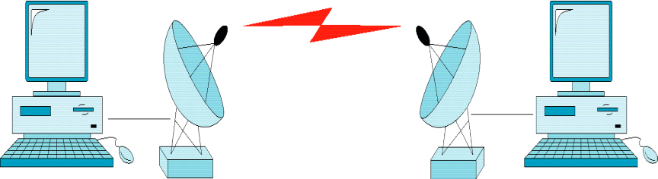
Networks
Point-to-Point
  Other options, such as microwave or satellite is possible
  Example: Television remote control

Slide 34
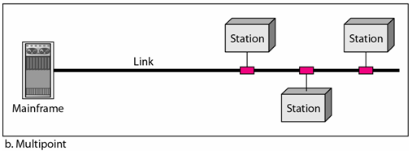
Networks
Multipoint (multidrop)
  More than two devices share a single link
  Capacity is shared
  Channel is shared either spatially or temporally
    Spatially shared: if devices use link at same time
    Timeshare: if users must take turns

Slide 35
Networks
Physical Topology
  The way a network is laid out physically
  Two or more links form a topology
  The topology of a network is the geometric representation of the relationship of all the links and linking devices (nodes) to one another.
  Four topologies : Mesh, Star, Bus, and Ring

Slide 36
Categories of Networks
Network Category depends on its size
Two primary categories
  LAN: Covers area < 2miles
  WAN: Can be worldwide
  MAN: Between LAN & WAN, span 10s of miles

Slide 37
Local Area Network (LAN)
Privately owned
Links devices in the same office, building, or campus
Simple LAN: 2 PCs & 1 printer in home or office
Size is limited to a few kilometers
Allow resources to be shared (hardware, software, or data)

Slide 38

Local Area Network (LAN)
An isolated LAN connecting 12 computers to a hub in a closet

Slide 39
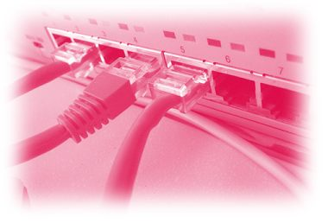
Local Area Network (LAN)
LAN is distinguished by:
  Size (# users of OS, or licensing restrictions)
  Transmission medium (only one type)
  Topology (bus, ring, star)
Data Rates (speed):
  Early: 4 to 16 Mbps
  Today: 100 to 1000 Mbps

Slide 40
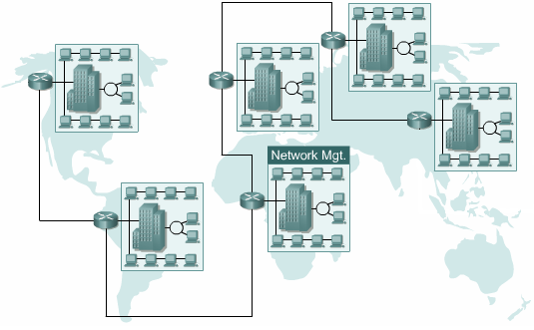
Wide Area Networks (WAN)
Provides long-distance transmission of data over large geographic areas (country, continent, world)

Slide 41
Wide Area Networks (WAN)
Switched WAN
  Backbone of the Internet
Dialup line point-to-point WAN
  Leased line from a telephone company

Slide 42

Wide Area Networks (WAN)

Slide 43
Metropolitan Area Networks (MAN)
Size between LAN and WAN
Inside a town or a city
Example: the part of the telephone company network that can provide a high-speed DSL to the customer

