Slide 1
Definition:In information technology, a network is a series of points or nodes interconnected by communication paths. Networks can interconnect with other networks and contain subnetworks.

Slide 2
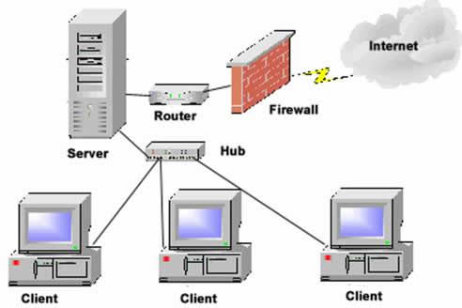

Slide 3
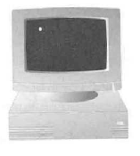
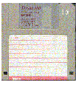
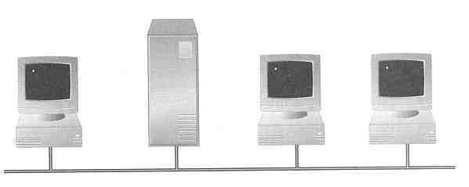
Why Computer Network?
Sharing information — i.e. data communication
Do you prefer these?
Or this?

Slide 4

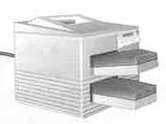
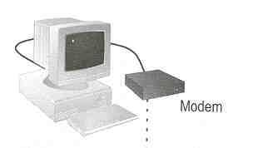
Why Computer Network?
Sharing hardware or software
E.g. print document
Centralize administration and support
E.g. Internet-based, so everyone can access the same administrative or support application from their PCs

Slide 5
Why Computer Network?
Sharing Resources
  Files, CDROM, Disk drive, printers
Back up:
  data stored on a server
Groupware applications:
  Collaborate on the same document.

Slide 6



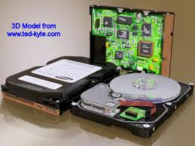

Why Computer Network?
A resource may be:
A file
A folder
A printer
A disk drive
Or just about anything else that exists on a computer.

Slide 7
Issues
Crashes :
  Server crashes means loss of data and time
Security :
  If security is weak , there may be unauthorized access
Privacy :
  loss of privacy

Slide 8
Performance depends on
  Number of users
    Assessment of the average number of users that will be communicating at peak loads, actual number of users are greater than average.
  Medium
    Defines the data rate of data
  Hardware
    Affects both the speed and capacity of transmission.
  Software
    Used to process data at the Sender ,receiver and intermediate node.

Slide 9
Performance depends on
Security
  Unauthorized access
    Sensitive data must be protected
  Lowest level
    Passwords
  Higher level
    Encryption techniques( alteration of data)
  Virus
    A network is accessible form many points so it is susceptible to computer virus.

Slide 10
Applications of Networks
Resource Sharing
  Hardware (computing resources, disks, printers)
  Software (application software)
Information Sharing
  Easy accessibility from anywhere (files, databases)
  Search Capability (WWW)
Communication
  Email
  Message broadcasting

Slide 11
Applications of Networks
Marketing/Sales
  collect, exchange and analyze data related to customer needs
  On line reservation services hotel/airline
Financial Service
  EFT /ATM
Info Services
Teleconferencing
Cell phone

Slide 12
The Following list presents categories used for classifying network:
Based on their scale, networks can be classified as
Local Area Network (LAN)
Wide Area Network (WAN)
Metropolitan Area Network (MAN)

Slide 13

This is a network covering a small geographic area, like a home, office, or building.
Current LANs are most likely to be based on Ethernet technology.
LANs are designed to allow resources to be shared between personal computers or workstations.
The resources to be shared can include hardware (e.g., printer), software (e.g., an application program) or data.

Slide 14
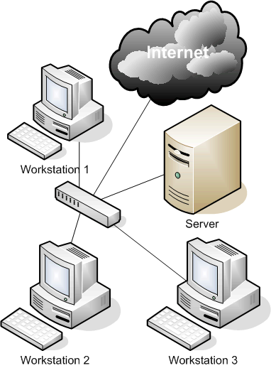

Slide 15

A Metropolitan Area Network is a network that connects two or more Local Area Networks or Campus Area Networks together but does not extend beyond the boundaries of the immediate town/city.
Routers, switches and hubs are connected to create a Metropolitan Area Network.

Slide 16

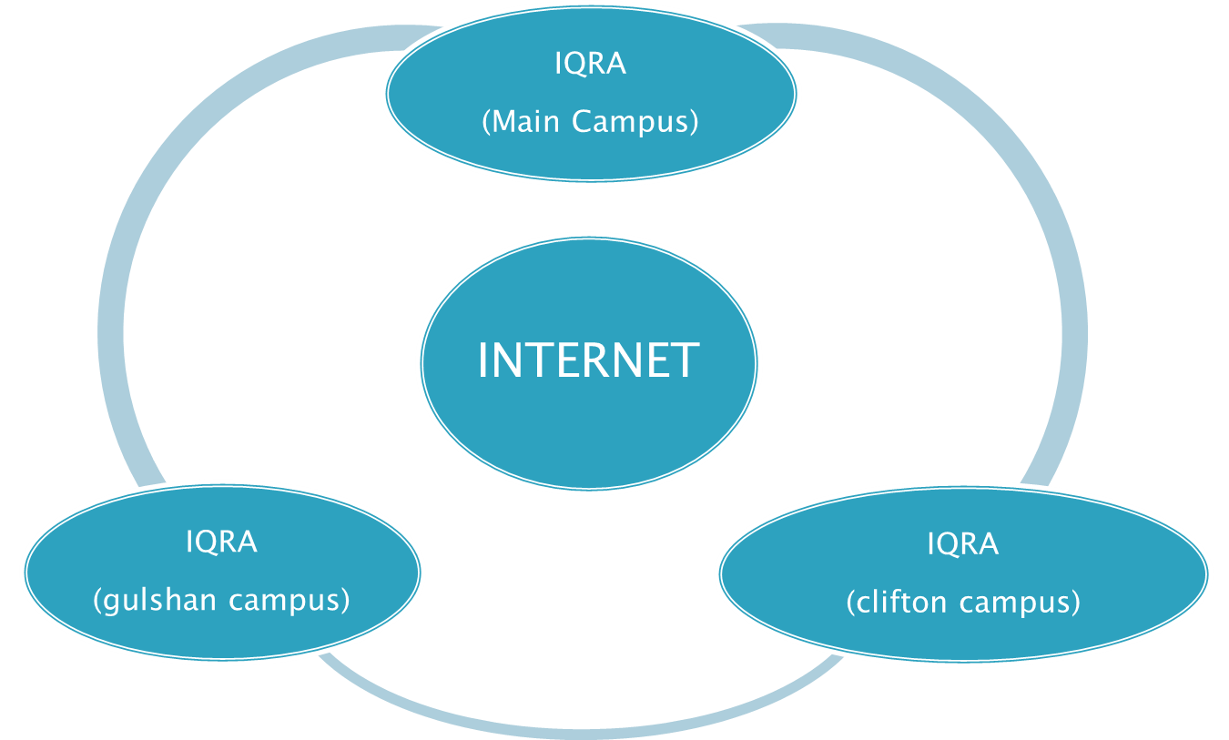

Slide 17

A WAN is a data communications network that covers a relatively broad geographic area (i.e. one city to another and one country to another country) and that often uses transmission facilities provided by common carriers, such as telephone companies.
WAN technologies generally function at the lower three layers of the OSI reference model: the physical layer, the data link layer, and the network layer.

Slide 18
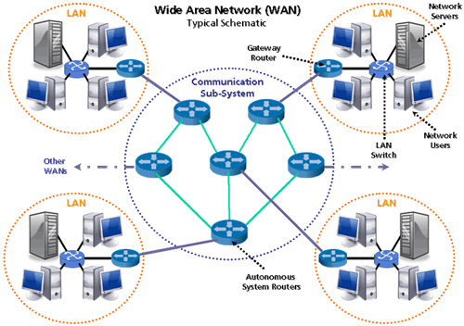

Slide 19
In modern practice, the interconnected networks use the Internet Protocol. There are at least three variants of internetwork, depending on who administers and who participates in them:
Intranet
Extranet
Internet

Slide 20
An "intranet" is the generic term for a collection of private computer networks within an organization.
The main purpose of an intranet is to share company information and computing resources among employees
An intranet can be understood as a private version of the Internet, or as a private extension of the Internet confined to an organization.
An organization's intranet does not necessarily have to provide access to the Internet. When such access is provided it is usually through a network gateway with a firewall.

Slide 21
An "extranet" is a computer network that allows controlled access from the outside for specific business or educational purposes.
Allowing controlled access to an otherwise private company network enables business-to-business transactions and file sharing.
An extranet can be viewed as part of a company's intranet that is extended to users outside the company (e.g.: normally over the Internet.

Slide 22
The Internet is a specific internetwork.
It consists of a worldwide interconnection of governmental, academic, public, and private networks based upon the networking technologies of the Internet Protocol Suite.
It is the successor of the Advanced Research Projects Agency Network (ARPANET) developed by DARPA of the U.S. Department of Defense.
The Internet is also the communications backbone underlying the World Wide Web (WWW).
The 'Internet' is most commonly spelled with a capital 'I' as a proper noun, for historical reasons and to distinguish it from other generic internetworks.

Slide 23

All networks are made up of basic hardware building blocks to interconnect network nodes, such as Network Interface Cards (NICs), Bridges, Hubs, Switches, and Routers. In addition, some method of connecting these building blocks is required, usually in the form of cables (most commonly Category 5 cable) and wireless.

Slide 24
A network card, network adapter or NIC (network interface card) is a piece of computer hardware designed to allow computers to communicate over a computer network.
It provides physical access to a networking medium and often provides a low-level addressing system through the use of MAC addresses.
It allows users to connect to each other either by using cables or wirelessly.
The NIC provides the transfer of data in megabytes

Slide 25
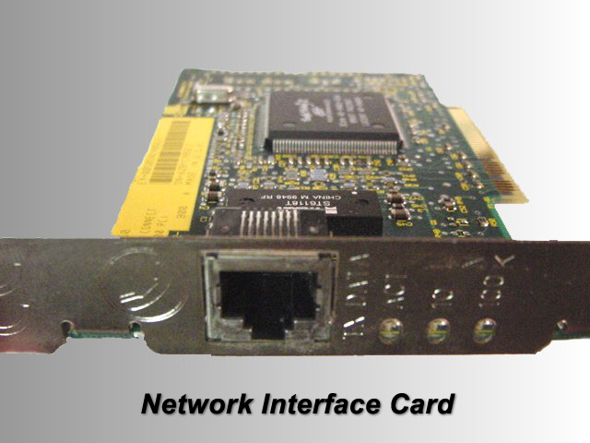

Slide 26

Most telephone lines attached to home and businesses are analog, not digital.
Because PCs transmit and receive data in digital format, a device called a modem is needed to convert digital data to analog format for transmission over phone lines.
When receiving data from another computer, the modem converts it from analog format to digital format.

Slide 27
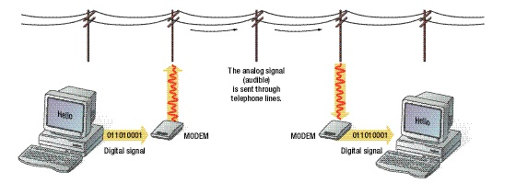
The analog signal
(audible)
is sent through
telephone lines.
011010001
011010001
This modem converts
digital to analog.
This modem converts
analog to digital.

Slide 28

A repeater is an electronic device that receives a signal and retransmits it at a higher power level, or to the other side of an obstruction, so that the signal can cover longer distances without degradation.
In most twisted pair Ethernet configurations, repeaters are required for cable runs longer than 100 meters away from the computer

Slide 29

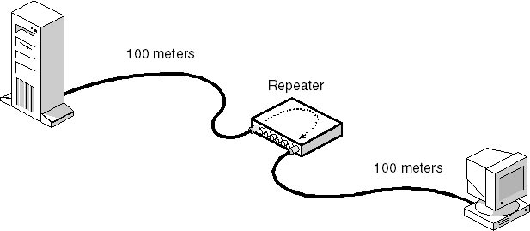

Slide 30
A hub contains multiple ports. When a packet arrives at one port, it is copied to all the ports of the hub for transmission.
Hub works at physical layer of OSI model.
Hub has one collision domain.
Hub has one broadcast domain.

Slide 31

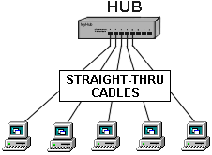
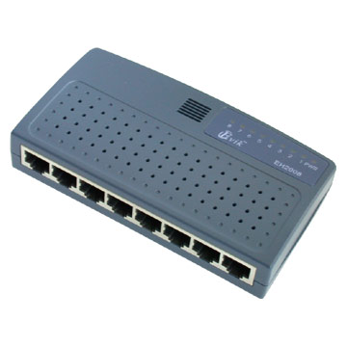

Slide 32

A switch is a device that performs switching. Specifically, it forwards and filters OSI layer 2 datagrams.
Switch forwards frames based on the MAC addresses.
A switch is used to segment a network.
Some switches are capable of routing based on IP addresses e.g Cisco layer 3 Switch.

Slide 33

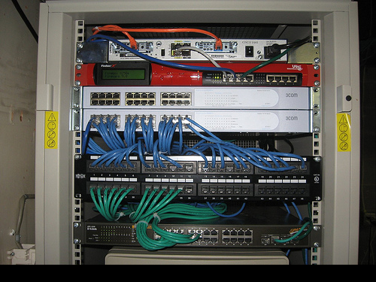

Slide 34

Routers are networking devices that forward data packets between networks.
Routers work at the network layer of the OSI model.
Router uses logical addresses (IP address).
Router select the best path from its routing table to forward the packets to remote destination.
Example: It is mainly used by Internet Service Providers (i.e. ISP), Banks etc.

Slide 35

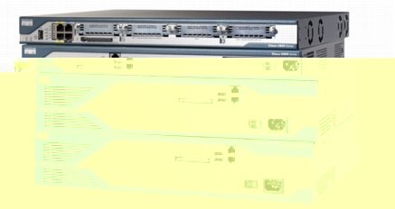

Slide 36

The hardware and software that transmits information from one location to another
Components include:
Hardware
Media
Networks
Software
Data comm providers
Protocols
Applications

Slide 37

Analog signals
  Continuous waves
  Information conveyed by changing wave characteristics (amplitude and frequency)
Digital signals
  Discrete pulses
  Information conveyed in binary form (on or off pulses)
  Easily understood by computer

Slide 38

Hardware devices utilized in data transmission and reception
  Modem - device that converts analog signals to digital (and vice versa); enables signal transmission over telephone system
  Multiplexor - device that transmits multiple signals over single medium
  Front-end processor – specialized computer dedicated to managing communication tasks

Slide 39

The topology of a network is its shape or the layout of its cable. The factors considered in choosing a cable system are: its cost, throughput and integrity. The types of network topologies are: Bus, Star, Ring, Tree and Mesh. Some network types can use more than one topology. For example, Ethernet networks can be laid out in a Bus, Star, or Tree topology, or any combination of the three.

Slide 40

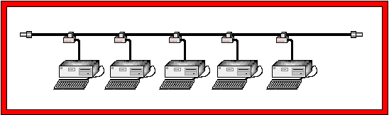
The common bus topology is one where computers are connected using one or more parallel lines. In this method each device listens to the bus and examines it data traffic. One popular form of bus network is Ethernet. Its common bus typically is the Ethernet Cable, which consists of copper, optical fiber or combinations of both. The major advantage of a bus is the ability to add new devices to the network easily.

Slide 41
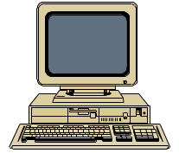
A bus topology uses one long cable, called the backbone. Short cables, called drop cables, can be attached to the backbone using t- connectors. The backbone is terminated at both ends.

Slide 42

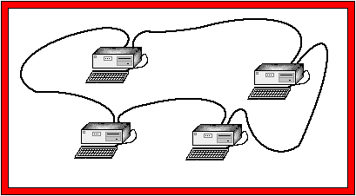
In a ring topology computers are connected circularly. Each computer in the ring can only communicate directly with the computer on either side of it. If it wants to communicate with a device further away, it sends a message that passes through each device in between. IBMs Token Ring is a variation of the ring topology.

Slide 43
Destination
A free token is routed around the ring. As it passes around the ring, it polls devices on the network to see if they want to transmit data.
Source

Slide 44

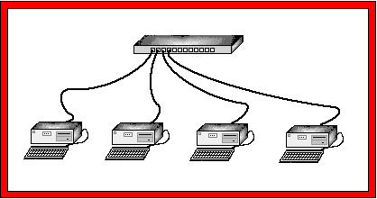
Star topology uses a central computer that communicates with other devices on the network. Control is centralized, if a computer wants to communicate is has to go through the central computer or concentrator.

Slide 45

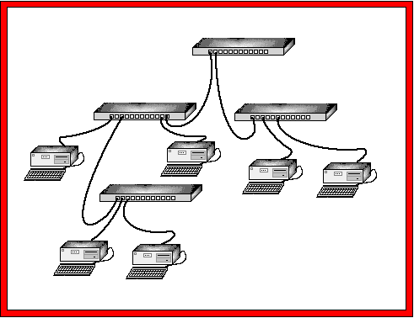
tree topology can be thought of as being a "Star of Stars" network. In a Tree network, each device is connected to its own port on a concentrator in the same manner as in a Star.

Slide 46

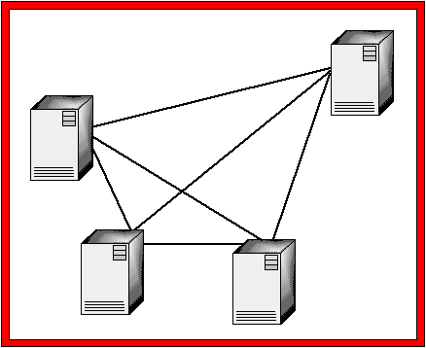
A Mesh topology consists of a network where every device on the network is physically connected to every other device on the network. This provides a great deal of performance and reliability, however the complexity and difficulty of creating one increases as the number of nodes on the network increases.
for example, a three or four node mesh network is relatively easy to create, whereas it is impractical to set up a mesh network of 100 nodes. Mesh networks are not used much in local area networks (LANs) but are used in Wide Area Networks (WANs) where reliability is important and the number of sites being connected together is fairly small.

Slide 47
Advantages and Disadvantages
Bus Topology
Advantages
Disadvantages
Low cost to create
High management cost
Less media used
Difficult to troubleshoot
One goes down, doesn’t affect rest.
All units affected by media failure.

Slide 48
Advantages and Disadvantages
Star Topology
Advantages
Disadvantages
more costly-uses more media
Easy to configure
Easy to troubleshoot
If hub fails, entire network fails
One goes down it doesn’t affect rest.
Hub can become bottleneck

Slide 49
Advantages and Disadvantages
Ring Topology
Advantages
Disadvantages
Cable faults easily identified.
More difficult to install
It can span longer distances. Each host repeats and amplifies signal.
media failure on a single unidirectional loop cause comple network failure

Slide 50
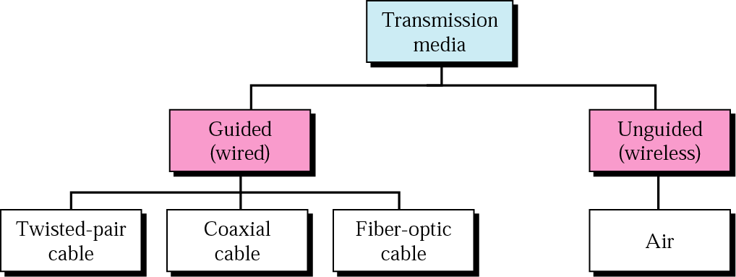
Classes of transmission media

Slide 51
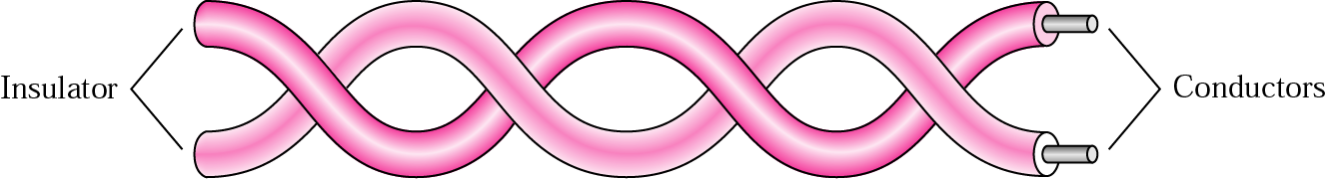
Twisted-pair cable

Slide 52
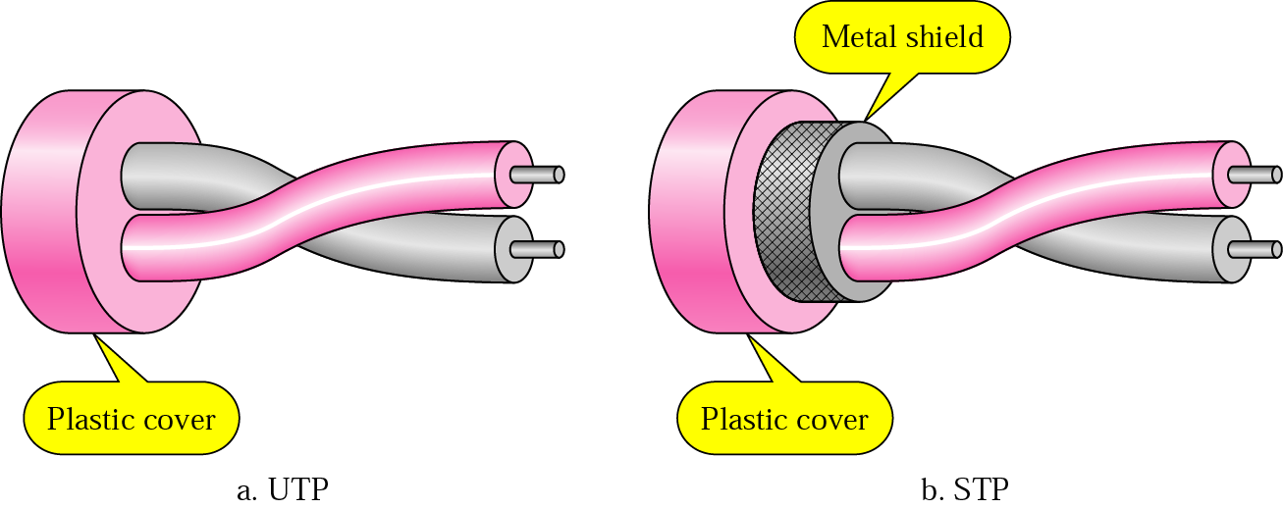
UTP and STP

Slide 53
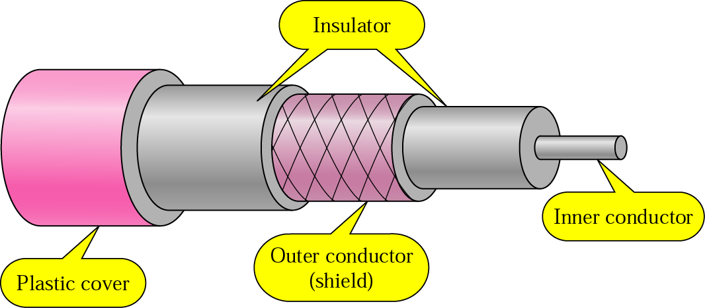
Coaxial Cable

Slide 54
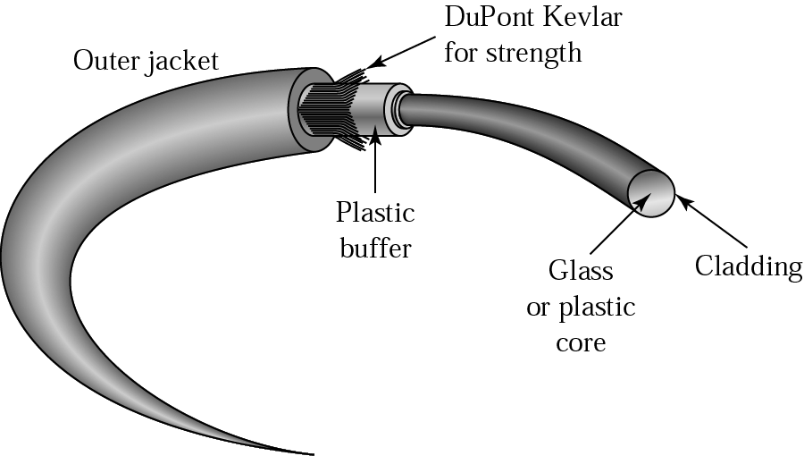
Fiber construction

Slide 55

Twisted-pair wire (telephone wire)
  Cheap and easy to work with
  Slow; subject to interference; low security
Coaxial cable
  Carries more data; shielded from interference
  More expensive; harder to work with; low security

Slide 56
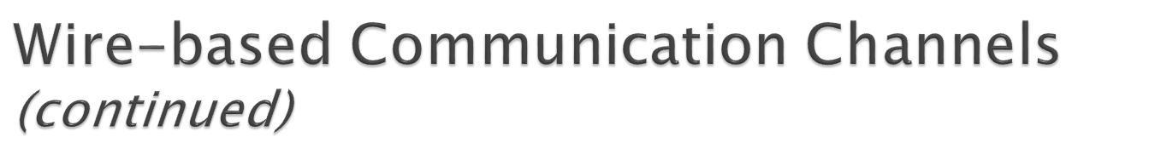
Fiber-optic cable
  Transmit information as light waves through glass fiber
  Fast; high-capacity; secure; not subject to interference
  Hard to work with

Slide 57

Microwave
  High capacity; inexpensive relative to wire
  Requires line of sight transmission towers; subject to environmental interference
Satellite
  Very high capacity; large coverage area
  Expensive; propagation delay; requires encryption for security

Slide 58
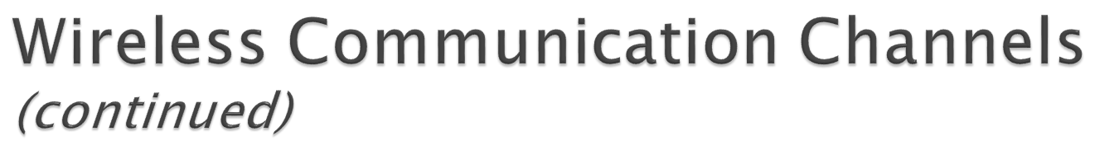
Radio
  Suitable for short distance communication; inexpensive; easy to install; high speed
  Interference problems; insecure
Cellular radio technology
Infrared

