Slide 1

Music Genres in Spotify
CSE 454 DATA MINING PROJECT
TUBA TOPRAK - 161044116
Instructor: BURCU YILMAZ
2021- 2022

Slide 2


Dataset and Data cleaning
I have a dataset of close to 100,000 rows and 10 columns containing musical styles.
(unnamed) , artist_names, artists_id, danceability, energy, valence, tempo, loudness, mode, key
Dataset cleaning , Unnamed column has been deleted.

Slide 3
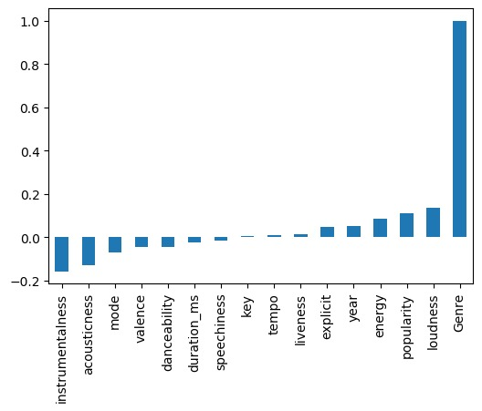
Correlation
Correlation between genre and the other features was analyzed
using “pearson correlation”

Slide 4
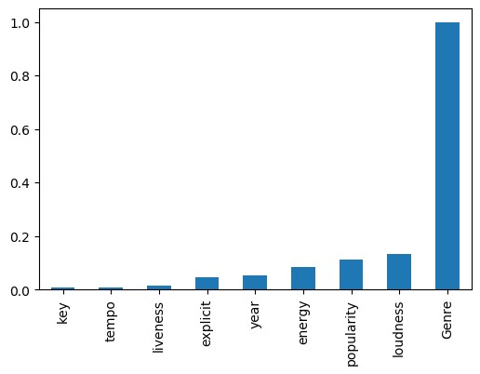
Feature Selectıon
•I created a subset by selecting the data that has a positive correlation with the genre feature, and thus we applied he feature selection process.

Slide 5
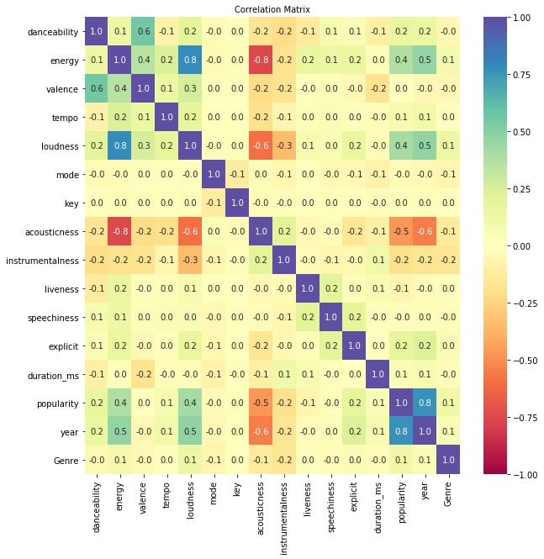
CorRelatıon matrıx

Slide 6
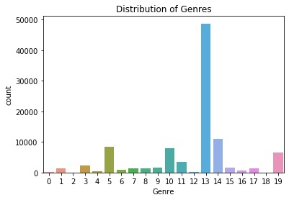
Distributions of music types

Slide 7
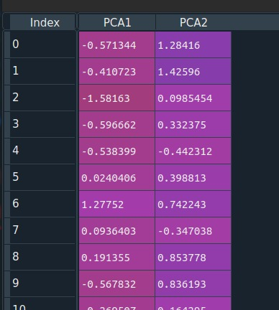
Dımensıonalıty reductıon (PCA)

Slide 8
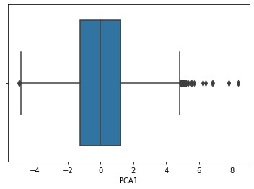
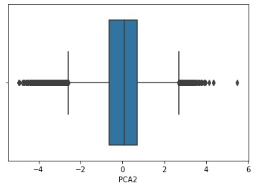
OUTLIER DETECTION

Slide 9
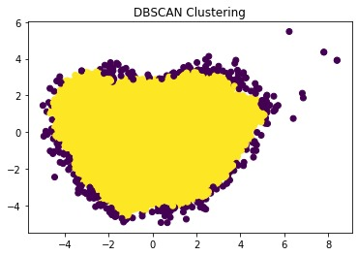
DBSCAN Clustering

Slide 10
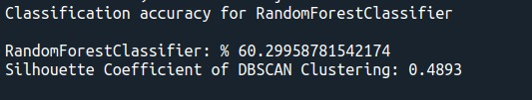
Random Forest Classifier

