Slide 1
Predicting cuisine name from recipe ingredients
CSE 496
Final Presentation
Tuba TOPRAK
Advisor: Yrd. Doç. Dr. Burcu YILMAZ
January 2023

Slide 2
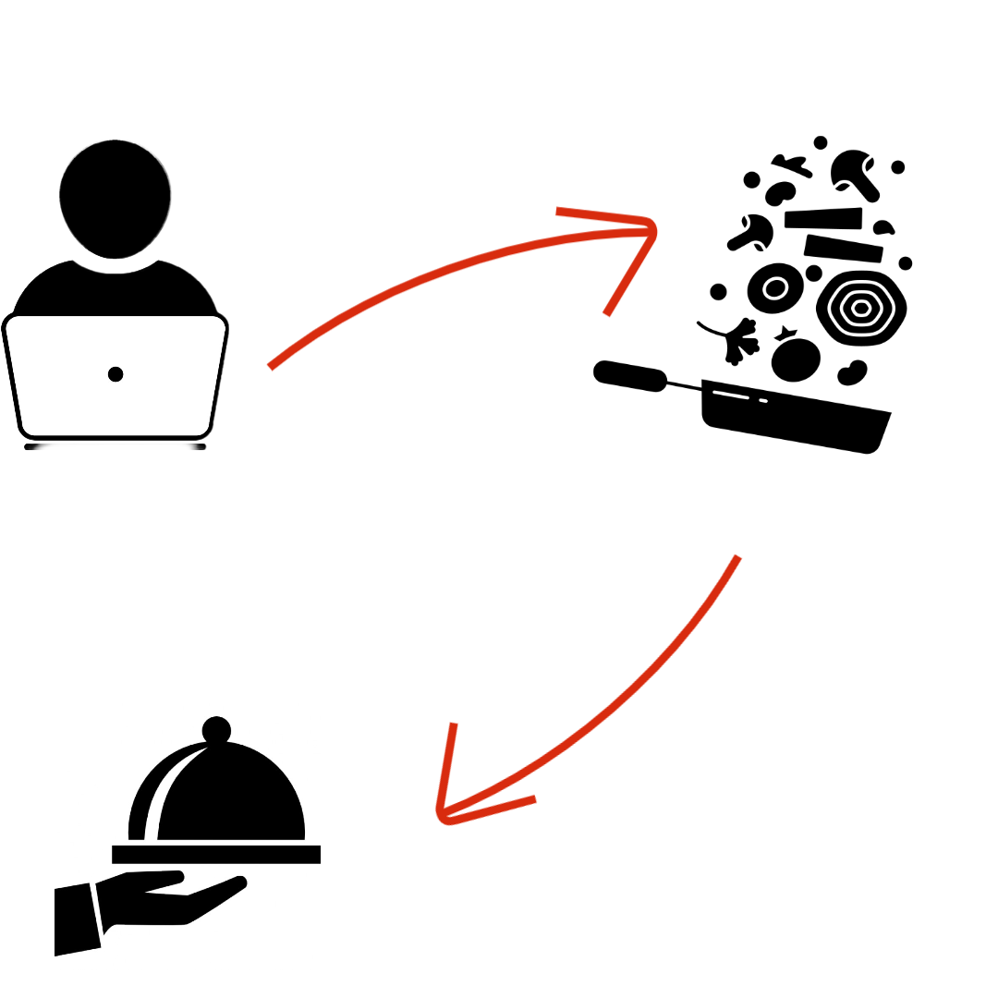
Project Definition
The user enters the ingredients list as text.
Project Definition
In this project, the program predicts the names of cuisine from the given ingredients.
Cuisine name comes as text from ingredient list

Slide 3
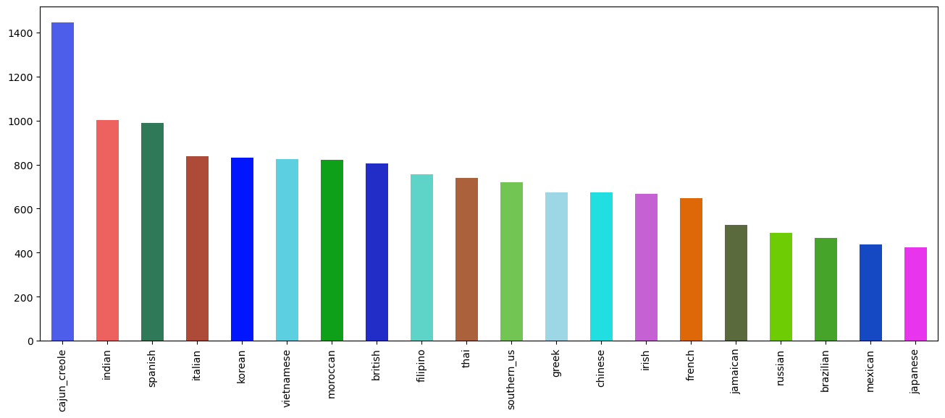
Balanced dataset
Unbalanced Dataset : 20 different cuisines 39,774 recipes.
Balanced Dataset: 20 different cuisines, 14,774 recipes.

Slide 4
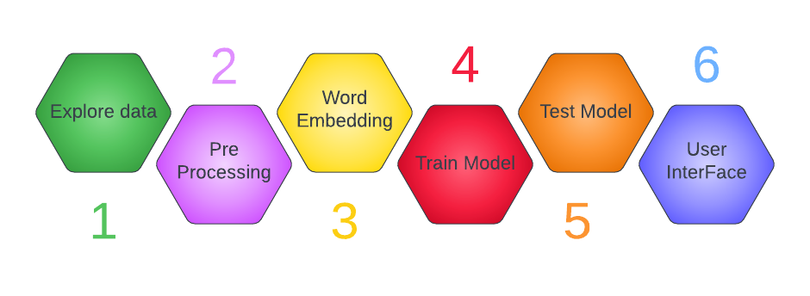
What has been done ?
2 model were applied.
1 - Dataset searched.
2 - The dataset has been preprocessed.
3 - Ingredients were converted to numeric values with TfidfVectorizer so that
computers can do mathematical operations with.
4- The svc model and neural network layers were used to train the models.
5 -The test dataset was used for the svc model and the results were compared.
6- User interface has been created.

Slide 5
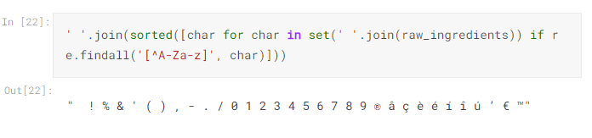
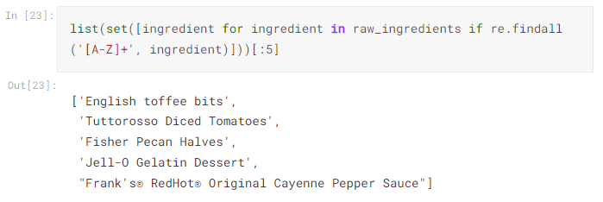
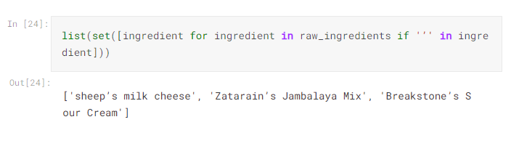
Pre-Processing
Remove outliers
convert to lowercase
remove hyphen
remove numbers
remove units
remove accents
lemmatize

Slide 6
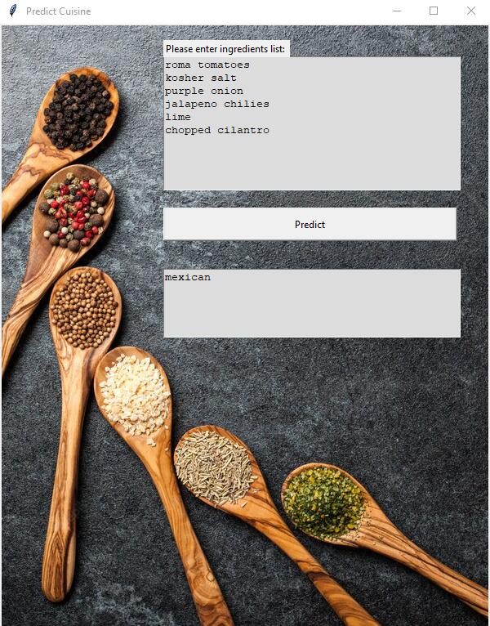
User Interface
Ingredient list entered for prediction
Output

Slide 7
Success Criteria
First Presentation: At least 85% accuracy rate,
Predicts the cuisine name in 3 seconds
Second Presentation: At least 60% accuracy rate
Result : 80% accuracy rate with SVC model

Slide 8
Source
1 - Yummly-Kaggle. 2015. Kaggle – What’s Cooking? (2015). Retrieved
November 28, 2015 from https://www.kaggle.com/c/whats-cooking
2- Scikit-learn: Machine Learning in Python, Pedregosa et al., JMLR 12, pp. 2825-
2830,2011.
3 - B¨ohning, Dankmar. ”Multinomial logistic regression algorithm.” Annals of the
Institute of Statistical Mathematics 44.1 (1992): 197-200.APA
4- Smola, A. J., Sch¨olkopf, B. (2004). A tutorial on support vector regression. Statistics
and computing, 14, 199-222
5-H. Su, M.-K. Shan, T.-W. Lin, J. Chang, and C.-T. Li. Automatic recipe cuisine
classification by ingredients. In Proceedings of the 2014 ACM International Joint Conference
on Pervasive and Ubiquitous Computing: Adjunct Publication, pages 565–570.
ACM, 2014.
6- Han Su, Ting-Wei Lin, Cheng-Te Li, Man-Kwan Shan, and Janet Chang. 2014.
Automatic recipe cuisine classification by ingredients. In Proceedings of the 2014
ACM International Joint Conference on Pervasive and Ubiquitous Computing: Adjunct
Publication (UbiComp ’14 Adjunct). ACM, New York, NY, USA, 565-570.
DOI=http://dx.doi.org/10.1145/2638728.2641335

Slide 9
Source
7- A Review onWord Embedding Techniques for Text Classification,Book cover Innovative
Data Communication Technologies and Application pp 267–281Cite as
8-AReviewonWord Embedding Techniques for Text Classification S. Selva Birunda,R.
Kanniga Devi

