Slide 1
Predicting cuisine name from recipe ingredients
CSE 496
Preliminary Presentation
Tuba TOPRAK
Advisor: Yrd. Doç. Dr. Burcu YILMAZ
October 2022

Slide 2
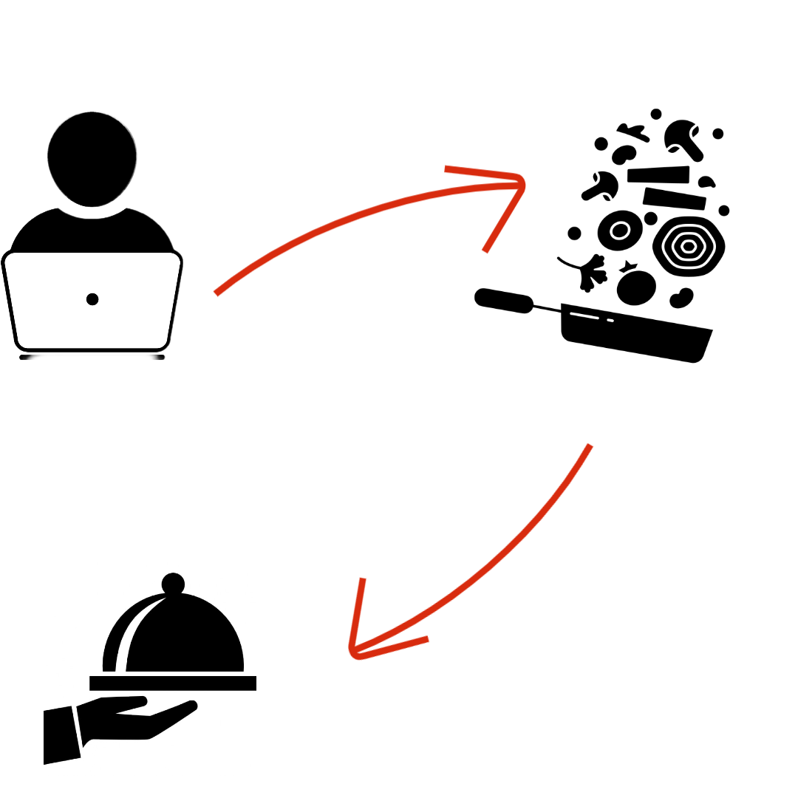
Project Definition
The user enters the ingredients list as text.
Project Definition
In this project, the program predicts the names of cuisine from the given ingredients.
Cuisine name comes as text from ingredient list

Slide 3
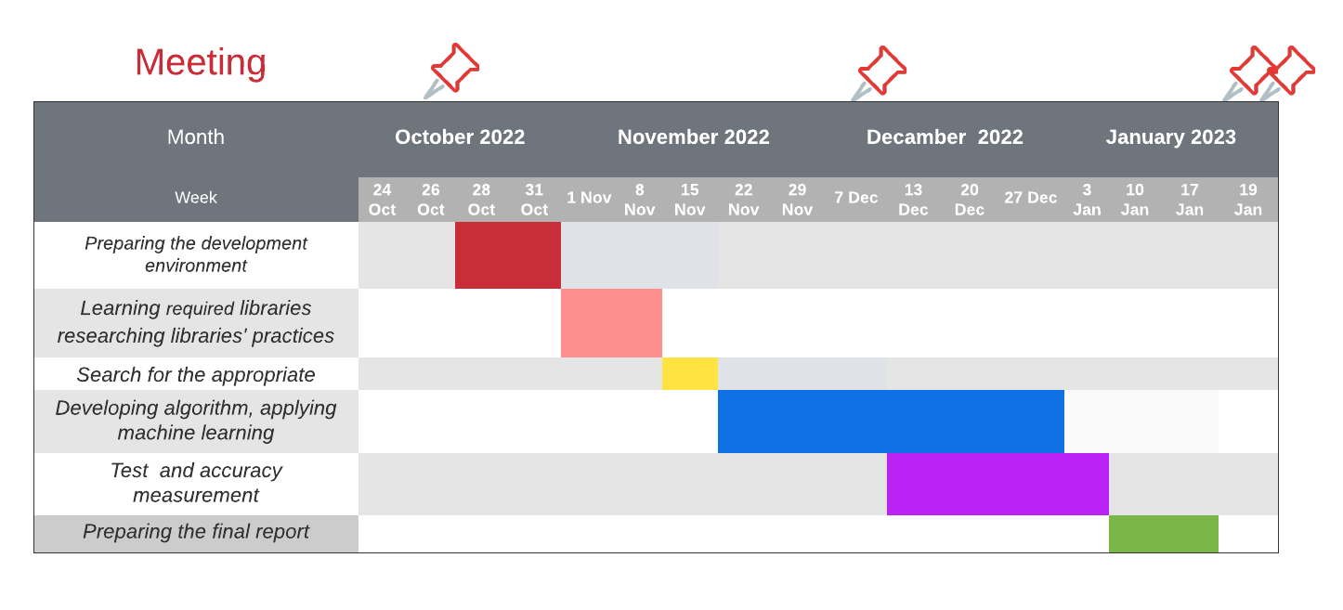
Project Design

Slide 4
Project Requirements - 1
I have to develop an algorithm accordingly by extracting the attributes of the cuisines with deep learning methods.
I have to train my algorithm with different recipe ingredients.
If the cuisine name cannot be found with the recipe ingredients , I should make a name classification.
Results of this project will be measured with the help of various performance metrics (Accuracy, F1 Score, AUC)
With the program, I have to present the cuisine name to the user as output.

Slide 5



Project Requirements - 2
A dataset with recipe ingredients is needed for deep learning.
There is a need to test projects with different train-test split ratios.
Software Requirements:
The program will be written in the python programming language.
Google Colab , Jupyter Notebook

Slide 6
Success Criteria
At least 85% accuracy rate
Predicts the cuisine name in 3 seconds

