Slide 1
Predicting cuisine name from recipe ingredients
CSE 496
2nd Presentation
Tuba TOPRAK
Advisor: Yrd. Doç. Dr. Burcu YILMAZ
Decamber 2022

Slide 2
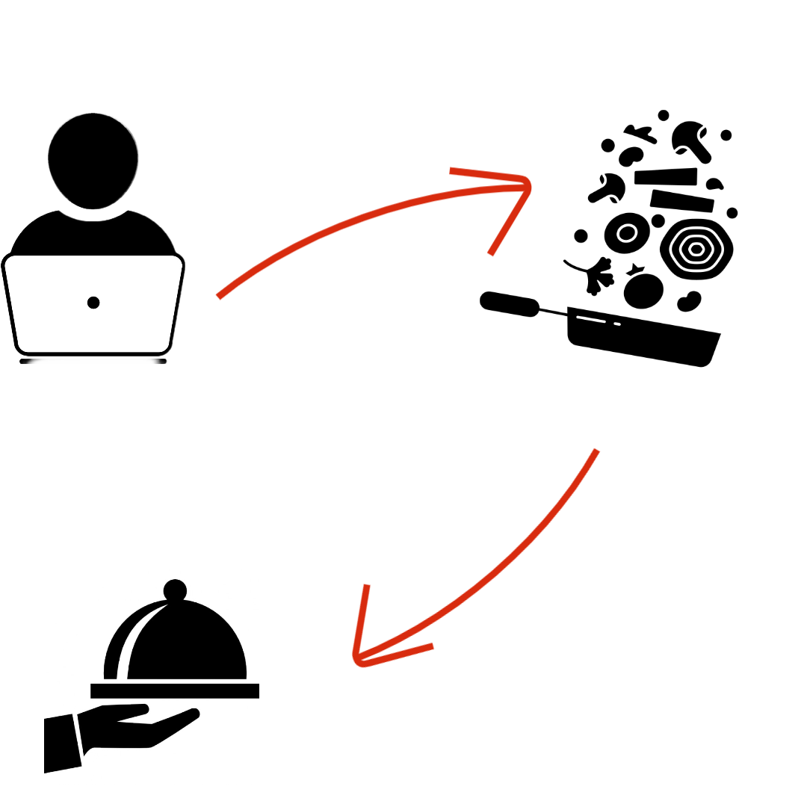
Project Definition (reminding)
The user enters the ingredients list as text.
Project Definition
In this project, the program predicts the names of cuisine from the given ingredients.
Cuisine name comes as text from ingredient list

Slide 3
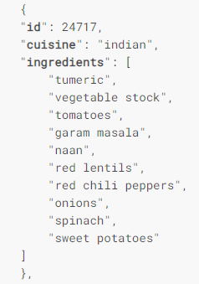
Datasets
In the dataset, include the recipe id, the type of cuisine, and the list of ingredients of each recipe (of variable length).
The data is stored in JSON format.
train.json - the training set containing recipes id, type of cuisine, and list of ingredients
test.json - the test set containing recipes id, and list of ingredients

Slide 4
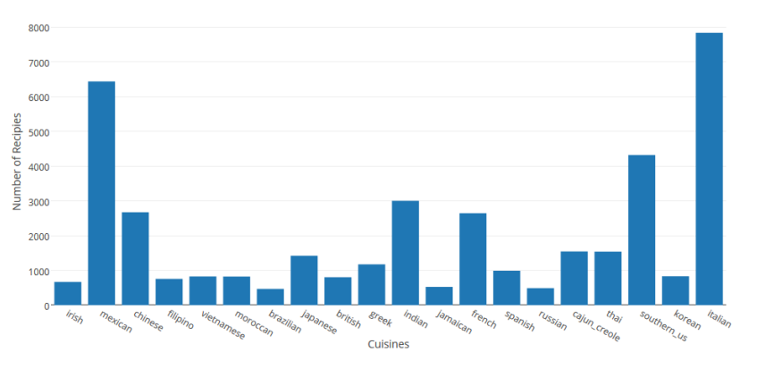
Dataset- Train
20 different cuisines , 6714 different ingredients, 39,774 recipes.

Slide 5
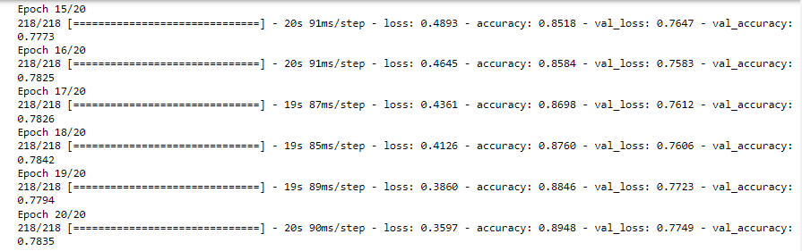
What has been done?
The model was trained.
In Train.json: %20 Test split and %80 Train split
New Success Criteria: %60 Accurate rate

Slide 6
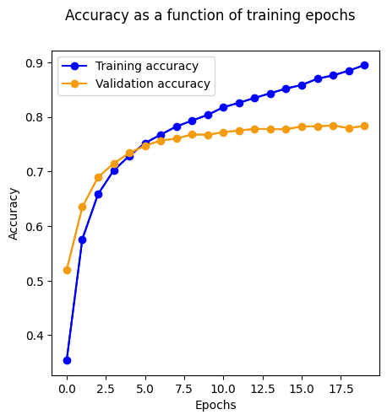
What has been done?

Slide 7
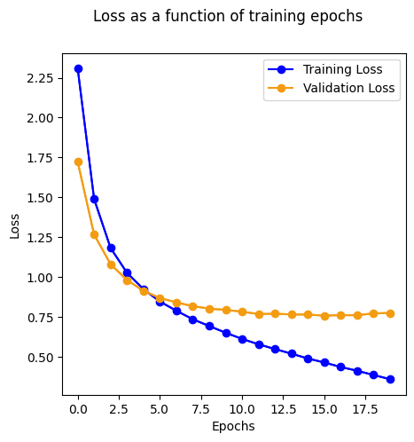
What has been done?

Slide 8
What will be done?
The model will be developed and the accuracy rate will be increased.
The test dataset will be applied and the results will be compared.
Turkish recipe will be added to the dataset.

Slide 9
Source
Yummly-Kaggle. 2015. Kaggle – What’s Cooking? (2015). Retrieved November 28, 2015 from https://www.kaggle.com/c/whatscooking
Rishikesh Ghewari and Sunil Raiyani. Predicting Cuisine from Ingredients

