Slide 1
Principles and Methods of Program Design Lecture 2: Overview of C++
Yuting Wang
SEIEE
John Hopcroft Center for Computer Science
2023.2.15

Slide 2
Last Time
Basics of Imperative Programming (C++)
Programming with Abstractions
Implementing Abstractions
Here!

Slide 3
This Time
Basic Concepts in C++
Variables
Data types
Basic input and output
Expressions
Statements
Underlying Concepts of Imperative Programming
Syntax vs. Semantics
Memory Layout
Loops and Infinite Behaviors

Slide 4
Variables & Data Types

Slide 5
Variables
A variable
represents a named location in memory
holds data of a particular type
Variable declarations:
Three component of a variable:
Name: a reference to the variable
Memory location: the place to store value
Type: what value can the variable hold
<type> <name1>, <name2>, …
// Examples
int age;
double pi, psi, phi;

Slide 6

What are Variables for?
Q: What variables are for?
A: Holding program states (remember what is computation in C++?)
This is very different from the concept of variables in mathematics
Variables in mathematics: bound to a fixed value
Variables in C++: contain states to be modified
$$f\left(x\right)=x^{3}+2×x^{2}−4$$

Slide 7
Initialization and Assignments
Initialization Statement:
The memory value of names is initialized to the value of exps
Assignment Statement:
The in-memory value of name is overwritten by the value of exp
<type> <name1> = <exp1>, <name2> = <exp2>, …;
// Examples
int age = 18;
double pi = 3.14159, psi = 4.2222, phi = 1.1111;
<name> = <exp>;
// Examples
int age;
age = 99;

Slide 8
Memory Layout
Variables have different memory layout at different level
// Examples
int age=18; double pi=3.14159, psi=4.2222, phi= 1.1111;
age
pi
psi
phi
Memory State of C++ Virtual Machine
18
3.14159
4.2222
1.1111
Mapped by Compiler
Memory State of Physical Machine
(4GB)
18
3.14159
4.2222
1.1111
age
pi
psi
phi
0
2000
300000
4294967296

Slide 9
Naming Conventions
Identifiers in C++ must
Begin with a letter or underscore (_)
Followed by letters, digits or underscore
Not be identical reserved identifiers (See page 16 of the textbook)
Identifiers in C++ are case-sensitive
Use sensible names for variables!
int _key;
double key123;
double return; // conflict with keywords!
int Key, key; // Two different variables
int numOfPages; // good name
int xxx, p123; // bad!

Slide 10
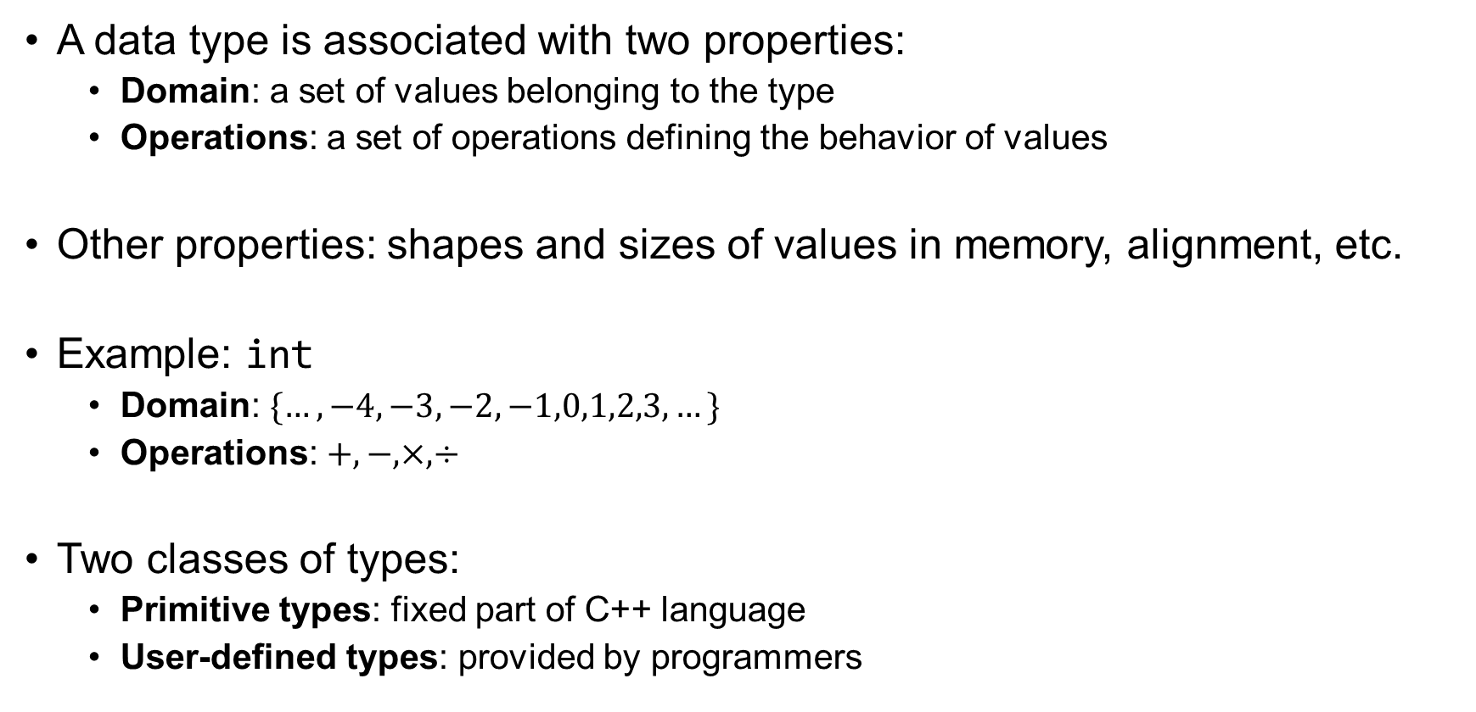
Data Type
A data type is associated with two properties:
Domain: a set of values belonging to the type
Operations: a set of operations defining the behavior of values
Other properties: shapes and sizes of values in memory, alignment, etc.
Example: int
Domain: $\{…,−4,−3,−2,−1,0,1,2,3,…\}$
Operations: $+, −, ×, ÷$
Two classes of types:
Primitive types: fixed part of C++ language
User-defined types: provided by programmers

Slide 11
Primitive Types
Integer
Floating-point
Boolean
Characters

Slide 12
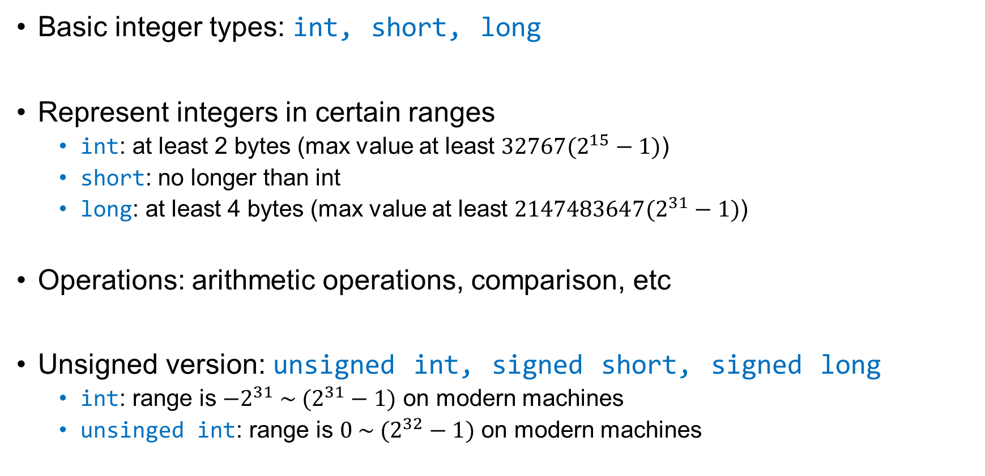
Integer
Basic integer types: int, short, long
Represent integers in certain ranges
int: at least 2 bytes (max value at least $32767(2^{15}−1)$)
short: no longer than int
long: at least 4 bytes (max value at least $2147483647(2^{31}−1)$)
Operations: arithmetic operations, comparison, etc
Unsigned version: unsigned int, signed short, signed long
int: range is ${−2}^{31} \sim (2^{31}−1)$ on modern machines
unsinged int: range is $0 \sim (2^{32}−1)$ on modern machines

Slide 13
Floating-point Types
Floating-point types: float, double, long double
Represent real numbers in certain ranges:
C++ standard makes no exact assumption of their representations
The order of ranges: float < double < long double
Operations: arithmetic operations, comparison, etc
double is considered the standard floating-point type by convention
Floating-point literals
//Examples
3.14159 // Pi
-3.14159 // Negation of Pi
2.9979E+8 // Speed of light

Slide 14
Boolean Types
Boolean type: bool
Two values for represents truth or falsity: {true, false}
Operations given by boolean operators
== Equal
!= Not equal
> Greater than
< Less than
>= Greater than or equal to
<= Less than or equal to
… and logical operators
! Logical not
&& Logical and
|| Logical or

Slide 15
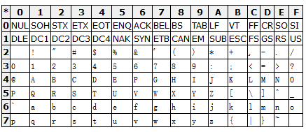
Characters
Types of individual characters: char
Internally represented as numeric code (ASCII):
Operations: arithmetic, comparison, etc.

Slide 16
Character Constants
Use constants to denote short cuts to ASCII code
Escape sequences
special characters beginning with a backward slash ‘\’
// More Examples
char c1, c2;
c1=‘a’; c2=‘b’; // Constants
c1=97; c2=98; // ASCII code
// Examples
‘\t’ // Move to the next tab stop
‘\n’ // Move to the beginning of the new line
‘\0’ // Null character
‘\\’ // Character \ itself

Slide 17
Enumerated Types
Format:
Represents a finite collection of elements in <namelist>
The enumerable elements are internally encoded as consecutive numbers
Sunday==0, Monday==1 and so on.
We can assign encodings to them explicitly:
enum <typename> { <namelist> };
// Examples
enum Direction {North, South, East, West};
enum WeekdayT {Sunday,Monday,Tuesday,Wednesday,Thursday,Friday,Saturday};
Direction dct = East; // Assignments
WeekdayT weekday = Wednesday;
// Examples
enum weekdayT {Sunday=1, Monday,Tuesday,Wednesday,Thursday,Friday,Saturday}; enum weekdayT {Sunday,Monday, Tuesday=5, Wednesday,Thursday,Friday,Saturday};

Slide 18
The enumerated type is the first user-defined type we saw.
We will look into more complex user-defined types later.

Slide 19
Literals
A literal is a sequence of symbols denoting a value of a certain data type
We have already seen some of them
String literals represent a sequence of characters:
// Examples
-3, 0, 1, 3, 0x66, 088 // Integer literals
3.14159, 2.9979E+8 // Floating point literals
true, false // Boolean literals
‘a’, ‘0’, ‘\n’ // Character literals
// Examples
“abcdefg”
“Hello World!”
“Hello World!\n”

Slide 20
Constant Variables
A class of variables whose in-memory value cannot be modified.
Constants must be initialized with a value
Examples:
const <type> <name> = <const_exp>;
const double PI = 3.14159;
const int MAX_INT = 2147483647;
const char ZETA = ‘z’;

Slide 21
Basic Input & Output

Slide 22
Basic Output
cout << expression << expression …
Print expressions on the standard output
endl
Inserts new line and forces stream buffers to synchronize
// Example
cout << “Hello!” << “I am ” << age << “ years old.”;
// Example
cout << “Hello!” << “I am ” << age << “ years old.” << endl;

Slide 23
Basic User Input
cin >> expression >> expression >> …
Read values from standard input
The expressions must denote a memory location
When reading multiple inputs, separate them by spaces
// Example
cin >> age;
cout << “Hello!” << “I am ” << age << “ years old.”;
// Example
cin >> age >> height;
cout << “I am ” << age << “ years old.”
<< “My height is ” << height << “.” << endl;

Slide 24
Example
// This program computes the circumference and area of a circle
#include <iostream>
using namespace std;
const double PI = 3.14159; //Definition of PI
int main()
{
double radius, area, circum;
cout << “Enter the radius of the circle: ”;
cin >> radius;
area = PI * radius * radius;
circum = 2 * PI * radius;
cout << endl;
cout << “Area of the circle is ” << area << endl;
cout << “Circumference of the circle is ” << circum << endl;
return 0;
}

Slide 25
Expressions & Statements

Slide 26
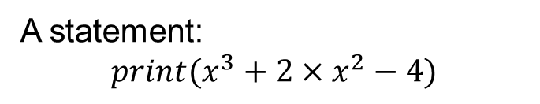
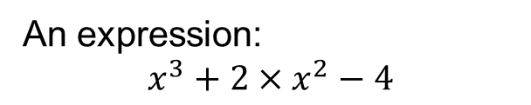
Expressions vs. Statements
In Principle:
Examples:
There are languages without statements!
E.g., Haskell (A functional programming Language)
Expressions | Statements
Denote Mathematical Expressions | Denote Operational Procedures
Computation via Evaluation | Computation via Effects on States
Have Types & Evaluate to Values | Has a Unit Type & Value
Constituents of Statements | Contain Expressions
An expression:
$$x^{3}+2×x^{2}−4$$
A statement:
$$print(x^{3}+2×x^{2}−4)$$

Slide 27
Expressions vs. Statements (Cont’d)
In C++, the distinction are not as nice:
Therefore, expressions are not PURE mathematical evaluation
Example:
We will see more in the upcoming discussion
Expressions | Statements
May Denote Mathematical Expressions | Denote Operational Procedures
Computation via Evaluation & Effects | Computation via Effects on States
Have Types & Evaluate to Values | No Type & Value
Constituents of Statements | Contain Expressions
cout << “Hello!” << “I am ” << age << “ years old.”

Slide 28
Expressions
Variable expressions: <variable_name>
Type: the type of the variable
Value: the in-memory value of the variable
A composite expression consists of
An operator: the (non-)mathematical operation performed
A list of terms: the operands (may be other expressions) to the operation
We discuss the following composite expressions:
Arithmetic Expressions
Type Casts
Assignment Expressions
Increment & Decrement Expressions
Boolean Expressions

Slide 29
Arithmetic Expressions
Operators: +, -, *, /, -(unary), %
Type: the type of the expression and its operands are usually the same
Arity: the number of operands the operator takes
All take 2 except for negation (-)
Binary operators: arity 2
Unary operators: arity 1
Precedence: How tightly an operator binds its operands?
See Table. 1-4 of page 27
Associativity: How operands to binary operators group by default?
Left associative: group to the left (+, -, *, /, %)
Right associative: group to the right (we shall see an example later)

Slide 30
Mixing Types in Expressions
When operands have different types:
They are first converted to a common type closed to the top of the hierarchy below:
long double
double
float
unsigned long
long
unsigned int
int
unsigned short
short
char
bool
Most precise
Least precise
//Example
double x = 3.2;
cout << x + 2 << endl;

Slide 31
Type Casts
Sometimes, we need force conversion of data types
Explicit Type Casting
C++ Style:
You should avoid using C style type casting! (e.g., (double)4/5)
Will be clear when we talk about initialization of objects
//Example
4/5 // Equal to 0. What if we need the result to be 0.8?
<type>(<expr>)
//Example
double(4)/5 // The result is 0.8

Slide 32
Assignment Expression
Assignment Expression:
Modification of in-memory values of variables
Note: no semicolon at the end! Not to be confused with assignment statements
This expression has a side effect:
Overwrite the value in memory location of <variable> with the value of <exp>
This expression has
the same type as <variable>
the same value as <exp>
Conversion happens if <variable> and <exp> have different types
<variable> = <exp>

Slide 33
Example
// Example
val = age + 3
age
val
Memory State of C++ Virtual Machine
18
-300
21
Mapped by Compiler
Memory State of Physical Machine
(4GB)
18
21
age
val
0
2000
300000
4294967296

Slide 34
Embedded Assignments
Assignment expressions may be operands to other expressions
The assignment operator has a lower precedence
The assignment operator associates to the right
Embedded Assignments should be avoided because of nondeterminism!
// Example
z = (x = 6) + (y = 7)
// The following expressions are equivalent
z = x = y = 0
z = (x = (y = 0))
// If x == 0, what is the value of y ?
y = x + (x = x + 1)

Slide 35
Shorthand Assignments
The following expressions are equivalent:
Shorthand assignment operators: +=，-=，*=，/=，%=
<variable> <op>= <expression> // shorthand assignment
<variable> = variable <op> <expression>
// Examples
balance += deposit
balance -= surcharge
x /= 10
salary *=2

Slide 36
Increment and Decrement Expressions
Prefix form of increment expression: ++x
Effect: increase x by 1
Value: x + 1
Suffix form of increment expression: x++
Effect: increase x by 1
Value: x
Similarly, decrement expressions have
Prefix form: --x
Suffix form: x--
// Assume i == 3
j = i++ // i=4, j=3
j = ++i // i=4, j=4

Slide 37
Boolean Expressions
Relational Expressions:
Logical Expressions:
<expr> <op> <expr>
where <op> is one of the following:
== Equal
!= Not equal
> Greater than
< Less than
>= Greater than or equal to
<= Less than or equal to
<expr> <op> <expr>
where <op> is one of the following:
! Logical not
&& Logical and
|| Logical or

Slide 38
Examples
Relational expressions
Logical expressions
// Which of the following styles should be avoided?
(a + b) > (c – 3)
(a = b) < 5
(a > b) == (c < d)
-2 < -1 < 0
// Which of the following styles should be avoided?
0 < x && x < 10
m % 2 == 0
a >= ’a’ && a <= ’z’ || a >= ’A’ && a <= ’Z’
5 % 2 && p
5 > 3 && 2 || 8 < 4 - !0

Slide 39
Short-Circuit Evaluation
<expr1> && <expr2>:
If <expr1> evaluates to false, then no need not evaluate <expr2>
<expr1> || <expr2>:
If <expr1> evaluates to true, then no need to evaluate <expr2>
Avoid short-circuit evaluation combing side effects!
// Example
(x != 0) && (y % x == 0)
// Example
(a > b) && (n = c > d)

Slide 40
Statements
Commands for affecting states
Simple Statements:
Control Statements:
The if statement
The switch statements
The while statements
The for statements
<expr>;
// Example: assignment statements
x = 2*x + 1;

Slide 41
Blocks
A block groups a list of related statements
A block is called a compound statement
It also confines the scopes of variables (we shall discuss variable scopes later)
{
statement1
statement2
statement3
...
}

Slide 42
If Statement
If <cond_exp> is true, then execute <stmt1>. Otherwise, execute <stmt2> if there is one.
if (<cond_exp>) <stmt1>
if (<cond_exp>) <stmt1> else <stmt1>
// Example 1
if (grade >= 60)
cout << “passed”;
// Example 3
if (grade >= 60)
cout << “passed”;
else {
cout << “failed”;
cout << “please try again!”
}
// Example 2
if (grade >= 60)
cout << “passed”;
else
cout << “failed”;

Slide 43
Example
// Checking of leap years
#include <iostream>
using namespace std;
int main()
{
int year;
bool result;
cout << “Please enter the year: ”;
cin >> year;
result = (year % 4 == 0 && year % 100 !=0) || year % 400 == 0;
if (result)
cout << year << “is a leap year!”<< endl;
else
cout << year << “is not a leap year.” << endl;
return 0;
}

Slide 44

Associativity of If Statements
// How to interpret the following if statement ?
if (x == 0)
if (y == 0)
x++;
else
y++;
// Interpretation 1
if (x == 0) {
if (y == 0)
x++;
}
else
y++;
// Interpretation 2
if (x == 0) {
if (y == 0)
x++;
else
y++;
}

Slide 45
Switch Statement
Switch statements are for branching into multiple cases:
If <expr> evaluates to <const_exp_i>, execute <stmt_i>. Otherwise, execute <stmt> in the default branch.
switch (<expr>) {
case <const_exp_1>:
<stmt_1>
break;
…
case <const_exp_n>:
<stmt_n>
break;
default:
<stmt>
break;
}

Slide 46
Example
// This program tests your skills in elementary arithmetics
#include <cstdlib> // Random number generators
#include <iostream>
using namespace std;
int main()
{
int num1, num2, // operands
op, // operator
result1, result2; // Your answers
num1=rand() % 10;
num2=rand() % 10;
op=rand() % 4;

Slide 47
Example (Cont’d)
switch (op) {
case 0:
cout << num1 << "+" << num2 << "= ?" ;
cin >> result1;
if (num1 + num2 == result1)
cout << "The answer is right!\n";
else
cout << "Wrong answer!\n";
break;
…
}
return 0;
}

Slide 48
Another Example (?)
// Convert grades between 0~100 to ‘A-E’
// Is the following switch statement correct?
switch (score) {
case score >= 90: cout << "A"; break;
case score >= 80: cout << "B"; break;
case score >= 70: cout << "C"; break;
case score >= 60: cout << "D"; break;
default: cout << "E";
}

Slide 49
Fall through in Switch
If <expr> evaluates to <const_exp_1>, executes <stmt2>
switch (<expr>) {
case <const_exp_1>:
case <const_exp_2>:
<stmt2>
break;
…
}
// Example
switch (score/10) {
case 10:
case 9: cout << "A"; break;
case 8: cout << "B"; break;
case 7: cout << "C"; break;
case 6: cout << "D"; break;
default: cout << "E";
}

Slide 50
While Statement
Iterate the following computational steps:
Evaluate <expr>
If <expr> evaluates to false, then end the iteration
If <expr> evaluate to true, then execute <stmt> and go back to Step 1
While statements are also called while loops
Notice:
The conditional test is performed before every cycle of the iteration, including the first
If the test is false initially, the body of the loop is not executed at all
The conditional test is performed only at the beginning of a loop cycle
while (<expr>) <stmt>

Slide 51
How to Determine Effects of Loops
How do I know what are the states of programs?
During the execution of a loop
After the execution of a loop
// This program computes the sum of integers up to a number
int main()
{
int n;
cin >> n;
if (n < 0) return -1; // n must be positive
int sum = 0, i = 1;
while (i <= n) {
sum += i;
i++;
}
cout << “The sum is ” << sum << endl;
return 0;
}
Try to Guess it!

Slide 52
Try and Guess with a Few Loops
Example: n = 3
At the beginning of the i-th loop: sum = 0 + 1 + … + (i-1)
Execution
i
i
i
i
++
++
++
1
2
3
4
sum
+
sum
+
sum
+
sum
0
1
3
6
Memory state
(before 1st loop)
Memory state
(before 2nd loop)
Memory state
(before 3rd loop)
Memory state
(loop ends)

Slide 53
Loop Invariants
Logical assertions about program states that hold before every loop
int sum = 0, i = 1;
// How to describe the property of memory state
// at the beginning of every memory loop
while (i <= n) {
sum += i;
i++;
}
cout << “The sum is ” << sum << endl;
return 0;

Slide 54
Loop Invariant
How do we make sure that a logical condition is indeed an invariant?
Example:
Let P be a logical assertion on the program state S before a loop;
Assume P is true on S;
Compute S’ which is the program state after executing the body of the loop
Prove P is also true on S’.
// Template
P is true on S // Assumption
<body> // Loop Statement
P is true on S’ // Conclusion
// Example
// sum = 0 + 1 + … + (i-1) is true
// in the current state
sum += i;
i++;
// sum = 0 + 1 + … + (i-1) is true
// after the loop
}

Slide 55
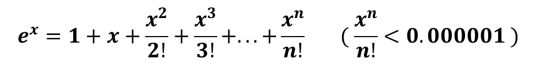
Example
$$e^{x}=1+x+\frac{x^{2}}{2!}+\frac{x^{3}}{3!}+...+\frac{x^{n}}{n!}\begin{matrix} & \end{matrix}( \frac{x^{n}}{n!}<0.000001 )$$
Compute the expression
// Solution
int main()
{
double x, ex=0, p=1;
int i = 0;
cout << “Enter x："; cin >> x;
// What is the invariant of the following loop?
while (p > 1E-6){
ex += p;
++i;
p = p * x / i;
}
cout << “e^” << x << “ is equal to ” << ex << endl;
return 0;
}

Slide 56




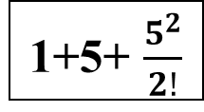
Loop Invariant
Example: x = 5
Execution
x
x
x
x
5
5
5
5
i
i
i
i
0
1
2
3
p
p
p
p
$$1$$
$$5$$
$$\frac{5^{2}}{2!}$$
$$\frac{5^{3}}{3!}$$
ex
ex
ex
ex
0
1
1+5
1+5+ $\frac{5^{2}}{2!}$
(before 1st loop)
(before 2nd loop)
(before 3rd loop)
(before 4th loop)

Slide 57
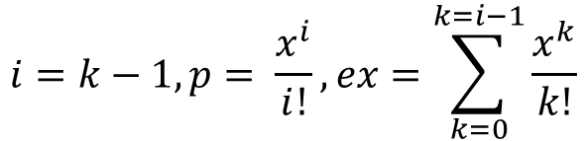
Loop Invariants
What is the invariant of the following loop?
Check the invariant holds under iteration
// Before the k-th loop, the memory state is as follows:
while (p > 1E-6){
ex += p;
++i;
p = p * x / i;
}
$$i=k−1, p= \frac{x^{i}}{i!}, ex=\sum_{k=0}^{k=i−1}{\frac{x^{k}}{k!}}$$

Slide 58
For Statement
Iterate the following steps:
Evaluate <expr1>
Evaluate <expr2>
If <expr2> evaluates to false, then end the iteration
If <expr2> evaluate to true, first execute <stmt>, then evaluate <expr3>, finally go back to Step 2
For statements are a special case of while statements:
for (<expr1>; <expr2>; <expr3>) <stmt>
<expr1>;
while (<expr2>) {
<stmt>
<expr3>;
}

Slide 59
Example
// This program computes the sum of integers up to a number
int main()
{
int n;
cin >> n;
if (n < 0) return -1; // n must be positive
int sum = 0;
// What is the loop invariant?
for (int i = 1; i <= n; i++)
sum += i;
cout << “The sum is ” << sum << endl;
return 0;
}
// Equivalent while loop:
int i = 1;
while (i <= n) {
sum += i;
i++;
}

Slide 60

Another Example
Compute the integral of
$$f\left(x\right)= x^{2}+5x+1$$
// Solution
#include <iostream>
using namespace std;
int main()
{
double a, b, dlt, integral = 0;
cout << “Enter the start and end points: ”;
cin >> a >> b;
cout << “Enter the width of the rectangle: ” ;
cin >> dlt;
// What is the loop invariant?
for (double x = a + dlt / 2; x < b; x += dlt)
integral += (x * x + 5 * x + 1) * dlt;
cout << “The integral is: “<< integral << endl;
return 0;
}
a
b

Slide 61
Break
Use break to jump out of the innermost loop
// Example
#include <iostream>
using namespace std;
int main()
{
int a;
for (a = 1; a < 10; a++) {
if (a % 2 == 0 && a %3 == 0)
break;
else
cout << a << endl;
}
return 0;
}

Slide 62
Continue
Use continue to jump over the current iteration of the innermost loop
// Example
#include <iostream>
using namespace std;
int main()
{
int a;
for (a = 1; a < 10; a++) {
if (a % 2 == 0 && a %3 == 0)
continue;
else
cout << a << endl;
}
return 0;
}

Slide 63
Before the Next Lecture
Read Chapter 2 of “Programming Abstractions”
Exercise (not counted towards grades):
Write a C++ program for outputting the hailstone sequence (Problem 10, Page 52 of the text book)

