Slide 1
Principles and Methods of Program Design Lecture 7: Pointers & Dynamic Resources
Yuting Wang
SEIEE
John Hopcroft Center for Computer Science
2023.4.23

Slide 2
Road Map
Basics of Imperative Programming (C++)
Programming with Abstractions
Implementing Abstractions
Here!

Slide 3
Last Time
Designing ADT/Classes
Object Initialization and Finalization
Operator Overloading
Interfaces vs. Implementations
Concrete Data Types

Slide 4
This Time
Execution Model Revisited
Pointers
Arrays
C-Style Strings
Heap and Dynamic Allocation
Dynamic Resource Management

Slide 5
Execution Model Revisited

Slide 6
Key Ideas
To understand pointers and pointer variables, we need an in-depth understanding of the execution model of C++ programs
Key Concepts:
In-memory values
Memory addresses as data values
lvalue and rvalue expressions

Slide 7


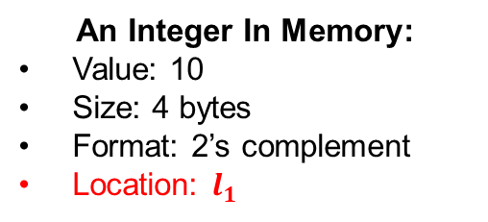
In-Memory Values
An in-memory value occupies a piece of memory with
Data values stored in this memory
Type information that determines
The size of the data (e.g., 1 byte for char, 4 bytes for int)
The format of the data (e.g., ASCII code for char, 2’s complement for int)
Memory Address (or Location) of the object
Created and destroyed during execution (global and stack variables)
4 bytes
$$l_{1}$$
$$l_{1}$$
1010
binary form
10
An Integer In Memory:
Value: 10
Size: 4 bytes
Format: 2’s complement
Location: $l_{1}$
We often omit
some details

Slide 8




Abstract Memory Spaces
We have assumed that every variable has its independent memory space
// Examples
int main()
int age=18;
double pi=3.14159, psi=4.2222, phi= 1.1111;
…
}
age
pi
psi
phi
$$l_{1}$$
$$l_{2}$$
$$l_{3}$$
$$l_{4}$$
18
3.14159
4.2222
1.1111
Stack Memory:

Slide 9
Memory Layout
The concrete layout of memory is determined by the compiler
Different concrete layout depending on the choices of compilers
User have no way to predict the relation between different locations
age
pi
psi
phi
Memory State of C++ Abstract Machine
18
3.14159
4.2222
1.1111
Mapped by Compiler
Memory State of Physical Machine
(4GB)
18
3.14159
4.2222
1.1111
age
pi
psi
phi
0
0x300000
0x100000000

Slide 10
Example
A counter example for predicting relative locations
Suppose we assume age, pi, psi, phi are adjacent
We print the value of psi by running the code below
Compiler find out that pi is not used and removed it from memory
age
pi
psi
phi
Memory State of C++ Abstract Machine
18
3.14159
4.2222
1.1111
Mapped by Compiler
Memory State of Physical Machine
(4GB)
18
4.2222
1.1111
age
psi
phi
0
0x300000
0x100000000

Slide 11

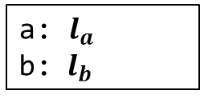

Variable Definitions Revisited
A variable definition:
By defining T p, we denote
an in-memory value of type T will be created at the right time
p will be mapped to location of that value
// Defines a variable
<type> <name>;
<type> <name> = <expr>;
$$l_{a}$$
$$l_{b}$$
int a = 10;
int main()
{
int b = 3;
return 0;
}
10
3
Created at the
start of program
Created at the
start of main function
a: $l_{a}$
b: ${ l}_{b}$

Slide 12


Composite In-Memory Values
In-memory values may be created from ADT/CDT
ADT/CDT with member variables denotes composite in-memory values
// Point structure
class Point {
public:
Point(int px, int py)
: x(px), y(py) {}
...
private:
int x;
int y;
};
int main() {
Point p(2, 3);
return 0;
}
4 bytes
4 bytes
$$l_{p}$$
2
3
x
y
p: $l_{p}$
PC

Slide 13

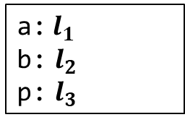


Memory States and Environments
Memory states: a collection of in-memory values
Note: they may either contain primitive data or an ADT/CDT object
Environments: a mapping from variable names to locations
int a = 10;
int main()
{
int b = 3;
Point p(2,3);
…
return 0;
}
Global
Memory
Stack
Memory
$$l_{1}$$
$$l_{2}$$
10
3
$$l_{3}$$
PC
2
3
a:$l_{1}$
b: $l_{2}$
p: $l_{3}$
Environment:

Slide 14
C++ Abstract Machine
A C++ program executes by running an abstract machine
A C++ abstract machine has the following components
The program being executing (may contain multiple modules)
The program state, including:
The program counter (points to the current command)
The environment变量地址
The memory state
I/O devices
The machine runs by executing the command pointed to by PC, which
Query the environment and memory state for evaluating expressions
Execute the commands and change the state (assignment, I/O etc)
Adjust PC (sequential execution, branching, loop, … etc)

Slide 15





Memory Addresses
Assume $l$ is the location of an in-memory value
$l$ points to the first byte of the value
$l+1$ points to the second byte of the value
... (and so on)
1 byte:
$$l$$
$l+1$
$l+2$
$l+3$
● ● ●

Slide 16




Memory Addresses
Example: $l_{p}$ is the location of an in-memory value with two adjacent integers (4 bytes)
$l_{p}$, points to the beginning of the first integer
$l_{p}+4$ points to the beginning of the second integer
$l_{p}+8$points to the end of the value
4 bytes
4 bytes
$$l_{p}$$
0
0
$l_{p}+8$
$$l_{p}+4$$

Slide 17
L-value Expressions
An expression is an L-value if it evaluates to an in-memory value
Denotes data in memory
The following are L-value expressions:
Variable expressions
Assignment expressions
Member Variable Access
Reference variables
Pointer dereferences (discussed later)
… (not an exhaustive list)
Note: we often conflate L-values with L-value expressions

Slide 18
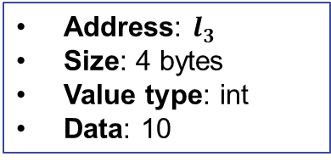

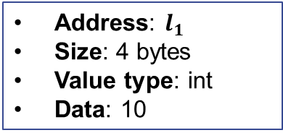
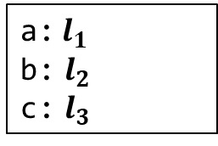


Variable Expressions
Evaluates to the in-memory value for the variable
int a = 10;
int main()
{
int b = 3;
Counter c(a);
c.get();
return 0;
}
Global
Memory
Stack
Memory
$$l_{1}$$
$$l_{2}$$
10
3
PC
$$l_{3}$$
10
a:$l_{1}$
b: $l_{2}$
c: $l_{3}$
Address: $l_{1}$
Size: 4 bytes
Value type: int
Data: 10
Address: $l_{3}$
Size: 4 bytes
Value type: int
Data: 10
Environment:

Slide 19


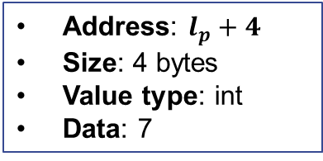
Member Variable Access
Evaluate to a part of the in-memory object for the object variable
Stack
Memory
// Point structure
struct Point {
Point(int px, int py)
: x(px), y(py) {}
int x;
int y;
};
int main() {
Point p(5, 7);
cout << p.y << endl;
return 0;
}
4 bytes
4 bytes
$$l_{p}$$
5
7
x
y
Environment:
p: $l_{p}$
Address: $l_{p}+4$
Size: 4 bytes
Value type: int
Data: 7
PC

Slide 20
Sizes of Data in L-values
Given a value, its size is determined by its type
Use the sizeof function to find out (returns the size in bytes)
sizeof can also be applied to types
int main()
{
Point p(3, 5);
int a = 10;
cout << sizeof(a) << endl;
cout << sizeof(p) << endl;
cout << sizeof(p.x) << endl;
cout << sizeof(p.y) << endl;
return 0;
}
cout << sizeof(int) << endl;
cout << sizeof(double) << endl;

Slide 21
R-value Expressions
An expression is an R-value if it is not an L-value
Denotes data not in memory
The following are R-value expressions:
Arithmetic expressions (e.g., expr1 + expr2, expr1 - expr2, expr1 * expr2, …)
Relational expressions(e.g., expr1 == expr2, expr1 != expr2, expr1 < expr2, …)
Logical expressions(e.g., expr1 && expr2, expr1 || expr2, !expr, …)
Function/method calls(e.g., add(expr1, expr2), c.get(), …)
Address-of expression (discussed later)
… (not an exhaustive list)
Note: we often conflate R-values with R-value expressions

Slide 22
L/R-values Positions
The same expression denotes either an L-value or an R-value depending on its positions
// The left a is an L-value
// The right a is an R-value
a = a + c;
用于rvalue时自动退化为一个值

Slide 23
L-value Positions
L-value positions: positions expecting in-memory values
Left of assignments:
The initial value of reference definitions: T& <var> = <expr>
Operand of & operator (discussed later): &<expr>
… (not an exhaustive list)
<expr1> = <expr2>
// Error: cannot assign to an R-value
// because it is not in memory
a + b = c;
// Error: cannot bind a new name for a
// R-value because it is not in memory
int& a = 3;

Slide 24


R-value Positions
Positions that expects R-values
Any position that is not an L-value position is an R-value position:
<expr1> + <expr2>
f(<expr_1>,…,<expr_n>)
T a = <expr>
… (and many others)
Global
Memory
Stack
Memory
int a = 10;
int main() {
cout << a << endl;
return 0;
}
$$l_{1}$$
10
Converted to 10
Environment:
a:$l_{1}$

Slide 25

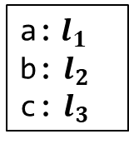


R-value positions
Another example
Global
Memory
Stack
Memory
int a = 10;
int main()
{
int b = 3;
int c = a;
cout << a + b + c << endl;
return 0;
}
$$l_{1}$$
$$l_{2}$$
10
3
$$l_{3}$$
PC
10
a:$l_{1}$
b: $l_{2}$
c: $l_{3}$
Environment:

Slide 26
Key Points
The key points to remember so far…
An L-value (expression) represents data in memory
Can be assigned values
Can be taken its memory address
An R-value (expression) represents data NOT in memory
Cannot be assigned values
Cannot be taken address
The same expression may denote either an L or R-value depending on its positions

Slide 27
Assignments Revisited

Slide 28



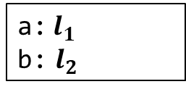
Evaluation of Assignments
Evaluation of the following assignment expression
Evaluate expr1 to an L-value with address $l$
Evaluate expr2 to an R-value $v$
Stores $v$ into the memory location at $l$
Data conversion happens if the types of expr1 and expr2 do not match
expr1 = expr2
int a = 10;
int main() {
int b;
b = a + 5;
return 0;
}
Global
Memory
Stack
Memory
$$l_{1}$$
$$l_{2}$$
10
?
PC
15
Environment:
a:$l_{1}$
b: $l_{2}$

Slide 29
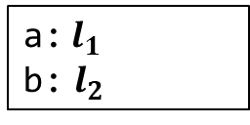


Assignment Revisited
Assignment expression can be an L-value expression
Evaluates to the L-value of expr1
expr1 = expr2
Global
Memory
Stack
Memory
int a = 10;
int main() {
int b;
(b=a+5) = 7;
cout << b << endl;
return 0;
}
$$l_{1}$$
$$l_{2}$$
10
?
7
PC
Environment:
a:$l_{1}$
b: $l_{2}$

Slide 30
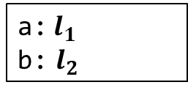
Other Forms
expr1 += expr2 is equivalent to expr1 = expr1 + expr2
similarly for -=, *=, etc.
int a = 10;
int main() {
int b = a;
b += 5;
return 0;
}
Global
Memory
Stack
Memory
$$l_{1}$$
$$l_{2}$$
10
10
PC
15
Environment:
a:$l_{1}$
b: $l_{2}$

Slide 31

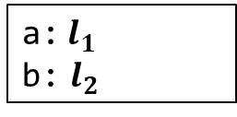
++ Operators
++expr is equivalent to expr = expr + 1算出来的就是左值本身
expr++ is somewhat complicated:
expr must be an L-value at some location $l$
The whole expression is an R-value equal to the data stored at $l$
Increases the values stored at $l$ by 1
int a = 10;
int main() {
int b = a;
cout << b++ << endl;
return 0;
}
Global
Memory
Stack
Memory
$$l_{1}$$
$$l_{2}$$
10
10
PC
11
The R-value is 10
a:$l_{1}$
b: $l_{2}$
Environment:

Slide 32

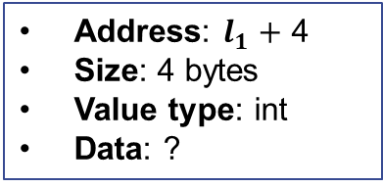

Assignment to Member Variables
Assignment of member variable access is similar to regular assignment:
The data stored in the L-value expr1.field is overwritten by R-value expr2
expr1.field = expr2
// Point structure
struct Point {
int x;
int y;
};
int main() {
Point p;
p.x = 10;
p.y = p.x + 10;
return 0;
}
Global
Memory
Stack
Memory
$$l_{1}$$
10
?
20
Address: $l_{1}+$ 4
Size: 4 bytes
Value type: int
Data: ?
PC
Environment:
p:$l_{1}$

Slide 33
References Revisited

Slide 34



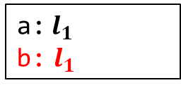
References and Evaluation
Syntax:
expr must be an L-value
The definition binds v to the location of expr
Introduce new mapping to environments
v behaves like expr after the definition
T& v = expr
Global
Memory
Stack
Memory
int a = 10;
int main() {
int& b = a;
cout << b << endl;
b = 12;
cout << a << endl;
return 0;
}
PC
$$l_{1}$$
10
12
a:$l_{1}$
Address: $l_{1}$
Size: 4 bytes
Value type: int
Data: 10
Environment:
a:$l_{1}$
b: $l_{1}$

Slide 35


Reference Variables
References introduce new mapping into environments
References behave like variable expressions
int a = 10;
int main() {
int& b = a;
cout << b << endl;
return 0;
}
Global
Memory
Stack
Memory
$$l_{1}$$
PC
10
Environment:
a:$l_{1}$
b: $l_{1}$
Address: $l_{1}$
Size: 4 bytes
Value type: int
Data: 10

Slide 36


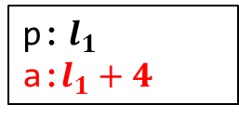
References to Member Variables
Representing L-values for member variables:
// Point structure
struct Point {
int x;
int y;
};
int main() {
Point p;
int& a = p.y;
p.x = 10;
a = p.x + 10;
cout << p.y << endl;
return 0;
}
Global
Memory
Stack
Memory
Address: $l_{1}+4$
Size: 4 bytes
Value type: int
Data: ?
$$l_{1}$$
?
?
10
20
PC
p:$l_{1}$
a:$l_{1}+4$
Environment:
p:$l_{1}$

Slide 37
Changes of States and Environments

Slide 38

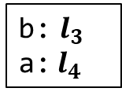
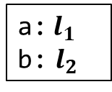



Evolution of Memory States and Environments
Environment mapping may change
Stack
Memory
// Example
void p(int b)
{
int a = 4;
cout << a << b << endl;
}
int main()
{
int a = 2, b = 3;
cout << a << b << endl;
p(b);
return 0;
}
$$l_{1}$$
main
Environment:
2
a:$l_{1}$
b: $l_{2}$
$$l_{2}$$
3
$$l_{3}$$
p
Environment:
3
b: $l_{3}$
a:$l_{4}$
$$l_{4}$$
PC
4

Slide 39


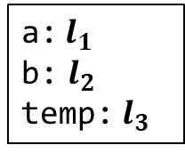

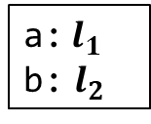
Evolution of Environments with References
Stack
Memory
// Swap two integers
void swap(int& a, int& b)
{
int temp = a;
a = b;
b = temp;
}
int main()
{
int a = 3, b = 5;
swap(a, b);
return 0;
}
$$l_{1}$$
main
3
Environment:
5
a:$l_{1}$
b: $l_{2}$
$$l_{2}$$
5
3
Environment:
PC
a:$l_{1}$
b: $l_{2}$
temp: $l_{3}$
$$l_{3}$$
swap
?
3

Slide 40
Pointers

Slide 41


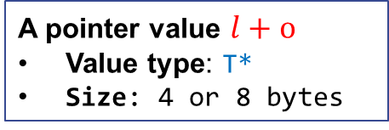
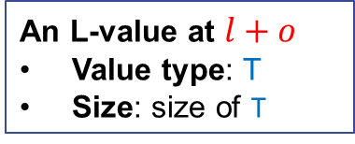

Pointers
Pointers: memory addresses as values
Value: $l$
Type: T* (the data value stored at $l$ is of type T)
Size: 4 bytes (32-bit machine) or 8 bytes (64-bit machine)
A pointer points to an L-value
$$o$$
$$l$$
A pointer value $l+o$
Value type: T*
Size: 4 or 8 bytes
An L-value at $l+o$
Value type: T
Size: size of T

Slide 42


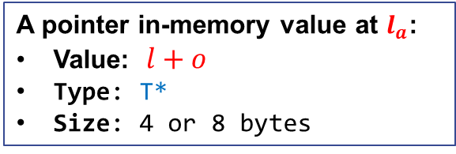
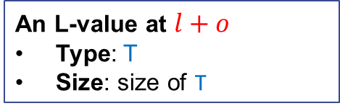


Pointer Variables
Syntax:
By defining T* p, we denote
an in-memory value storing pointers of type T* will be created at the right time
p will be mapped to location of that value
// Defines a pointer variable
<type> *<name1>, *<name2>, …;
$$o$$
$$l_{a}$$
$$l$$
$$l\text{+}o$$
A pointer in-memory value at $l_{a}$:
Value: $l+o$
Type: T*
Size: 4 or 8 bytes
An L-value at $l+o$
Type: T
Size: size of T

Slide 43

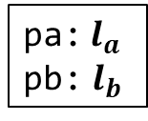

Examples
Pointer variables functions like regular variables
The in-memory value being points to is determined by its type
May store locations for integer L-values
May store locations for double L-values
int *pa;
int main()
{
double *pb;
return 0;
}
$$l_{a}$$
$$l_{b}$$
?
?
Created at the
start of program
Created at the
start of main function
pa:$l_{a}$
pb: $l_{b}$

Slide 44
Why We Need Pointers?
Multiple references to the shared in-memory data
Passing references to memory without copying their data
Optional references (Some or None)
Efficient navigation of memory (using pointer arithmetic)
Reserve new memory during execution (dynamic allocation)
Describe relationship between data structures

Slide 45
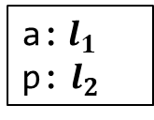



Address-of Operator
Syntax:
<expr> must be an L-value expression (i.e., <expr> is an L-value position)
This is an R-value expression
The R-value is a pointer to (memory address of) <expr>
The R-value’s type is T* where T is the type of <expr>
// Taking the address of expr
&<expr>
int a = 10;
int main()
{
int *p;
p = &a;
return 0;
}
Global
Memory
Stack
Memory
$$l_{1}$$
$$l_{2}$$
10
?
$$l_{1}$$
PC
Environment:
a:$l_{1}$
p: $l_{2}$

Slide 46



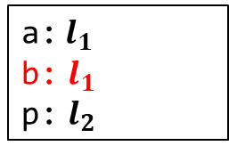
Address-of References
References are L-values
int a = 10;
int main() {
int& b = a;
int *p = &b;
return 0;
}
Global
Memory
Stack
Memory
$$l_{1}$$
$$l_{2}$$
PC
10
?
$$l_{1}$$
Environment:
a:$l_{1}$
b: $l_{1}$
p: $l_{2}$
Address: $l_{1}$
Size: 4 bytes
Value type: int
Data: 10

Slide 47



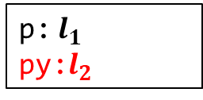
Address-of Members
Member variable accesses are L-values
// Point structure
struct Point {
int x;
int y;
};
int main() {
Point p;
int* py = &p.y;
…
return 0;
}
Global
Memory
Stack
Memory
$$l_{1}$$
?
?
$$l_{2}$$
?
PC
$$l_{1}+4$$
Address: $l_{1}+4$
Size: 4 bytes
Value type: int
Data: ?
p:$l_{1}$
py:$l_{2}$
Environment:

Slide 48
Exercises
Which of the following address-of expressions are invalid?
&3
&(a + b)
&(a || b)
&&p (suppose p is variable of type int)
&(a = a+b)
&(++x)
&(x++)
int id(int x) { return x; }
int main() {
int a;
int *p = &id(a);
return 0;
}
int& id(int& x) { return x; }
int main() {
int a;
int *p = &id(a);
return 0;
}

Slide 49



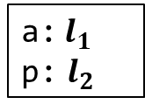
Dereference Operator
Syntax:
<expr> expects an R-value (i.e., <expr> is an R-value position)
The value of <expr> must be a pointer (of some type T*)
This is an L-value expression
It denotes the L-value of type T pointed by the pointer
// Dereference
*<expr>
int a = 10;
int main()
{
int *p;
p = &a;
*p = 3;
cout << *p << endl;
cout << a << endl;
return 0;
}
Global
Memory
Stack
Memory
$$l_{1}$$
$$l_{2}$$
10
3
$$l_{1}$$
PC
Environment:
a:$l_{1}$
p: $l_{2}$

Slide 50

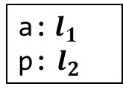
Implicit Conversion in Dereferencing
For example, in *p = 3;
The L-value p is implicitly converted to the pointer it contains
Then the dereference operator takes the pointer and convert it into an L-value
int a = 10;
int main()
{
int *p;
p = &a;
*p = 3;
cout << *p << endl;
cout << a << endl;
return 0;
}
Global
Memory
Stack
Memory
$$l_{1}$$
$$l_{2}$$
10
$$l_{1}$$
PC
Environment:
a:$l_{1}$
p: $l_{2}$
R-value positions

Slide 51

Pointer Variables as Containers
In essence, a pointer variable T* p is a container for pointers of type T*
Creation of the container: according to the definition (global or stack)
Write to the container: Assignment to p
Read from the container: Implicit conversion of the L-value p to R-value
int a = 10;
int main()
{
int *p;
p = &a;
*p = 3;
cout << *p << endl;
cout << a << endl;
return 0;
}
Global
Memory
Stack
Memory
$$l_{1}$$
$$l_{2}$$
10
?
PC
3
$$l_{1}$$
Environment:
a:$l_{1}$
p: $l_{2}$

Slide 52



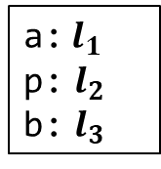
Why Need Pointer Containers?
Store and retrieve pointers
Modify the contained pointers as needed
int a = 10;
int main() {
int *p;
p = &a;
*p = 3;
cout << *p << endl;
cout << a << endl;
int b = 5;
p = &b;
*p = *p + 1;
cout << *p << endl;
cout << b << endl;
return 0;
}
Global
Memory
Stack
Memory
$$l_{1}$$
$$l_{2}$$
3
$$l_{1}$$
$$l_{3}$$
$$l_{3}$$
5
6
PC
Environment:
a:$l_{1}$
p: $l_{2}$
b: $l_{3}$

Slide 53

Dereferencing References
References function like ordinary variables
int a = 10;
int main() {
int& b = a;
int *p = &b;
*p = 3;
cout << *p << endl;
cout << a << endl;
cout << b << endl;
return 0;
}
Global
Memory
Stack
Memory
$$l_{1}$$
$$l_{2}$$
PC
10
?
3
$$l_{1}$$
Environment:
a:$l_{1}$
b: $l_{1}$
p: $l_{2}$

Slide 54


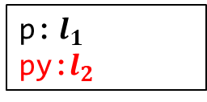
Dereferencing Members
// Point structure
struct Point {
int x;
int y;
};
int main() {
Point p;
int *py = &p.y;
*py = 10;
cout << *py << endl;
cout << p.y << endl;
return 0;
}
Global
Memory
Stack
Memory
$$l_{1}$$
?
?
10
$$l_{2}$$
$$l_{1}+4$$
PC
Environment:
p:$l_{1}$
py:$l_{2}$

Slide 55


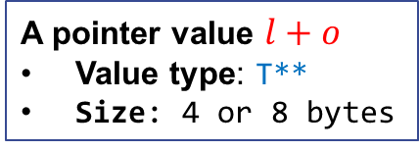


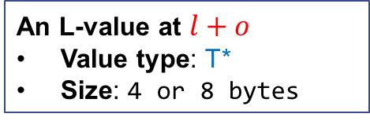


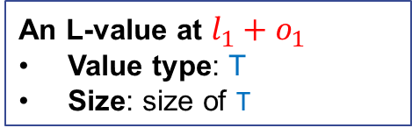
Pointers of Pointers
A pointer of type T** is a pointer to pointer
A variable holding a pointer to pointer is defined by T **p
$$o$$
$$o_{1}$$
$$l$$
$$l_{1}$$
$$l+o$$
$l_{1}+o_{1}$
A pointer value $l+o$
Value type: T**
Size: 4 or 8 bytes
An L-value at $l+o$
Value type: T*
Size: 4 or 8 bytes
An L-value at $l_{1}+o_{1}$
Value type: T
Size: size of T

Slide 56







Example
int main() {
int a = 10;
int *p = &a;
int **pp = &p;
**pp = 5;
cout << **pp << endl;
cout << a << endl;
int b = 7;
// Switch of address
p = &b;
**pp = 16;
cout << **pp << endl;
cout << b << endl;
return 0;
}
Global
Memory
Stack
Memory
PC
$$l_{1}$$
10
5
$$l_{2}$$
?
$$l_{1}$$
$$l_{4}$$
$$l_{3}$$
?
$$l_{2}$$
$$l_{4}$$
?
16
7
Environment:
a: $l_{1}$
p:$l_{2}$
pp:$l_{3}$
b: $l_{4}$

Slide 57
Const Pointer
Syntax:
With const T *p, p holds a pointer to an L-value that cannot be modified
// Defines a const pointer variable
const <type> *<name1>, *<name2>, …;
const int a = 10;
int main() {
const int *p = &a;
cout << *p << endl;
// Error: modify a const L-value
*p = 11;
const int b = 5;
// p itself can be modified!
p = &b;
cout << *p << endl;
return 0;
}

Slide 58
Exercise
Which of the following dereference expressions are invalid?
*10
int a; *&a
int a; *&*&*&*&a
int a; **&a
int *a; **&a

Slide 59






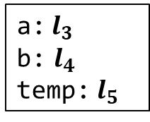
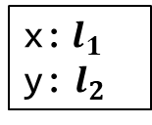

Pointers as Function Parameters
Pointers arguments are still passed using Call-By-Value
Stack
// Swap two integers
void swap(int* a, int* b) {
int temp = *a;
*a = *b;
*b = temp;
}
int main() {
int x = 3, y = 5;
swap(&x, &y);
cout << x << y << endl;
return 0;
}
$$l_{1}$$
3
main
Environment:
5
x:$l_{1}$
y: $l_{2}$
$$l_{2}$$
5
3
Environment:
$$l_{3}$$
a:$l_{3}$
b: $l_{4}$
temp: $l_{5}$
$$l_{1}$$
PC
$$l_{4}$$
swap
$$l_{2}$$
$$l_{5}$$
?
3

Slide 60
Invalid Pointers
Dereferencing an invalid pointer result in an undefined behavior
An invalid pointer may come from
Uninitialized pointer variable
Pointer to destroyed in-memory object
Out-of-bound pointers from pointer arithmetic
NULL pointer
...
// Error: x is dead after return
int* getX() {
int x;
return &x;
}
int main() {
cout << *getX() << endl;
return 0;
}
// Error: p is not initialized
int main() {
int *p;
cout << *p << endl;
return 0;
}

Slide 61
NULL Pointer
nullptr: is a special invalid pointer reserved by C++
Usage of nullptr:
Initialize or reset pointer variables
Return nullptr pointer to indicate failure
Compare with nullptr pointer to guard against errors
Note: Always instantiate a pointer variable to nullptr if it is not given an initial value
// allocate space
int* allocate(int size) {
int *p = nullptr;
if (enough space) {
p = newly allocated space;
return p;
}
// make use of allocate
int main() {
int *spc = allocate(10);
if (spc == nullptr)
return -1;
// Otherwise, proceed
…
}

Slide 62
Pointers to Object Variables
Pointer and pointer variables for ADT/CDT objects work as usual
// Point structure
struct Point {
int x;
int y;
};
int main() {
Point p;
Point *pp = &p;
(*pp).x = 3;
(*pp).y = 5;
cout << (*pp).x << (*pp).y;
return 0;
}
// Counter as defined previously
class Counter { … };
int main()
{
Counter c;
Counter *p = &c;
for (int i = 0; i < 10; i++)
(*p).incr();
cout << (*p).get() << endl;
return 0;
}

Slide 63
Syntactic Sugar
Special syntax for accessing members through pointers
p->var is equivalent to (*p).var
p->f(…) is equivalent to (*p).f(…)
// Point structure
struct Point {
int x;
int y;
};
int main() {
Point p;
Point *pp = &p;
pp->x = 3;
pp->y = 5;
cout << pp->x << pp->y;
return 0;
}
// Counter as defined previously
class Counter { … };
int main()
{
Counter c;
Counter *p = &c;
for (int i = 0; i < 10; i++)
p->incr();
cout << p->get() << endl;
return 0;
}

Slide 64
This Pointer
A special pointer called this is used to refer to the current object
References to member variables implicitly refer to the this pointer
// Counters
class Counter {
public:
void reset()
{ cnt = 0; }
int get()
{ return cnt; }
void incr()
{ cnt++; }
private:
int cnt;
};
// Counters
class Counter {
public:
void reset()
{ this->cnt = 0; }
int get()
{ return this->cnt; }
void incr()
{ this->cnt++; }
private:
int cnt;
};
Expands

Slide 65
This Pointer
Definitions of member function contains the implicit this parameter
void Counter::reset()
{
cnt = 0;
}
int Counter::get() const
{
return cnt;
}
void Counter::incr()
{
cnt++;
}
void reset(Counter *this)
{
this->cnt = 0;
}
int get(const Counter *this)
{
return this->cnt;
}
void incr(Counter *this)
{
this->cnt++;
}
Compiles

Slide 66
This Pointer
Calls to member functions implicitly passes the this pointer
int main()
{
Counter c;
c.reset();
int n;
cin >> n;
for (int i = 0; i < n; i++)
c.incr();
cout << c.get() << endl;
return 0;
}
int main()
{
Counter c;
reset(&c);
int n;
cin >> n;
for (int i = 0; i < n; i++)
incr(&c);
cout << get(&c) << endl;
return 0;
}
Compiles

Slide 67
Pointers vs. References

Slide 68
Comparison
Pointers: a typed memory address
Is also a regular value
May be stored in variables
May be part of the memory state
Can be uninitialized
Can be modified
Usage:
Multiple references to the shared in-memory data
Passing references to memory without copying their data
Navigation of memory
Reserve new memory
Describe relationship between data
References: an aliasing of L-value
Is NOT a value (but a name binding)
CANNOT be stored in variables
NOT part of the memory
MUST be bound to some L-value
NO WAY to modify references
Usage:
Multiple references to the shared in-memory data
Passing references to memory without copying their data

Slide 69
When to use which
Use references if you need to
Describe aliases to L-values (variables, fields, etc)
Bind to some L-values throughout the entire execution
Use pointers if you ALSO need to
Have optional references (None or SOME reference)
Modify the pointer value during execution (navigate memory space)
Note: pointers exposes the underlying memory structure, be very careful when using them together with ADTs!

Slide 70
Pointer Arithmetic

Slide 71

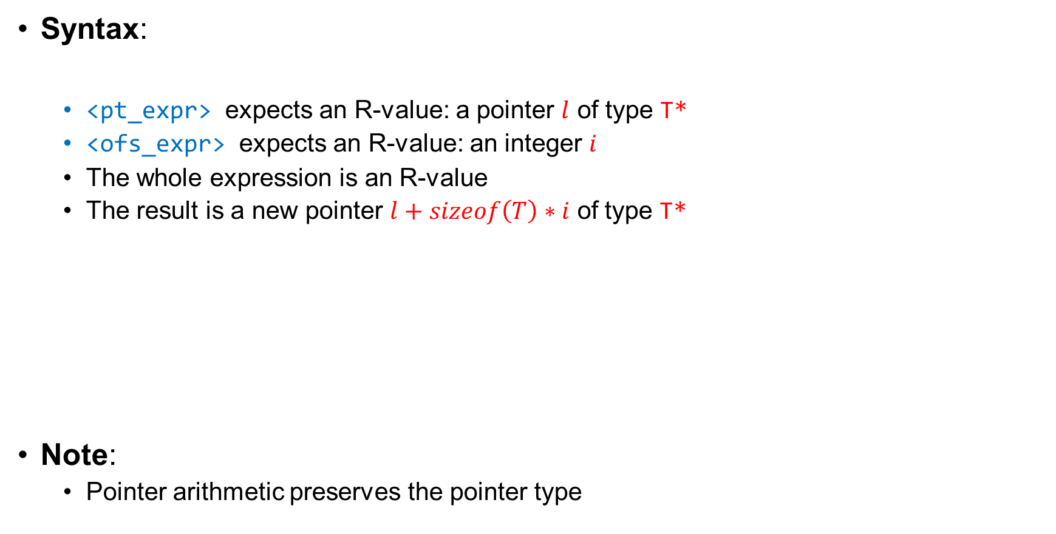


Pointer Arithmetic
Syntax:
<pt_expr> expects an R-value: a pointer $l$ of type T*
<ofs_expr> expects an R-value: an integer $i$
The whole expression is an R-value
The result is a new pointer $l+sizeof\left(T\right)∗i$ of type T*
Note:
Pointer arithmetic preserves the pointer type
// Adjust pointers
<pt_expr> + <ofs_expr>
$$l$$
$l+sizeof\left(T\right)∗i$
$$sizeof\left(T\right)∗i$$

Slide 72
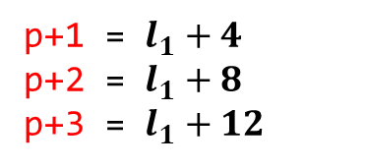


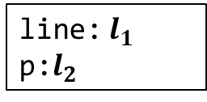
Usage
Navigate the space in memory
Stack
Memory
struct Line {
Line(int px1, int py1, int px2, int py2)
: x1(px1), y1(py1), x2(px2), y2(py2) {}
int x1, y1, x2, y2;
};
int main() {
Line line(2, 3, 7, 9);
int *p = &line.x1;
cout << *p << endl;
cout << *(p+1) << endl;
cout << *(p+2) << endl;
cout << *(p+3) << endl;
return 0;
}
$$l_{1}$$
2
3
7
9
4 bytes
$$l_{2}$$
$$l_{1}$$
Environment:
line:$l_{1}$
p:$l_{2}$
PC
p+1 = $l_{1}+4$
p+2 = $l_{1}+8$
p+3 = $l_{1}+12$

Slide 73



Pointer Arithemtic
The offset can also decrease
<pt_expr> - <ofs_expr> is equivalent to <pt_expr> + (-<ofs_expr>)
$l−sizeof\left(T\right)∗i$
$$l$$
$$sizeof\left(T\right)∗i$$

Slide 74
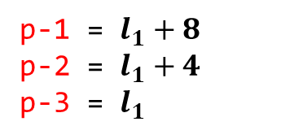

Usage
Navigate the space in memory
Stack
Memory
struct Line {
Line(int px1, int py1, int px2, int py2)
: x1(px1), y1(py1), x2(px2), y2(py2) {}
int x1, y1, x2, y2;
};
int main() {
Line line(2, 3, 7, 9);
int *p = &line.y2;
cout << *p << endl;
cout << *(p-1) << endl;
cout << *(p-2) << endl;
cout << *(p-3) << endl;
return 0;
}
$$l_{1}$$
2
3
7
9
4 bytes
$$l_{2}$$
$$l_{1}−12$$
Environment:
line:$l_{1}$
p:$l_{2}$
PC
p-1 = $l_{1}+8$
p-2 = $l_{1}+4$
p-3 = $l_{1}$

Slide 75


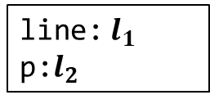
Pointers to the End of Objects
Pointers to the end of objects are invalid for access
Accessing them result in error
Note: this kind of pointers have a special use in accessing arrays
struct Line {
Line(int px1, int py1, int px2, int py2)
: x1(px1), y1(py1), x2(px2), y2(py2) {}
int x1, y1, x2, y2;
};
int main() {
Line line(2, 3, 7, 9);
int *p = &line.x1;
// Error: invalid pointer for access
cout << *(p+4) << endl;
return 0;
}
($l_{1}$, $16$)
Stack
Memory
$$l_{1}$$
2
3
7
9
4 bytes
$$l_{2}$$
$$l_{1}$$
Environment:
line:$l_{1}$
p:$l_{2}$

Slide 76
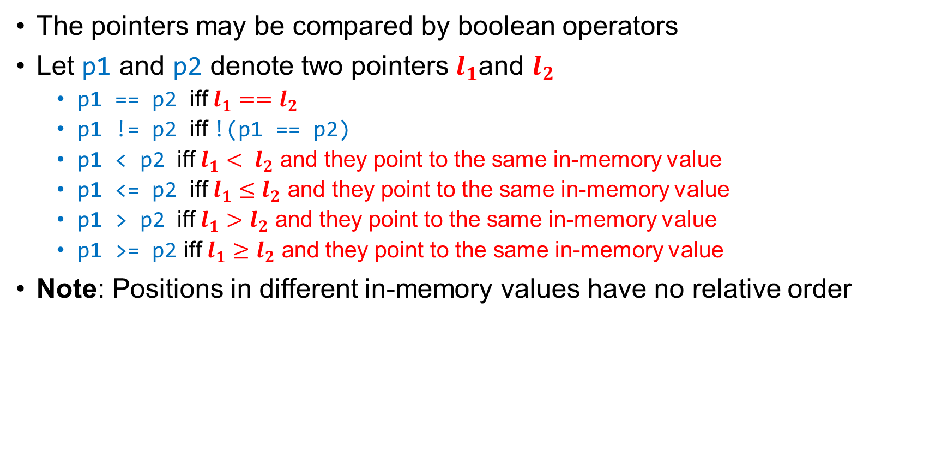
Compare Pointers
The pointers may be compared by boolean operators
Let p1 and p2 denote two pointers $l_{1}$and $l_{2}$
p1 == p2 iff $l_{1}==l_{2}$
p1 != p2 iff !(p1 == p2)
p1 < p2 iff $l_{1}< l_{2}$ and they point to the same in-memory value
p1 <= p2 iff $l_{1}≤l_{2}$ and they point to the same in-memory value
p1 > p2 iff $l_{1}>l_{2}$ and they point to the same in-memory value
p1 >= p2 iff $l_{1}≥l_{2}$ and they point to the same in-memory value
Note: Positions in different in-memory values have no relative order
int main() {
int a, b;
if (&a < &b) // Undefined behavior
cout << “&a < &b” << endl;
return 0;
}

Slide 77




Distances between Pointers
Syntax:
<pt_expr1> and <pt_expr2> expects to be pointers $l_{1}$ and $l_{2}$ of type T*
The whole expression is an integer value $(l_{1}−l_{2})/sizeof(T)$
Note:
Distances only make sense for pointers to the same in-memory value
// Compute the distance between pointers
<pt_expr1> - <pt_expr2>
$l_{2}$
$$l_{1}$$
$$(l_{1}−l_{2})/sizeof(T)$$

Slide 78



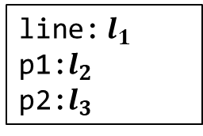
Example
Compute distances
Stack
Memory
struct Line {
Line(int px1, int py1, int px2, int py2)
: x1(px1), y1(py1), x2(px2), y2(py2) {}
int x1, y1, x2, y2;
};
int main() {
Line line(2, 3, 7, 9);
int *p1 = &line.y2;
int *p2 = &line.x1
cout << (p1-p2) << endl;
return 0;
}
$$l_{1}$$
2
3
7
9
4 bytes
$$l_{2}$$
$$l_{1}+12$$
$$l_{3}$$
$$l_{1}$$
PC
p1-p2 = 3
Environment:
line:$l_{1}$
p1:$l_{2}$
p2:$l_{3}$

Slide 79
Arrays

Slide 80

Arrays
An array is a fixed-sized sequence of elements of the same type
Syntax:
The size expression must be constant
The index expression must be an integer value
// Define an array of a given size
<type> name[<size>]
// Access the element at the given index
name[<index>] // Note: an L-value
Stack
Memory
// Example
const int N = 5;
int a[N];
for (int i = 0; i < N; i++)
a[i] = rand();
for (int i = 0; i < N; i++)
cout << a[i] << " ";
$$l_{1}$$
?
?
?
?
?
Environment:
a:$l_{1}$

Slide 81
Initialization and Assignment
Array may be initialized with a sequence of elements
Use sizeof to get the sizes of arrays
An array is a non-modifiable l-value:
// Examples
int a[5] = {4, 2, 1, 3, 5};
// Do not need to specify a size
int a[] = {4, 2, 1, 3, 5}
int n = sizeof(a)/sizeof(a[0]);
cout << n << endl;
// Example
int a[5] = {4, 2, 1, 3, 5};
int b[5];
b = a; // Cannot assign to an array

Slide 82


Decay to Pointers
An array variable of type T[] decays to a pointer of type T* at R-value positions
Stack
Memory
int main()
{
int a[5] = {4, 2, 1, 3, 5};
// Print 4
cout << *a << endl;
}
$$l_{1}$$
4
2
1
3
5
Environment:
a:$l_{1}$
Decay to the R-value
Address: $l_{1}$
Size: 4 bytes
Value type: int
Data: 4

Slide 83


Pointer Arithmetic
Pointer arithmetic is applicable to array variables
(a+i) is equivalent to &a[i]
*(a+i) is equivalent to a[i]
int main()
{
int a[5] = {4, 2, 1, 3, 5};
cout << *(a+2) << endl;
for (int i = 0; i < 5; i++)
cout << *(a+i) << endl;
// Alternatively, use p++
for (int *p = a; p != a+5; p++)
cout << *p << endl;
return 0;
}
Stack
Memory
$$l_{1}$$
4
2
1
3
5
Environment:
a:$l_{1}$
Evaluate to the pointer $l_{1}+8$ of type int*

Slide 84

Pointer Arithmetic
Reverse pointer arithmetic for array variables
Stack
Memory
int main()
{
int a[5] = {4, 2, 1, 3, 5};
int *p = a+5;
for (int i = 1; i <= 5; i++)
cout << *(p-i) << endl;
return 0;
}
$$l_{1}$$
4
2
1
3
5
Environment:
a:$l_{1}$

Slide 85
Arrays as Function Parameters
Often pass the length of array as a second argument
Array may decay to a pointer
// Pass an array and its size
void printArray1(int a[], int n)
{
for (int i = 0; i < n; i++)
cout << a[i] << " ";
cout << endl;
}
// Pass the decayed pointer
void printArray2(int* a, int n)
{
for (int i = 0; i < n; i++)
cout << a[i] << " ";
cout << endl;
}
// Main
int main()
{
int a[5] = {4, 2, 1, 3, 5};
printArray1(a, 5);
printArray2(a, 5);
return 0;
}

Slide 86
Higher-Dimension Arrays
Syntax:
// Define a higher-dimension array
<type> name[<size_1>]...[<size_n>]
// Access the element at the given index
name[<index_1>]..[<index_n>]
int main()
{
int a[4][3] = {{1, 2, 3}, {4, 5, 6}, {7, 8, 9}, {10, 11, 12}};
for (int i = 0; i < 4; i++) {
for (int j = 0; j < 3; j++)
cout << setw(4) << a[i][j] << " ";
cout << endl;
}
return 0;
}

Slide 87

Layout in Memory
Higher-dimension arrays reside in a linear address
int a[4][3] = {{1, 2, 3}, {4, 5, 6}, {7, 8, 9}, {10, 11, 12}};
$$l_{1}$$
1
2
3
4
5
6
7
8
9
10
11
12
Environment:
a:$l_{1}$
a[i][j] is equivalent to *(a+(i*3+j)*sizeof(int))
// Example
cout << a[0][2] << endl;
cout << a[3][2] << endl;

Slide 88
C-Style Strings

Slide 89
C-Style Strings
An array of characters ending with a NULL character ‘\0’ (ASCII value 0)
Example: (note the last NULL character)
Functions for Manipulation in <cstring>:
‘H’
‘e’
‘l’
‘l’
‘o’
‘,’
‘ ’
‘w’
‘o’
‘r’
‘l’
‘d’
‘!’
‘\0’
0
1
2
3
4
5
6
7
8
9
10
11
12
13
Function | Effect
strcpy(dst, src) | Copy the string in src to dst
strcat(dst, src) | Append the string in src to dst
strlen(s) | Return the length of the string
strcmp(s1, s2) | Compare s1 and s2, return +/0/- if s1 > s2 / s1=s1 / s1<s2
strstr(s1, s2) | Find s2 in s1 and return a pointer to the first occurrence

Slide 90
Buffer Overflow
Be careful of overwriting beyond the end of C-style strings when copying
Q: what happens if you execute the above code?
A: In theory, undefined behavior
In practice, much worse can happen. See:
https://www.eecs.umich.edu/courses/eecs588/static/stack_smashing.pdf
// Example of buffer overflow
int main()
{
int a = 10;
char dst[10];
char str[] = "beauty is only skin deep";
strcpy(dst, str);
cout << a << endl;
return 0;
}

Slide 91
Heap and Dynamic Allocation

Slide 92


Heap Memory
Heap memory is a third memory region besides global and stack memory
Objects must be explicitly allocated and released from heap
known as dynamic (de-)allocation
Every in-memory objects in heap has a unique location
Heap allocation may fail if there is not enough free space
Global
Memory
Heap
Memory
Stack
Memory
$$l_{1}$$
$$l_{2}$$
$$l_{3}$$
● ● ●
● ● ●
● ● ●
Grows

Slide 93

Dynamic Allocation and Deallocation
Syntax for Allocation:
Returns a pointer to the allocated object
Syntax for Deallocation:
<expr> must evaluate to a pointer $l$
Attention: the offset must be 0! (meaning it points to the head of the object)
Remove the in-memory object with location $l$
// Allocate an in-memory object of type T on heap
new T
// Remove the in-memory object from the heap
delete <expr>

Slide 94




A First Example
Note:
Remember to deallocate heap objects before exiting (o.w., memory leaks occur)
The value in variable p is an invalid pointer after deallocation
Reset the value of those pointer variables to nullptr if it will be reused later!
int main()
{
int *p = new int;
*p = 10;
cout << *p << endl;
delete p;
return 0;
}
Heap
Memory
Stack
Memory
PC
$$l_{2}$$
$$l_{1}$$
?
?
10
($l_{2}$, 0)
Environment:
p:$l_{1}$

Slide 95




Allocation of ADT Objects
int main()
{
Counter* c = new Counter;
c->reset();
int n;
cin >> n;
for (int i = 0; i < n; i++)
c->incr();
cout << "The value of the counter is: "
<< c->get() << endl;
delete c;
return 0;
}
Heap
Memory
Stack
Memory
PC
$$l_{2}$$
$$l_{1}$$
?
?
0
$$l_{2}$$
Environment:
c:$l_{1}$

Slide 96
Whack-A-Mole Revisited
// The field where moles happily live
class Field {
public:
// Constructor
Field(int sz);
// Get the information of a mole (if any)
const Mole* getMole(int row, int col) const;
// Add a mole
const Mole* addMole(int row, int col, bool big);
// Remove mole
bool removeMole(int row, int col);
...
private:
// Size (n x n) of the filed
int size;
// Moles in the field
Grid<Mole*> moles;
};

Slide 97

Dynamic Arrays
Syntax for Allocation:
Returns a pointer to the allocated array
Syntax for Deallocation:
<expr> must evaluate to a pointer ($l$, 0) to a dynamic array
Remove the array with location $l$
// Allocate an dynamic array of T on heap
new T[<size>]
// Example
new int[5];
$$l_{1}$$
?
?
?
?
?
// Remove the in-memory object from the heap
delete[] <expr>

Slide 98
Fixed-Length Vector
We can define a vector of integers with fixed length using a dynamic array
// Vectors with a fixed length
class FVector {
public:
// Constructors and destructors
FVector(int n);
~FVector();
int length() const;
void set(int i, int v);
int at(int i) const;
private:
int n;
int* arr;
};
FVector::FVector(int l) : n(l)
{ arr = new int[l]; }
FVector::~FVector()
{ delete[] arr; }
int FVector::at(int i) const {
if (i >= 0 && i < n)
return arr[i];
return -1;
}
void FVector::set(int i, int v) {
if (i >= 0 && i < n)
{ arr[i] = v; }
}

Slide 99
Ownership of Resources

Slide 100
Ownership of Dynamic Memory
An object owns a piece of memory if it is responsible for its destruction
This memory may be created by its constructor and other methods
Or transferred over by another owner
The internal structure of the memory is usually not visible outside
Examples: An FVector owns its dynamic array
// Vectors with a fixed length
class FVector {
public:
...
private:
int n;
int* arr;
};
// Allocation and deallocation
FVector::FVector(int l) : n(l)
{ arr = new int[l]; }
FVector::~FVector()
{ delete[] arr; }

Slide 101
Resource Acquisition is Initialization
RAII is a programming idiom
Lifetime of resource is tied to the lifetime of objects
Resources are acquired during object initialization (constructor)
Resources are released during object finalization (destructor)
Slogan: No object leaks, No memory leaks
When resources are memory, RAII ensures ownership of memory
Resources may also be anything other than memory
File handlers
Internet sockets
Process identifiers
...

Slide 102
Shallow Copying
Copying of objects copies their member variables by default
This is called shallow copying
// What goes wrong with the following code?
void test()
{
FVector vec(5);
for (int i = 0; i < vec.length(); i++)
vec.set(i, randomInteger(1, 100));
FVector vec1(3);
vec1 = vec;
}
int main()
{
test();
return 0;
}

Slide 103








Shallow Copying
Shallow copying may violate resource ownerships
Memory leak
Unwanted sharing
Stack
Memory
Heap
Memory
$$l_{1}$$
$$l_{2}$$
5
$$l_{2}$$
?
?
?
?
?
Shallow Copying
$$l_{3}$$
$$l_{4}$$
4
$$l_{4}$$
?
?
?
5
$$l_{2}$$
Environment:
vec:$l_{1}$
vec1:$l_{3}$

Slide 104




Deep Copying
Make a copy of owned resources when duplicating objects
Release the owned resources when overwriting objects
Stack
Memory
Heap
Memory
$$l_{1}$$
$$l_{2}$$
5
$$l_{2}$$
?
?
?
?
?
Deep Copying
Deep Copying
$$l_{3}$$
$$l_{5}$$
4
$$l_{4}$$
?
5
$$l_{5}$$
?
?
?
?
Environment:
vec:$l_{1}$
vec1:$l_{3}$
$$l_{4}$$
?
?
?

Slide 105
Deep Copying
Define a private function for deep copying
// Vectors with a fixed length
class FVector {
public:
...
private:
void deepCopy(const FVector& vec);
int n;
int* arr;
};
// Deep copy of FVector
void FVector::deepCopy(const FVector& vec)
{
arr = new int[vec.n];
for (int i = 0; i < vec.n; i++)
arr[i] = vec.arr[i];
n = vec.n;
}

Slide 106
Assignment Overloading
Overload the assignment operator for the objects
This will overwrite the behavior of shallow copying
Note:
Do not overwrite self!
Release the resources before copying
class FVector {
public:
...
// Overloaded Assignment
FVector& operator=(const FVector& vec);
private:
...
};
FVector& FVector::operator=(const FVector& vec)
{
if (this != &vec) {//自己不需要操作
delete[] arr;
deepCopy(vec);
}
return *this;//当前对象解引用
}

Slide 107
Copy Constructors
Overload the copy constructor for creating objects using deep copying
class FVector {
public:
...
// Copy constructor
FVector(const FVector& vec);
private:
...
};
FVector::FVector(const FVector& vec)
{
deepCopy(vec);
}

Slide 108
Other Methods for Managing Heap Memory
Reference Counting
Keep a counter of references/pointers to a heap object
When the counter drops to 0, delete the object
Need to break cycles of references
No run-time needed
Garbage Collection (GC)
Garbage refers to heap memory allocated but no longer referenced
A garbage collector scans the memory to reclaim garbages
Many different implementations
Need run-time to support GC
High-overhead and hard-to-control performance

Slide 109
Relations between Data Structures

Slide 110

Linked Lists
A data structure representing a sequence of values linked by pointers
// Linked lists of integers
struct LinkedList{
LinkedList() : value(0), next(NULL) {}
int value;
LinkedList* next;//不能去掉*
};

Slide 111
Basic Operations
We define the following operations for using linked lists
// Push to the head of linked lists
LinkedList* push(LinkedList* l, int value);
// Peek the head value
int peek(LinkedList* l);
// Pop the head of the linked lists
LinkedList* pop(LinkedList* l);
// Destroy the whole list
void destroy(LinkedList* l);
// Print the values
void print(LinkedList* l);

Slide 112
Basic Operations
LinkedList* push(LinkedList* l, int value) {
LinkedList* newl = new LinkedList;
newl->value = value;
newl->next = l;
return newl;
}
int peek(LinkedList* l) {
if (l == NULL) return 0;
return l->value;
}
LinkedList* pop(LinkedList* l) {
if (l == NULL) return NULL;
LinkedList* next = l->next;
delete l;
return next;
}

Slide 113
Basic Operations
The following operations traverses the lists using iterations
Q: How to destroy and print lists by using recursion?
void destroy(LinkedList* l) {
while (l != NULL)
l = pop(l);
}
void print(LinkedList* l) {
for (LinkedList* p = l; p != NULL; p = p->next)
cout << p->value << " ";
cout << endl;
}

Slide 114
Copying Linked Lists
Follow the pointers to performed a deep copy
Exercise: write a version of copy that uses iteration instead of recursion
// Deep copy using recursion
LinkedList* copy(LinkedList* l)
{
if (l == NULL)
return NULL;
LinkedList* newl = new LinkedList;
newl->value = l->value;
newl->next = copy(l->next);
return newl;
}

Slide 115
Get the I-th Element
It is convenient to get both the i-th element in its predecessor
pair<LinkedList*, LinkedList*> getIthPrev(LinkedList* l, int i)
{
assert(i >= 0);
LinkedList* prev = NULL;
while (l != NULL && i != 0) {
prev = l;
l = l->next;
i--;
}
return make_pair(prev, l);
}
LinkedList* getIth(LinkedList* l, int i) {
return getIthPrev(l, i).second;
}

Slide 116
Designing Collections

Slide 117
Design Collections
Define collections by using dynamic memory
Elements in collections are resources owned by collections
We use vectors of integers as an example and discuss two approaches
Vectors implemented using linked lists

Slide 118
Vector of Integers
Class definition
class IVector{
public:
IVector();
~IVector();
int size() const;
bool isEmpty() const;
void clear();
int get(int i) const;
void set(int i, int v);
void add(int v);
void insert(int i, int v);
void remove(int i);
private:
LinkedList* lst;
};

Slide 119
Add Elements
Append elements to the end
Navigate to the last element
Create a new last element
Append it
void IVector::add(int v)
{
LinkedList *prev = NULL, *cur = lst;
while (cur != NULL) {
prev = cur;
cur = cur->next;
}
LinkedList* newl = new LinkedList;
newl->value = v;
if (prev != NULL)
prev->next = newl;
else
lst = newl;
}

Slide 120
Insert Elements
Insert an element to i-th position
Find the i-th element and its predecessor
Create a new element
Insert it into between the i-th element and its predecessor
Note: if i >= size, then insert functions like add
void IVector::insert(int i, int v)
{
if (i < 0) return;
std::pair<LinkedList*, LinkedList*>
p = getIthPrev(lst, i);
LinkedList *prev = p.first,
*cur = p.second;
LinkedList* newl = new LinkedList;
newl->value = v;
newl->next = cur;
if (prev != NULL)
prev->next = newl;
else
lst = newl;
}

Slide 121
Remove Elements
Remove the i-th element
Find the i-th element and its predecessor
Remove the i-th element and adjust the next pointer of the predecessor
Note: if i >= size, then remove has no effect
void IVector::remove(int i)
{
if (i < 0) return;
std::pair<LinkedList*, LinkedList*> p = getIthPrev(lst, i);
LinkedList *prev = p.first, *cur = p.second;
if (cur == NULL) return;
if (prev != NULL)
prev->next = cur->next;
else
lst = cur->next;
}

Slide 122
Constructors and Destructors
void IVector::clear()
{
destroy(lst);
lst = NULL;
}
IVector::IVector() : lst(NULL) {}
IVector::~IVector()
{
clear();
}
int IVector::size() const
{
int i = 0;
LinkedList* l = lst;
while (l != NULL) {
i++;
l = l->next;
}
return i;
}
bool IVector::isEmpty() const
{
return lst == NULL;
}

Slide 123
Copying and Assignment
Perform deep copying for copy construction and assignment
Release the memory before copying in assignments
//Copy constructor
IVector::IVector(const IVector& vec)
{
lst = copy(vec.lst);
}
//Assignment operator
IVector& IVector::operator=(const IVector& vec)
{
if (this != &vec) {
clear();
lst = copy(vec.lst);
}
return *this;
}

Slide 124
Generic Collections

Slide 125
Template Classes
Define a collection of classes parameterized by type variables
Syntax:
Examples: Vector, Stack, Map, ..., etc
Note: The definitions and declarations must be in the same header files
Template functions/classes are patterns for generating code (not the code themselves)
The users of templates must see ALL the definitions for instantiation
Programming using templates is known as Generic Programming
template <class T1, ..., class Tn>
class <name>{
...
}

Slide 126
Generic Linked Lists
Similar to previous definition but with a type parameter
By instantiating T, we get linked lists containing different types of values
// Definition of generic linked lists
template <class T>
struct LinkedList{
LinkedList(T v) : value(v), next(NULL) {}
T value;
LinkedList* next;
};
// Different instances of linked list
LinkedList<int>
LinkedList<double>
LinkedList<LinkedList<int>>
...

Slide 127
Generic Operations
Some operations:
template <class T>
LinkedList<T>* push(LinkedList<T>* l,
T value) {
LinkedList<T>* newl =
new LinkedList<T>;
newl->value = value;
newl->next = l;
return newl;
}
template <class T>
LinkedList<T>* pop(LinkedList<T>* l) {
if (l == NULL) return NULL;
LinkedList<T>* next = l->next;
delete l;
return next;
}
template <class T>
T peek(LinkedList<T>* l) {
if (l == NULL) return 0;
return l->value;
}
template <class T>
LinkedList<T>* copy(LinkedList<T>* l) {
if (l == NULL)
return NULL;
LinkedList<T>* newl =
new LinkedList<T>(l->value);
newl->next = copy(l->next);
return newl;
}

Slide 128
Generic Vectors
Similar to IVector but with a type parameter
template <class T>
class Vector{
public:
Vector() : lst(NULL) {}
~Vector() { clear(); }
//Copy constructor
Vector(const Vector& vec) {
lst = copy(vec.lst);
}
...
private:
LinkedList<T>* lst;
};

Slide 129
Generic Member Functions
T get(int i) const{
if (i < 0) return 0;
LinkedList<T>* l = getIth(lst, i);
if (l == NULL)
return T();
else
return l->value;
}
void set(int i, T v)
{
if (i < 0) return;
LinkedList<T>* l = getIth(lst, i);
if (l != NULL)
l->value = v;
}
void insert(int i, T v)
{
if (i < 0) return;
std::pair<LinkedList<T>*, LinkedList<T>*>
p = getIthPrev(lst, i);
LinkedList<T> *prev = p.first,
*cur = p.second;
LinkedList<T>* newl =
new LinkedList<T>(v);
newl->next = cur;
if (prev != NULL)
prev->next = newl;
else
lst = newl;
}

Slide 130
Next Time
We will discuss
Subtyping of ADTs
Inheritance of Classes
Dynamic Binding and Virtual Functions
Design Patterns
You should read Chapter 19 of the text book

