Slide 1
Principles and Methods of Program Design Lecture 8: Subtyping of ADTs
Yuting Wang
SEIEE
John Hopcroft Center for Computer Science
2023.5.16

Slide 2
Road Map
Basics of Imperative Programming (C++)
Programming with Abstractions
Implementing Abstractions
Here!

Slide 3
Last Time
Pointers
Arrays
Dynamic Allocation & Deallocation
Dynamic Resource Management

Slide 4
This Time
Subtyping
Inheritance of Classes
Dynamic Dispatching
Virtual Functions
Design Patterns

Slide 5
Inheritance

Slide 6
Subtyping
A type represents a collection of objects
A subtype represents a special kind of objects in this collection
Animal
Mammals
Reptiles
Birds
Horses
Human
Crocodiles
Snakes

Slide 7
Inheritance
A subclass represents a special kind of objects of its parent class
The relation between a class and its subclasses is called inheritance
Syntax:
// Inheritance
class <subclass> : public <parentclass> {
...
}
// Exmaples
class Mammals: public Animal {
...
}
// Exmaples
class Human: public Mammals {
...
}

Slide 8
Inheritance of Public Members
Public members of subclass include those in the parent class
// Parent Class
class Personal {
public:
Personal()
: id("None"), age(0) {}
string getID() const
{ return id; }
int getAge() const
{ return age; }
private:
string id;
int age;
};
// Subclass
class Student : public Personal {
public:
Student()
: classNo("None"), yearEn(2022) {}
string getClassNo() const
{ return classNo; }
int getYear() const
{ return yearEn; }
private:
string classNo; // Class number
int yearEn; // Year enrolled
};

Slide 9
Inheritance of Public Members
Public members of subclass include those in the parent class
int main()
{
Student s;
// Methods inherited from the parent
cout << "Student ID: " << s.getID() << endl;
cout << "Student Age: " << s.getAge() << endl;
// Methods newly introduced in the subclass
cout << "Student ClassNo: " << s.getClassNo() << endl;
cout << "Year Enrolled: " << s.getYear() << endl;
return 0;
}

Slide 10
Hidden Private Members
Private members of parent class is inaccessible from the subclass
class Student : public Personal {
public:
void printParent() const {
// Error: cannot access
// private fields of the parent
cout << "ID: " << id << endl
<< "AGE: " << age << endl;
}
...
};
class Student : public Personal {
public:
void printParent() const {
// Access the public
// members of the parent
cout << "ID: " << getID() << endl
<< "AGE: " << getAge() << endl;
}
...
};

Slide 11


In-Memory Objects
In-memory objects contain fields from both the subclass and its parent
Stack
Memory
int main()
{
Student s;
...
return 0;
}
$$l_{1}$$
“None”
0
“None”
2022
PC
id
age
classNo
yearEn
Environment:
s:$l_{1}$

Slide 12
Initialization & Finalization
When instantiating an object of a subclass
The constructor of parent class is called first
The constructor of the subclass is called second
When finalizing an object of a subclass
The destructor of the subclass is called first
The destructor of the parent class is called second

Slide 13
Example
Note: the initialization of Student calls the constructor of Personal
class Personal {
public:
Personal() : id(“None”), age(0) {
cout << "Personal: Constructor" << endl;
}
Personal(string sid, int sage)
: id(sid), age(sage) {
cout << "Personal: Constructor" << endl;
}
~Personal() {
cout << "Personal: Destructor" << endl;
}
...
};
class Student : public Personal {
public:
Student() : classNo(“None”), yearEn(2022) {
cout << "Student: Constructor" << endl;
}
Student(string sid, int sage, string sclassNo,
int syear) : Personal(sid, sage),
classNo(sclassNo), yearEn(syear) {
cout << "Student: Constructor" << endl;
}
~Student() {
cout << "Student: Destructor" << endl;
}
...
};

Slide 14
Overriding
Overriding: members in the subclass overshadows those in the parent class with the same names
class Personal {
public:
void print() const {
cout << "ID: " << id << endl;
cout << "Age: " << age << endl;
}
...
};
class Student : public Personal {
public:
void print() const {
cout << "ID: " << getID() << endl;
cout << "Age: " << getAge() << endl;
cout << "Class: " << classNo << endl;
cout << "Year Enrolled: "
<< yearEn << endl;
}
...
};
// Invocation of print
Student s("12345", 19, "F2212345", 2022);
s.print();

Slide 15
Overriding
Write <parent>::<method> to access the overrided methods
class Personal {
public:
void print() const {
cout << "ID: " << id << endl;
cout << "Age: " << age << endl;
}
...
};
class Student : public Personal {
public:
void print() const {
Personal::print();
cout << "Class: " << classNo << endl;
cout << "Year Enrolled: "
<< yearEn << endl;
}
...
};

Slide 16
Conversion between Classes
An object of subclass can be converted into that of its parent
Note: it is not possible to convert a sub-object to one of the parent class
// Conversion from student to personal
int main()
{
Student s("12345", 19, "F2212345", 2022);
Personal p;
p = s;
p.print();
return 0;
}

Slide 17
Multiple Inheritance
A subclass may have multiple parent classes
class Transient {
public:
Transient() : months(0) {}
Transient(int m) : months(m) {}
int getMonths() const { return months; }
private:
int months;
};
class Student : public Personal, public Transient {
public:
Student() : classNo(“None”), yearEn(2022) {}
Student(string sid, int sage, string sclassNo,
int syear, int months)
: Personal(sid, sage), Transient(months),
classNo(sclassNo), yearEn(syear) {}
...};

Slide 18
Multiple Inheritance
Inherit all the members of parents
class Student : public Personal, public Transient {
public:
void print() const {
cout << "ID: " << getID() << endl;
cout << "Age: " << getAge() << endl;
cout << "Class: " << classNo << endl;
cout << "Year Enrolled: " << yearEn << endl;
cout << "Months to Stay: " << getMonths() << endl;
}
...
};

Slide 19
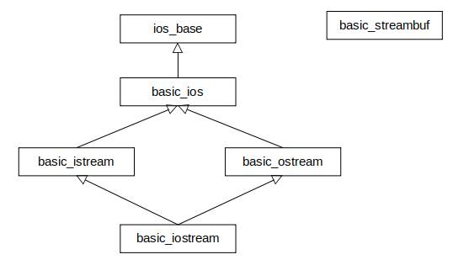
Multiple Inheritance
Most of the cases, single inheritance is sufficient
In rare cases, we need multiple inheritance (e.g., iostream)
Note: use multiple inheritance only when absolutely needed

Slide 20
Dynamic Dispatch

Slide 21
Motivation
Methods calls viewed as dispatching messages
Problem:
Previously, obj.print is fixed to a single method determined by the compiler
We would like print to choose different methods depending on the receiving obj
Static Dispatching
The method to be called is determined before the program runs
Dynamic Dispatching:
The method to be called is determined when the call actually happens
// Binding an object
Object& obj = ....;
// Send “print” message to “obj”
obj.print();

Slide 22
Dynamic Dispatching in C++
A class defines a collection of message interfaces (virtual functions)
Its different subclasses
Share the same interface
Give different implementation to these interfaces
Users dynamically dispatch messages through interfaces to sub-objects
SubObj1
Parent
SubClass1
SubClass2
SubClass3

Slide 23
Virtual Functions
Overrided member functions that may be accessible from parent classes
Syntax:
Define message interfaces that you would like to dynamically dispatch to
class <classname> {
virtual <fundef>
...
};
// The unit class has two virtual functions
class Unit {
public:
// Get movement points
virtual int getMovPts() const { return 0; }
// Get the symbol
virtual string getSymbol() const { return “None”; }
};

Slide 24
Virtual Functions
Subclasses provide different implementations to parent virtual functions
// Footmen
class Footman : public Unit {
public:
virtual int getMovPts() const
{ return 3; }
virtual string getSymbol() const
{ return "FT"; }
};
// Knights
class Knight : public Unit {
public:
virtual int getMovPts() const
{ return 5; }
virtual string getSymbol() const
{ return "KN"; }
};
// Archers
class Archer : public Unit {
public:
virtual int getMovPts() const
{ return 3; }
virtual string getSymbol() const
{ return "AR"; }
};
// Mages
class Mage : public Unit {
public:
virtual int getMovPts() const
{ return 2; }
virtual string getSymbol() const
{ return "MG"; }
};

Slide 25
Invoking Virtual Functions
Dynamic dispatching is realized by
Binding sub-objects to a pointer or reference of their parent class
Call the virtual function through the pointer or reference
int main() {
Footman f;
// Invoke Footman::getMovPts and Footman::getSymbol
// through a reference
Unit& u = f;
cout << "Move Points: " << u.getMovPts() << endl;
cout << "Unit Type: " << u.getSymbol() << endl;
// Invoke Footman::getMovPts and Footman::getSymbol
// through a pointer
Unit* p = &f;
cout << "Move Points: " << p->getMovPts() << endl;
cout << "Unit Type: " << p->getSymbol() << endl;
return 0;
}

Slide 26
Functions using Dynamic Dispatching
Functions may dynamically invoke methods depending on objects
// Randomly generate a unit
Unit* generateUnit() {
int i = randomInteger(1, 4);
switch (i) {
case 1:
return new Footman;
case 2:
return new Knight;
case 3:
return new Archer;
case 4:
return new Mage;
}
}
// Print objects using dynamic dispatching
void printUnit(Unit* u) {
cout << "Unit: " << u->getSymbol() <<
" Movement: " << u->getMovPts() << endl;
}
// Main
int main() {
for (int i = 0; i < 10; i++) {
Unit* u = generateUnit();
printUnit(u);
delete u;
}
return 0;
}

Slide 27
Degeneration of Virtual Functions
Dynamic dispatching does not happen when NOT using pointers or references
int main() {
Footman f;
// Direct invocation, no dynamic dispatching
cout << "Move Points: " << f.getMovPts() << endl;
cout << "Unit Type: " << f.getSymbol() << endl;
// Conversion instead of binding, no dynamic dispatching
Unit u = f;
cout << "Move Points: " << u.getMovPts() << endl;
cout << "Unit Type: " << u.getSymbol() << endl;
return 0;
}

Slide 28
Pure Virtual Functions
In many cases, the only use of parent classes is for providing interfaces
Pure virtual functions: without a definition, only an interface
You cannot define objects of a class with any pure virtual function
Pure virtual functions are inherited by subclasses if not overrided
Guideline: make every interface class contain pure virtual functions
// Example
class Unit {
public:
// Pure virtual functions
virtual int getMovPts() const = 0;
virtual string getSymbol() const = 0;
};

Slide 29
A Bigger Example
Racing between hares and tortoises
A number of hares and tortoises enters the race
Every second they may move forward or backward with different probabilities
Any animal that first crosses the finish line wins the game
Define an interface class for animals
class Animal {
public:
// Provide the moved length
virtual int move() = 0;
// Display the animal
virtual void display() = 0;
};

Slide 30
Implementation of the Players
Tortoise and Hare
class Tortoise : public Animal {
public:
int move() {
int probability =
randomInteger(1, 10);
if (probability < 5)
return 3;
else if (probability < 7)
return -6;
else
return 1;
}
void display()
{ cout << “T”; }
};
class Hare : public Animal {
public:
int move() {
int probability =
randomInteger(1, 10);
if (probability < 2) return 0;
else if (probability < 4) return -9;
else if (probability < 5) return 14;
else if (probability < 8) return 3;
else return -2;
}
void display()
{ cout << “H”; }
};

Slide 31
Play Loop
int play(Animal **players, int num, int LENGTH) {
//是个数组，里面存的指针，指向数组
int *distance, winner, length = 0;
distance = new int[num];
for (int i = 0; i < num; ++i)
distance[i] = 0;
// Game loop
do {
for (int i = 0; i < num; ++i) {
distance[i] += players[i]->move();
if (distance[i] > length) {
length = distance[i];
winner = i;
}
}
displayStatus(players, distance, num);
} while (length < LENGTH);
delete[] distance;
return winner;
}
int displayStatus(Animal **players,
int *distance,
int num)
{
for (int i = 0; i < num; ++i) {
players[i]->display();
cout << '\t';
}
cout << endl;
for (int i = 0; i < num; ++i)
cout << distance[i] << '\t';
cout << endl;
}

Slide 32
Entry Point
int main() {
const int LENGTH = 20;
int num, winner;
Animal **players;
cout << "Number of players ? ";
cin >> num;
players = new Animal*[num];
for (int i = 0; i < num; ++i)
if (randomBool())
players[i] = new Tortoise;
else
players[i] = new Hare ;
winner = play(players, num, LENGTH);
cout << "The winner is player : " << winner << endl;
for (int i = 0; i < num; i++)
delete players[i];
delete[] players;
return 0;
}

Slide 33
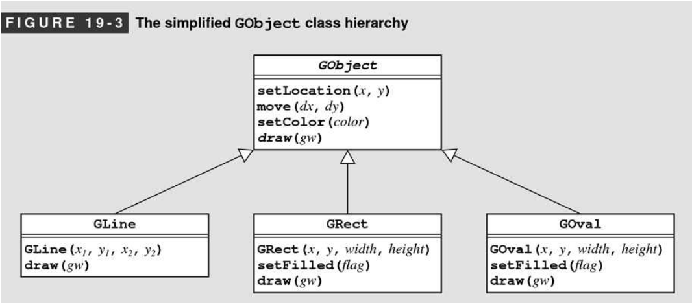
Inheritance in Graphic Libraries
A common usage of inheritance is in defining graphic libraries
Draw method behave differently depending on objects (see textbook for full examples)

Slide 34
Design Patterns

Slide 35
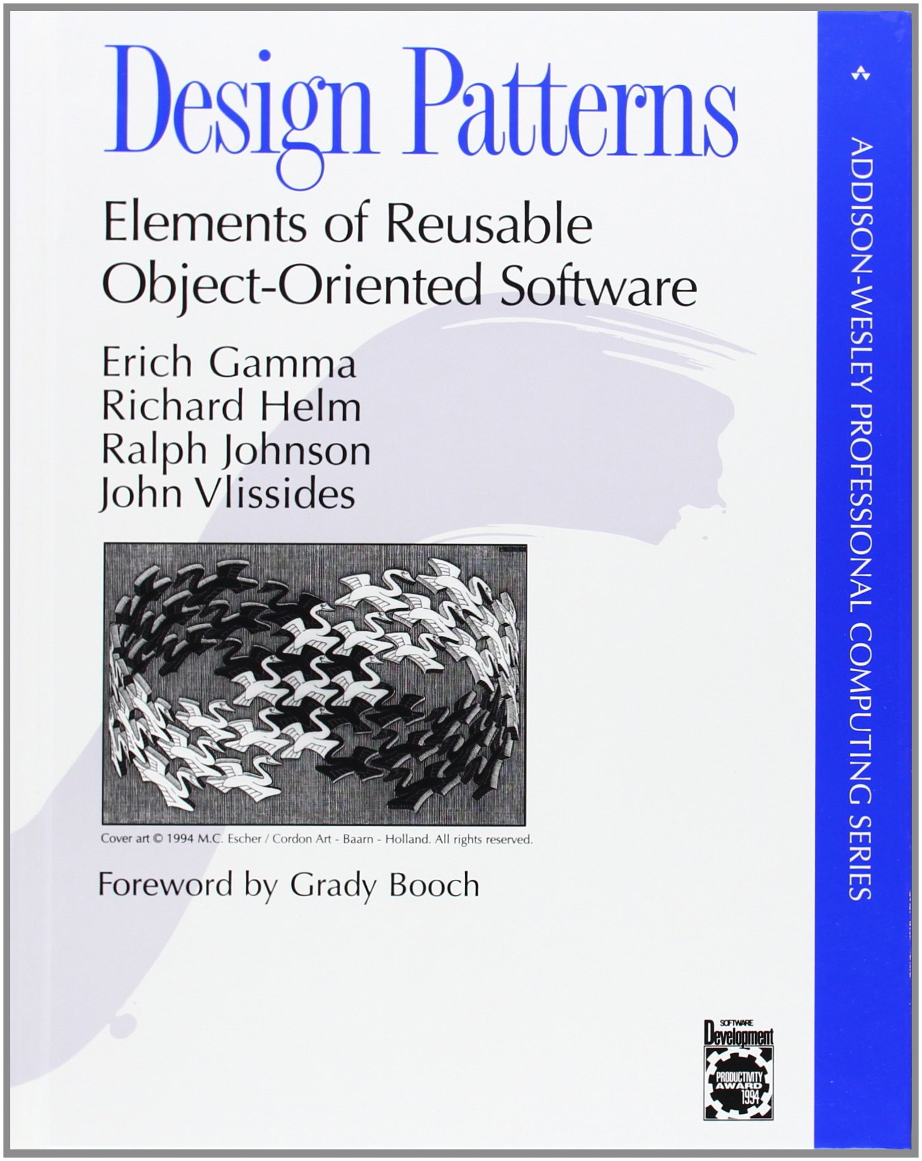
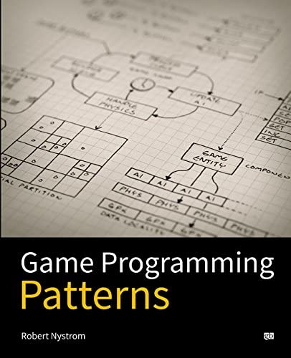
Design Patterns
Best practices used in Object-Oriented Programming
A pattern is a blueprint for solving a particular design problem

Slide 36
Catalog
Creational Patterns
Concerns the process of object creation
Structural Patterns
Concerns the composition of classes or objects
Behavioral Patterns
Characterizes the ways in which classes or objects interact
We focus on one commonly used behavioral pattern: Visitor Pattern

Slide 37
Overview of Visitor
Represent an operation to be performed on elements as an object.
Allow definition of new operations without changing classes of elements
Command Class:
TypeCheck()
PrettyPrint()
GenerateCode()
Assignments:
TypeCheck()
PrettyPrint()
GenerateCode()
IfStmt:
TypeCheck()
PrettyPrint()
GenerateCode()
WhileStmt:
TypeCheck()
PrettyPrint()
GenerateCode()

Slide 38
Problems
Adding one new operation requires changes to the whole class hierarchy
Some operation may NOT have meaning to all subclasses
Command Class:
TypeCheck()
PrettyPrint()
GenerateCode()
getLValue()
Assignment:
TypeCheck()
PrettyPrint()
GenerateCode()
getLValue()
IfStmt:
TypeCheck()
PrettyPrint()
GenerateCode()
getLvalue()?
WhileStmt:
TypeCheck()
PrettyPrint()
GenerateCode()
getLvalue()?

Slide 39
Solution
Define a visitor class
CommandVisitor:
visitAssignment(Assignment&)
visitIfStmt(IfStmt&)
visitWhileStmt(WhileStmt&)
TypeCheckVisitor:
visitAssignment(Assignment&)
visitIfStmt(IfStmt&)
visitWhileStmt(WhileStmt&)
GetLValueVisitor:
visitAssignment(Assignment&)
visitIfStmt(IfStmt&)
visitWhileStmt(WhileStmt&)

Slide 40
Solution
Define a virtual function to accept visitors and invoke appropriate methods
Command Class:
accept(CommandVisitor&)
Assignments:
accept(CommandVisitor& v)
{v.visitAssignment(*this);}
IfStmt:
accept(CommandVisitor& v)
{v.visitIfStmt(*this);}
WhileStmt:
accept(CommandVisitor& v)
{v.visitWhileStmt(*this);}

Slide 41
Applicability
An object structure contains many classes of objects with differing interfaces, you want to perform operations on these objects that depend on their concrete classes.
The classes defining the object structure rarely change, but you often want to define new operations over the structure.

Slide 42
Example
Design a game with various kinds of units (Footman, Knight, Archer, Mage)
Each units may perform certain types of actions:
Move: All units
Attack: Footman and Knight
Cast Spells: Mage
...
 | Footman | Knight | Archer | Mage
Move | O | O | O | O
Attack | O | O | X | X
Shoot | X | X | O | X
Cast | X | X | X | O
Charge | X | O | X | X

Slide 43
First Attempt
Define a unit class that support all the operations
Derive subclasses for each type of units
Problems:
Not all sub classes support all the actions
What if we would like to add new actions (Shoot for archers, Charge for knights)?
class Unit {
public:
virtual void move(...) = 0;
virtual void attack(...) = 0;
virtual void cast(...) = 0;
...
};

Slide 44
Visitor for Actions
Define a visitor class (ActionVisitor) as an interface for different actions
Define the unit class to accept the visitors
class ActionVisitor {
public:
virtual bool visitFootman(Footman& ft) = 0;
virtual bool visitKnight(Knight& kn) = 0;
virtual bool visitArcher(Archer& ar) = 0;
virtual bool visitMage(Mage& mg) = 0;
};
class Unit {
public:
virtual void accept(ActionVisitor& vis) = 0;
};
class Footman: public Unit {
public:
void accept(ActionVisitor& vis)
{ vis.visitFootman(*this); }
};
class Knight: public Unit {
public:
void accept(ActionVisitor& vis)
{ vis.visitKnight(*this); }
};

Slide 45
Unit Interface
Every unit has an ID, movement points and symbols
class Unit {
public:
Unit(int uid) : id(uid) {}
virtual int getMovPts() const = 0;
virtual std::string getSymbol() const = 0;
virtual void accept(ActionVisitor& vis) = 0;
int getID() const { return id; }
private:
int id;
};

Slide 46
Unit Implementations
Implementation of Footman (Others are similar)
class Footman : public Unit {
public:
Footman(int uid) : Unit(uid) {}
virtual int getMovPts() const;
virtual std::string getSymbol() const;
virtual void accept(ActionVisitor& vis);
};
// Implementation of methods
int Footman::getMovPts() const
{ return 3; }
string Footman::getSymbol() const
{ return "FT_" + to_string(getID()); }
void Footman::accept(ActionVisitor& vis)
{ vis.visitFootman(*this); }

Slide 47
Hierarchies of Visitors
class MoveVisitor: public ActionVisitor {
public:
MoveVisitor(int xx, int yy)
: x(xx), y(yy) {}
virtual bool visitFootman(Footman& ft);
virtual bool visitKnight(Knight& kn);
virtual bool visitArcher(Archer& ar);
virtual bool visitMage(Mage& mg);
private:
int x, y;
};
class CastVisitor: public ActionVisitor {
public:
CastVisitor(Unit* t, std::string sname)
: target(t), spellName(sname) {}
virtual bool visitFootman(Footman& ft);
virtual bool visitKnight(Knight& kn);
virtual bool visitArcher(Archer& ar);
virtual bool visitMage(Mage& mg);
private:
Unit* target;
std::string spellName;
};
class AttackVisitor : public ActionVisitor {
public:
AttackVisitor(Unit* t) : target(t) {}
virtual bool visitFootman(Footman& ft);
virtual bool visitKnight(Knight& kn);
virtual bool visitArcher(Archer& ar);
virtual bool visitMage(Mage& mg);
private:
Unit* target;
};

Slide 48
Move Visitor
Every unit perform the same move action
void moveAction(Unit& u, int x, int y) {
cout << "Move " << u.getSymbol()
<< ": Movement Points " << u.getMovPts()
<< ": Move to (" << x << "," << y << ")" << endl;
}
bool MoveVisitor::visitFootman
(Footman& ft) {
moveAction(ft, x, y);
return true;
}
bool MoveVisitor::visitKnight
(Knight& kn){
moveAction(kn, x, y);
return true;
}
bool MoveVisitor::visitArcher(Archer& ar)
{
moveAction(ar, x, y);
return true;
}
bool MoveVisitor::visitMage(Mage& mg)
{
moveAction(mg, x, y);
return true;
}

Slide 49
Attack Visitor
Only footmen and knights can attack
void attackAction(Unit& src,
Unit& tgt) {
cout << src.getSymbol()
<< ": attacks: "
<< tgt.getSymbol() << endl;
}
void attackNoAction(Unit& u) {
cout << u.getSymbol()
<< ": cannot attack!" << endl;
}
bool AttackVisitor::visitFootman
(Footman& ft) {
attackAction(ft, *target);
return true;
}
bool AttackVisitor::visitKnight
(Knight& kn) {
attackAction(kn, *target);
return true;
}
bool AttackVisitor::visitArcher
(Archer& ar) {
attackNoAction(ar);
return false;
}
bool AttackVisitor::visitMage
(Mage& mg) {
attackNoAction(mg);
return false;
}

Slide 50
Cast Visitor
Only mages can cast spells
void castAction(Unit& src, Unit& tgt,
string spell) {
cout << src.getSymbol() << ": casts "
<< spell << " at: "
<< tgt.getSymbol() << endl;
}
void castNoAction(Unit& u) {
cout << u.getSymbol()
<< ": cannot cast spell!"
<< endl;
}
bool CastVisitor::visitFootman
(Footman& ft) {
castNoAction(ft);
return false;
}
bool CastVisitor::visitKnight
(Knight& kn) {
castNoAction(kn);
return false;
}
bool CastVisitor::visitArcher
(Archer& ar) {
castNoAction(ar);
return false;
}
bool CastVisitor::visitMage
(Mage& mg) {
castAction(mg, *target, spellName);
return true;
}

Slide 51
Double Dispatch
Visitors Implicitly Supports Double Dispatch:
A mechanism that dispatches a function call to different concrete functions depending on the type of two objects involved
 | Footman | Knight | Archer | Mage
Move | moveAction | moveAction | moveAction | moveAction
Attack | attackAction | attackAction | attackNoAction | attackNoAction
Shoot | shootNoAction | shootNoAction | shootAction | shootNoAction
Cast | castNoAction | castNoAction | castNoAction | castAction
Charge | chargeNoAction | chargeAction | chargeNoAction | chargeNoAction

Slide 52
Specialized Visitors
Define subclasses of visitors to get specialized visitors
Example: Implement magic resistance for mages
Mages with magic resistance will not be affected by spells
class CastMageVisitor: public CastVisitor {
public:
CastMageVisitor(Mage* mg, std::string sname)
: CastVisitor(mg, sname), target(mg) {}
virtual bool visitMage(Mage& mg);
private:
Mage* target;
};

Slide 53
Specialized Visitors
Override the behaviors of default CastVisitor
bool CastMageVisitor::visitMage(Mage& mg)
{
if (target->resistMagic())
cout << mg.getSymbol() << ": casts "
<< getSpellName() << " at: "
<< target->getSymbol()
<< ": Resisted!" << endl;
else
CastVisitor::visitMage(mg);
}

Slide 54
Variant Types
Visitors implicit supports variant types
A summation of different types as a single type
Note: see also std::variant and std::visit
// Example
Unit = Footman + Knight + Mage + ....
class Unit {
public:
virtual void accept(ActionVisitor& vis) = 0;
...
};
class Footman {
public:
void accept(ActionVisitor& vis)
{ vis.visitFootman(*this); }
...
};
class Knight {
public:
void accept(ActionVisitor& vis)
{ vis.visitKnight(*this); }
...
};

Slide 55
A Lot of Design Patterns
Design patterns are experiences collected from practices
They are abundant and still evolving
They can significantly improve code quality and productivity
Learn to Use Design Patterns
Beyond this Class!

