Slide 1

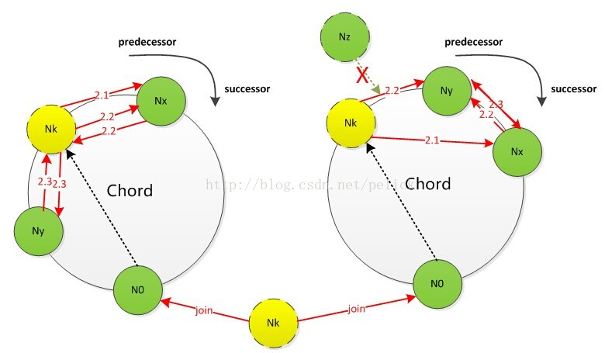
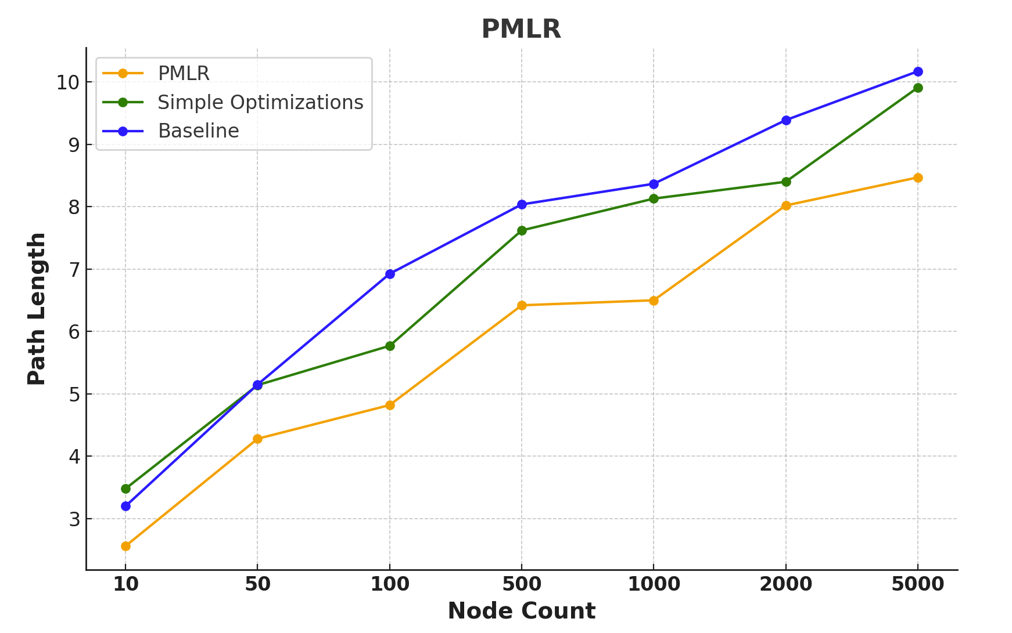
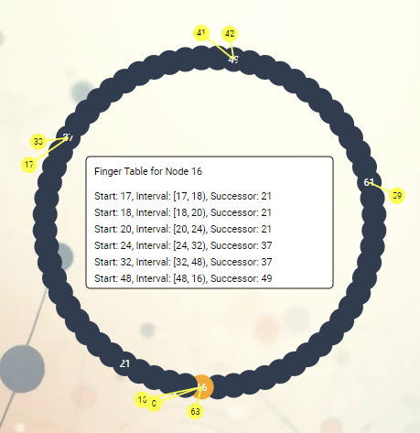
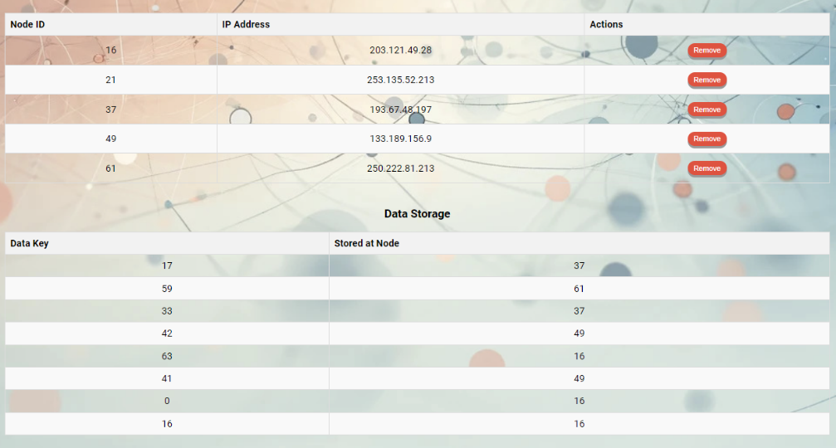
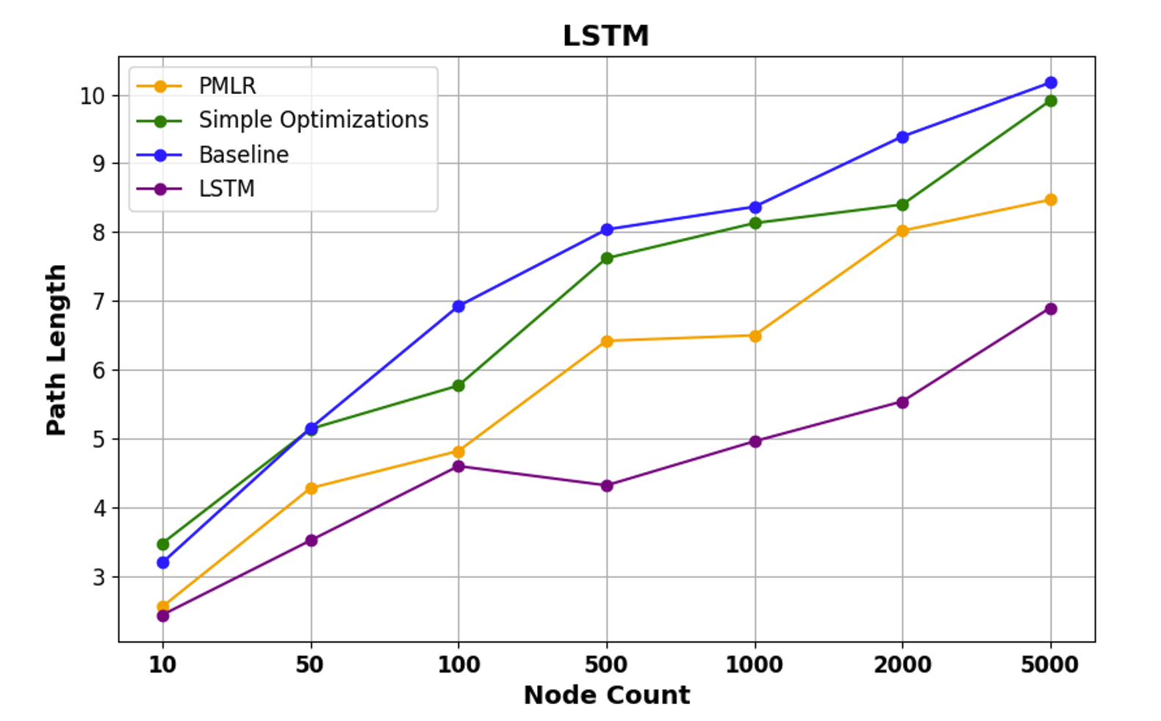
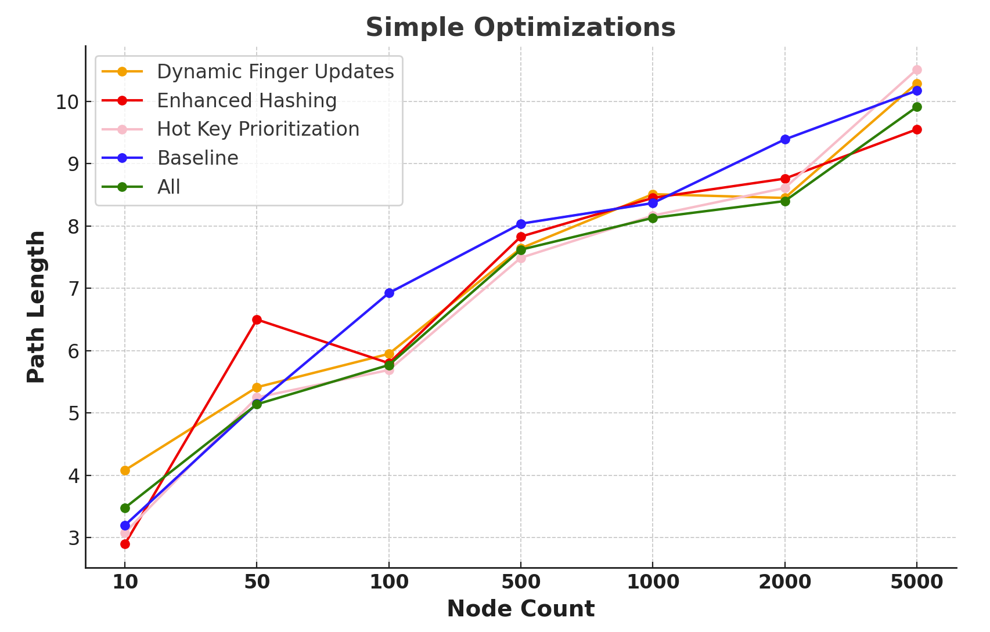
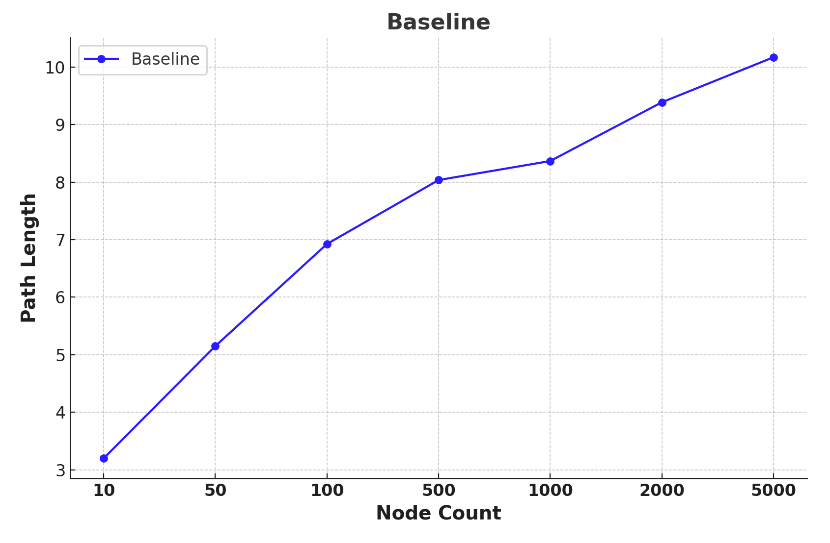
P2P Network Topology Implementation and Optimization
Huanyu Li, Hao Guan, Haoyang Yu, Yujie Tang
Chord Protocol and Complexity
Visualization of Chord Algorithm
Predictive Modeling with Linear Regression
The Chord protocol is a scalable, distributed peer-to-peer system designed for efficient key lookup.
We analyzed the complexity of chord (derivation in report):
The routing time complexity is O(log N) and the total space complexity is O(N log N), where N is the number of nodes.
1. Draw network nodes and datagram circles, add consistent hash functions to nodes and datagrams.
2. Each node maintains a Finger table. When the mouse moves over a network node, the Finger table content of that node can be displayed.
3. Implemented node lookup function using Finger table for routing addressing. Display the jump paths between nodes during search.
4. Implemented a table to present information of each node.
Access Tracking: Monitor node access frequency.
Future Prediction: Use linear regression to forecast future accesses.
Dynamic Adjustment: Update Finger Tables based on predictions.
Benefits:
Adaptability: Adjusts to real-time usage patterns to optimize path.
Efficiency: Simple, computationally efficient model.
Contributions:
Implementation of Chord logical model with full functionality.
Visualization of network nodes, Finger table and node lookup process.
Proposed some simple optimizations: Dynamic Finger updates, enhanced hashing, and prioritized frequently accessed keys to reduce lookup hops.
Proposed Predictive Modeling via Linear Regression for Finger Table Optimization (PMLR)
Proposed LSTM-Based Chord Optimization
Conducted comprehensive experiments to test our methods.
Long Short-Term Memory Network-Based
Chord Optimization
Simple Optimizations for Addressing Hops
1. Dynamic Finger Updates
Adjusting the frequency and method of Finger Table updates to ensure the network quickly adapts to changes, keeping the network more consistent and up-to-date, reducing lookup hops.
2. Enhanced Hashing
Using SHA-256 for hashing keys to achieve a more uniform distribution and minimize hash collisions.
3. Hot Key Prioritization
Dynamically adjusting the Finger Table based on access frequency, prioritizing frequently accessed keys, significantly reducing lookup time for frequently used keys, lowering the average number of hops.
Highlights:
LSTM neural networks predict future data access patterns.
Real-time finger table adjustments prioritize frequently accessed nodes.
Reduces average hops, speeding up data lookups.
Continuously adapts to changing access patterns.
Implementation of Chord
1. Network Setup: Define the network, assign unique node identifiers.
2. Node Operations. Insertion: New nodes find their place, update pointers, and adjust finger tables. Deletion: Departing nodes transfer keys and update pointers.
3. Hash keys to nodes for efficient storage and lookup, optimizing search time.
4. Periodic tasks ensure network stability and accuracy.
Conclusion:
Our implementation and optimization of the Chord protocol, including dynamic finger updates, enhanced hashing, PMLR, and LSTM-based adjustments, significantly reduce lookup hops and improve network efficiency, validated through comprehensive experiments.
We managed to reduce lookup hops by up to 33.4% compared to the baseline, proving the effectiveness of our proposed methods.
Performance of Baseline Implementation
Performance of Simple Optimizations

