Slide 1

Comparing SVD and Poisson MLE ???-????? models
Mortality Forecasting Across Countries
Bendegúz Birkmayer, Bojta Rácz,
Kristóf Légrádi, Roland Tuboly
2025.12.10

Slide 2

Comparing SVD and Poisson MLE Lee-Carter models
Mortality Forecasting Across Countries
Bendegúz Birkmayer, Bojta Rácz,
Kristóf Légrádi, Roland Tuboly
2025.12.10

Slide 3
Motivation
Policy making
Pensions, insurance
State pension system
Capacity of the public health system
Insurance companies
Size of active population
Important question

Slide 4
Research question
Can we decide which forecasting method performs better for our given data?
Clear winner → accurate forecasting
Predicting better in different aspects → differentiated forecasting

Slide 5
Data
30 countries, both sexes
0-90+ age groups
Train: 1960-2004
Test: 2005-2019
Human Mortality Database

Slide 6
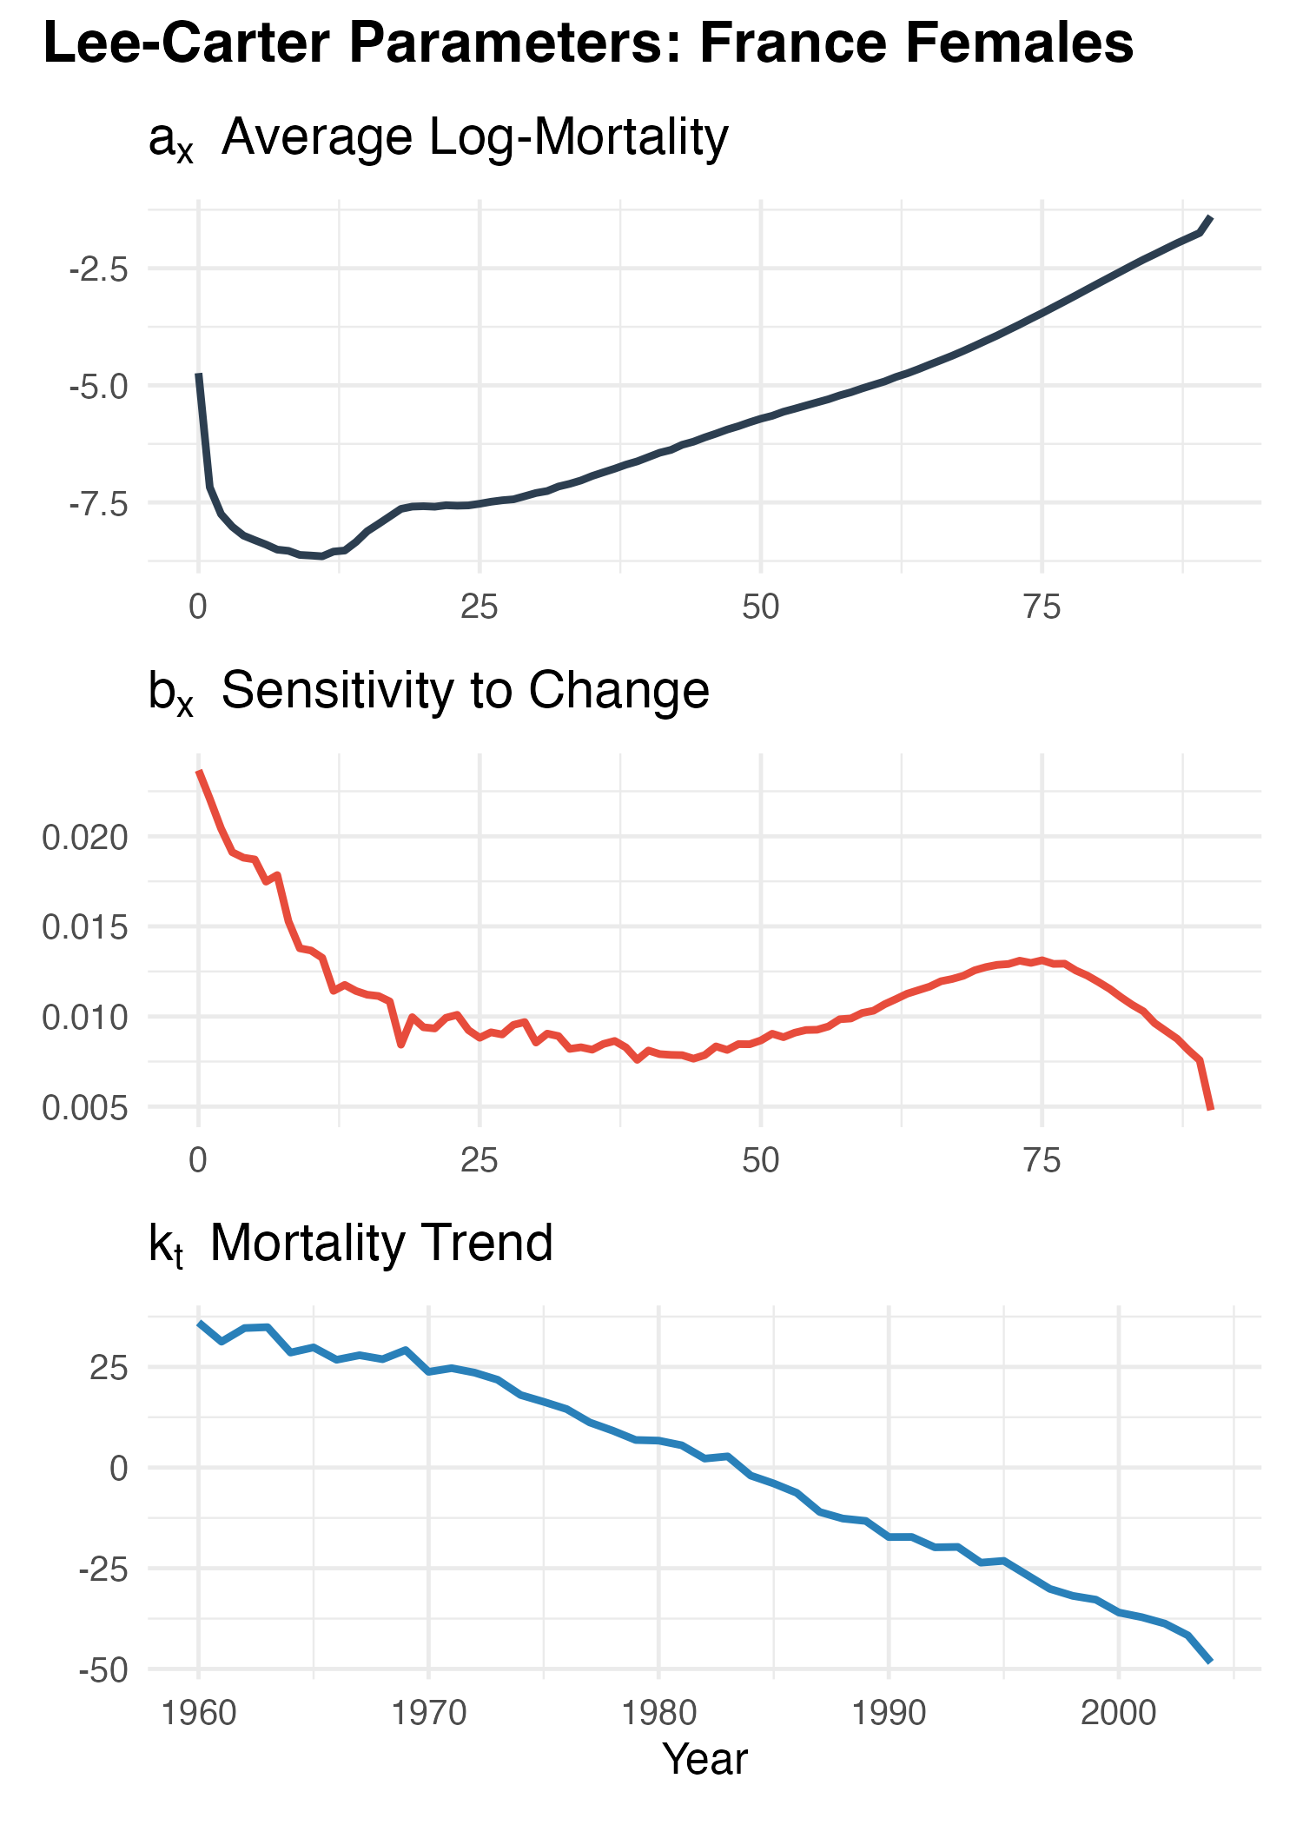
The Lee-Carter Model
ln(𝑚_{𝑥,𝑡})=𝑎_{𝑥}+𝑏_{𝑥}𝑘_{𝑡}+𝜀_{𝑥,𝑡}
m_{x,t}: central death rate at age x and time t
a_{x}: average log-mortality at each age across time
b_{x}: sensitivity of mortality at age x
k_{t}: time-varying mortality index
Refinements:
MLE introduction
𝐷_{𝑥,𝑡} ~ 𝑃𝑜𝑖(𝐸_{𝑥,𝑡}*𝑚_{𝑥,𝑡})
𝐷_{𝑥,𝑡}: Number of deaths
𝐸_{𝑥,𝑡}: Exposure to risk (population at risk of dying)
Forecast: ARIMA(p,q) on k_{t}

Slide 7
Methodology I.
Robust
Simple
Fast
Linear interpolation
SVD

Slide 8
Methodology II.
Correct likelihood
Unstable
High dimensions
Poisson MLE

Slide 9
Results I.
Types | Poisson MLE | SVD
Overall | 18.3% | 81.7%
Males | 20% | 80%
Females | 16.6% | 83.4%
Mediterranean | 16.6% | 83.4%
Post-Socialist | 16.6% | 83.4%

Slide 10
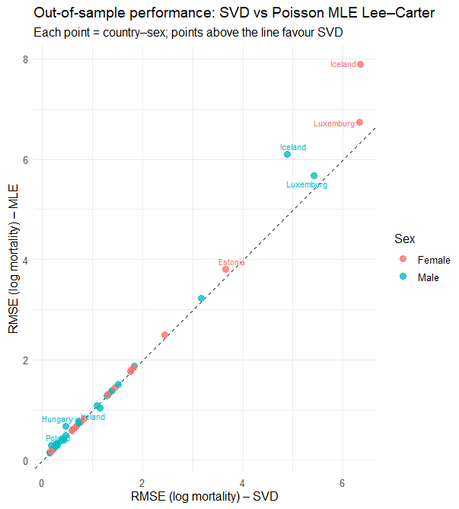
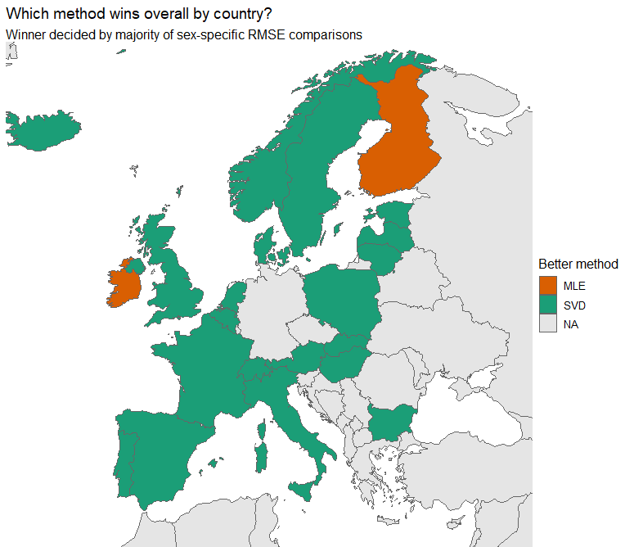
Results II.

Slide 12
Results II.

Slide 14
Conclusion
Based on results
SVD outperforms MLE overall
Room for improvement
Model averaging ~ Ensembling
Handles noise better
MLE likely overfits
Multi-population Lee-Carter model
No sex or region where MLE clearly wins

Slide 15
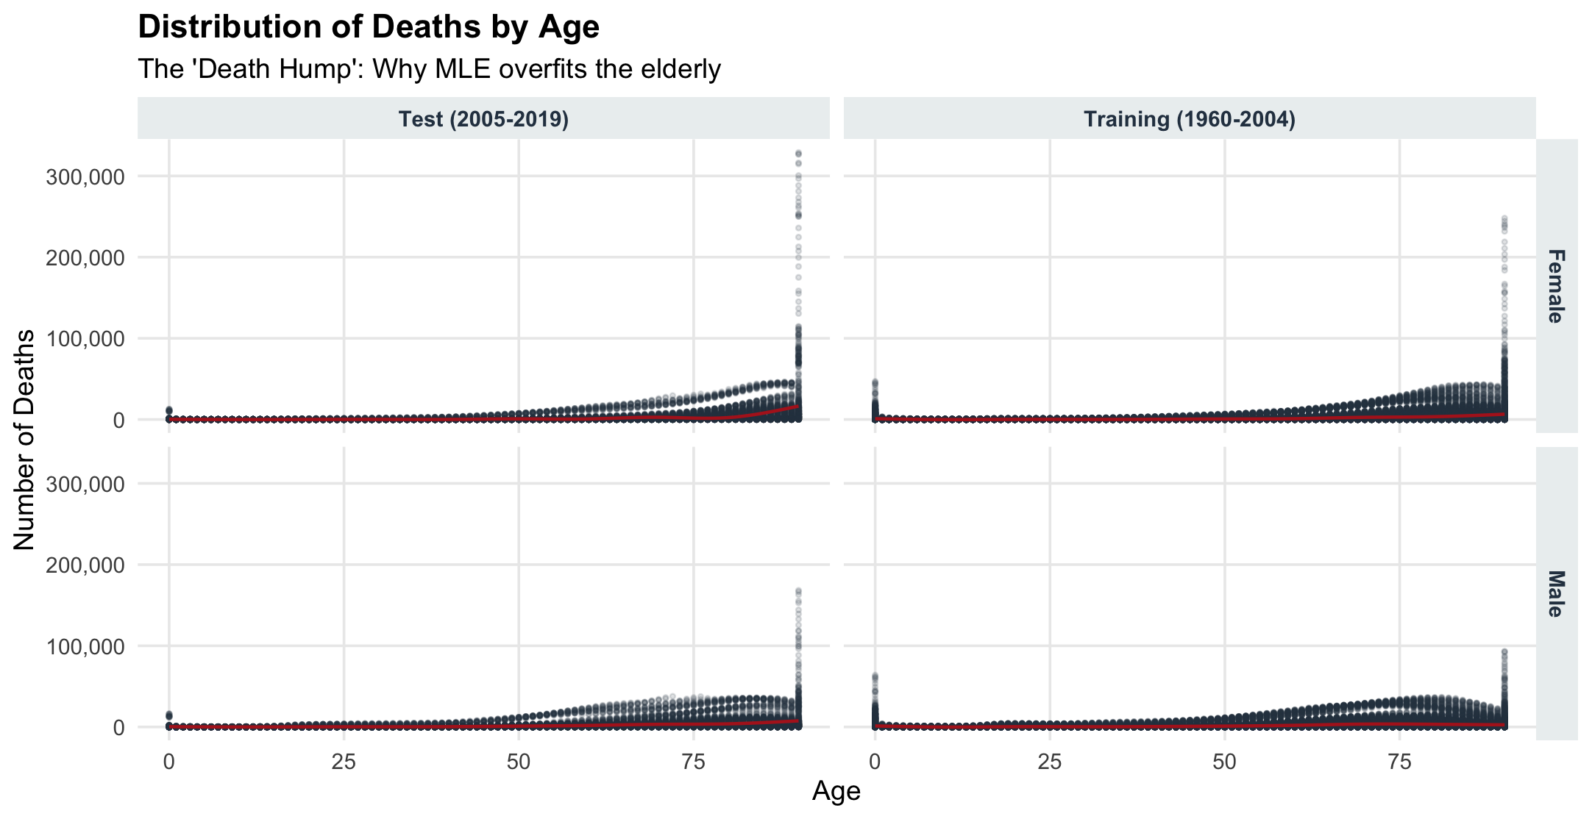
Intuition/question

Slide 16
Thank you for your attention!
bendeguz.birkamyer@stud.uni-corvinus.hu
bojta.racz@stud.uni-corvinus.hu
kristof.legradi@stud.uni-corvinus.hu
roland.tuboly@stud.uni-corvinus.hu

