Slide 1
Do LLMs Shape the Diffusion of New Software?
Training cutoffs and adoption dynamics in the Python ecosystem.
Roland Tuboly · MSc Social Data Science
TDK Presentation · May 2026

Slide 2
Why software diffusion, and why now?
The measurable object
Research question
Software libraries are a clean unit of technological diffusion: released on a specific date, downloaded at a measurable rate, used in public code.
Do Python libraries released after an LLM's training cutoff diffuse more slowly than otherwise-identical libraries released before the cutoff?
Why it matters
• Productivity vs. variety — Doshi & Hauser (2024): individual gains can narrow collective variety.
• Knowledge frontier — Acemoglu (2024); Evans; Daniotti et al. on scientific search.
• Gatekeeping — Wachs on platforms steering adoption.
Tuboly · Knowledge Wall · TDK 2026

Slide 3
Method at a glance
Option A — Single-year RDD
Option B — Diff-in-RDD (primary)
Compare libraries released just before vs. just after Sept 2021, within a narrow bandwidth.
Stack 2018–2020 placebo cohorts at the same calendar position. Subtract the placebo jump from the 2021 jump.
Problem: the jump we see is a mix of the LLM effect and raw calendar seasonality (September releases differ from August releases every year).
Payoff: seasonality is differenced out; the residual is the LLM-specific treatment effect.
Both estimators are reported. The Diff-in-RDD is the primary specification.

Slide 4
Data and unit of analysis
Sources
Scale
• PyPI: weekly downloads for every registered package.
• GitHub: code-import counts (linked sample).
527,361
PyPI packages
28,243
linked to GitHub
Panel
88,001
Library-week, from first release through January 2026.
Diff-in-RDD (Broad tier)
Sept '21
training-data cutoff
Tuboly · Knowledge Wall · TDK 2026

Slide 5
Design timeline
Sept 2021 cutoff
ChatGPT release Nov 2022
9-week donut
2018–2020 placebo cohorts
Post-AI observation window
Jan 2018
2019
2020
Sept 2021
Nov 2022
Jan 2026
14-month latency
The September 2021 cutoff is an invisible property of training data; libraries released a week before or after look identical to a developer in 2021. No one could have anticipated ChatGPT, released 14 months later.

Slide 6
Identification
• As-if random assignment: the exact week of release relative to an invisible training cutoff is exogenous to the library itself (McCrary density test: p = 0.43).
• RDD specifics: bandwidth h = 13 weeks; local-linear regression with triangular kernel; 9-week donut excludes the Aug–Sept 2021 window of ambiguous training inclusion.
• Inference: cluster-robust standard errors at the year-by-week level (~72 clusters); bias-corrected CIs via rdrobust.
• Diff-in-RDD: 2021 discontinuity minus the mean placebo discontinuity (2018–2020) isolates the LLM-specific effect from calendar seasonality.
Tuboly · Knowledge Wall · TDK 2026

Slide 7
Validity diagnostics
• No manipulation: McCrary density smooth across the cutoff (p = 0.43) — developers cannot time their release to an unannounced boundary.
• Covariate balance, pre-AI: post-cutoff libraries actually start ahead on pre-ChatGPT downloads (a seasonal headwind for our hypothesis) — so the post-AI suppression is a conservative estimate.
• Placebo years: 2018–2020 cohorts show no discontinuity at the same calendar position, ruling out seasonality as the driver.
Tuboly · Knowledge Wall · TDK 2026

Slide 8
Post-cutoff libraries have
+430%
fewer weekly downloads by January 2026.
Ratio of pre-cutoff to post-cutoff downloads (Jan 2026). Diff-in-RDD: p = 0.001 (Broad), p = 0.002 (Successful), baseline-adjusted, cluster-robust SE.

Slide 9
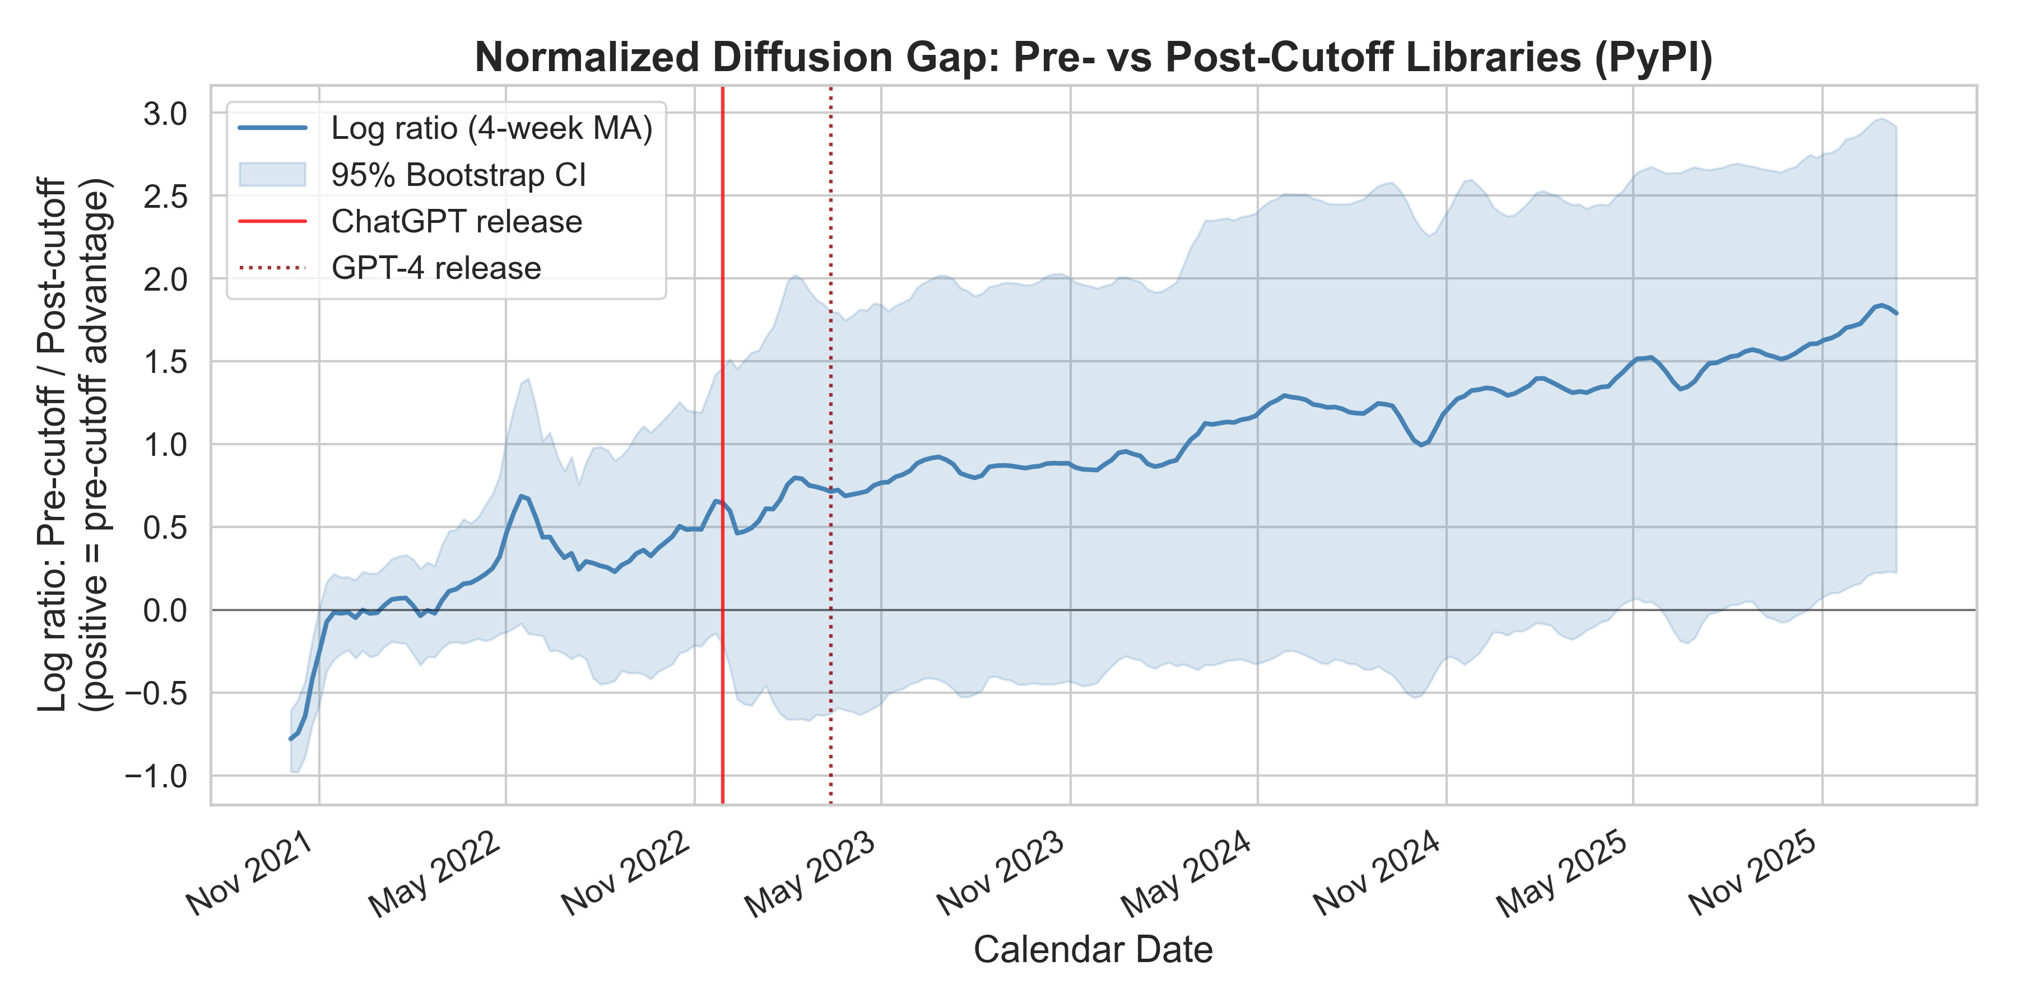
Activation dynamics
• Dormant: gap flat at ~28% seasonal baseline before Nov 2022.
• Activation: discontinuity emerges only after ChatGPT's mass adoption.
• Trajectory: +136% at 12 months, +287% at 24 months, +430% by Jan 2026.
• Shaded band: 95% bootstrap confidence interval.
Tuboly · Knowledge Wall · TDK 2026

Slide 10
Mechanism: GitHub imports
Directional evidence
Interpretation
• Matched subsample, N = 6,582 in the Diff-in-RDD.
• All-time imports: +2.12 log-point jump (baseline-adjusted, p = 0.022) — post-cutoff libraries accumulate MORE GitHub imports, opposite sign to PyPI.
• Flow vs. stock: PyPI downloads are a flow; GitHub imports are a stock of existing code.
• Displacement: new libraries displace old ones in flow, but existing repos keep their old imports.
• LLM steering: the LLM pushes the FIRST try, not every line of legacy code.
Tuboly · Knowledge Wall · TDK 2026

Slide 11
Moderation & scope
• AI-exposure heterogeneity: directional but non-significant (p = 0.18) — suggests a broad, systemic effect rather than a subset-specific channel.
• Ecosystem: Python only. Rust, JS, R may show different magnitudes.
• One cutoff: effects estimated around September 2021; newer-model cutoffs would require separate estimation.
• SUTVA: the gap reflects direct suppression plus substitution toward established tools — both are part of the LLM effect.
Tuboly · Knowledge Wall · TDK 2026

Slide 12
Implications
The Knowledge Wall
Training-data cutoffs act as a functional barrier for newly released software tools.
• Durable advantage: tools embedded in LLM weights gain persistent visibility.
• Spillovers: same logic plausibly applies to research papers, blog posts, documentation.
• Policy: raises questions about how AI systems update their internal knowledge and what the costs are of being ‘outside the wall’.
Tuboly · Knowledge Wall · TDK 2026

Slide 13
Limitations
• We observe outcomes (downloads, imports), not LLM usage directly.
• AI systems are evolving — web search and retrieval may erode the wall over time.
• One language, one cutoff, one year of treatment — external validity is local.
• Running variable is release date; metadata errors could attenuate estimates.
Tuboly · Knowledge Wall · TDK 2026

Slide 14
Conclusion
A +430% diffusion gap by January 2026, activated only after ChatGPT, with no placebo discontinuities — a clean quasi-experiment for collective narrowing in the age of LLMs.
• LLMs steer adoption toward tools already in training data.
• Libraries released post-cutoff face persistent disadvantages.
• The Knowledge Wall is real, measurable, and widening.

Slide 15
Thank you.
Questions?
2018
Sept '21
Nov '22
Jan '26
+430%
diffusion gap by Jan 2026.

Slide 16
Appendix

Slide 17
A1. Summary statistics
Horizon | Pre-cutoff mean | Post-cutoff mean | Δ%
ChatGPT + 6 months | 1,467 | 630 | +133%
ChatGPT + 12 months | 2,559 | 1,085 | +136%
ChatGPT + 24 months | 8,218 | 2,124 | +287%
January 2026 | 18,085 | 3,410 | +430%
Post-ChatGPT average | 6,538 | 1,703 | +284%
Weekly PyPI downloads, mean across libraries in each cohort. Pre-cutoff: libraries released Jan–Aug 2021. Post-cutoff: Oct 2021–.
Tuboly · Knowledge Wall · TDK 2026

Slide 18
A2. Diff-in-RDD estimates (PyPI)
Panel | Tier | Excess jump | SE | p | N
Pre-ChatGPT baseline | Successful | -3.72 | 1.67 | 0.026 | 75,313
Post-ChatGPT, adjusted | Broad | -7.29 | 2.20 | 0.001 | 88,001
Post-ChatGPT, adjusted | Successful | -7.29 | 2.39 | 0.002 | 75,313
Post-ChatGPT, adjusted | Superstar | -0.25 | 0.35 | 0.473 | 57,931
Post-ChatGPT, unadjusted | Broad | -9.14 | 4.42 | 0.039 | 88,001
Post-ChatGPT, unadjusted | Successful | -12.79 | 4.83 | 0.008 | 75,313
Log-scale estimates: discontinuity in log(1 + downloads) at the cutoff, differenced against 2018–2020 placebos. Baseline adjustment = ANCOVA on log pre-ChatGPT downloads.
Tuboly · Knowledge Wall · TDK 2026

Slide 19
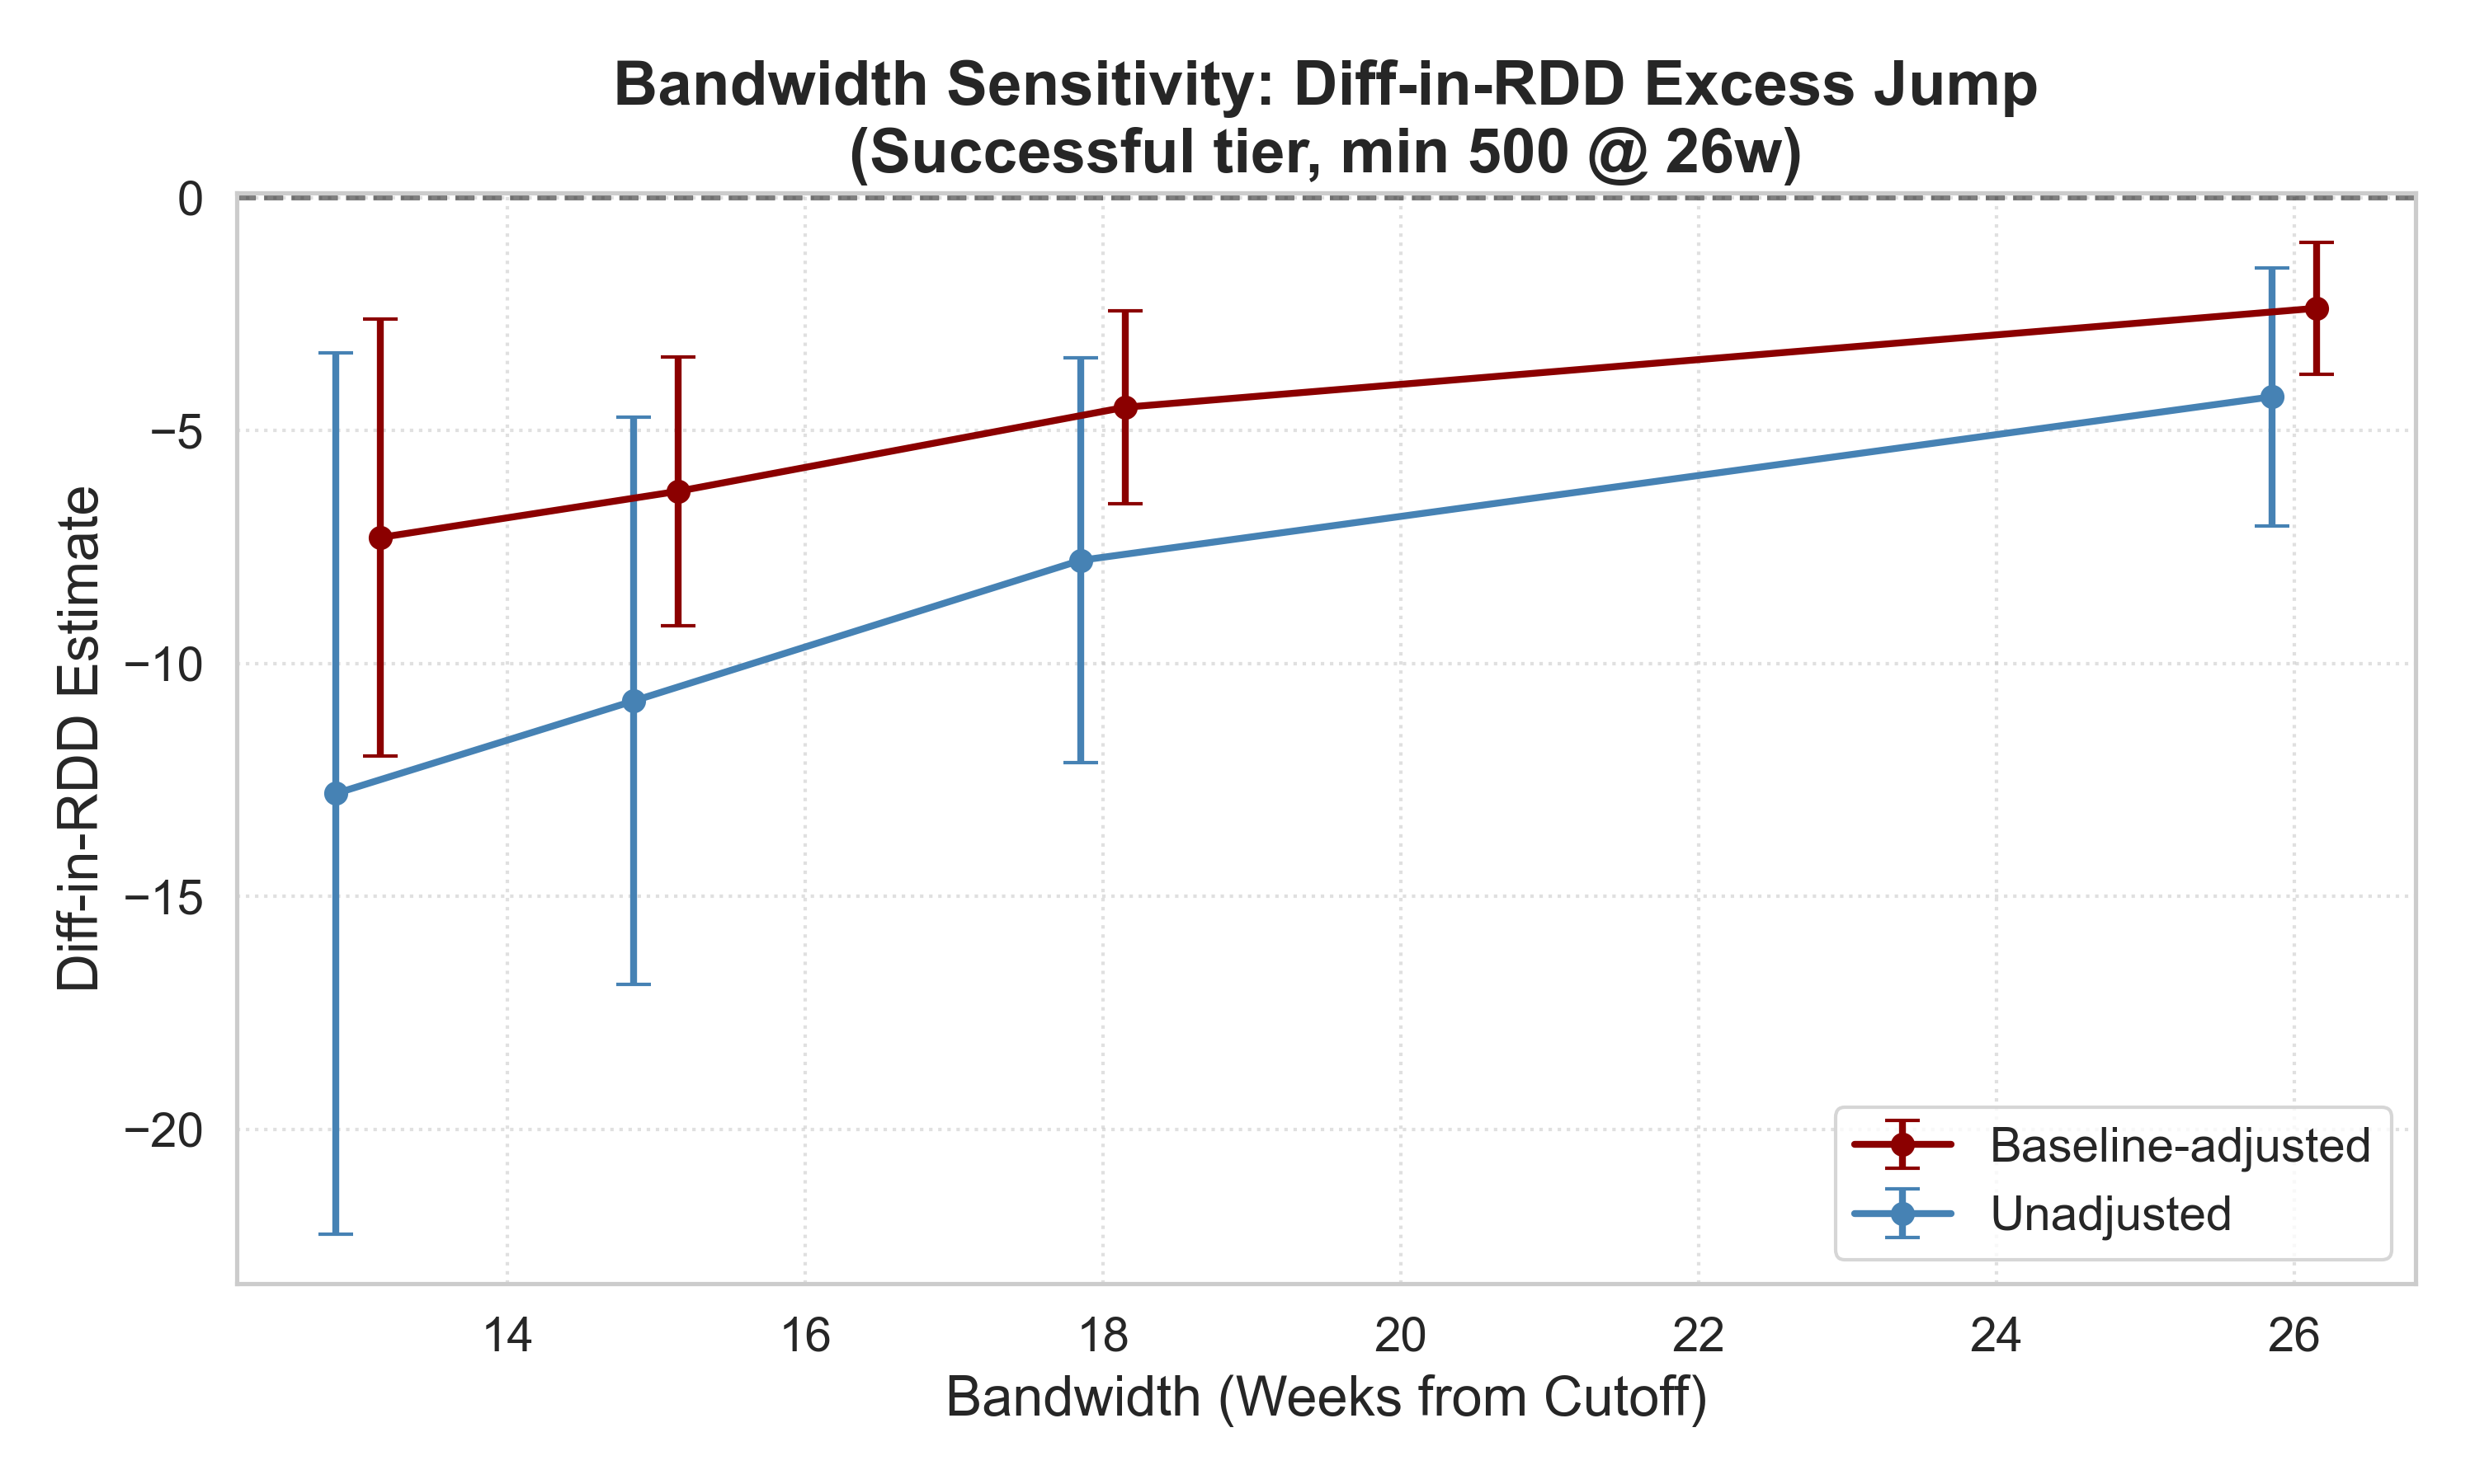
A3. Bandwidth sensitivity
Point estimate and 95% CI across bandwidth choices h ∈ {10, 13, 18, 26, 39, 52} weeks. Sign and significance stable.
Tuboly · Knowledge Wall · TDK 2026

Slide 20
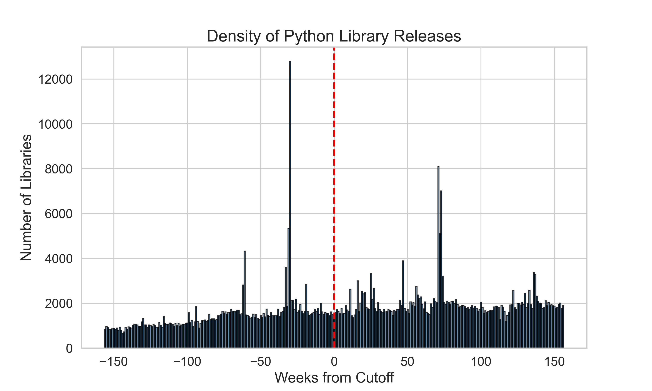
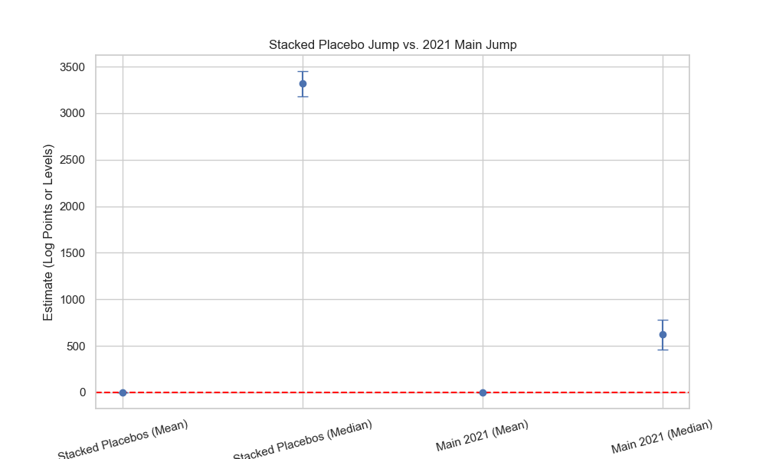
A4. Density test and placebo years
McCrary density, p = 0.43.
2018–2020 placebo coefficients vs. 2021. Only 2021 is significant.
Tuboly · Knowledge Wall · TDK 2026

Slide 21
A5. GitHub mechanism results
Tier | Outcome | Excess jump | SE | p
Broad | All-time imports | +2.12 | 0.92 | 0.022
Broad | Post-AI imports | +1.87 | 1.05 | 0.075
Successful | All-time imports | +2.29 | 0.96 | 0.017
Successful | Post-AI imports | +2.09 | 1.15 | 0.069
Baseline-adjusted Diff-in-RDD on log(1 + GitHub imports), N = 6,582 (Broad). Positive sign: post-cutoff libraries accumulate MORE imports — consistent with stock-vs-flow interpretation.
Tuboly · Knowledge Wall · TDK 2026

Slide 22
A6. Reviewer comments placeholder
Notes for discussion
•
[to be populated during Q&A]
•
•
•
•

