Slide 1


TDK PRESENTATION · 11 MAY 2026 · NETWORK AND DATA SCIENCE SECTION
Do LLMs Shape the Diffusion of New Software?
Training cutoffs and adoption dynamics in the Python ecosystem
AUTHOR
SUPERVISOR
PROGRAMME
Roland Tuboly
Johannes Wachs
Social Data Science MSc - Corvinus University of Budapest

Slide 2




Why software diffusion, and why now?
RESEARCH QUESTION
Do LLM training-data cutoffs create a persistent adoption barrier
for newly released Python libraries?
If ChatGPT never saw your library, will developers ever find it?
THE MEASURABLE OBJECT
WHY IT MATTERS
SOFTWARE LIBRARIES
Productivity vs. variety - Doshi & Hauser
clean units of technological diffusion
1
3
Knowledge frontier - Acemoglu, Evans, Daniotti et al.
used in public code
2
released on a specific date
Gatekeeping - del Rio-Chanona et al.
downloaded at a measurable rate
Do LLMs Shape the Diffusion of New Software? · Tudományos Diákköri Konferencia · 2026, tavaszi félév

Slide 3



Data and unit of analysis
SOURCES
PyPI: weekly downloads for every registered package
GitHub: code-import counts (linked sample)
527 361
75 313
28 243
total PyPI packages after filtering
main sample in the main tier
linked to GitHub
PANEL
Library-week – from first release through January 2026
Do LLMs Shape the Diffusion of New Software? · Tudományos Diákköri Konferencia · 2026, tavaszi félév

Slide 4

Design timeline
Post-AI observation window
September 2021 Training cutoff
November 2022 ChatGPT launch
June 2021
Donut
January 2026
Pre-cutoff (Treatment)
Post-cutoff (Control)
March 2023 GPT-4
14-month latency before activation
Do LLMs Shape the Diffusion of New Software? · Tudományos Diákköri Konferencia · 2026, tavaszi félév

Slide 5

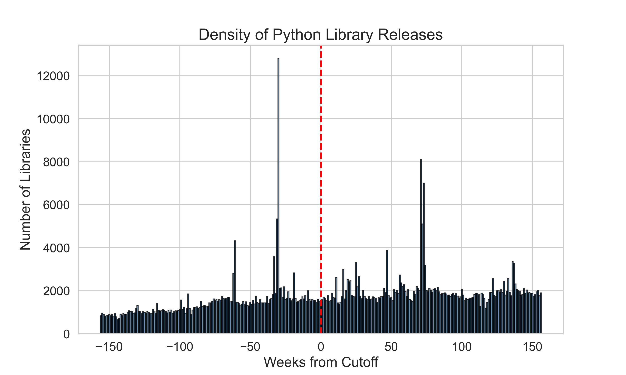
Research design
MCCRARY DENSITY - NO BUNCHING (P = 0.43)
Regression Discontinuity Design
Difference-in-Discontinuities
No manipulation
Density smooth across the cutoff (McCrary p = 0.43)
Post-cutoff libraries start ahead pre-AI, meaning the estimate is conservative
Post-AI observation window
September 2021 Training cutoff
November 2022 ChatGPT launch
June 2021
Pre-cutoff (Treatment)
Donut
Post-cutoff (Control)
January 2026
March 2023 GPT-4
14-month latency before activation
Do LLMs Shape the Diffusion of New Software? · Tudományos Diákköri Konferencia · 2026, tavaszi félév

Slide 6

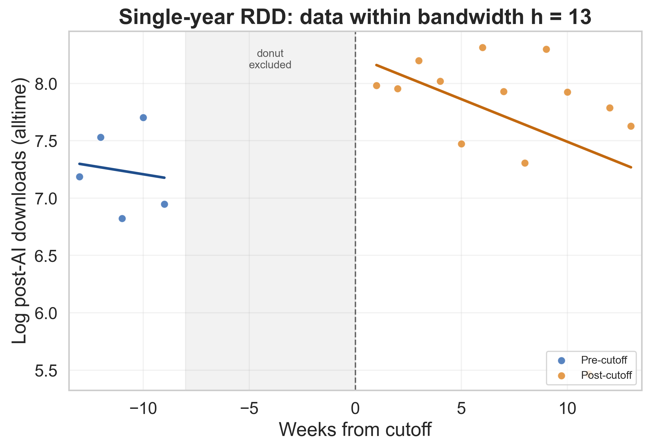
Methodology – single-year RDD
SINGLE-YEAR RDD
Compare libraries released just before vs. just after September 2021, within a 13-week bandwidth, with a 9-week asymmetric donut
POSSIBLE PROBLEM
LLM effect + seasonality may be confounded
Do LLMs Shape the Diffusion of New Software? · Tudományos Diákköri Konferencia · 2026, tavaszi félév

Slide 7
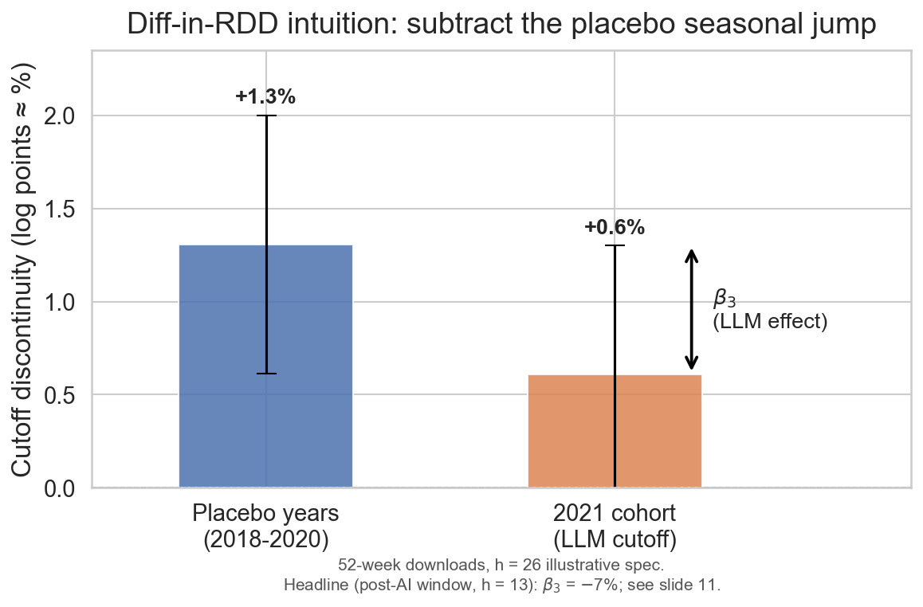
Methodology – Diff-in-RDD intuition
DIFFERENCES-IN-RDD
Stack 2018-2020 placebo cohorts, then subtract their jump from 2021's jump
PAYOFF
Residual = LLM-cutoff effect only
Do LLMs Shape the Diffusion of New Software? · Tudományos Diákköri Konferencia · 2026, tavaszi félév

Slide 8
Methodology – Diff-in-RDD specification
DIFFERENCES-IN-RDD
PAYOFF
Residual = pure LLM-cutoff effect
Y_{i} = α + β₀B_{i} + β₁D_{i} + β₂ 𝟙_{2021,i} + β₃(D_{i} × 𝟙_{2021,i}) + g(r_{i}) + ε_{i}
(triangular kernel, h=13, year×week clustered SE)
constant
post-cutoff indicator
pre-AI 52-wk downloads (baseline)
2021-specific excess jump (coeff. of interest)
error term
log(1 + post-AI downloads)
2021 cohort (vs 2018–2020 placebo)
running-variable slopes
Do LLMs Shape the Diffusion of New Software? · Tudományos Diákköri Konferencia · 2026, tavaszi félév

Slide 9
Methodology – Diff-in-RDD specification
Y_{i} = α + β₀B_{i} + β₁D_{i} + β₂ 𝟙_{2021,i} + β₃(D_{i} × 𝟙_{2021,i}) + g(r_{i}) + ε_{i}
(triangular kernel, h=13, year×week clustered SE)
Yᵢ
log(1 + post-AI downloads)
α
constant
β₀Bᵢ
pre-AI 52-wk downloads (baseline)
β₁Dᵢ
post-cutoff indicator
β₂ 𝟙_{2021,i}
2021 cohort (vs 2018–2020 placebo)
β₃(Dᵢ × 𝟙₂₀₂₁_{,i})
2021-specific excess jump (coeff. of interest)
g(rᵢ)
running-variable slopes
εᵢ
error term
Do LLMs Shape the Diffusion of New Software? · Tudományos Diákköri Konferencia · 2026, tavaszi félév

Slide 10

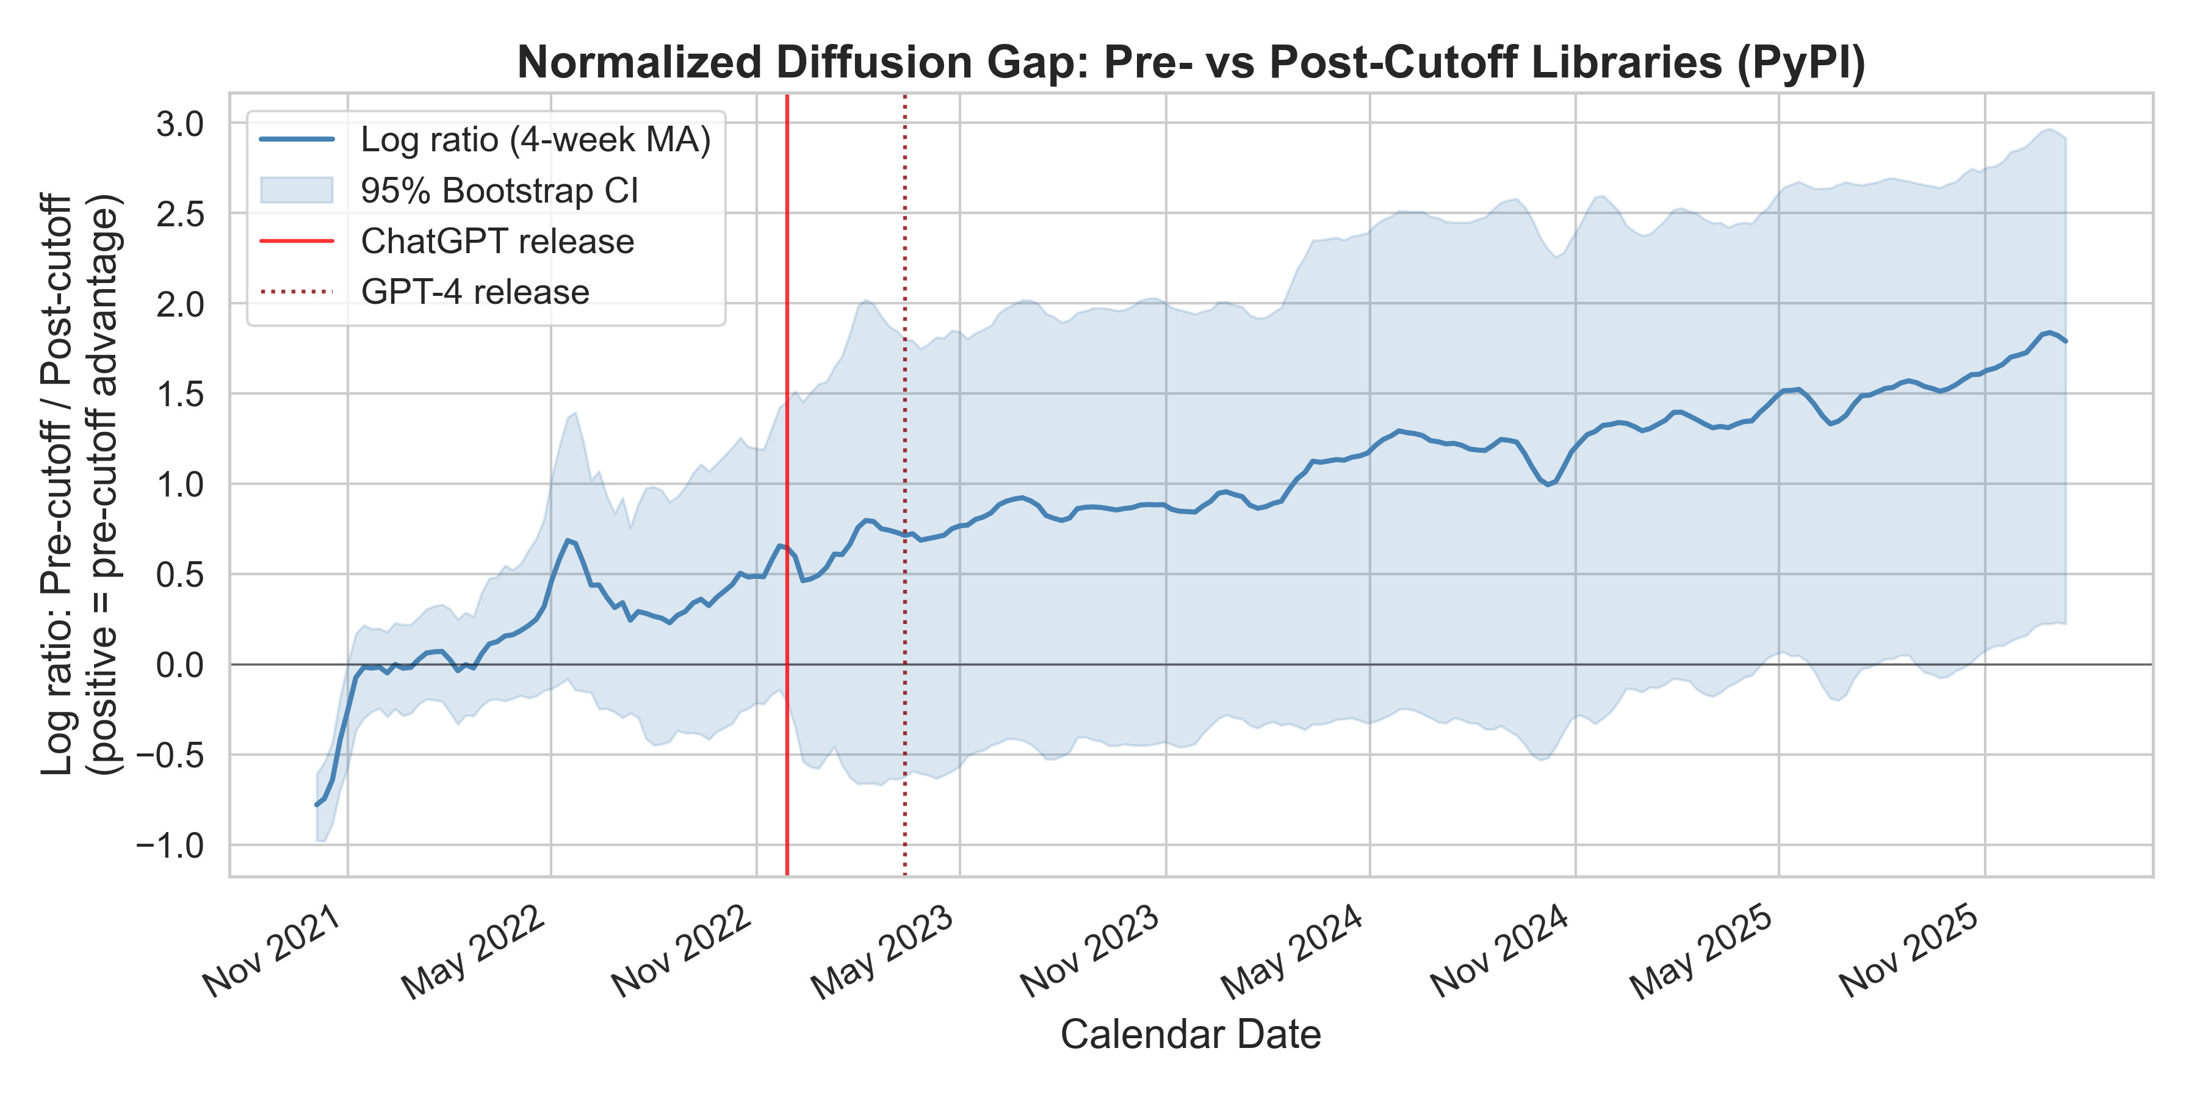

Results – Activation dynamics
DIFFUSION GAP OVER TIME (weekly-average downloads)
Before ChatGPT
Gap flat through Nov 2022 → cutoff has no effect without a mass interface
After ChatGPT
Gap widens monotonically to 5:1
by Jan 2026, with no sign of closing
12 MONTHS
24 MONTHS
BY JAN 2026
+136%*
+287%*
+430%*
*mean aggregate volumes, descriptive, not cumulative
Do LLMs Shape the Diffusion of New Software? · Tudományos Diákköri Konferencia · 2026, tavaszi félév

Slide 11

Results – Mechanism, GitHub imports
PYPI DOWNLOADS: FLOW
GITHUB IMPORTS: STOCK
−7%
+2.1%
Post-cutoff libraries receive fewer downloads overall
general adoption is suppressed
Post-cutoff libraries maintain a slight edge in imports
later libraries > LLMs suggestions
Diff-in-RDD · baseline-adjusted · PyPI: p < 0.001, N = 75,313 · GitHub: p = 0.022, N = 6,582
Do LLMs Shape the Diffusion of New Software? · Tudományos Diákköri Konferencia · 2026, tavaszi félév

Slide 12
Results – Mechanism, GitHub imports
Robustness
Sign + significance stable across bandwidths
h ∈ {10, 13, 18, 26, 39, 52} weeks
→ permutation test confirms (p < 0.05)
week of 27 Sept 2021 is special
DIRECTIONAL EVIDENCE
INTERPRETATION
GitHub imports on the matched subsample
Both signs stable across baseline-adjusted specs
BUT GitHub is underpowered relative to PyPI
Opposite signs suggest LLMs affect
tool discovery (PyPI – flow)
more than ongoing usage (GitHub – stock)
Diff-in-RDD · baseline-adjusted · PyPI: p < 0.001, N = 75,313 · GitHub: p = 0.022, N = 6,582
Do LLMs Shape the Diffusion of New Software? · Tudományos Diákköri Konferencia · 2026, tavaszi félév

Slide 13

Implications: The Knowledge Wall
Training-data cutoff creates a latent barrier, activated by mass LLM adoption
01
Durable advantage
Tools present in LLM training data gain persistent visibility that compounds over time
Do LLMs Shape the Diffusion of New Software? · Tudományos Diákköri Konferencia · 2026, tavaszi félév

Slide 14
Implications: The Knowledge Wall
Training-data cutoff creates a latent barrier, activated by mass LLM adoption
01
Durable advantage
Tools present in LLM training data gain persistent visibility that compounds over time
02
Possibilities
Same logic could apply to research papers, blog posts, documentation; not just code – methodological transferability
Do LLMs Shape the Diffusion of New Software? · Tudományos Diákköri Konferencia · 2026, tavaszi félév

Slide 15
Implications: The Knowledge Wall
Training-data cutoff creates a latent barrier, activated by mass LLM adoption
01
Durable advantage
Tools present in LLM training data gain persistent visibility that compounds over time
02
Possibilities
Same logic could apply to research papers, blog posts, documentation; not just code – methodological transferability
03
Policy
Raises questions about AI knowledge updates and the costs of being outside the wall
Do LLMs Shape the Diffusion of New Software? · Tudományos Diákköri Konferencia · 2026, tavaszi félév

Slide 16
Implications: The Knowledge Wall
Training-data cutoff creates a latent barrier, activated by mass LLM adoption
01
Durable advantage
Tools present in LLM training data gain persistent visibility that compounds over time
02
Possibilities
Same logic could apply to research papers, blog posts, documentation; not just code – methodological transferability
03
Policy
Raises questions about AI knowledge updates and the costs of being outside the wall
Breadth
04
AI-relevant libraries are NOT differentially suppressed (p = 0.18) – the barrier is broad rather than topical
Do LLMs Shape the Diffusion of New Software? · Tudományos Diákköri Konferencia · 2026, tavaszi félév

Slide 17

Limitations
EXTERNAL VALIDITY
INDIRECT MEASUREMENT
One language, one cutoff, one year of treatment
external validity is local
Outcomes (dwnlds, imports) were observed
not LLM usage directly
CONTINUOUS ADVANCEMENT
SPECIFICATION CHOICES
Web search, RAG may erode the wall over time
AI systems are evolving
Bandwidth, asymmetric donut, 2018–2020 placebos as cohort counterfactuals
sensitivity reported in appendix
Do LLMs Shape the Diffusion of New Software? · Tudományos Diákköri Konferencia · 2026, tavaszi félév

Slide 18

Beyond the cutoff – A question for future work
REVIEWERS’ QUESTION
Do LLMs amplify concentration toward
already-popular libraries?
LLMs may simply boost preferential attachment for incumbents
Do LLMs Shape the Diffusion of New Software? · Tudományos Diákköri Konferencia · 2026, tavaszi félév

Slide 19
Beyond the cutoff – Scope of the paper
REVIEWERS’ QUESTION
Do LLMs amplify concentration toward already-popular libraries?
LLMs may simply boost preferential attachment for incumbents
This paper estimates: are post-cutoff entrants suppressed?
It does not estimate whether incumbent concentration rises after ChatGPT
Suppression of new entrants is a necessary first step for concentration to rise
BUT the two questions require different identification
Do LLMs Shape the Diffusion of New Software? · Tudományos Diákköri Konferencia · 2026, tavaszi félév

Slide 20
Beyond the cutoff – Possible extensions
REVIEWERS’ QUESTION
Do LLMs amplify concentration toward already-popular libraries?
LLMs may simply boost preferential attachment for incumbents
This paper estimates: are post-cutoff entrants suppressed?
It does not estimate whether incumbent concentration rises after ChatGPT
Suppression of new entrants is a necessary first step for concentration to rise
BUT the two questions require different identification
POSSIBLE EXTENSIONS
· HHI / top-k share over incumbent libraries
· Event-study around ChatGPT release
· Replicated in npm / crates.io / CRAN
Do LLMs Shape the Diffusion of New Software? · Tudományos Diákköri Konferencia · 2026, tavaszi félév

Slide 21

Conclusion
POST-CHATGPT DOWNLOAD PENALTY
-7%
~
· Diff-in-RDD, baseline-adjusted
· Local effect at the Sept 2021 boundary, not an ecosystem-wide LLM impact estimate
→
The gap is dormant before ChatGPT, activates after Nov 2022, no catch-up through Jan 2026
→
Mechanism signature: opposite signs across the two datasets - flow down, stock up
→
The Knowledge Wall is persistent and compounding
Do LLMs Shape the Diffusion of New Software? · Tudományos Diákköri Konferencia · 2026, tavaszi félév

Slide 22
?

Slide 23

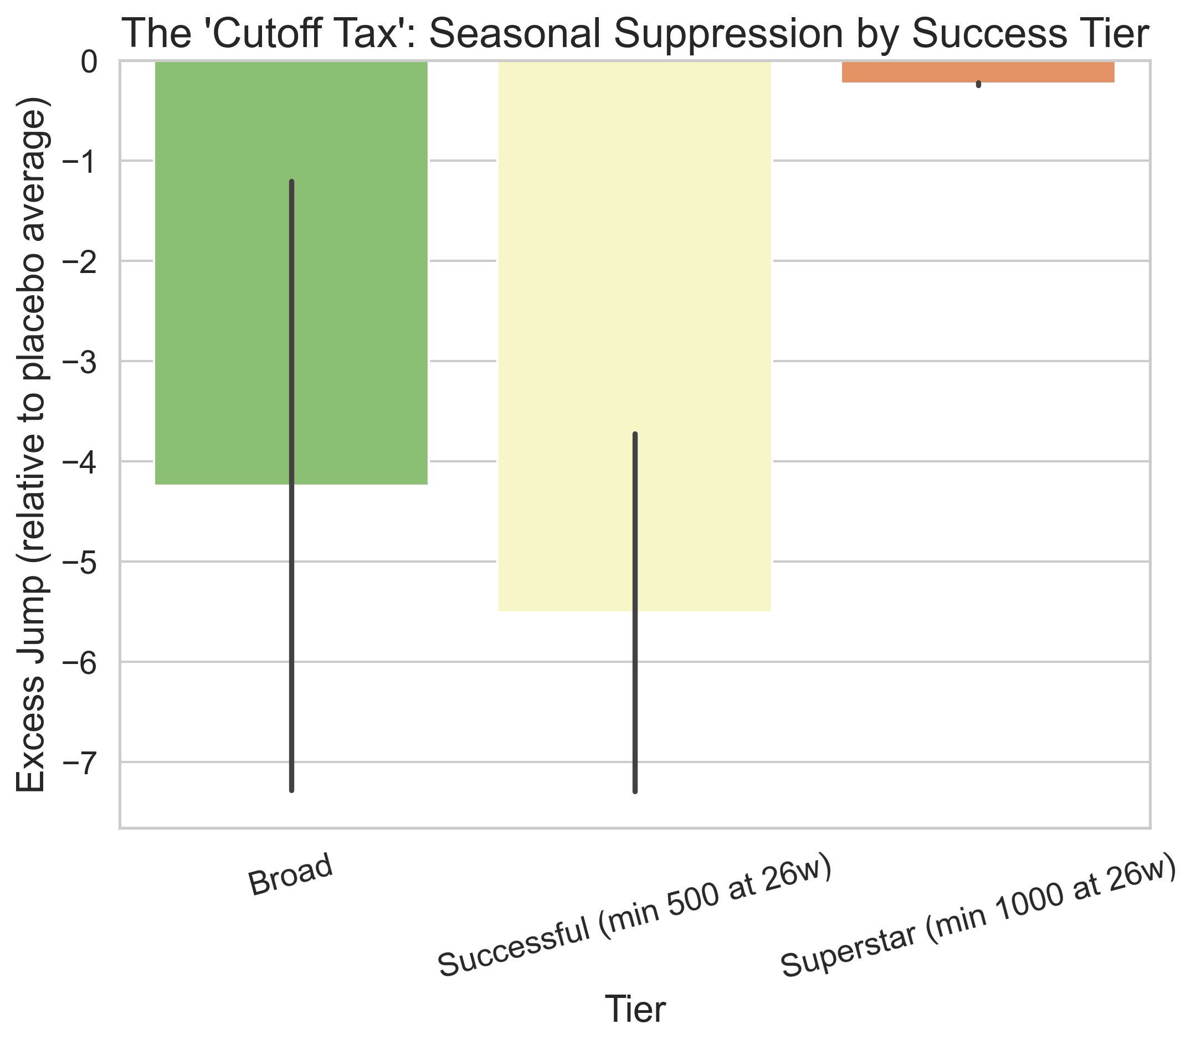
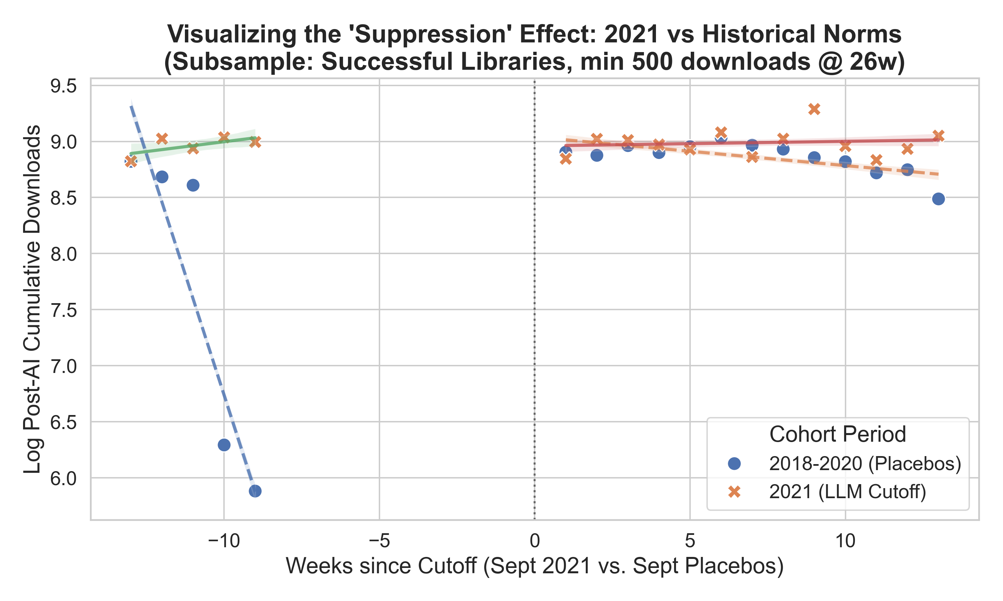
Issue 1 – What triggered my concern
?
?
Do LLMs Shape the Diffusion of New Software? · Tudományos Diákköri Konferencia · 2026, tavaszi félév

Slide 24
Issue 1 – The spike-bin sensitivity check
Do LLMs Shape the Diffusion of New Software? · Tudományos Diákköri Konferencia · 2026, tavaszi félév

Slide 25
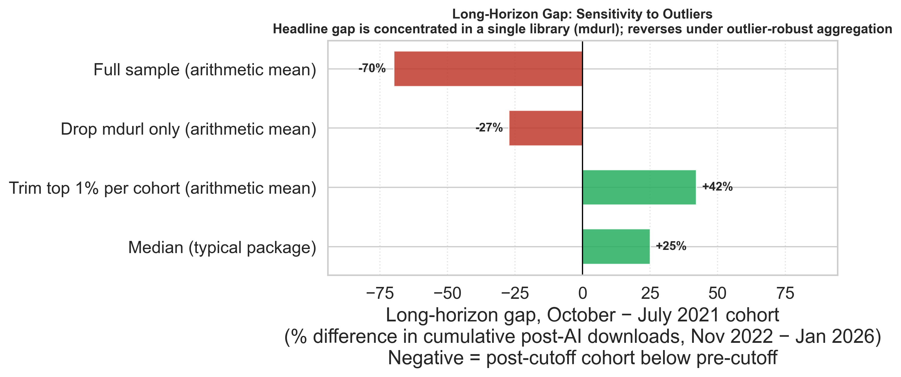
Issue 2 – mdurl, a single outlier
Cumulative post-AI download differences between pre- and post-cutoff cohorts
Do LLMs Shape the Diffusion of New Software? · Tudományos Diákköri Konferencia · 2026, tavaszi félév

Slide 26
Conclusion
POST-CHATGPT DOWNLOAD PENALTY
-7%
~
· Diff-in-RDD, baseline-adjusted
· Local effect at the Sept 2021 boundary, not an ecosystem-wide LLM impact estimate
→
The gap is dormant before ChatGPT, activates after Nov 2022, no catch-up through Jan 2026
→
Mechanism signature: opposite signs across the two datasets - flow down, stock up
→
The Knowledge Wall is persistent and compounding
Do LLMs Shape the Diffusion of New Software? · Tudományos Diákköri Konferencia · 2026, tavaszi félév

Slide 27
Revised
Conclusion
CORRECTED
POST-CHATGPT DOWNLOAD PENALTY
-7%
-0.65%
~
~
· Diff-in-RDD, baseline-adjusted
· Local effect at the Sept 2021 boundary, not an ecosystem-wide LLM impact estimate
→
The gap is dormant before ChatGPT, activates after Nov 2022, no catch-up through Jan 2026
→ outlier-driven
→
Mechanism signature: opposite signs across the two datasets - flow down, stock up
→ GitHub does not change, opposite signs hold
→
The Knowledge Wall is persistent and compounding
→ The Knowledge Wall is real, but small
Do LLMs Shape the Diffusion of New Software? · Tudományos Diákköri Konferencia · 2026, tavaszi félév

Slide 28
Thank you.
CORRECTED POST-CHATGPT DOWNLOAD PENALTY
−0.65%
AUTHOR
Roland Tuboly · Social Data Science MSc · Corvinus University of Budapest · E: roland.tuboly@stud.uni-corvinus.hu
SUPERVISOR
Johannes Wachs · Director, Center for Collective Learning, Corvinus Institute of Advanced Study · E: johannes.wachs@uni-corvinus.hu
Do LLMs Shape the Diffusion of New Software? · Tudományos Diákköri Konferencia · 2026, tavaszi félév

Slide 29

SUPPLEMENTARY MATERIAL
Appendix

Slide 30
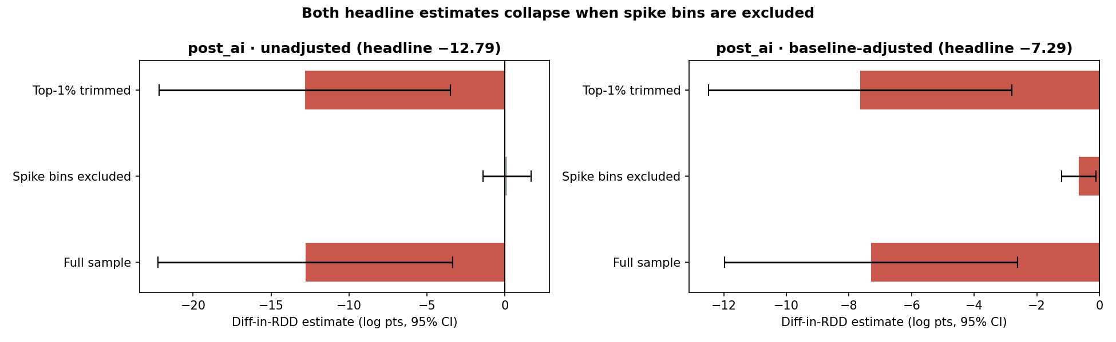
Spike-Bin Sensitivity Check
Dropping 3 contaminated bins (Placebo_2018 dist=−10; Placebo_2020 dist=−10, −9):
Specification | Main estimand | p-value
Unadjusted Diff-in-RDD | + 0.13 log points | 0.87 (not significant)
Baseline-adjusted Diff-in-RDD | - 0.65 log points | 0.019
The 2021 cohort has no analogous spikes, which means contamination is one-sided
Do LLMs Shape the Diffusion of New Software? · Tudományos Diákköri Konferencia · 2026, tavaszi félév

Slide 31
Spike-Bin Sensitivity Check
Cohort | Date | N | Median 26-wk dl | Median post-AI dl | Dominant families
P2018, dist=−10 | 2018-07-16 | 1,806 | 734 | 11 | odoo10-addon-* (11), libra-py-* (8), ie-mbdbl2018-* (7)
P2020, dist=−10 | 2020-07-20 | 2,651 | 903 | 1,362¹ | odoo13-addon-* (26), odoo12-addon-* (25), cloudcomponents-cdk-* (18)
P2020, dist=−9 | 2020-07-27 | 4,142 | 674 | 9 | odoo13-addon-* (27), odoo12-addon-* (8), dsnd-probability-* (7)
¹this release also picked up 18 cloudcomponents-cdk packages (AWS CDK construct library) that genuinely retain post-AI traffic via CI/IaC pipelines
Do LLMs Shape the Diffusion of New Software? · Tudományos Diákköri Konferencia · 2026, tavaszi félév

Slide 32
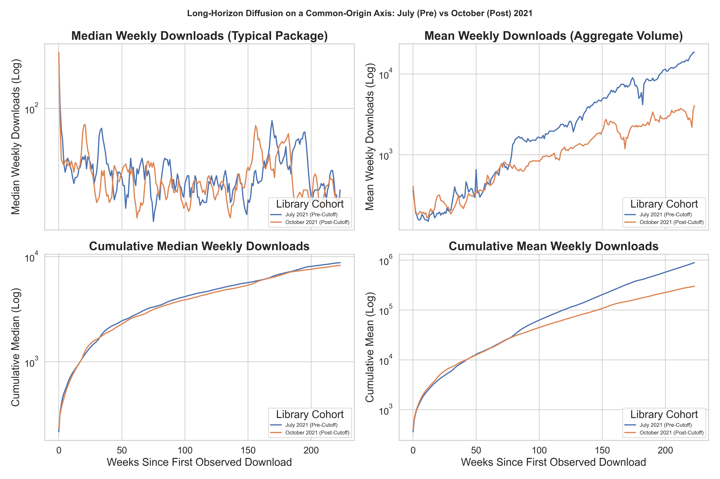
mdurl
Do LLMs Shape the Diffusion of New Software? · Tudományos Diákköri Konferencia · 2026, tavaszi félév

Slide 33
Summary statistics – activation dynamics
HORIZON
PRE-CUTOFF MEAN
POST-CUTOFF MEAN
Δ %
ChatGPT + 6 months
1,467
630
+133%
ChatGPT + 12 months
2,559
1,085
+136%
ChatGPT + 24 months
8,218
2,124
+287%
January 2026
18,085
3,410
+430%
Post-ChatGPT average
6,538
1,703
+284%
Weekly PyPI downloads, mean across libraries in each cohort. Pre-cutoff: libraries released Jan-July 2021; Post-cutoff: Oct 2021 onward
Do LLMs Shape the Diffusion of New Software? · Tudományos Diákköri Konferencia · 2026, tavaszi félév

Slide 34
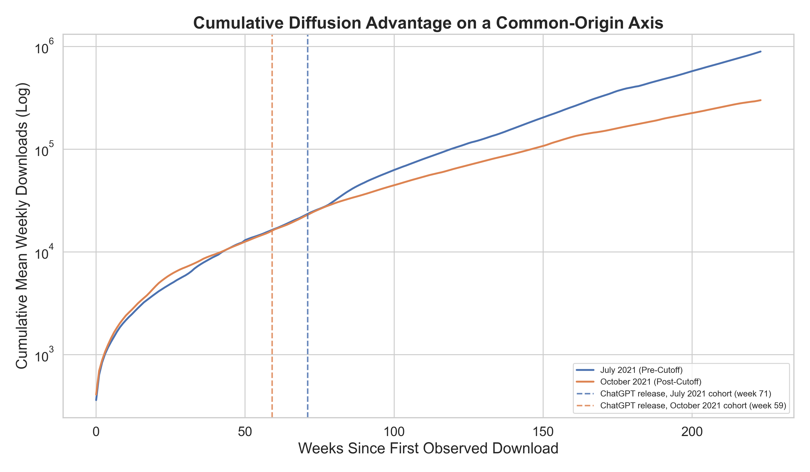
Long-horizon diffusion on a common-origin axis
Cumulative mean weekly downloads, July 2021 (pre-cutoff) versus October 2021 (post-cutoff) cohorts, plotted against weeks since each package's first observed download. The common-origin axis removes the calendar head-start the pre-cohort would otherwise carry.
Cohort means track each other for the first ~75 weeks of life, then the July cohort pulls ahead on aggregate volume
The figure illustrates a long-run level gap on aggregate volume, not an immediate boundary discontinuity.
Do LLMs Shape the Diffusion of New Software? · Tudományos Diákköri Konferencia · 2026, tavaszi félév

Slide 35
Diff-in-RDD estimates (PyPI)
PANEL
TIER
EXCESS JUMP
SE
P
N
Pre-ChatGPT baseline
Successful
−3.72
1.67
0.026
75,313
88,001
Post-ChatGPT, adjusted
Broad
−7.29
2.20
0.001
75,313
Post-ChatGPT, adjusted
Successful
−7.29
2.39
0.002
Post-ChatGPT, adjusted
Superstar
−0.25
0.35
0.473
57,931
88,001
Post-ChatGPT, unadjusted
Broad
−9.14
4.42
0.039
Post-ChatGPT, unadjusted
Successful
−12.79
4.83
0.008
75,313
Log-scale Diff-in-RDD estimates.
Do LLMs Shape the Diffusion of New Software? · Tudományos Diákköri Konferencia · 2026, tavaszi félév

Slide 36

Which libraries are affected?
AI-EXPOSURE MODERATION
HETEROGENEITY
Not targeted at AI tools
Broad
Significant suppression
p = 0.001
AI-relevant libraries are not suppressed more than others (p = 0.179, N = 1,303)
≥ 10 downloads
Why this matters
Successful
Significant suppression
p = 0.002
Uniform suppression rules out a domain-specific explanation
→ The barrier is temporal, not topical
→ Any post-cutoff library is disadvantaged regardless of what it does
≥ 500 downloads
SUTVA
Superstar
Unaffected: high-visibility libraries maintain adoption
p = 0.473
Estimates capture direct suppression plus any substitution spillovers - both are part of the total adoption effect
≥ 1,000 downloads
Do LLMs Shape the Diffusion of New Software? · Tudományos Diákköri Konferencia · 2026, tavaszi félév

Slide 37
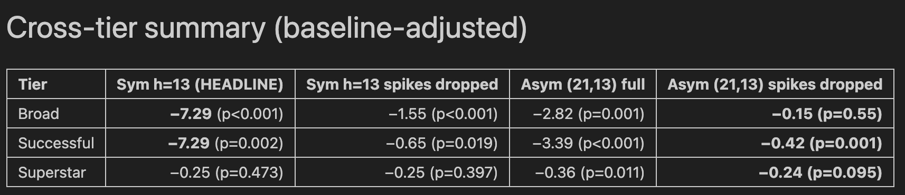
Bandwidth sensitivity + symmetric bandwidth
H (WKS)
ADJUSTED
P
N
INTERPRETATION
13
−7.294
0.002
75,313
Baseline-adjusted Diff-in-RDD (Successful tier, post-AI downloads) across bandwidths h ∈ {13, 15, 18, 26} weeks. Sign and significance stable throughout.
15
−6.301
<0.001
92,291
18
−4.498
<0.001
119,296
26
−2.372
0.001
196,602
Do LLMs Shape the Diffusion of New Software? · Tudományos Diákköri Konferencia · 2026, tavaszi félév

Slide 38
Density test + placebo years
MCCRARY DENSITY TEST
PLACEBO COEFFICIENTS BY YEAR
2018
2019
p = 0.43
Not significant
Not significant
2020
2021
Smooth density across the Sept 2021 cutoff. Developers cannot time their release to an unannounced boundary, supporting as-if random assignment.
p < 0.01
Not significant
The 2021 cohort shows no significant September boundary jump, contrary to the 2020 placebo cohort. The Diff-in-RDD captures the 2021 deviation from the seasonal baseline.
Do LLMs Shape the Diffusion of New Software? · Tudományos Diákköri Konferencia · 2026, tavaszi félév

Slide 39
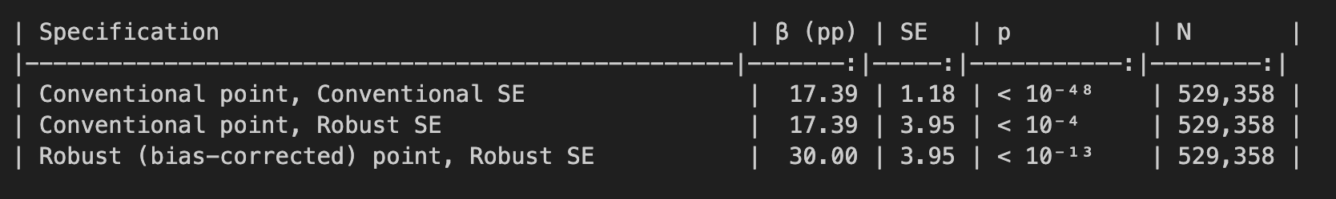
Covariate balance
A pre-treatment balance test on Pr(cum_downloads_26wk ≥ 500) an outcome whose window closes in March 2022, before ChatGPT, yields a positive boundary jump of +17.4 pp (Conventional point, Robust SE 3.95) to +30.0 pp (Robust bias-corrected point), p ≪ 0.001, N = 529,358 (rdrobust, h = 26, donut [−8, 0]).
Predating mass LLM deployment, this imbalance reflects release-month seasonality rather than an LLM channel.
Because it is positive for post-cutoff cohorts, it makes the post-AI suppression results directionally more conservative and motivates the Diff-in-RDD specification with 2018–2020 placebo cohorts.
Do LLMs Shape the Diffusion of New Software? · Tudományos Diákköri Konferencia · 2026, tavaszi félév

Slide 40
GitHub mechanism results
TIER
OUTCOME
EXCESS JUMP
SE
P
Broad
52-week imports
+11.554
10.778
0.284
Broad
GPT-4 era imports
+23.256
11.541
0.044
Broad
Post-AI imports (total)
+26.767
10.932
0.014
Broad
All-time imports
+27.863
9.987
0.005
POSITIVE SIGN
CAVEAT
Post-cutoff libraries accumulate more imports, consistent with stock-vs-flow interpretation.
Diff-in-RDD not significant at p = 0.060 (underpowered).
RDD (rdrobust, robust bias-corrected) on log(1 + GitHub imports) · N = 28,243.
Do LLMs Shape the Diffusion of New Software? · Tudományos Diákköri Konferencia · 2026, tavaszi félév

Slide 41
Conventional vs Bias-corrected
SINGLE-COHORT 2021 RDD, BROAD TIER, h = 13
Outcome
Conventional point (SE, p)
Bias-correction term
Bias-corrected (Robust SE, p)
BC ÷ Conv
PyPI Broad post-AI
+2.05 (0.41, p < 10⁻⁶)
+11.49
+13.54 (4.49, p = 0.004)
5.6 ×
GitHub imports alltime
+1.46 (—, p ≈ 0.30)
+26.40
+27.86 (—, p = 0.005)
19 ×
CCT (2014, Econometrica) §3 caution
When the bias-correction term exceeds the Conventional point estimate, report the Conventional point with Robust SE; the bias-corrected point is a numerical-instability flag, not an elasticity.
DEFENSIBLE READING
PyPI Conventional +2.05, significant. GitHub Conventional +1.46, not significant.
Channel direction is preserved at much smaller magnitudes; the +13 / +27 numbers are not elasticities.
Do LLMs Shape the Diffusion of New Software? · Tudományos Diákköri Konferencia · 2026, tavaszi félév

Slide 42
Sample attrition
FROM PYPI UNIVERSE TO EACH ESTIMATION CELL
527,361
PyPI universe (post quality filter)
↓ ± 13-week bandwidth, donut [−8, 0]
88,001
Diff-in-RDD Broad headline
↓ cum_downloads_26wk ≥ 500
75,313
Diff-in-RDD Successful tier
↓ exact-name match to a public GitHub repo
28,243
GitHub-linked subsample
↓ ± 13-week bandwidth, donut, Broad filter
6,582
Matched-sample Diff-in-RDD
↓ AI-exposure score available (post-treatment)
1,303
AI-exposure moderation cell
Varying N across tables (88k → 75k → 28k → 6.6k → 1.3k) reflects documented attrition layers, not selection bias.
Do LLMs Shape the Diffusion of New Software? · Tudományos Diákköri Konferencia · 2026, tavaszi félév

Slide 43
AI tools declaration
PER TDK GUIDELINES
Tools used
Scope of use
Not AI-generated
Claude (Anthropic)
Literature search, citation triage
The research question
primary writing & code review
Code drafting, review, refactoring
The identification strategy
Gemini (Google)
RDD, Diff-in-RDD, donut, placebo cohorts
secondary writing & brainstorming
Prose editing for clarity
All empirical estimates
GitHub Copilot
Brainstorming
in-IDE code completion
Interpretation of audit findings
Audit assistance
Every econometric judgment
-- The contribution is mine, the tools only accelerated drafting and review --
Do LLMs Shape the Diffusion of New Software? · Tudományos Diákköri Konferencia · 2026, tavaszi félév

