Slide 1
Utility of the Growth Hormone gene for estimating phylogenetic relationships among cypriniform fishes
Henry L. Bart, Jr.¹, Mark D. Clements¹,
Michael H. Doosey¹, David L. Hurley²
1 -Tulane University Museum of Natural History, Belle Chasse, LA 70037, and Department of Ecology and Evolutionary Biology, Tulane University, New Orleans, LA 70118
2- Department of Biochemistry, Tulane University School of Medicine, New Orleans, LA 70112

Slide 2
Growth Hormone Gene
Growth Hormone (GH) is a single chain, pituitary- specific hormone essential for promotion and maintenance of somatic growth in vertebrates.
A number of GH coding sequences are available for fishes and recent studies have shown that GH is an excellent locus for phylogenetic inference.
In cypriniforms, GH comprises 5 exons, and 4 introns and codes for a protein of approximately 220 amino acid residues. Genomic sequence ~ 2000-2500 bp.

Slide 3
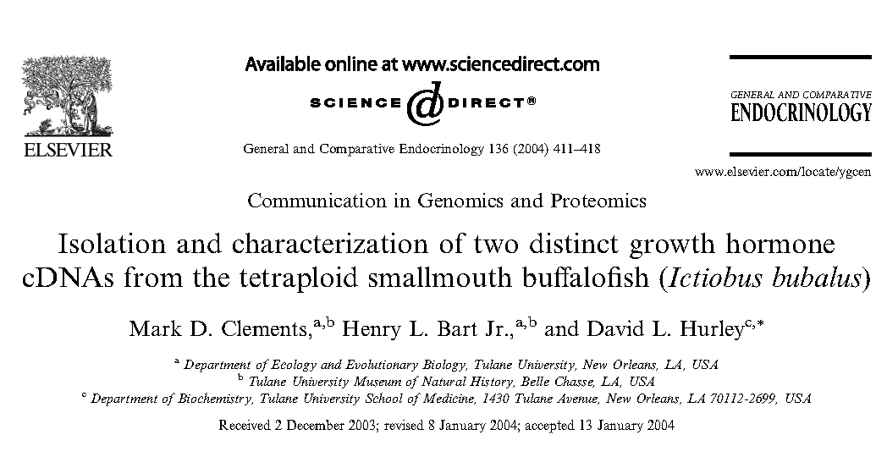
We recently isolated and sequenced two paralogous GH cDNAs for the
smallmouth buffalo Ictiobus bubalus (Catostomidae).
Primers designed from alignments of cypriniform GH sequences
deposited in GenBank.
Reverse transcribed mRNA; cloned product; RACE; cloned again
Polymorphisms in 5’ UTRs of I. bubalus GH cDNAs used to design
locus-specific primers to selectively amplify both copies of gene.

Slide 4
Anguilla
Among cypriniforms,
I. bubalus sister to
minnows; not loaches.
Results suggested that
tetraploidy/duplication
events in catostomids
and Asian cyprinids
occurred independently
Representation of suckers
and other cypriniform
groups limited
94
Ctenopharyngodon idellus
Hypophthalmichthys nobilis
100
H. moltrix
Cypriniformes
Mylopharyngodon piceus
Megalobrama amblycephala
99
100
99
Labeo rohita
Cyprinidae
84
Catla catla
Cirrhinus mrigala
76
99
Cyprinus carpio GHII
Carassius auratus GHII
76
99
Cyprinus carpio GHI
100
Carassius cuvieri
100
Carassius auratus GHI
Catostomidae
Ictiobus bubalus GHI
100
I. bubalus GHII
Cobitidae
Siluriformes
Misgurnus mizolepis
99
100
M. anguillicaudatus
Pangasius pangasius
Pangasianodon gigas
96
Heteropneustes fossilis
100
Clarias batrachus
C. gariepinus
Ictalurus punctatus
Silurus asotus
Protacanthomorphs
Oncorhyncus nerka GHI
O. tshawytscha GHI
100
100
O. keta GHI
88
O. mykiss GHI
O. kisutch GHI
100
Salmo salar GHI
100
Corregonous autamnalis
C. lavaretus
99
O. nerka GHII
O. keta GHII
86
O. mykiss GHII
S. salar GHII
77
Esox lucius
Plecoglossus altivelis
100
Talapia nilotica GHII
Acanthomorphs
Talapia nilotica GHI
Sparus auarata
76
Siniperca kneri
Seriola quinqueradiata
Monopterus albus
Perca flavescens
Cottus kazika
100
Epinephelus coioides
Pseudosciaena crocea
Verasper veriegatus
Fugu rubripes
0.05 substitutions/site
Neighbor-joining tree from Clements et al (2004) based on T-N distances among
GH cDNAs of fishes.

Slide 5
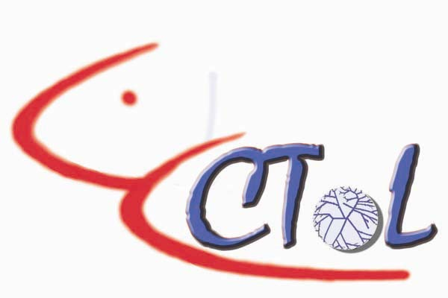
This study
Fact that our primers designed from alignments of cypriniform
GH sequences allows us to expand the study to other cypriniform taxa.
Pursuing this as part of Cypriniformes Tree of Life Project
Here we report preliminary GH sequence results for additional
cypriniform species.
We present data from GH exons to demonstrate the phylogenetic
resolving power of the gene.
We compare our expanded GH cypriniform phylogeny to phylogenies
for cypriniforms based on morphology and mitochondrial
genes.

Slide 6
Primers and amplification
5’ UTRF
E3R
3’ UTRR
E3F
Exon 1
Exon 2
Exon 3
Exon 4
Exon 5
5’ UTR
3’ UTR
E2F
E5R
Amplified GH from genomic DNA using primers designed
from cDNA of I. bubalus GH Copy I (5’UTRF / 3’UTRR);
sequenced using 5’UTRF/ E3R and E3F/3’UTRR (two
overlapping pieces) for suckers.
Minnows and loaches were amplified with E2F/E5R.

Slide 7
Data and Analysis
Analysis based on ~ 374 bp of GH coding sequence for Cyprinella lutrensis, 453 bp for Algansea tincella, 455 bp for Epalzorychus bicolor, 522 bp for Lefua echigonia; 548 bp for Gyrinocheilus aymonieri; 621 bp for Cobitis biwae; 606-633 bp for nine species of suckers, and 633 bp of cDNA sequence from GenBank for other cypriniform species plus stinging catfish Heteropneustus fossilis (outgroup).
The data set contained 248 variable sites, of which 163 sites were
phylogenetically informative (31 first-position, 25 second position,
and 107 third position substitutions).
Trees produced by Bayesian analysis (Mr. Bayes) and maximum parsimony as implemented in PAUP.

Slide 8
Results
GH coding sequence divergence among cypriniform families ranges from 12-15% and shows little evidence of saturation or loss of phylogenetic signal, even at the third codon position.
Average amino acid (aa) sequence divergence among these taxa is 8.8% (previous work suggests these characters good for resolving relationships at and above ordinal level).
MP and Bayesian analyses yield identical trees

Slide 9
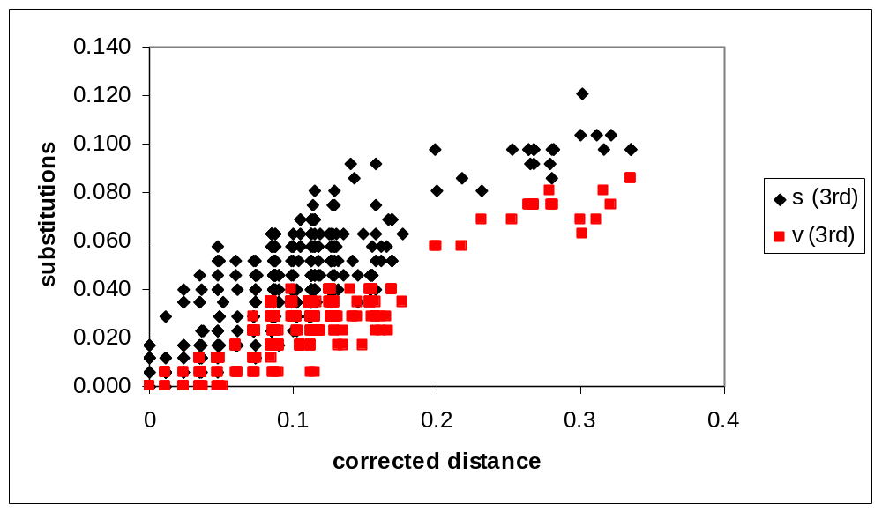
Substitution analysis
Within ingroup
Ingroup-outgroup
Evidence of saturation only in ingroup-outgroup comparisons
for 3rd position substitutions.

Slide 10
Results
GH coding sequence divergence among cypriniform families ranges from 12-15% and shows little evidence of saturation or loss of phylogenetic signal, even at the third codon position.
Average amino acid (aa) sequence divergence among these taxa is 8.8% (previous work suggests these characters good for resolving relationships at and above ordinal level).
MP and Bayesian analyses yield identical trees.

Slide 11
Bayesian majority rule consensus tree
Heteropneustus fossilis
Cyprinidae
100
Algansea tincella
100
Cyprinella lutrensis
Phoxininae
Cultrinae
Xenocyprininae
Mylopharyngodon piceus
72
Megalobrama terminalis
Hypothalmichthys moltrix
99
Ctenopharyngodon idella
Cyprinoidea
Epalzeorhynchus bicolor
Labeoninae
Cyprininae
100
Labeo rohita
100
100
Catla catla
Cirrhinus mrigala
100
Carrassius auratus
98
Cyprinus carpio
Gymnocypris przewalski
Catostomidae
100
Ictiobus bubalus
Carpiodes cyprinus
Ictiobinae
Minytrema melanops
100
100
72
Moxostoma anisurum
Catostominae
100
Moxostoma duquesnei
Hypentelium nigricans
Catostomus commersoni
Cycleptinae
Cycleptus elongatus
Myxocyprininae
Myxocyprinus asiaticus
100
Cobitis biwae
Cobitidae
Misgurnus anguilicaudatus
Balitoridae
Lefua echigonia
Gyrinocheilidae
Gyrinochelius aymonieri

Slide 12
GH Intron data
useful for resolving
relationships within
familes (T-N
distance).
Introns not
alignable across
families.
Moxostoma erythrurum
M. valenciennesi
M. poecilurum
Scartomyzon austrinum
S. congestum
Moxostoma falcatum
Catostominae
Scartomyzon ariommus
Moxostoma breviceps 1
M. breviceps 2
Moxostoma
M. macrolepidotum
M. duquesnei 1
M. hubbsi
Scartomyzon rupiscartes
M. duquesnei 2
Scartomyzon cervinum
S. braseus
M. collapsum
M. anisurum
Hypentelium nigricans 1
H. nigricans 2
H. roanokense
Hypentelium
Thoburnia. atripinnis
T. hamiltoni
Catostomus commersoni
Carpiodes velifer 1
C velifer 2
Ictiobinae
C. carpio 1
Carpiodes
C. carpio 2
C. cyprinus 1
C. cyprinus 2
C. cyprinus 3
Ictiobus bubalus 1
I. bubalus 2
Ictiobus
I. cyprinellus

Slide 13
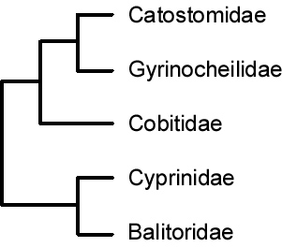
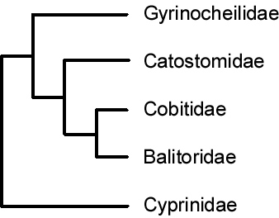
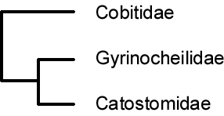
Cypriniform Phylogenetic Hypotheses
Wu et al (1981)
Siebert (1987)
Cyprinidae
Catostomidae
Cobitidae
Balitoridae
Gyrinocheilidae
Harris and Mayden (2001)
This study

Slide 14
Conclusions
GH is a useful marker for resolving relationships within Order Cypriniformes.
cDNA provides good characters for resolving relationships within and among families; no evidence of saturation even at third codon position.
Introns useful for resolving relationships within families.
Results suggest that catostomids sister to cyprinids, contrary to hypotheses based and morphology and mitochodrial DNA data (limited taxon sampling).

Slide 15
Acknowledgements
Funding:
Systematics of Ictiobinae
(NSF DEB 0237013) HLB,
R.D. Suttkus, and D.L.Hurley.
Cypriniformes Tree of Life Project (NSF DEB 0431259)
Tissues of Cobitus biwae
provided by Kenji Saitoh
Tohoku National Fisheries Laboratory

