Slide 1
A preliminary analysis of the river carpsucker,
Carpiodes carpio (Rafinesque), in the southern portion of its range…
...with new results and comments on the taxonomic status of C. c. elongatus Meek
Royal D. Suttkus and Henry L. Bart, Jr.
Tulane University Museum of Natural History

Slide 2
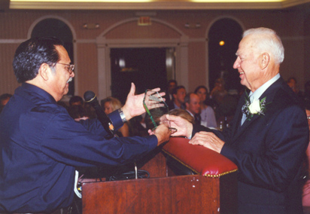
“We are pleased to offer this paper in recognition of the many contributions of Dr. Salvador Contreras-Balderas during his professional career at the University of Nuevo Leon, Monterrey, Mexico. We hope that he will continue to devote time during his retirement to the important scientific and conservation activities that occupied so much of his career.”

Slide 3
“Nosotros estamos contentos ofrecer este papel en el reconocimiento de las muchas contribuciones de el Dr. Salvador Contreras Balderas durante su carrera profesional en la Universidad Autónoma de Nuevo Leon en Monterrey,
Mexico. Esperamos que él continúe dedicar tiempo durante su retiro al importante científico y las actividades de la conservación que ocuparon tanto de su carrera.

Slide 4
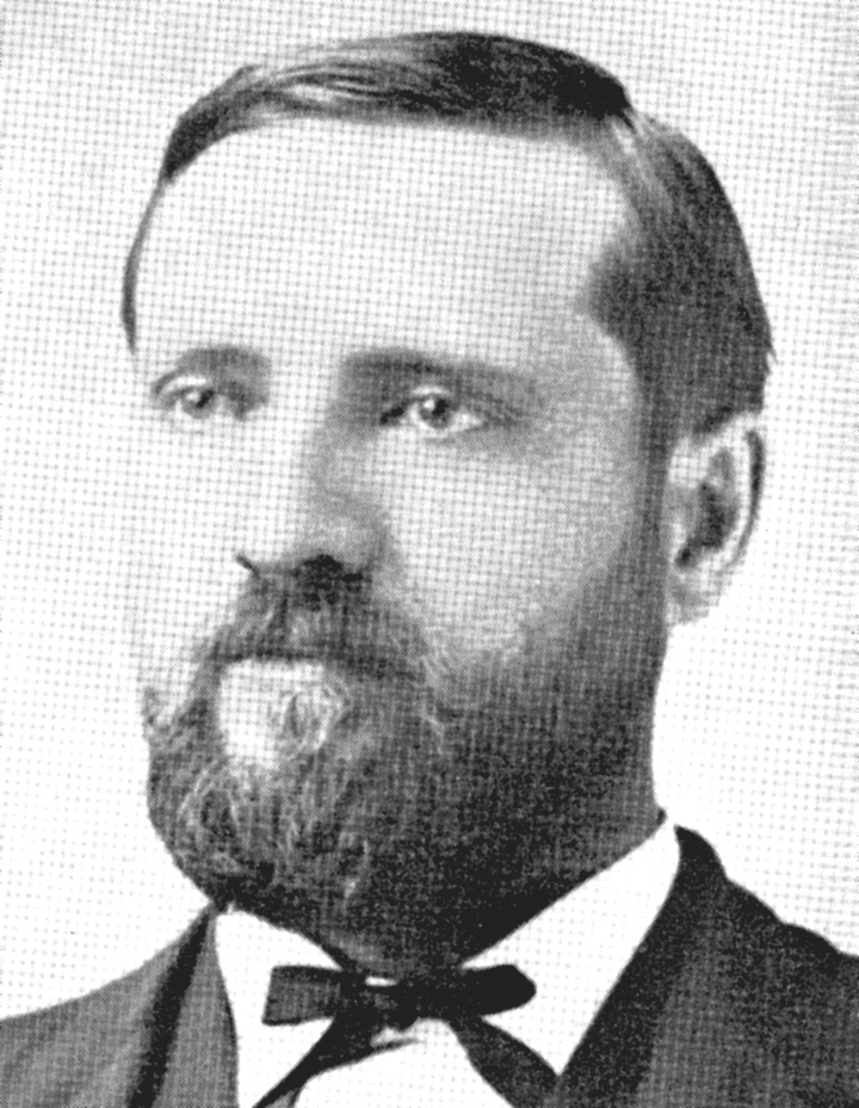
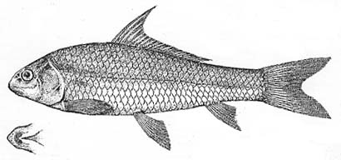
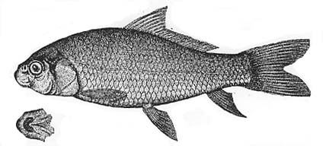
Carpiodes elongatus
Rivers of NE Mexico Rio Pánuco to Rio Grande
Seth Eugene Meek
(1859-1914)
Carpiodes microstomus
Santa Rosalia and Jimenez (Rio Conchos)
Meek (1904) The Fresh-water Fishes of Mexico North of the Isthmus of Tehuantepec

Slide 5
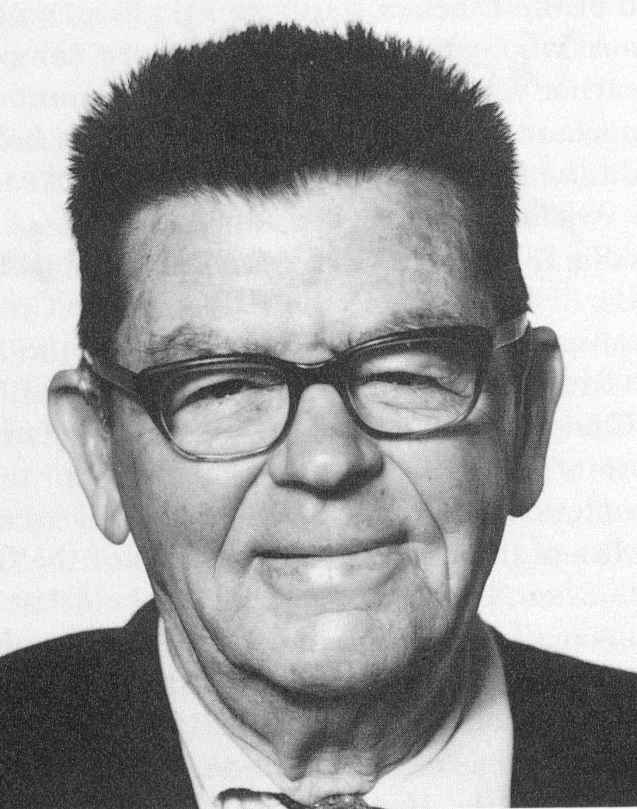
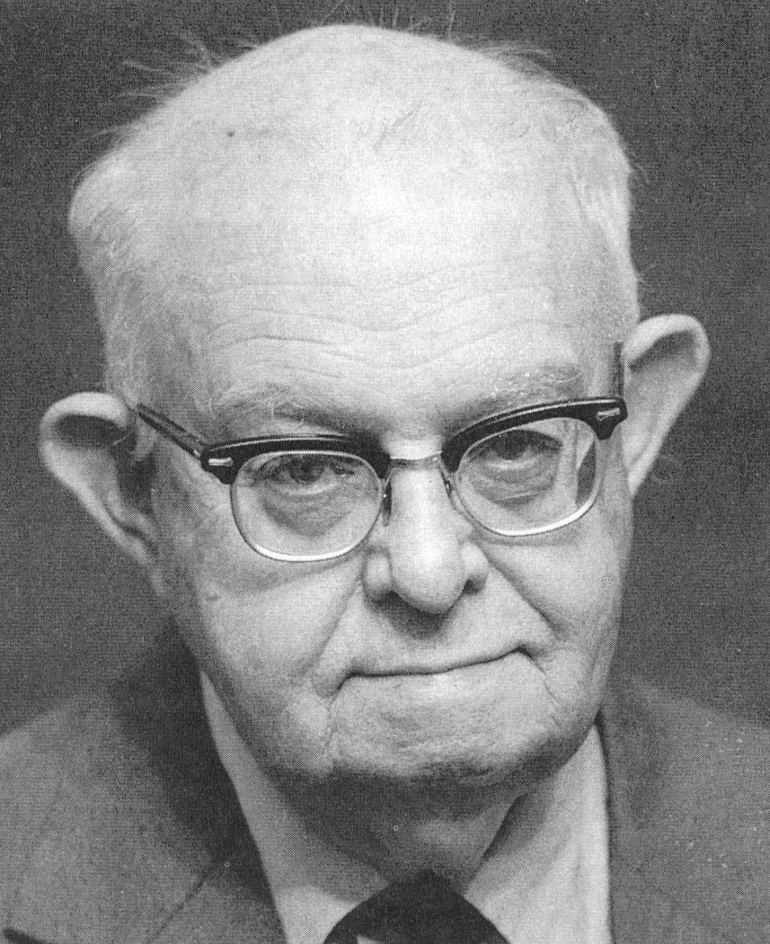
HUBBS, C.L. & J.D. BLACK 1940. Status of the catostomid
fish, Carpiodes carpio elongatus Meek. Copeia, 1940 (4):226-230.
Carl L. Hubbs
John D. Black
Gave range of C. c. elongatus as Soto la Marina and Sabinas river
systems of northern Mexico, Rio Grande system of Texas and Mexico,
coastal streams of Texas, and (tentatively) the Mississippi River
near the Louisiana-Arkansas line. Expressed doubts about the latter…

Slide 6
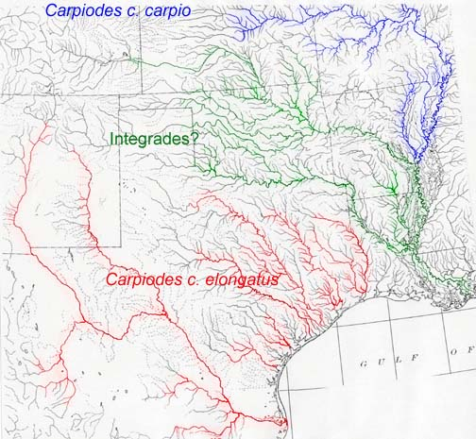
Subsequent workers interpreted this to mean that the Mississippi
River in the vicinity of the Arkansas state line was a zone of
contact between the two subspecies, and that Arkansas and Red
river populations may represent intergrades

Slide 7
Methods
Gathered data on 8 meristic and 22 mensural characters for 1023 specimens of C. carpio representing the following Mississippi River Basin and western Gulf Slope populations: Rio Grande, Colorado, Brazos, Trinity, Sabine, Red, lower Mississippi, and Arkansas rivers.
Specimens varied in size from juveniles to adults;
tested for allometry
Mensural characters analyzed as residuals from regressions on standard length
Data subjected to ANOVA with SNK multiple range tests and canonical discriminant analysis

Slide 8
Characters used
Meristic characters (8):
Lateral line scales
Body circumferential scales
Caudal peduncle scales
Dorsal rays
Anal rays
Pectoral rays
Pelvic rays
Caudal rays
Mensural characters (22):
Standard length
Body depth
Body width
Head length
Head width
Head depth
Mensural characters (cont’d):
Caudal peduncle length
Caudal peduncle depth
Snout length
Orbit length
Post-orbital length
Dorsal fin base length
Dorsal fin height
Tail length
Pectoral length
Pelvic length
Anal length
Dorsal origin to posterior orbit rim
Predorsal length
Post-dorsal length
Prepectoral length
Pectoral to pelvic distance

Slide 9

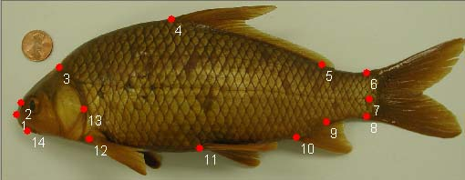
Also used Rohlf’s morphometrics software to digitize
14 landmarks on 431 specimens representing all study
populations.

Slide 10
Methods cont’d
Landmark data analyzed with thin-plate spline methods (multivariate regression and relative
warp analysis)
Compared reference shapes across populations
Derived variables subjected to canonical discriminant analysis

Slide 11
Results (univariate tests)
No significant differences in meristics
Specimens from the Río Bravo have significantly lower means for body depth and dorsal fin base length; longer caudal peduncle
Specimens from the Sabine have significantly higher means for body depth, body width, head width, caudal peduncle depth, predorsal length, orbit length, dorsal height, pelvic length, anal length, tail length

Slide 12
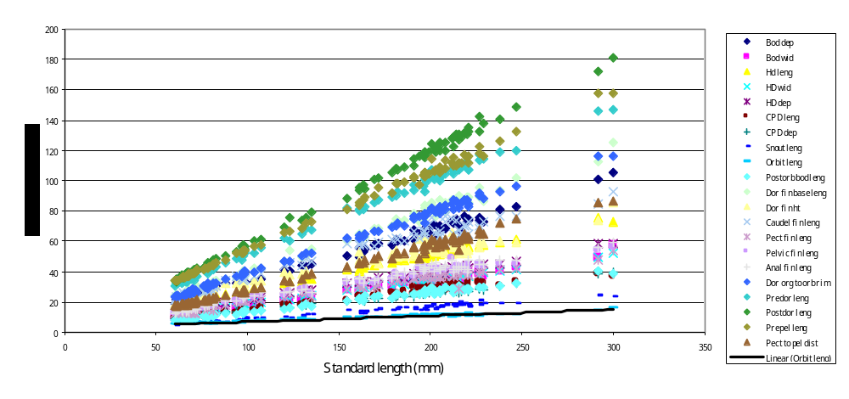
Measurements increased linearly with standard length
(no allometry)

Slide 13
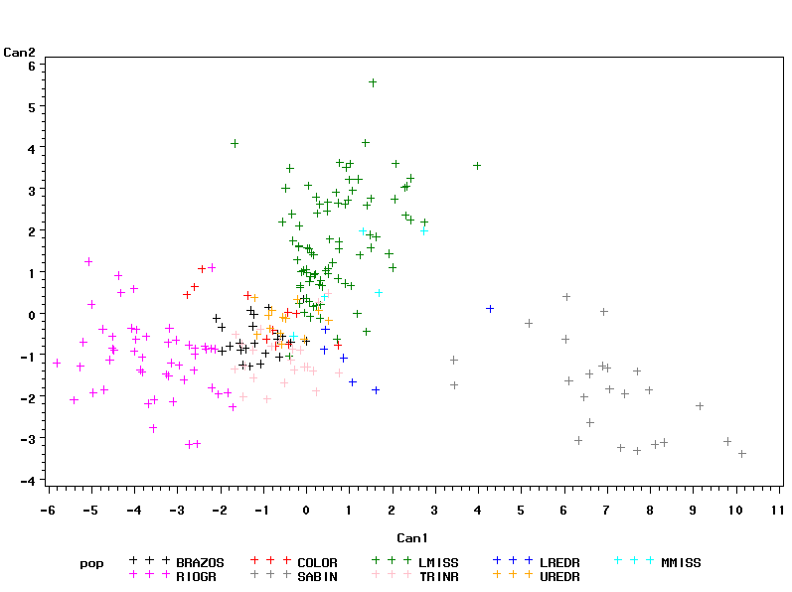
Canonical discriminant plot based on residuals of mensural characters
Narrow body;
Short dorsal base;
Long caudal peduncle
Deep, wide
body; deep
caudal peduncle;
long predorsal;
big eye; high
Dorsal; long anal
Pelvic and tail
Río Bravo
Sabine
*Canonical Variate 1 accounts for 76% of the variation; CV 2 accounts for 17%

Slide 14
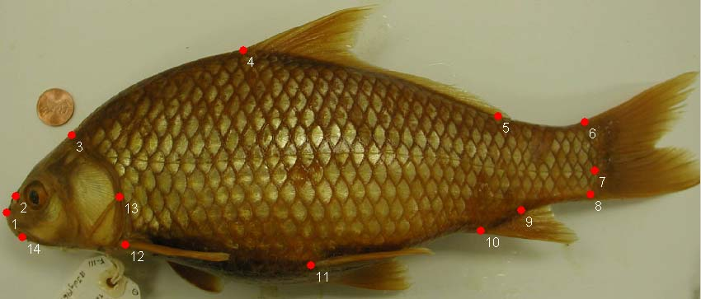
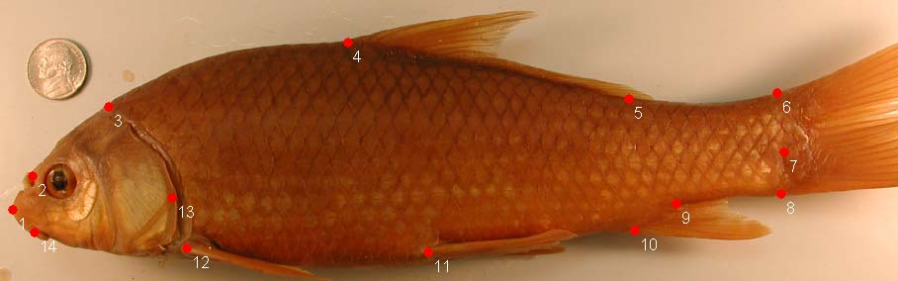
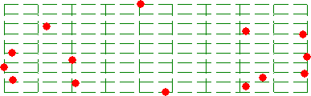

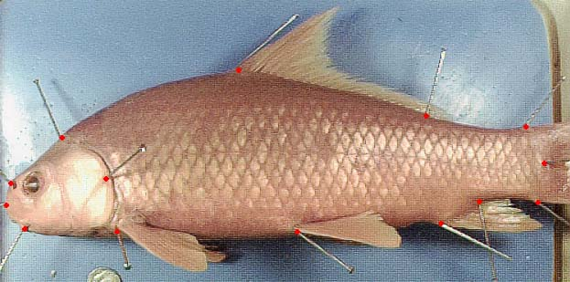
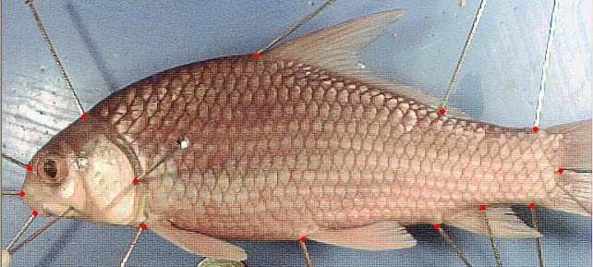
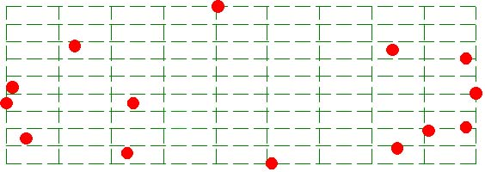
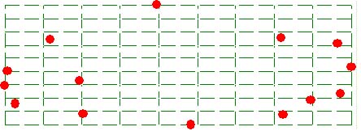
Río Grande
Colorado
Brazos
Trinity

Slide 15
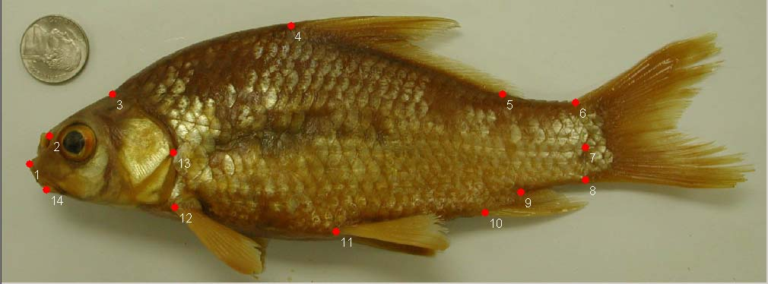
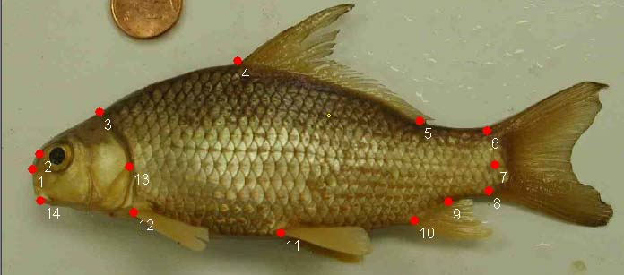
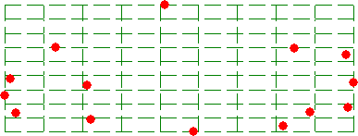

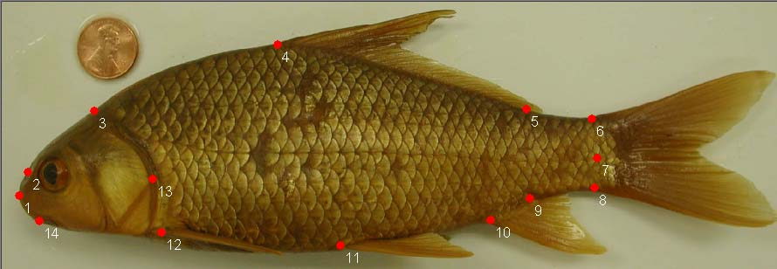
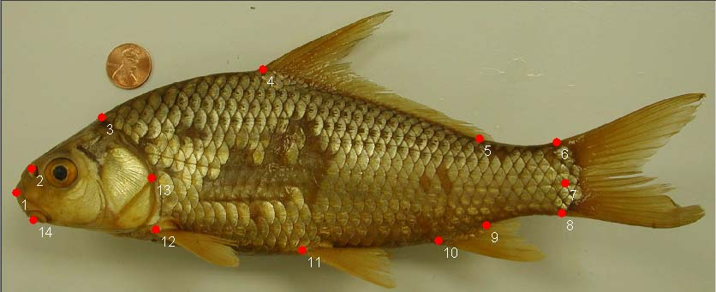


Sabine
Lower Red
Lower Miss
Arkansas

Slide 16
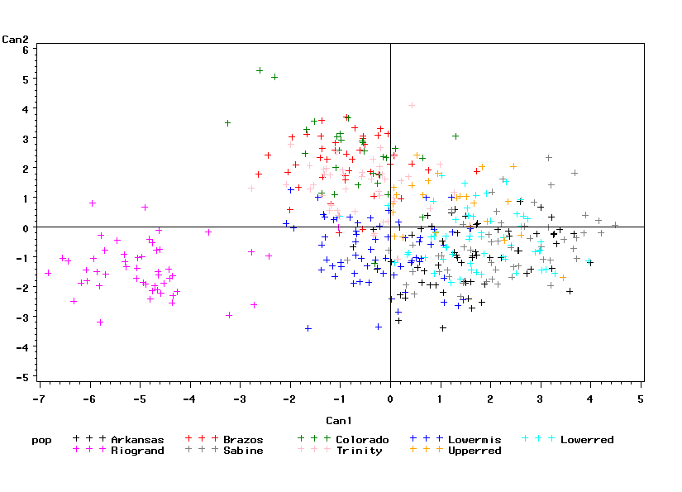
Canonical discriminant analysis of derived
shape variables from partial warp analysis
Río Bravo
Canonical variates 1 and 2 account for 70% of the variation in the data

Slide 17
Conclusions
Distinct morphotypes of C. carpio in the Río Bravo and Sabine River based on body proportions (distance measurements)
Multivariate analysis of geometric shape (landmarks) also supports the distinctiveness of the Río Bravo population
Most other western Gulf populations, including populations in the Red and Arkansas Rivers, agree with C. carpio in the Mississippi River Basin

Slide 18
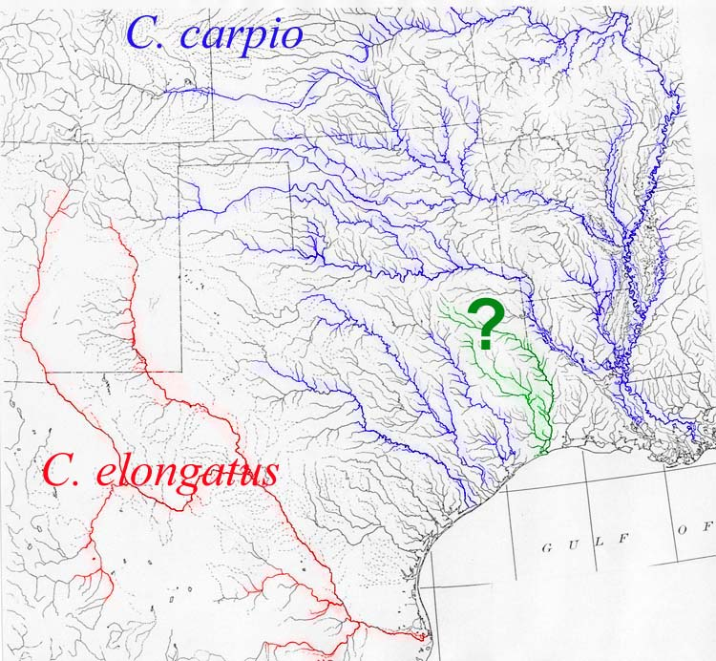
If we recognize populations in the Sabine (and probably
the Neches) as a distinct species, what effect does this have on
more western Gulf Slope Rivers?

Slide 19
Conclusions cont’d
Results provide morphological evidence for recognizing C. elongatus as a distinct species, diagnosable by body morphometry.
Distinctiveness of the Sabine River population presents a dilemma for establishing taxonomic limits for the rest of C. carpio

Slide 20
Ongoing and Future Work
Studies of genetic variation in Mississippi River Basin populations of C. carpio ongoing
Planning to collect specimens and tissues from western Gulf Slope rivers of Texas, and C. elongatus populations in Texas, New Mexico, and Mexico
Studies of C. carpio complex part of larger systematic revision of subfamily Ictiobinae

