Slide 1
Utility of the Growth Hormone gene for estimating phylogenetic relationships among cypriniform fishes
Mark D. Clements^{1,} Henry L. Bart, Jr.¹, Michael H. Doosey¹, David L. Hurley²
1 -Tulane University Museum of Natural History, Belle Chasse, LA 70037, and Department of Ecology and Evolutionary Biology, Tulane University, New Orleans, LA 70118
2- Department of Biochemistry, Tulane University School of Medicine, New Orleans, LA 70112

Slide 2
Growth Hormone Gene
Growth Hormone (GH) is a single chain, pituitary- specific hormone essential for promotion and maintenance of somatic growth in vertebrates.
A number of GH coding sequences are available for fishes and recent studies have shown that GH is an excellent locus for phylogenetic inference.
In cypriniforms, GH comprises 5 exons, and 4 introns and codes for a protein of approximately 220 amino acid residues. Genomic sequence ~ 2500 bp in catostomids

Slide 3
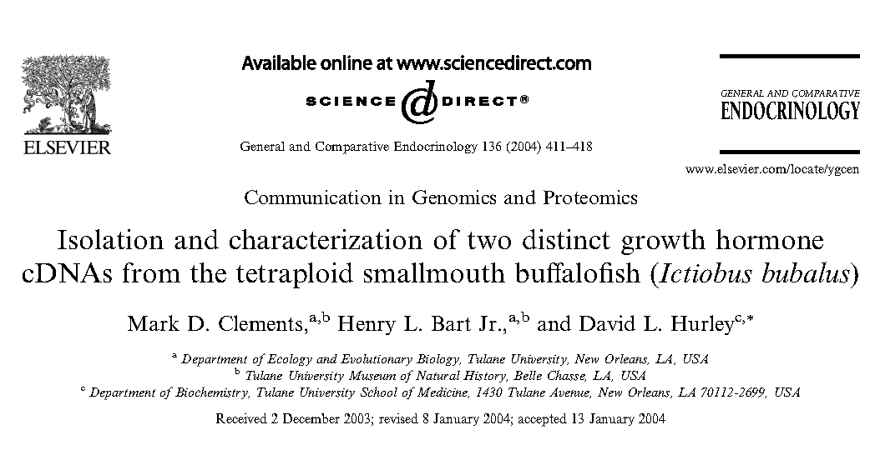
We recently isolated and sequenced two paralogous GH cDNAs for the
smallmouth buffalo Ictiobus bubalus (Catostomidae).
Primers designed from alignments of cypriniform GH sequences
deposited in GenBank. (reverse transcribed; cloned; RACE; cloned again)
Polymorphisms in 5’ UTRs of I. bubalus GH cDNAs used to design
locus-specific primers to selectively amplify both copies of gene.

Slide 4
Anguilla
I. bubalus GH cDNAs
compared to those of
other fishes
Among cypriniforms,
loaches sister to I. bubalus
plus minnows
Results suggested that
tetraploidy/duplication
events in catostomids
and Asian cyprinids
occurred independently
Representation of suckers
and other cypriniform
families limited
94
Ctenopharyngodon idellus
Hypophthalmichthys nobilis
100
H. moltrix
Cypriniformes
Mylopharyngodon piceus
Megalobrama amblycephala
99
100
99
Labeo rohita
Cyprinidae
84
Catla catla
Cirrhinus mrigala
76
99
Cyprinus carpio GHII
Carassius auratus GHII
76
99
Cyprinus carpio GHI
100
Carassius cuvieri
100
Carassius auratus GHI
Catostomidae
Ictiobus bubalus GHI
100
I. bubalus GHII
Cobitidae
Siluriformes
Misgurnus mizolepis
99
100
M. anguillicaudatus
Pangasius pangasius
Pangasianodon gigas
96
Heteropneustes fossilis
100
Clarias batrachus
C. gariepinus
Ictalurus punctatus
Silurus asotus
Protacanthomorphs
Oncorhyncus nerka GHI
O. tshawytscha GHI
100
100
O. keta GHI
88
O. mykiss GHI
O. kisutch GHI
100
Salmo salar GHI
100
Corregonous autamnalis
C. lavaretus
99
O. nerka GHII
O. keta GHII
86
O. mykiss GHII
S. salar GHII
77
Esox lucius
Plecoglossus altivelis
100
Talapia nilotica GHII
Acanthomorphs
Talapia nilotica GHI
Sparus auarata
76
Siniperca kneri
Seriola quinqueradiata
Monopterus albus
Perca flavescens
Cottus kazika
100
Epinephelus coioides
Pseudosciaena crocea
Verasper veriegatus
Fugu rubripes
0.05 substitutions/site
Neighbor-joining tree from Clements et al (2004) based on T-N distances among
GH cDNAs of fishes.

Slide 5
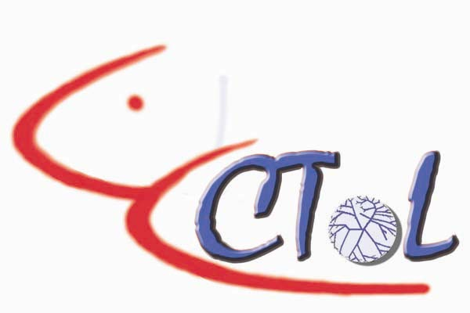
This study
Fact that our primers designed from alignments of cypriniformes
GH sequences allows us to expand the study to other cypriniform taxa.
Proposed to pursue this as part of Cypriniformes Tree of Life Project
Here we report preliminary GH sequence results for additional
cypriniform species.
We present data from both GH exons and introns to demonstrate
the resolving power of the gene at different phylogenetic levels.
We compare our expanded GH cypriniform phylogeny to other
phylogenies for these fishes based on morphology and mitochondrial
genes.

Slide 6
Methods
Pituitaries dissected from freshly-killed specimens.
Total RNA extracted using a modified acid guanidinium thiocyanate-phenol-chloroform protocol.
First strand cDNA reverse-transcribed using oligo-dT12-18 and Superscript II RT.
Used degenerate primers designed by Clements et al. (2004) from alignments of all cypriniform GH sequences deposited in GenBank to amplify GH.
Amplified GH from genomic DNA for Carpiodes and Moxostoma.

Slide 7
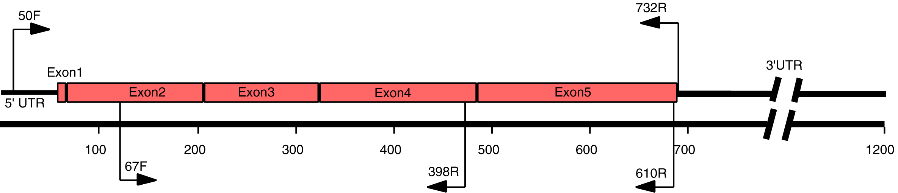
Primers and amplification
Cobitis biwae and Myxocyprinus asiaticus GH cDNA amplified
with degenerate primers 67F/398R. Gyrinocheilus
aymonieri amplified with primers 67F/610R.
Used primers designed for GH copy one I. bubalus cDNA
(50F/732R) to amplify genomic sequence (exons and
introns) for other suckers.

Slide 8
Data Analysis
Analysis based on 314-405 bp of GH cDNA sequence for
Gyrinocheilus aymonieri, Cobitis biwae, and Myxocyprinus asiaticus
and 633 bp of cDNA sequence from GenBank for 17 other cypriniform
species plus Ictalurus punctatus (outgroup).
The data set contained 208 variable sites, of which 100 sites were
phylogenetically informative (21 first-position, 18 second position,
and 61 third position substitutions).
Trees produced by neighbor-joining method as implemented in PAUP
(corrected distance) and Bayesian analysis (Mr. Bayes).

Slide 9
Results
GH coding sequence divergence among cypriniform families ranges from 12-15% and shows little evidence of saturation or loss of phylogenetic signal, even at the third codon position.
Average amino acid (aa) sequence divergence
among these taxa is 8.8% (previous analysis suggests these characters good for resolving relationships at and above ordinal level).
Introns useful for resolving relationships within families (difficult to align at family level).

Slide 10
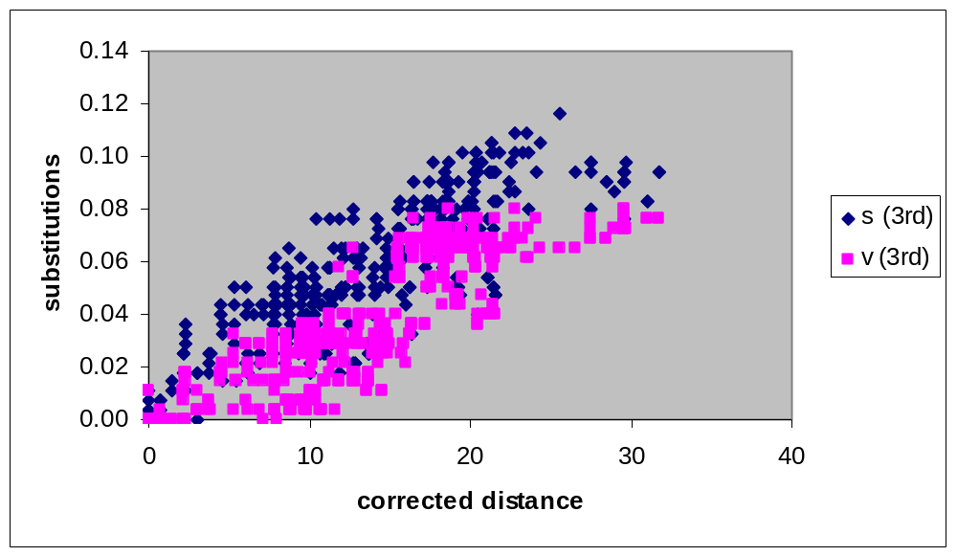
Substitution analysis
Within ingroup
comparisons
Ingroup-outgroup
comparisons
Evidence of saturation only in ingroup-outgroup comparisons
for 3rd position substitutions.

Slide 11
Bayesian
ML tree
partial GH
cDNA data
Cobitis biwae
Cobitoids
77
98
Misgurnus mizolepis
100
M. anguillicaudatus
Gyrinocheilus aymonieri
Myxocyprinus asiaticus GHII
Catostomids
100
Ictiobus bubalus GHII
100
100
Carpiodes cyprinus GHI
100
100
I. bubalus GHI
Moxostoma duquesnii GHI
94
Ctenopharyngodon idella
100
Hypopthalmichthys molitrix
74
77
H. nobilis
100
Megolabrama amblycephala
Mylopharyngodon piceus
Cyprinids
100
Labeo rohita
99
100
Catla catla
Cirrhinus cirrhosus
100
Cyprinus carpio GHI
100
Carassius cuvieri
100
Carassius auratus GHI
99
Cyprinus carpio GHII
Carassius auratus GHII
Ictalurus punctatus

Slide 12
Results
GH coding sequence divergence among cypriniform families ranges from 12-15% and shows little evidence of saturation or loss of phylogenetic signal, even at the third codon position.
Average amino acid (aa) sequence divergence
among these taxa is 8.8% (previous analysis suggests these characters good for resolving relationships at and above ordinal level).
Introns useful for resolving relationships within families (difficult to align at family level).

Slide 13
Tamura-Nei
distance
GH Intron data
Moxostoma erythrurum
M. valenciennesi
M. poecilurum
Scartomyzon austrinum
S. congestum
Moxostoma falcatum
Catostominae
Scartomyzon ariommus
Moxostoma breviceps 1
M. breviceps 2
Moxostoma
M. macrolepidotum
M. duquesnei 1
M. hubbsi
Scartomyzon rupiscartes
M. duquesnei 2
Scartomyzon cervinum
S. braseus
M. collapsum
M. anisurum
Hypentelium nigricans 1
H. nigricans 2
H. roanokense
Hypentelium
Thoburnia. atripinnis
T. hamiltoni
Catostomus commersoni
Carpiodes velifer 1
C velifer 2
Ictiobinae
C. carpio 1
Carpiodes
C. carpio 2
C. cyprinus 1
C. cyprinus 2
C. cyprinus 3
Ictiobus bubalus 1
I. bubalus 2
Ictiobus
I. cyprinellus

Slide 14
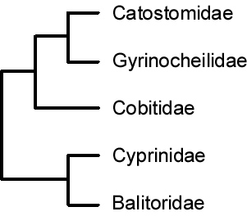
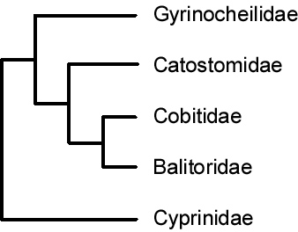
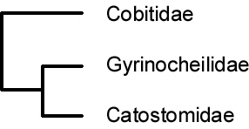
Cypriniform Phylogenetic Hypotheses
Wu et al (1981)
Siebert (1987)
Cobitidae
Gyrinocheilidae
Catostomidae
Cyprinidae
Harris and Mayden (2001)
This study

Slide 15
Conclusions
GH is a useful marker for resolving relationships within Order Cypriniformes.
cDNA provides good characters for resolving family-level relationships; no evidence of saturation even at third codon position.
Introns less conserved, but useful for resolving relationships within families.
Results suggest that gyrinocheilids sister to cobitids; catostomids sister to minnows, contrary to recent hypotheses based and morphology and mitochodrial DNA data.

Slide 16
Acknowledgements
Funding:
Systematics of Ictiobinae
(NSF DEB 0237013) HLB,
R.D. Suttkus, and D.L.Hurley.
Cypriniformes Tree of Life Project (NSF DEB 0431259)
Tissues of Cobitus biwae
provided by Kenji Saitoh
Tohoku National Fisheries Laboratory

