Slide 1
Patterns of variation and relationships of living ictiobines (Cypriniformes: Catostomidae) based on mitochondrial and nuclear genes
Henry Bart, Jr.¹, Mark Clements¹, Rebecca Blanton¹, Mollie Cashner¹, M. H. Doosey¹,
Kyle R. Piller², D.L. Hurley³
1 -Tulane University Museum of Natural History, Belle Chasse, LA 70037, and Department of Ecology and Evolutionary Biology, Tulane University, New Orleans, LA 70118
2- Department of Biological Sciences, Southeastern Louisiana University, Hammond, LA 70402
3- Department of Biochemistry, Tulane University School of Medicine,
New Orleans, LA 70112

Slide 2
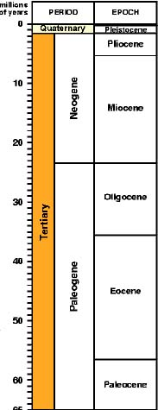
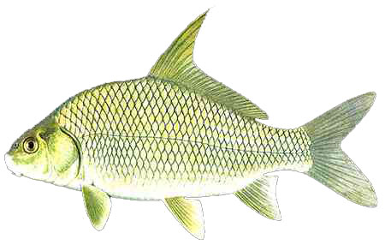
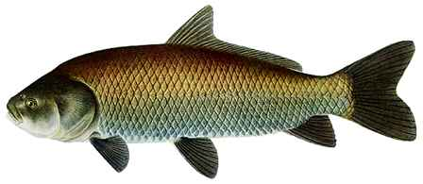
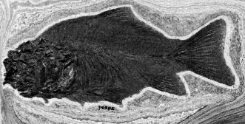
Subfamily Ictiobinae
Oldest catostomids, arguably most basal and pliesiomorphic as well.
I. cf cyprinellus
I. cf niger
I. cf bubalus
Carpiodes 3 species;
Fossils to Pleistocene
Ictiobus 4 or 5 species;
fossils to Lower Pliocene
†Amyzon and other fossils Paleocene to Oligocene

Slide 3
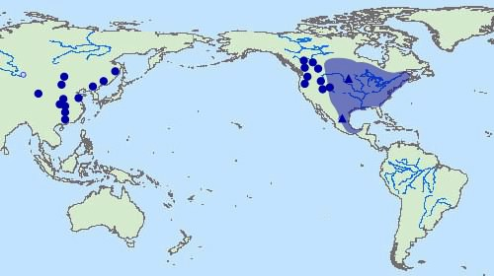
Distribution of the Subfamily
Holarctic; extant forms and more recent fossils only found in North American
east of continental divide.
Early Tertiary
Late Tertiary, Quaternary
Recent
Modified from Chang et al.(2001)

Slide 4
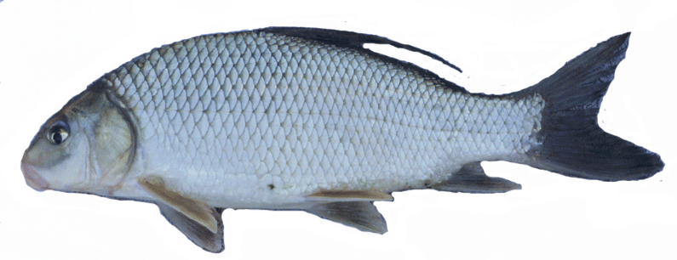
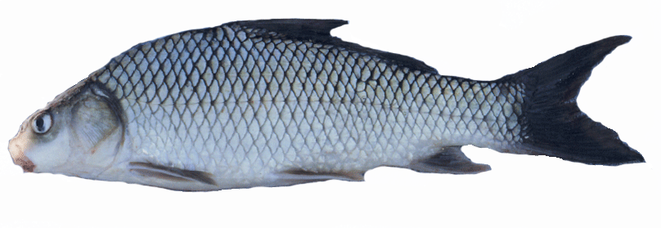
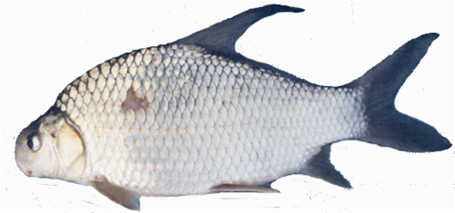
Genus Carpiodes Rafinesque
Carpsuckers
Carpiodes cyprinus
Quillback
Large head; elongate body;
elongate snout; no lip nipple.
Carpiodes carpio
River carpsucker
Small head; elongate body;
short snout; lip nipple.
Carpiodes velifer
Highfin carpsucker
Small head; short, deep
body; very short snout;
lip nipple.

Slide 5
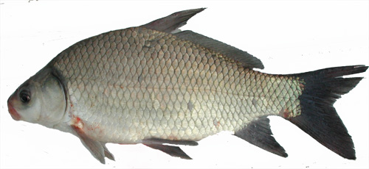


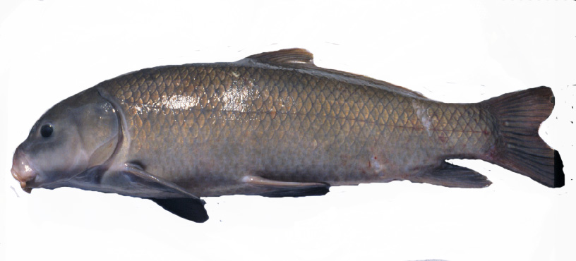
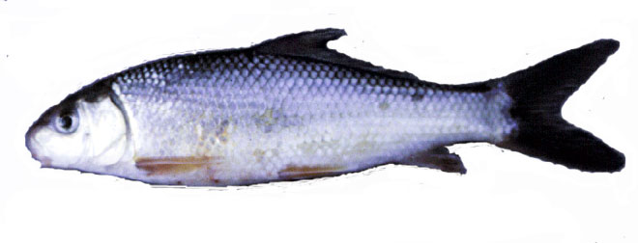
Genus Ictiobus Rafinesque, Buffalofishes
Ictiobus bubalus
(I. meridionalis)
Smallmouth buffalo (Boquin)
Small head, deep body,
subterminal mouth
Ictiobus cyprinellus
Bigmouth buffalo
Terminal mouth
Ictiobus niger
Black buffalo
Large head, shallow,
elongate body,
subterminal mouth
Ictiobus labiosus
Fleshylip matalote
Slender body, thick fleshy lips

Slide 6
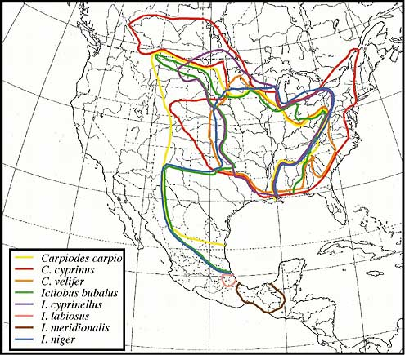
Distribution of extant ictiobines
North America east
of continental divide
Southern-most
Catostomids
Highly overlapping
ranges, especially
Mississippi River
Basin
Confusion over
taxonomic status of
populations in more
isolated parts of
distribution
Modified from Smith (1992)

Slide 7

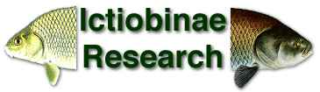
Systematic revision of Subfamily Ictiobinae
Henry L. Bart, Jr., Royal D. Suttkus, David L. Hurley
Ictiobines more diverse than presently recognized
(currently recognized species are complexes
diagnosable by suites of morphological characters)
Current taxonomic confusion stems from poor species
diagnoses; limited study of material in isolated
portions of species ranges
Modern revision: traditional morphological variation,
geometric morphometrics, molecular systematics

Slide 8
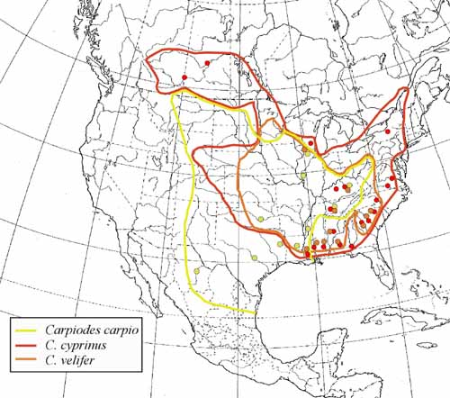
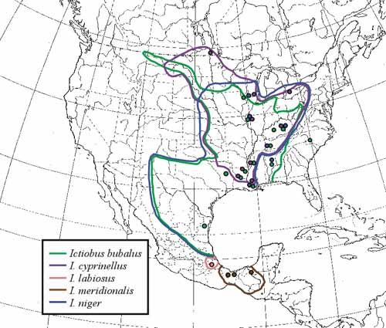
Species and population sampling
Comparing samples from throughout the geographic ranges of each of the
currently recognized species. Paying particular attention to isolated Eastern Gulf
and lower Atlantic Slope populations of Carpiodes, and Western and Southern
Gulf populations/species of Ictiobus.
Ictiobus
Carpiodes

Slide 9
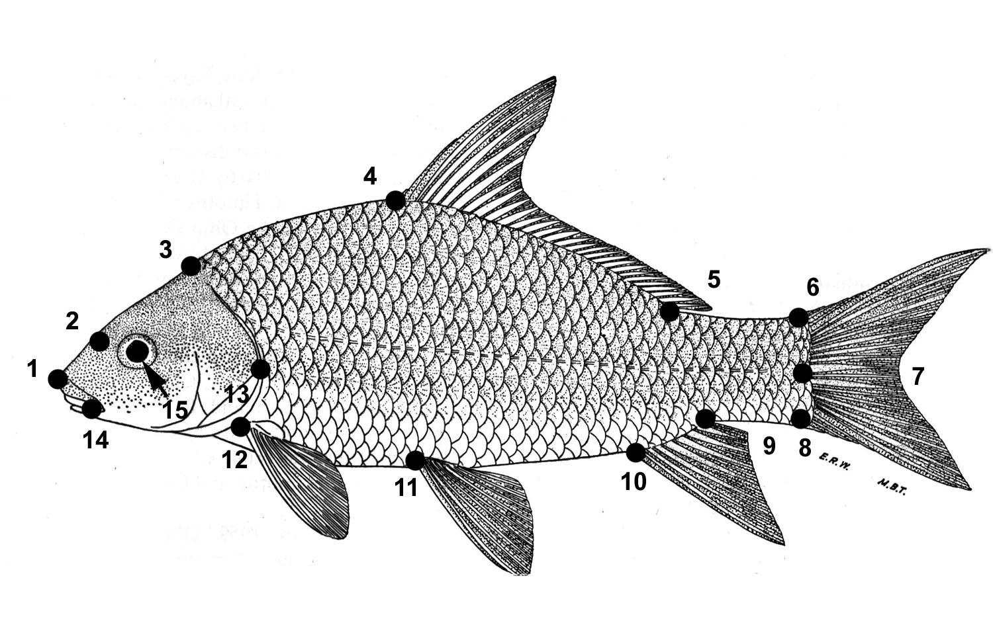
Can ictiobine species complexes be distinguished based on body shape?
We used geometric
morphometric techniques
to analyze variation in
body shape in Carpiodes
and Ictiobus.
Digitized 15 homologous
landmarks using Tpsdig
Version 1.4 (© 2004 by
F. James Rohlf).
Landmark data (x and y coordinates) analyzed with TpsRegr Version 1.28
(© 2002 by F. James Rohlf), using centroid size as the regressor variable.
Weight matrix of size-adjusted shape variables (partial warps) subjected to
Canonical Discriminant Analysis (CDA) using SAS Version 8.02 software.

Slide 10
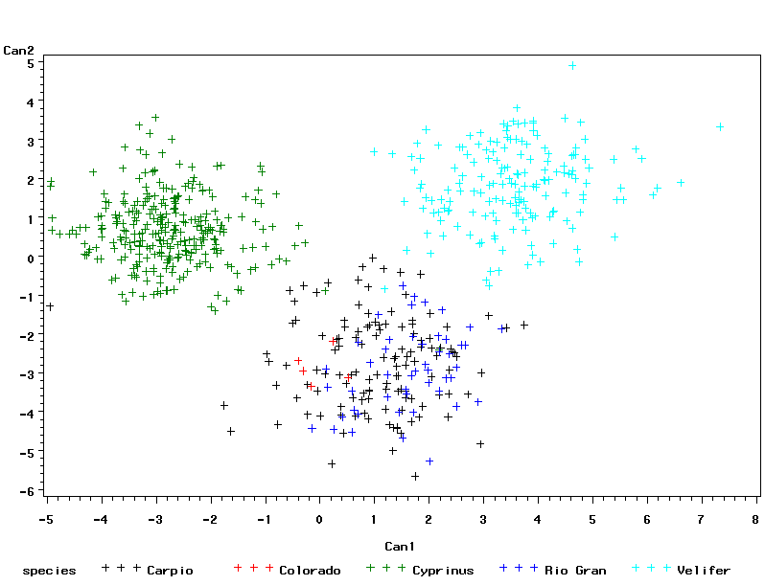
Body shape variation in Carpiodes
(landmark data)
Carpiodes cyprinus
Carpiodes velifer
Carpiodes carpio

Slide 11
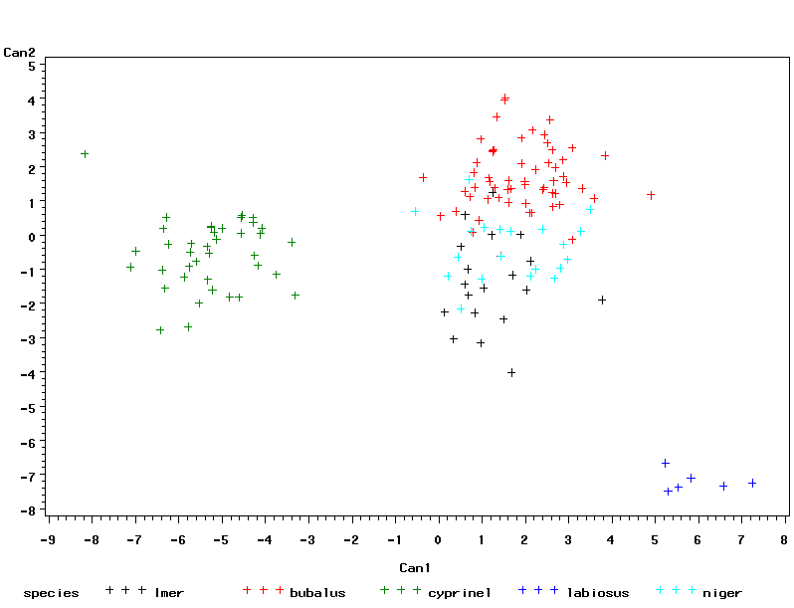
Body shape variation in Ictiobus
I. bubalus
I. meridionalis
I. niger
I. cyprinellus
I. labiosus

Slide 12
DNA sequence variation
We sequenced the complete mitochodrial cytochrome b gene (1140 bp)
for 64 specimens of Carpiodes and 93 specimens of Ictiobus to assess
degrees of genetic differentiation and phylogenetic relationships.
Sequenced and/or identified (using Single-Stranded Conformational
Polymorphism analysis) Intron B (300 bp) of one of two paralogous
copies of the nuclear growth hormone (GH) gene for 45 specimens of
Ictiobus and 23 Carpiodes representing multiple populations of all
currently recognized species.
Phylogenetic trees were generated with PAUP (vers 4.0b10, D.L.
Swofford, (Sinauer Associates) using maximum likelihood (ML)
optimality criteria. Posterior probabilities (i.e. confidence) of
nodes in ML trees estimated by Bayesian analysis using MRBAYES.

Slide 13
I. labiosus
Tamura-Nei
Distance
6%
Ictiobus
>1%
Carpiodes
1.4%
~6-7%
C. cf. cyprinus Eastern Gulf
0.001 substitutions/site

Slide 14
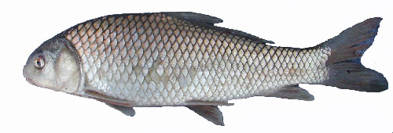
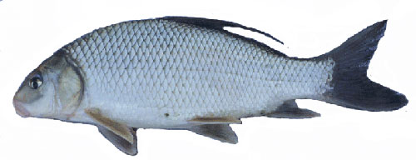
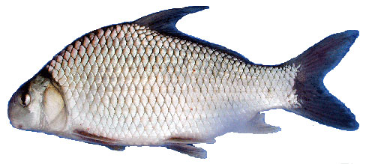
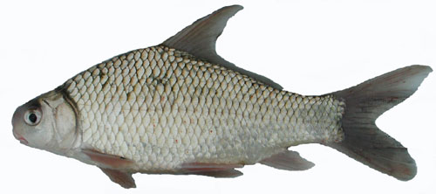
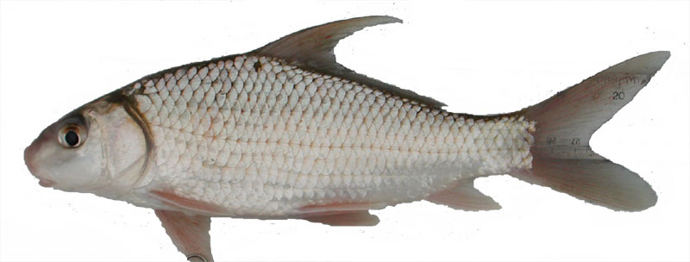
Ictiobus labiosus (outgroup)
?
Bayesian
majority-rule
consensus tree
51 cyt b haplotypes
63 Carpiodes specimens
C. carpio Rio Conchos
C. cyprinus Upper Miss
C. cyprinus Lake Michigan
C. cyprinus Ohio R.
100
C. cyprinus Hudson Bay
91
C. cyprinus Hudson Bay
100
C. cyprinus Hudson Bay
?
C. carpio Colorado R.
C. carpio Ohio R.
C. cyprinus Upper Miss.
82
C. cyprinus Lake Ontario
C. cyprinus Hudson Bay
C. cyprinus Hudson Bay
C. cyprinus Hudson Bay
64
C. carpio Upper Miss.
C. cyprinus Chesapeake Bay
100
C. cyprinus Altamaha R.
C. cyprinus Savannah River
C. cyprinus Roanoke R.
88
100
C. cyprinus Pee Dee R.
C. cyprinus Santee R.
?
C. cyprinus Pee Dee R.
C. cf velifer Santee R.
100
C. cf velifer Escambia
95
C. cf velifer Choctawhatchee R.
100
100
C. cf velifer Lake Pontchartrain
96
C. cf velifer Pearl R.
C. cf velifer Pascagoula R.
C. carpio Upper Miss.
97
99
C. carpio Lower Miss.
C. velifer Upper Miss.
C. velifer Middle Miss.
100
C. velifer Upper Miss.
C. velifer Ohio R.
100
C. velifer Upper Miss.
C. velifer Upper Miss.
100
96
C. carpio Lower Miss.
95
C. carpio Middle Miss.
100
C. carpio Ohio R.
C. carpio Red R.
100
100
C. carpio Upper Miss.
100
C. carpio Sabine R.
C. carpio Red R.
?
C. carpio Arkansas R.
C. cf velifer Savannah R.
100
C. cf cyprinus Escambia R.
100
C. cf cyprinus Pascagoula R.
100
C. cf cyprinus Pearl R.
C. cf cyprinus Amite R.
C. cf cyprinus Choctawhatchee R.
?
C. cf cyprinus Apalachicola R.

Slide 15
Carpiodes cf cyprinus Apalachicola River (outgroup)
Ictiobus labiosus
98
I. bubalus Eastern Gulf
96
I. niger Eastern Gulf
I. bubalus, I. niger Upper Miss.
I. bubalus Lower Miss.
I. meridionalis Southern Gulf
I. bubalus Lower Miss.
BOX A
I. bubalus (2) Great Lakes,
Middle Miss.; I. cyprinellus (13)
Upper, Middle, Lower Miss.,
Great Lakes; I. meridionalis (2);
I. niger (6) Great Lakes, Upper
Miss.
I. bubalus Atlantic Slope
99
I. meridionalis Southern Gulf (2)
BOX A
I. bubalus Upper Miss. (2)
I. cyprinellus Upper Miss.
I. cyprinellus Great Lakes
I. niger Great Lakes
I. ? Great Lakes
I. bubalus Eastern Gulf
96
I. bubalus Upper Miss. (2)
I. bubalus Upper, Middle Miss.
BOX B
I. bubalus (4) Eastern Gulf, Great
Lakes, Lower Miss; I. cyprinellus
(5) Great Lakes, Middle, Upper
Miss.; I. meridionalis; I. niger (4)
Great Lakes, Middle, Upper Miss.;
I. ? Great Lakes
99
I. bubalus Upper Miss.
98
I. bubalus Upper Miss.
BOX B
I. bubalus Western Gulf
100
I. bubalus Upper Miss.
81
95
I. niger Upper Miss.
I. bubalus Western Gulf
I. niger Upper Miss.
I. bubalus, I. niger Upper Miss.
I. bubalus Lower Miss.
100
I. niger Upper Miss.
Bayesian
majority-rule
consensus tree
36 cyt b haplotypes
92 Ictiobus specimens
I. niger Upper Miss.
I. ? Great Lakes
I. bubalus Upper Miss.
I. cyprinellus Hudson Bay
I. cyprinellus Hudson Bay
I. cyprinellus Lower Miss
BOX C
I. cyprinellus (3) Eastern Gulf,
Upper Miss.; I. niger (3) Middle,
Upper Miss.
BOX C
I. niger Middle Miss.
I. niger Upper Miss.

Slide 16
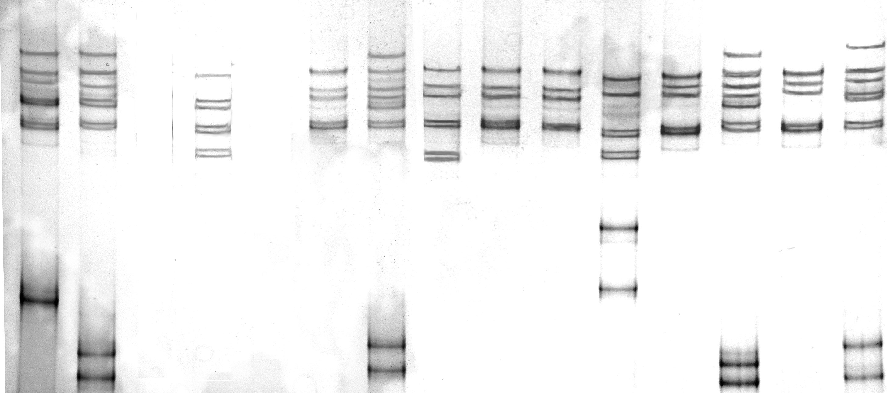
Interpreting SSCP gels
AF
AB
EF
CC
AC
CD
CC
CC
??
BB
AH
BB
AB
Ictiobus bubalus
I. cyprinellus
I. niger

Slide 17
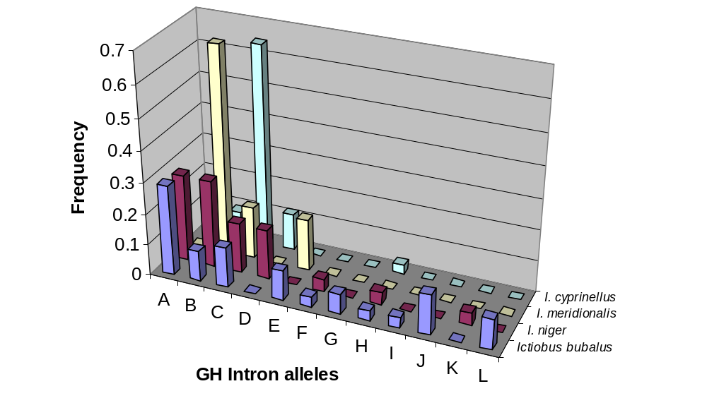
Ictiobus GH Intron allele results
Common alleles
A, B and C (others
variants of these)
A differs from other
alleles by 13 nt
B and C differ by 3 nt
AA and BB individuals
have I. bubalus, I. meridionalis
and I. niger morphotypes;
CC usually I. cyprinellus
Morphotype N Heterozygosity # alleles Shared alleles Most common allele
Ictiobus bubalus 13 0.69 10 6 A
I. niger 17 0.58 7 4 A/B
I. meridionalis 3 0.67 3 3 B
I. cyprinellus 12 0.53 4 4 C

Slide 18
Tamura-Nei distance
GH Intron data
Average divergence 1.8%
I. bubalus (Allele A) Lake Pontchartrain
I. niger (Allele A) Upper Miss
I. niger (Allele K) Upper Miss.
I. bubalus (Allele I) Upper Miss.
I. niger (Allele B) Upper Miss.
I. bubalus (Allele B) Upper Miss.
I. cyprinellus (Allele D) Upper Miss.
I. bubalus (Allele J) Upper Miss.
I. bubalus (Allele G) Upper Miss.
I. niger (Allele F) Upper Miss.
I. bubalus (Allele F) Upper Miss.
I. cyprinellus (Allele C) Upper Miss.
I. cyprinellus (Allele C) Upper Miss.
I. bubalus (Allele C) Upper Miss.
Carpiodes carpio Sabine

Slide 19
Tamura-Nei distance
GH Intron data
Average divergence = 1.4%
C. cf velifer Choctawhatchee R.
C. cf velifer Escambia R.
C. cf velifer Savannah R.
C. cf velifer Cahaba R.
C. cf velifer Broad R.
C. cf velifer Pearl R.
C. carpio Sabine R.
C. carpio Red R.
C. velifer Upper Miss. (heterozygote)
C. carpio Arkansas R. (heterozygote)
C. cyprinus Hudson Bay (heterozygote)
C. cf cyprinus Apalachicola
C. cf cyprinus Santee R. (heterozygote)
C. cyprinus Hudson Bay (heterozygote?)
C. cyprinus Hudson Bay (heterozygote)
C. cf cyprinus Altamaha (heterozygote)
C. carpio Colorado R. (heterozygote)
C. cyprinus Great Lakes (heterozygote)
C. cyprinus Upper Miss (heterozygote)
C. cf cyprinus Escambia R. (heterozygote)
C. cf cyprinus Pearl R.
C. cf cyprinus Choctawhatchee R.
C. cf cyprinus Pascagoula R.
Ictiobus cyprinellus Upper Miss. (outgroup)

Slide 20
Conclusions
Little support for recognizing Ictiobus morphotypes as species based on either cyt b or GH intron data. Carpiodes species complexes not monophyletic.
Mitochondrial and nuclear evidence of congeneric interspecific hybridization in areas of sympatry in both Carpiodes and Ictiobus.
No apparent morphological signal.
Many recent examples of mitochondrial introgression without any morphological signal. Questions surrounding the use of mitochondrial genes for phylogenetic inference, especially for closely related species.
Limited data available at present for nuclear genes; results in better
agreement with morphology in Carpiodes. Additional data may help
to resolve conflicts between morphological and molecular variation.

Slide 21
Acknowledgements
FINANCIAL ASSISTANCE: NSF DEB 0237013 to HLB,
R.D. Suttkus, and D.L.Hurley.
FIELD ASSISTANCE: Mike Taylor, Steve McIninch,
Mike Doosey, Pat Ceas, Dave Etnier, Bob Jenkins,
Steve Powers, Matt Thomas, Jason Tipton, John Lyons,
Norman Mercado, Scott Harpold, Phil Cochran, Tom Turner,
Steve Platania, Salvador Contreras, Lourdes Lozano,
Armando Contreras, Ma. Elena Garcia, Salvador Contreras,
Jr., Nelson Rios,Jason Bettinger, Patrick Nelson.
LAB ASSISTANCE: Larry Minor, Liesl Schmidt, Justin Mann.
SPECIAL THANKS: Jim Grady, University of New Orleans

