Slide 1
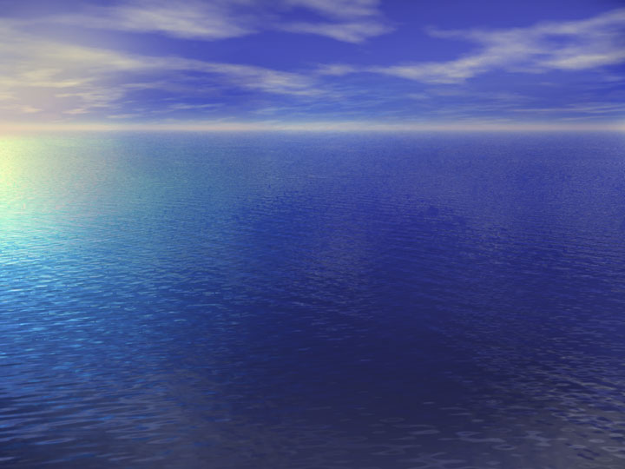
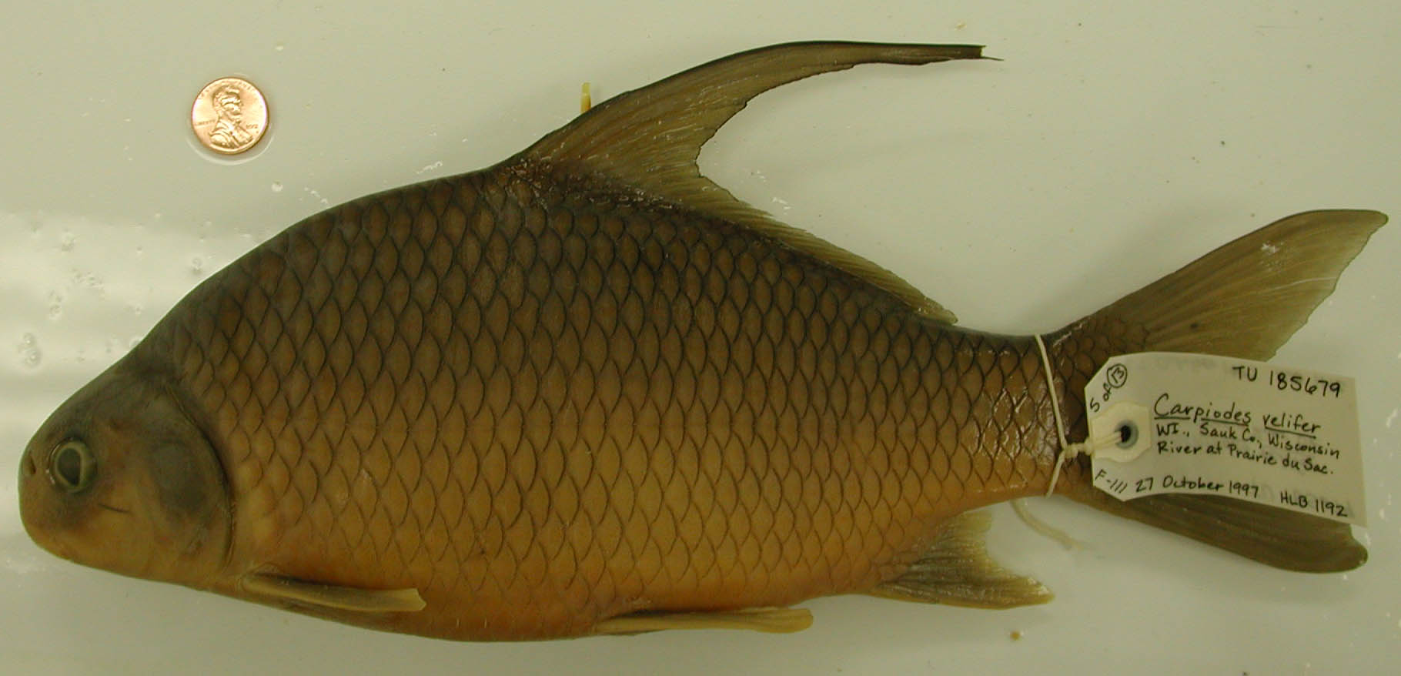
Carpiodes velifer
Determining Shape Variation Using Geometric Morphometrics
Larry D. Minor jr
Southern University A&M College of Baton Rouge

Slide 2
Geometric Morphometrics
Computer based program
Use in this study?

Slide 3
Species and Allopatric Speciation
Species
Group of actually or potentially interbreeding populations
Reproductively isolated from other such groups
Allopatric
Speciation
When one or a group of populations of a species is isolated from the rest of the species

Slide 4
What Is a Subspecies?
Recognizably different groups of populations
Hybridize and produce morphological intermediates at zones of contact
Not a distinct species
Result of allopatric speciation

Slide 5
Initial Description of Carpiodes velifer
Rafinesque (1820) described a species of suckers that occurred in the Ohio river valley, he named it the sailing sucker (Catostomus velifer)
Diameter less than one fourth of the length
Elliptical body, silvery with golden shades
Dorsal fin very broad falcated with 25 rays, the first dorsal fins being very long, anal fin trapezoidal lunulate with 10 rays
Sloping head
Rounded snout

Slide 6
Recent Descriptions of Carpiodes velifer
Also known as the Highfin Carpsucker
Deep bodied fish with a distinct nipple on its lower lip
A subterminal mouth and a blunt rounded snout
Long dorsal fin and liking to swim at the surface with its dorsal fin exposed

Slide 7
Distribution
Eastern gulf of Mexico
Lower Atlantic slope
Mississippi river basin
Ohio river valley

Slide 8
Hypothesis
I hypothesize that unrecognized diversity exists in the species Carpiodes velifer.
My alternative hypothesis is that populations of C. Velifer are not differentiated into distinct species.

Slide 9
Why Is This Study Relevant?
It will determine shape variation which could lead to taxonomic naming of different species
Previous studies using geometric morphometrics have concluded with new species names

Slide 10
Definitions
Landmarks
Partial warps
Partial warp scores

Slide 11
Procedure
Samples of C. velifer to be studied will be collected from its range
Digital pictures
15 landmarks
Comparison of shape variation

Slide 12
Sample Populations
East gulf
Lower Atlantic
Upper Mississippi

Slide 13
Methods of Analyzing Data
Canonical Variates analysis
Analysis of partial warp scores

Slide 14
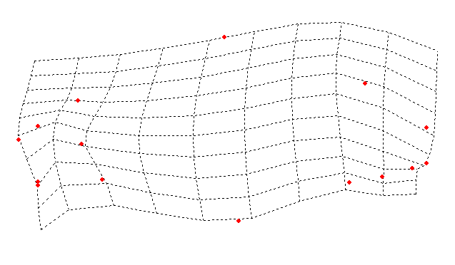
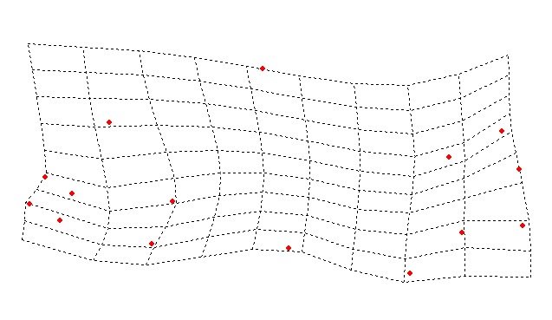
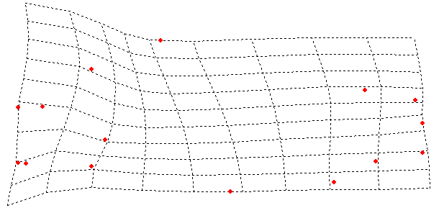
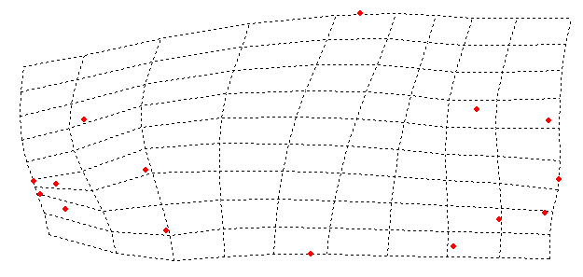
East Gulf Analysis
CV2
4
3
Pearl
+ Can2
Escambia/Choctawatchee
2
1
0
-1
- Can 2
-2
-3
Mobile
-4
-3
-2
-1
0
1
2
3
CV 1
+ Can 1
- Can 1
Notes:
East Gulf Analysis

Slide 15
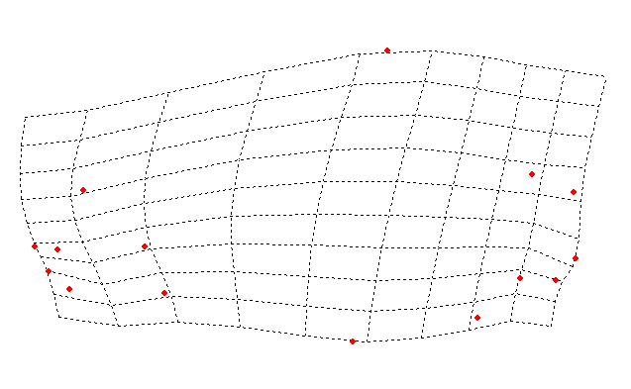
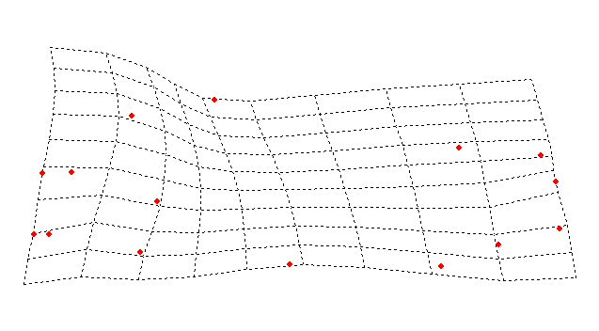
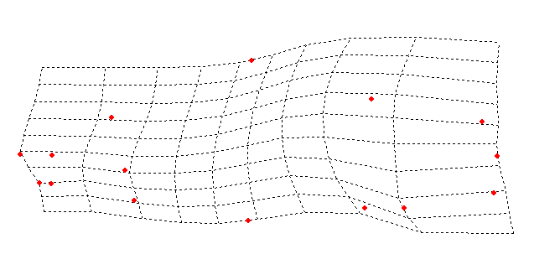
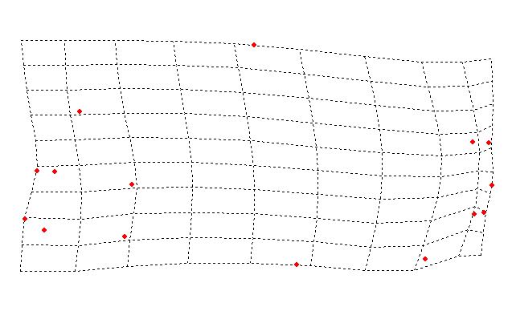
All Populations Analysis
+ Can 2
5
Lower Atlantic
4
East Gulf
3
CV 2
2
1
- Can 2
0
-1
-2
Upper Mississippi
-3
-4
-3
-2
-1
0
1
2
3
4
5
CV1
- Can 1
+ Can 1

Slide 16
Discrepancies
Size difference
Older specimens
Obstructed view

Slide 17
What Did We Gather From Partial Warps Analysis?
Escambia-Choctawatchee differed from other east gulf groups
Lower Atlantic varied from all groups
Upper Mississippi varied from all groups

Slide 18
What Do the Results Mean?
Canonical axis 1 is responsible for highest percentage of difference
Eastern Gulf and Lower Atlantic/Upper Mississippi populations show greatest morphological differences
Less support for distinctive Lower Atlantic
slope form (along CV 2)

Slide 19
Conclusions
Significant shape variation exists within the C. velifer species complex
Shape differences greatest between Eastern Gulf and Upper Mississippi/Lower Atlantic slope populations…
Differences between Upper Mississippi and
lower Atlantic Slope also significant, but involve less of overall variation.

Slide 20
Conclusions continued
Results suggest that there is enough difference in shape to recognize a distinct species on the Eastern Gulf Slope
The Lower Atlantic Slope form may also prove to be different pending further testing
Future studies of this complex will include genetic variation and other aspects of morphology

Slide 21
Acknowledgements
Thanks to the LAMP program and staff. Personal thanks to Ms. Jannie Price, Dr. Henry Bart jr., Dr. Calvin Mackie, and Margot Brown. Also personal thanks to all the graduate students in the lab, Rebecca Blanton, Mollie Cashner, Mark Clements, Michael Doosey, Myra Kurns and Justin Mann. Thanks to my mentor at Southern University Dr. Twintilla Tate. Thanks to my family for supporting my endeavors. And thanks to all other students in the program who made this an enjoyable experience.

