Slide 1
Funding Fish Biodiversity Research in Africa
Hank Bart
Tulane Museum of Natural History

Slide 2
African Biodiversity Organizations
Participants from organizations committed to supporting biodiversity research in Africa will be invited to participate in the panel discussion on Funding Fish Biodiversity Research in Africa
JRS Biodiversity Foundation (http://www.jrsbdf.org/v2/home.asp)
African Biodiversity Information Centre (ABIC) of the Royal Museum of Central Africa (RMCA) (http://www.africamuseum.be/research/zoology/research/zoology/ABIC)
BioNET International (http://www.bionet-intl.org/opencms/opencms/index1.jsp)
Global Biodiversity Information Facility (GBIF, http://www.gbif.org/).

Slide 3
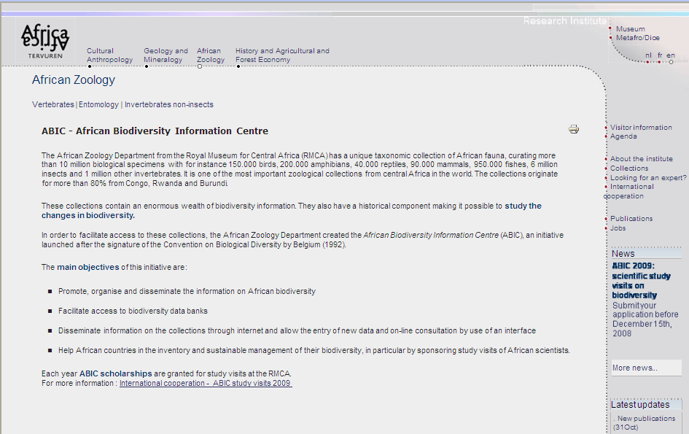
African Biodiversity Information Center

Slide 4
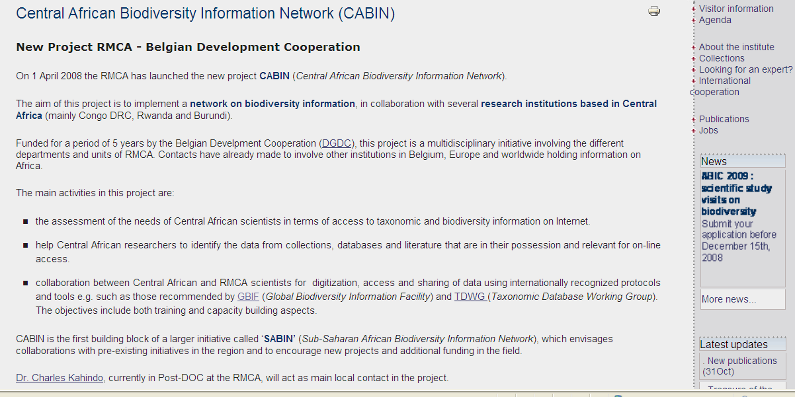
Central African Biodiversity Information Network

Slide 5
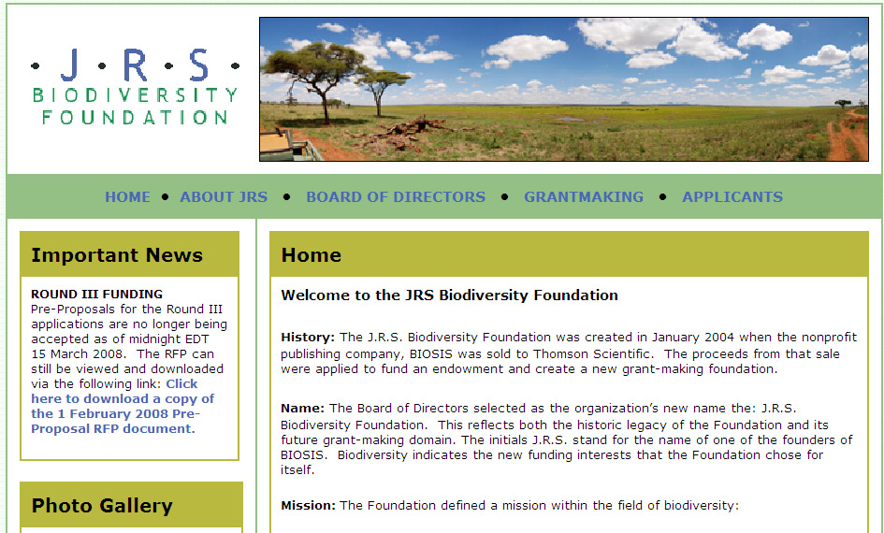
JRS Biodiversity Foundation

Slide 6
J.R.S. Biodiversity Foundation
Mission: The Foundation defined a mission within the field of biodiversity:
To enhance knowledge and promote the understanding of biological diversity for the benefit and sustainability of life on earth.
Scope: To further advance the Foundation’s mission a scope was developed as:
Interdisciplinary activities primarily carried out via collaborations in developing countries and economies in transition. The Foundation Board of Trustees has expressed a particular interest in focusing its grant-making in Africa.

Slide 7
Previous Grants
African Conservation Fund (ACF)
Ashoka Trust for Research in Ecology and the Environment (ATREE)
Asociacion Instituto Nacional de Biodiversidad (INBio)
Botanical Gardens Conservation International US, Inc.(BGCI)
Centro de Referência em Informação Ambiental (CRIA)
Field Museum of Natural History (FMNH) Inter-American Biodiversity Information Network (IABIN)
Kenya Marine & Fisheries Research Institute (KMFRI) Planning Grant
Missouri Botanical Garden (MBG)
Noguchi Memorial Institute for Medical Research (NMIMR)
Smithsonian Institution (SI)
University of Cape Town (UCT)
Wildlife Conservation Network – Save The Elephants (WCN-STE)
World Health Organization – African Programme for Onchocerciasis Control (WHO-APOC)

Slide 8
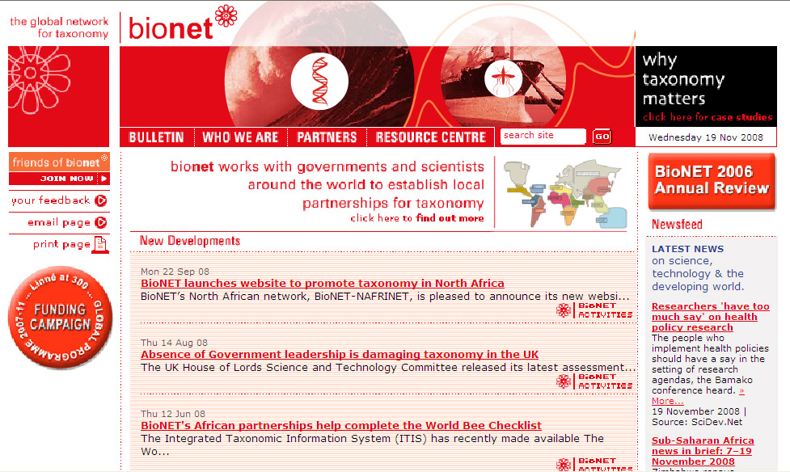
Bionet (www.bionet_international.org)

Slide 9
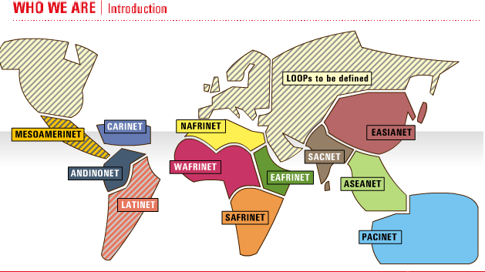
Bionet Organization

Slide 10

Bionet mission & vision

Slide 11
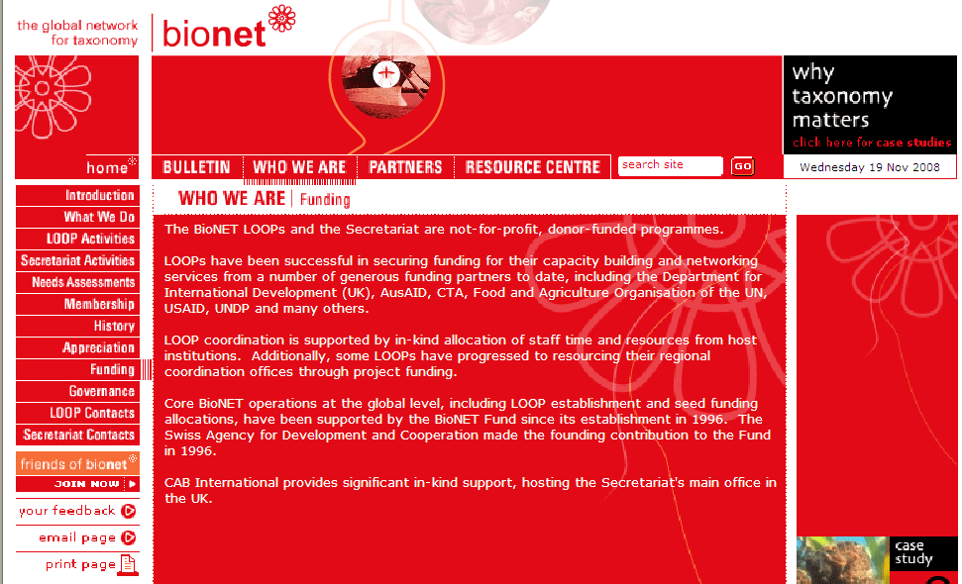
Bionet funding

Slide 12
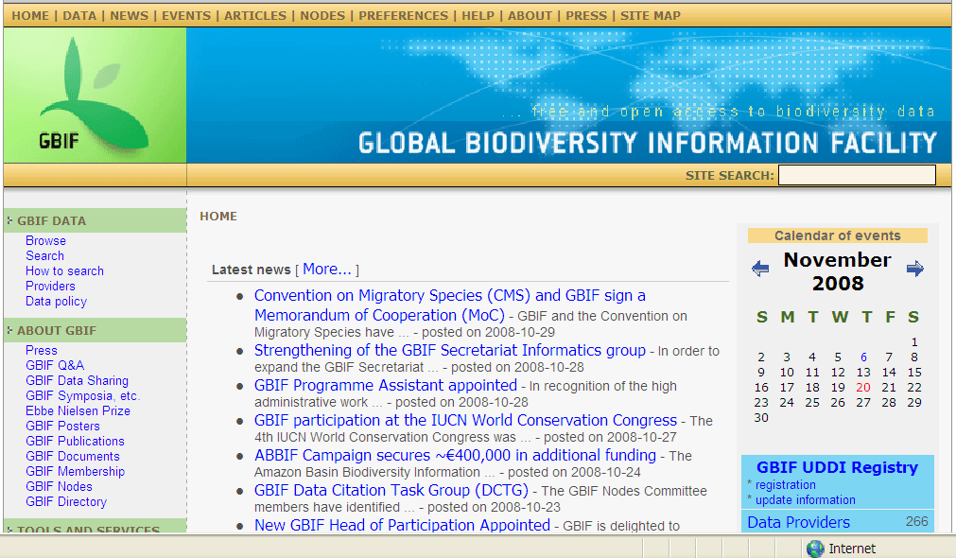
Global Biodiversity Information Network

Slide 13
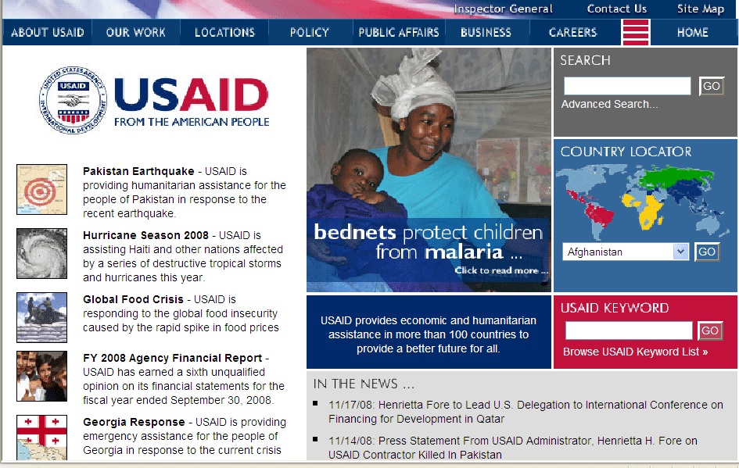
US Agency for International Development

Slide 14
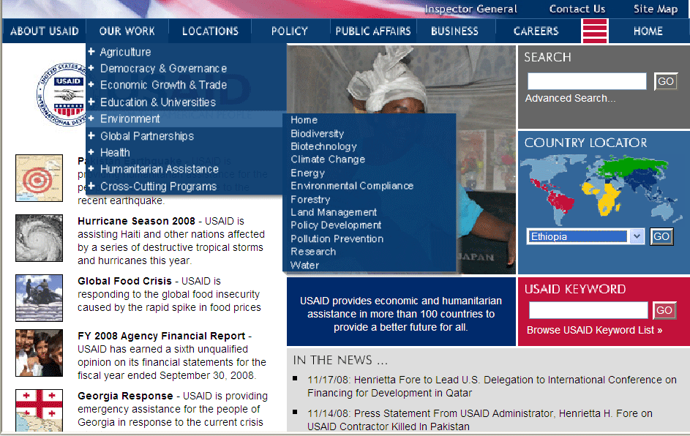
US Agency for International Development - Environment

Slide 15
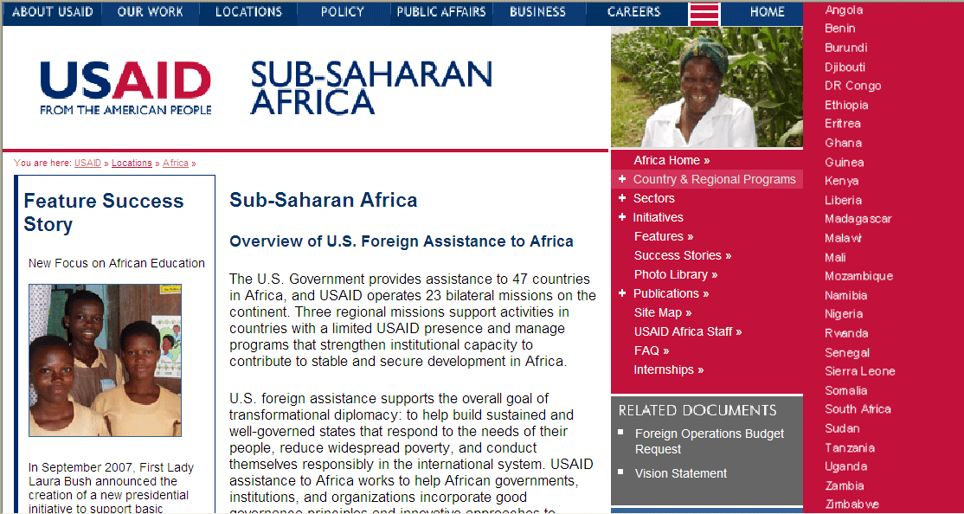
US Agency for International Development - Africa

Slide 16
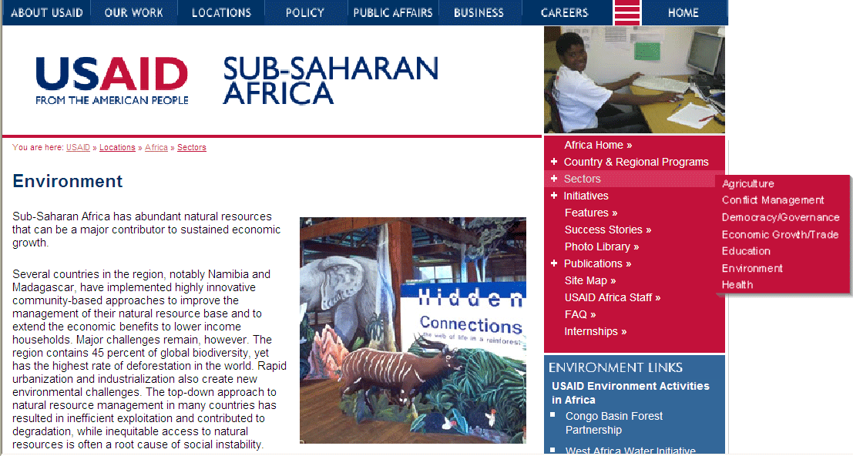
US Agency for International Development - Environment

Slide 17
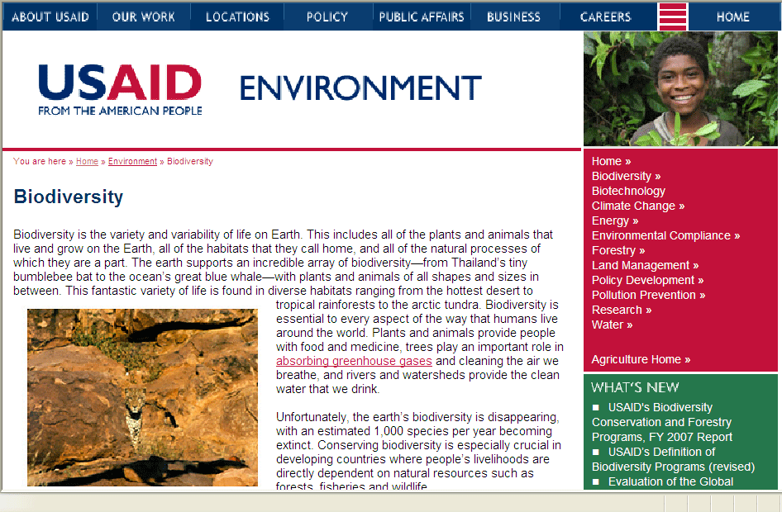
US Agency for International Development - Biodiversity

Slide 18
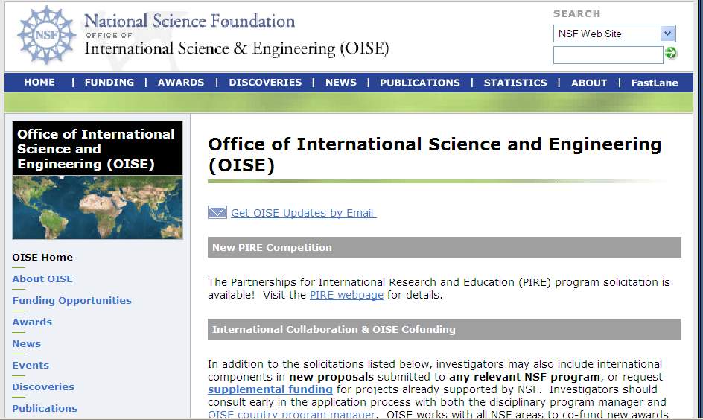
US National Science Foundation - OISE

Slide 19
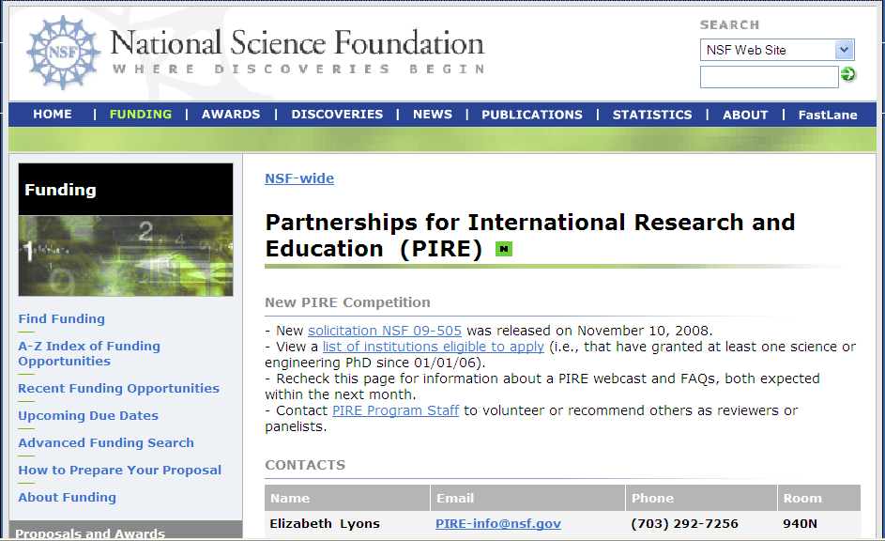
US National Science Foundation - PIRE

Slide 20
PIRE Synopsis
The Partnerships for International Research and Education (PIRE) program seeks to catalyze a higher level of international engagement in the U.S. science and engineering community by supporting innovative, international research and education collaborations. The program will enable U.S. scientists and engineers to establish collaborative relationships with international colleagues in order to advance new knowledge and discoveries at the frontiers of science and engineering and to promote the development of a diverse, globally-engaged U.S. scientific and engineering workforce.
The PIRE program will support bold, forward-looking research whose successful outcome results from all partners—U.S. and foreign—providing unique contributions to the research endeavor. It is also intended to facilitate greater student preparation for and participation in international research collaboration, and to contribute to the development of a diverse, globally-engaged U.S. science and engineering workforce.

