Slide 1
Biomaterials collections and curation in Africa
Gavin Gouws & Unathi Lwana
South African Institute for Aquatic Biodiversity, Grahamstown, South Africa
g.gouws@ru.ac.za u.lwana@ru.ac.za

Slide 2
The SAIAB Biomaterial Bank
Ethical obligation to maximize research opportunities & benefits
  Field-work is costly (public funds)
  Large numbers of animals are sacrificed
  Food and livelihoods
Recognition of importance of molecular systematics
Establishment of Molecular Laboratory
Critical to SAIAB’s inhouse research and national mandate
FISH-BOL activities and commitments
Barcoding a driving force behind establishment
Investment:
Infrastructure (designated within Collections Facility)
Equipment and materials/consumables
Human Resources (Biomaterials Officer)

Slide 3
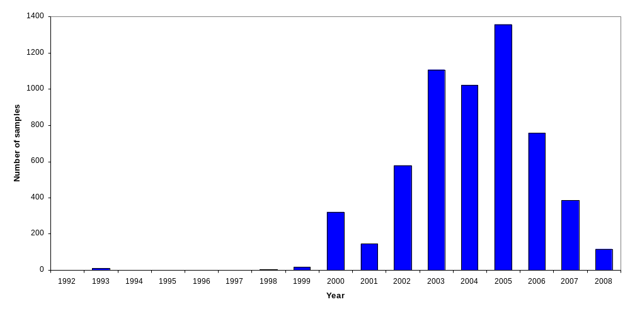
The SAIAB Biomaterials Bank development
Collection of tissue for molecular research begun in 1992
Rapid recent growth
Development of Biomaterials Collection Facility: 2006-2007
Establishment phase: 2007-2009

Slide 4
The collection
Estimate of samples collected yet to enter system = 14 000
African freshwater exploration
Western Indian Ocean (ACEP, ASCLME), sub-Antarctic
Collaborations
Accessioned samples | 4 144
Species | 300 +
Genera | 176
Families | 86
Orders | 24

Slide 5
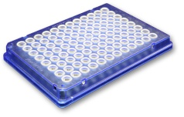
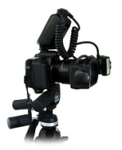
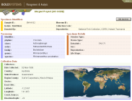

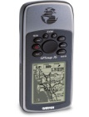
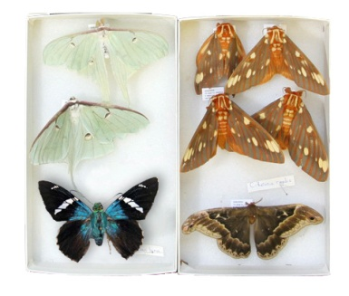
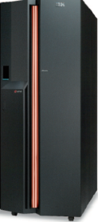
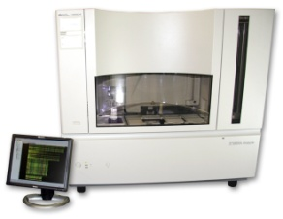

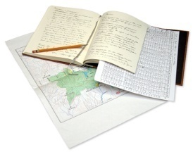
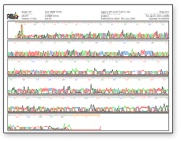
Where does biomaterials banking fit in?
CENTRALLY important
Quality tissue cornerstone of barcoding initiative
  Accuracy
  Cost-effectiveness and time constraints
  Longevity
Collection and
Databasing
Curation and
Identification
Sequencing
Mirrored
Databases
Data Analysis
and Access
(Diagram: Les Christidis)

Slide 6
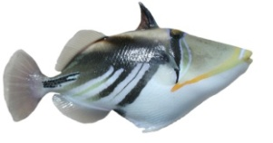
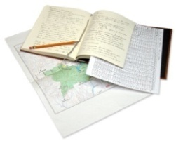

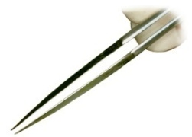

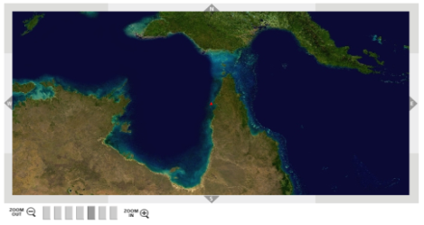
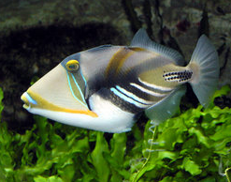
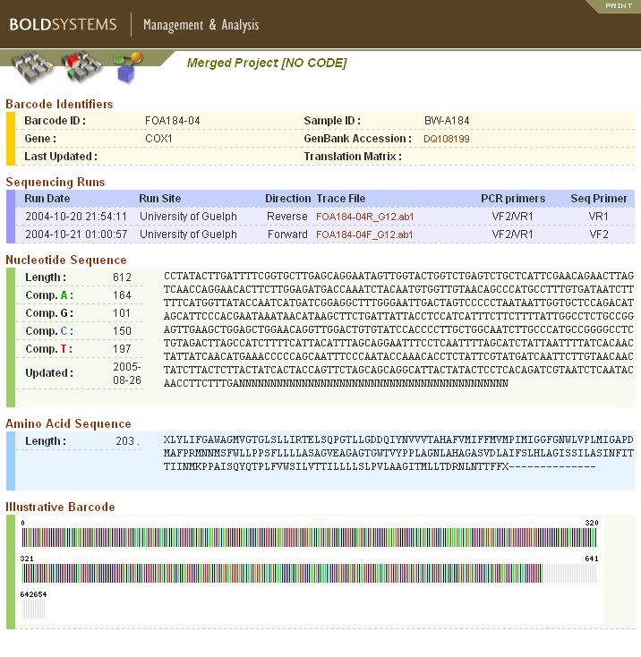
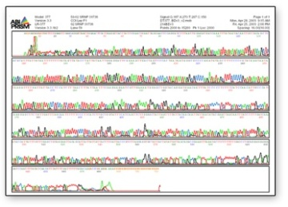
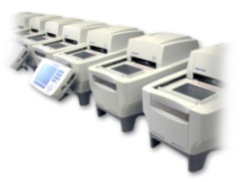

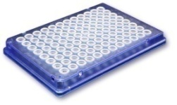
Importance of biomaterials
Specimen
Collection Data
Web-Accessible Data and
DNA Barcode
Tissue Sample
Photograph
Extract
DNA
PCR Amplify
Sequence
(Diagram: Robert Hanner)

Slide 7
Broader importance
Adds value to collections (reference and voucher)
Unlocks research potential
“Currency” in establishing research projects and collaborations
Capitalise on research opportunities
Technical aspects are a research field in their own right

Slide 8
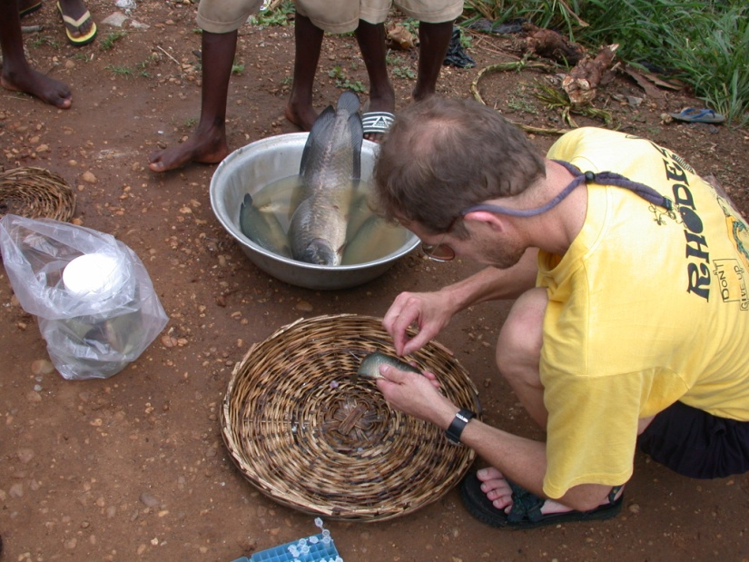
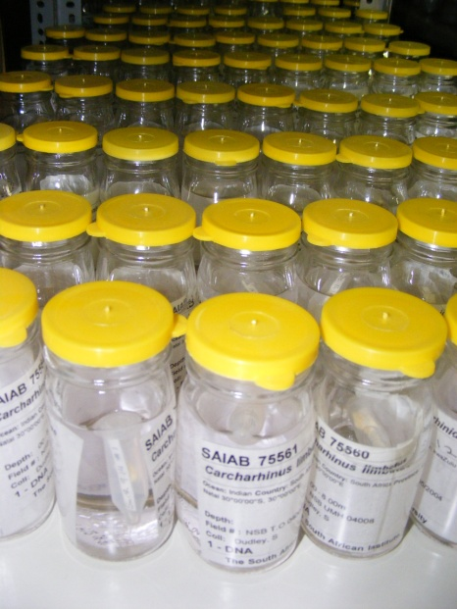
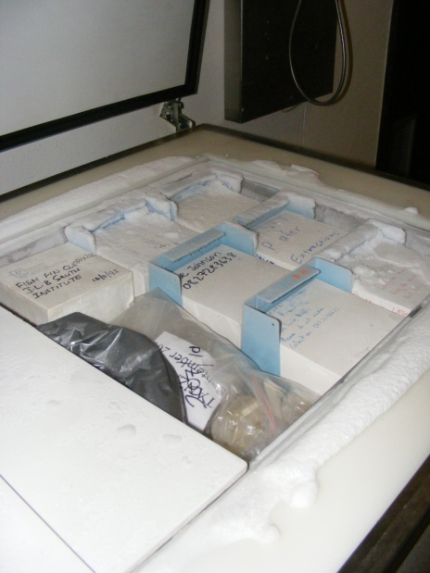
Systems and Processes
Geared to maintain CRITICAL linkages between voucher, image, collection data and DNA-sample at ALL times
  Sampling process
  Storage
  Data capture and data management
Linkages through to barcoding and BOLD, biodiversity information dissemination
SOP, regardless of whether barcoded or specific project

Slide 9
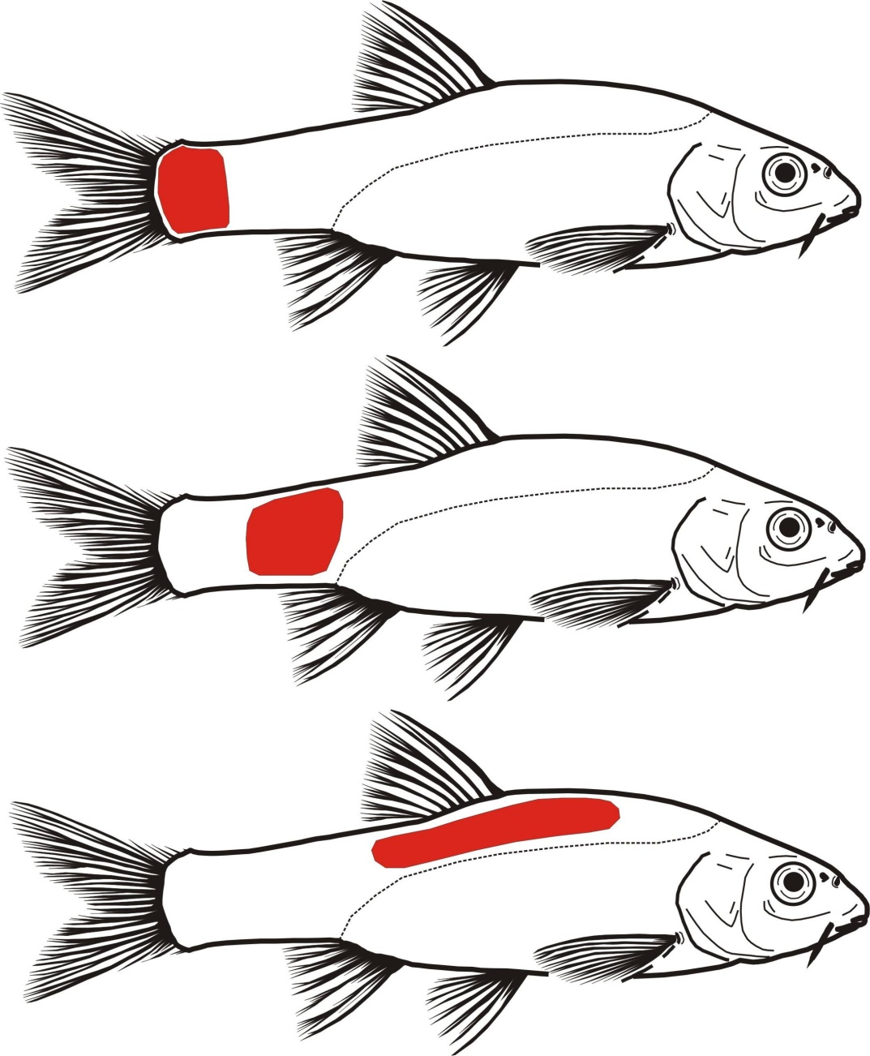
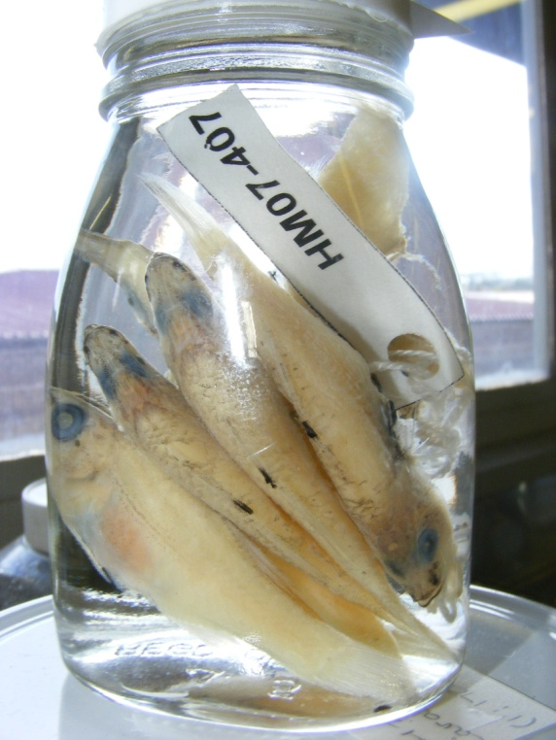
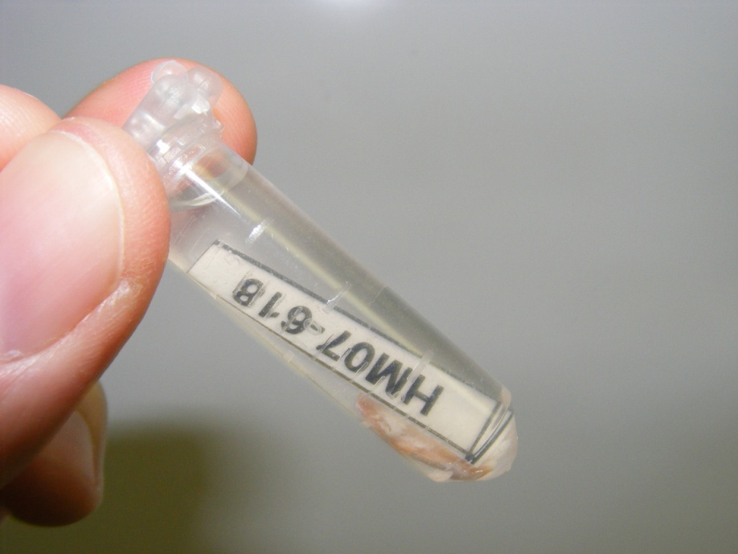
DNA sampling & specimen identification
Station #: PCH07-10
DNA #: GG07-A011



Slide 10
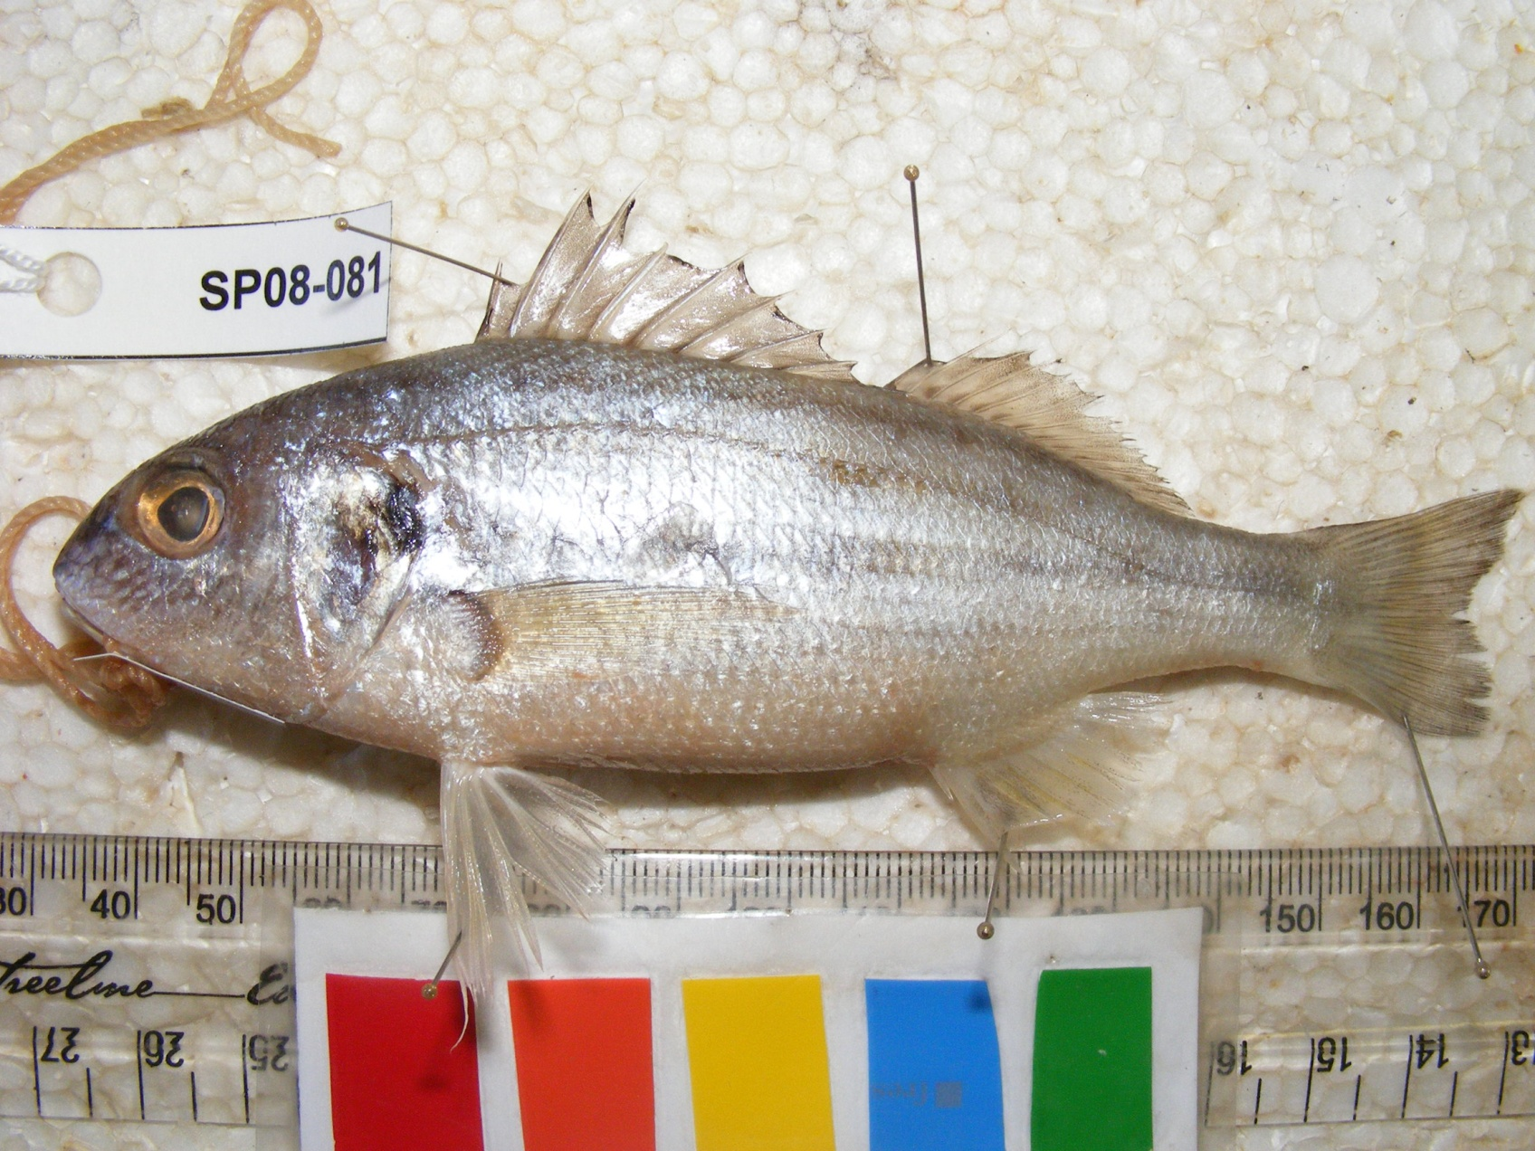
Images

Slide 11
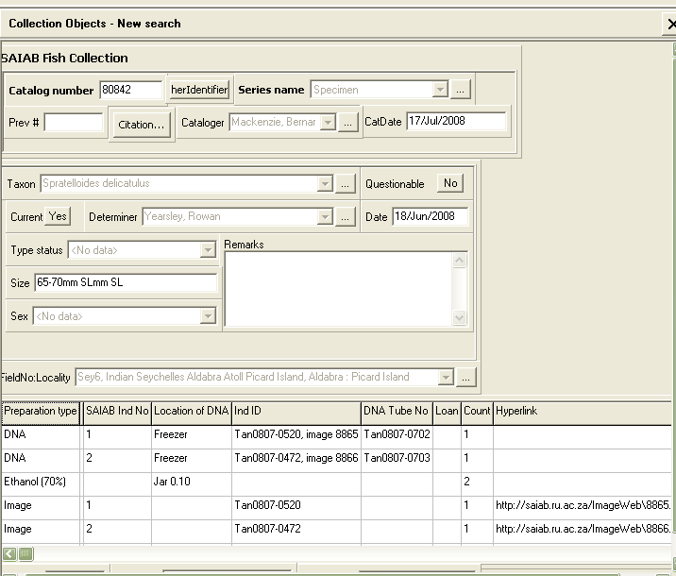
Data Management

Slide 12



South African landscape
Varied applications
BioBank SA
  Co-ordinating body
  Championing the cause
  Repository
South African National Biodiversity Institute (SANBI)
  Botanical, seed bank (Kew Gardens, Darwin Initiative)
  Herpetological
National Zoological Gardens
  Conservation genetics
  Animal breeding, reproduction
South African Institute for Aquatic Biodiversity
  Varied in-house research
  Representative sampling
  FISH-BOL
  Potential to incorporate broader aquatic biodiversity

Slide 13




(continued)
Agricultural Research Council (ARC)
University of Johannesburg
  Trees/vegetation of the Kruger National Park
NRF Centre for Invasion Biology (CIB)
  Barcoding of invasive species (Marion Island)
Forestry and Agriculture Biotechnology Institute (FABI)
  Mycology, plant pathogens
Expertise and established network
“Ad hoc” collections
  Universities, museums & research institutes
  No long-term biomaterials collection-building
  Curation, data quality, linkage and vouchering

Slide 14
Beyond South Africa?
African activities and facilities???
Southern Africa, East Africa, Central Africa
Isolation? Active promotion of activities, facilities
“Nature of the business”
  In-house
  “Near-sighted”, short-term
Impediments
Molecular research incentives
Cost infrastructure/equipment, curation, human capital
Risk management, contingencies
Expertise

Slide 15
The way forward?
Regional centres, nodal networks?
Ownership, access, benefits
Managing collaborations, responsibilities and conflicts of interest
Funding? National? Industry? Biodiversity initiatives?
Reality is dependency on developed nations
Trust; legislation indicative of distrust
Access to material for African research to address African problems
Knowledge repatriation
Interaction: FISH-BOL, CToL, ACSI
Network (share ideas & information, strategize, seize opportunities)
High-level engagement

