Slide 1


Overview of the status of fish biodiversity research and training in Benin
Philippe LALÈYÈ
Laboratory of Hydrobiology and Aquaculture
University of Abomey-Calavi / Bénin
laleye@bj.refer.org / laleyeph@yahoo.fr
01 BP 526 Cotonou-Bénin

Slide 2
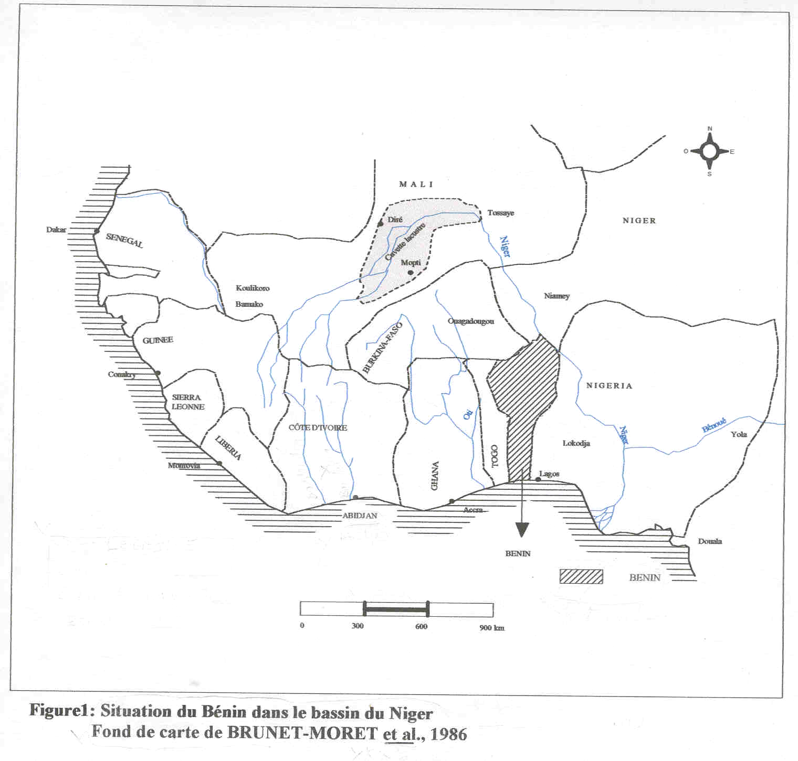

Slide 3
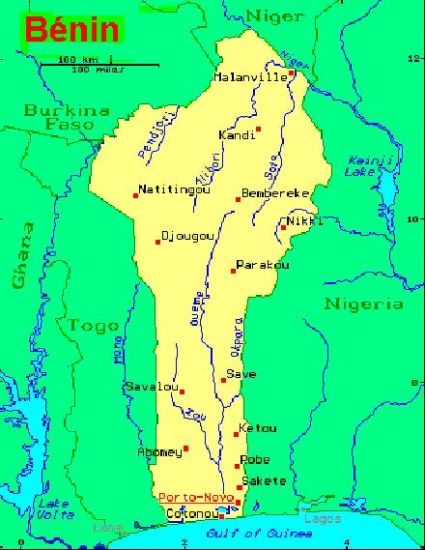
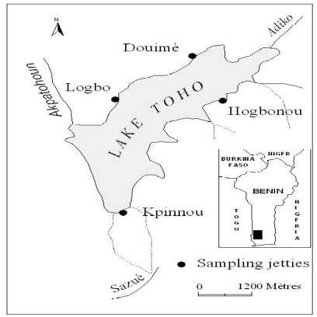
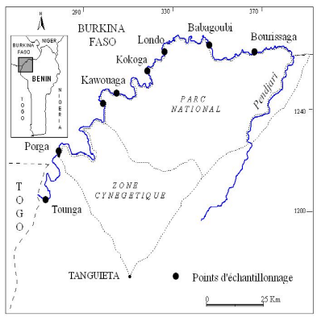
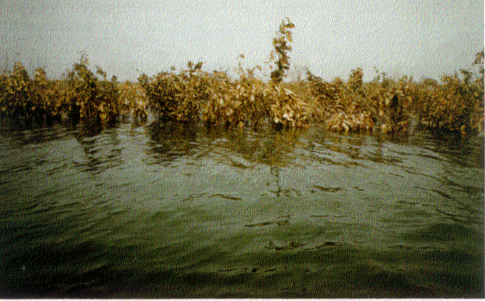
STUDY AREAS AND PROGRAMMES
Biodiversity and Aquaculture of catfishes in Benin (UAC-ULg-MRAC): 1998-2003
- Ecology and exploitation of freshwater fish species of Lake Toho in Bénin
Ecological functioning of Lake Nokoue (UAC-ENSAT): 2000-2003
Impact of the Acadja system on Chrysichthys population dynamic of the lake Nokoué and the Porto-Novo lagoon in Benin: 2002-2006
- Biodiversity and exploitation of the fishes and crustaceans of the Pendjari River in Benin. (Abomey-Calavi Univ.-Benin / Univ. Würzburg-Germany), BIOTA WEST (2005-2008)
- Ecology, Exploitation and farming-Potential of Freshwater Oysters in the Pendjari River, Benin, (BIOTA WEST 2007-2010)
N
O
u
é
m
S
é
ô
S
Ö
-
A
V
A
#
P
O
R
T
O
-
N
O
V
#
V
#
O
ê
k
A
i
#
B
O
M
E
Y
#
e
P
o
r
t
o
N
d
-
n
e
C
u
A
L
A
V
I
o
G
g
v
a
n
v
i
#
é
L
a
o
L
a
c
N
o
k
o
u
é
Z
o
g
G
#
#
b
o
O
D
O
M
E
Y
0
2
0
k
C
m
O
T
O
N
O
#
U
O
C
E
A
N
A
T
L
A
N
T
I
Q
U
E
- Dynamic and exploitation of cichlids in the lagoons of Bénin: 2004-2006
MUGIL Project: Main Uses of the Grey mullet as Indicator of Littoral environmental changes. INCO-CT-2006-026180 Programme (J. Panfili, IRD-France) (2006-2009)
Composition, structure and determinism of phytoplancton of Lake Nokoue and Porto-Novo lagoon in Benin
Studies on the invertabrates communities in the Beninese lagoons: abundance, demography and place in the trophic chain.

Slide 4
Fishes from the Niger River at Malanville, Benin (BIOTA WEST 2007-2010)

Slide 5
CAPACITY BULDING
3 PhD already finished (2005 and 2006)
6 PhD-Students
3 Master-Students
Their areas of research are mainly: Biology and Ecology of fish and fisheries

Slide 6
PUBLICATIONS
Lalèyè, A. P. 1999. Acadja fisheries enhancement systems in Benin. Their productivity and Environmental impacts. In « Biodiversity and sustainable use of fish in the coastal zone ». ABBAN E.K., V.C.M.CASAL; FALK M.Th. & PULLIN S.V.R. (Eds Sc.). Ed. ICLARM. pp. 51-52. Philippines
Lalèyè, P. 2000. Acadja fisheries enhancement systems in Benin: Their productivity and environmental impacts. ICLARM - The World Fish Center: Penang (Malaysia); ICLARM Conf. Proc; vol. 63, pp. 51-52; 2000; (Biodiversity and sustainable use of fish in the coastal zone) ISSN: 0115-4435 ISBN: 971-802-009-8. Philippines
Lalèyè P., C. Niyonkuru, J. Moreau & G. Teugels. 2003. Spatial and seasonal distribution of the ichthyofauna of Lake Nokoué, Bénin, west Africa; African Journal of Aquatic Science. 28(2): 151-161. South Africa
Baras E. & P. Lalèyè. 2003. Ecology and Behaviour of Catfishes. In G. Arratia, B.G. Kapoor, M. Chardon & R. Diogo (Eds.). Catfishes. Science Publishers, Inc. Vol 2. pp 525-579. ISBN 1-57808-283-8 USA
Lalèyè P., A. Chikou, J.C. Philippart, G. Teugels & P. Vandewalle. 2004. Etude de la diversité ichtyologique du bassin du fleuve Ouémé au Bénin (Afrique de l’Ouest). Cybium, 28(4) : 329-339. France
Lalèyè P., 2003. Fonctionnement et exploitation du lac Nokoué et de la lagune de Porto-Novo. Océanique 46-47. pp16-19. Bénin
Lalèyè P. & J. Moreau. 2004. Resources and constraints of west African coastal waters for fish production. In Abban, E.K., C.M.V. Casal, P. Dugan and T.M. Falk (eds). Biodiversity, Management and Utilization of West African Fishes. WorldFish Center Conference Proceedings, pp. 28-30. Contribution no 1718. ISBN 983-2346-32-0. Philippines

Slide 7
Lalèyè, P.; Salako, O.; Chikou A. ; Philippart J.C. 2005. Artisanal gill-net fishery catches of the catfish, Schilbe intermedius (Teleostei: Schilbeidae) in two ributaries of Ouémé river, Bénin, West Africa. African Journal of Aquatic Science. 30(2): 163-166. South Africa
Yehouenou Pazou E., Lalèyè P., Ahissou H. Bokou M. Van Straalen N.M. & Akpona S. 2005. Pesticide pollution of African wetlands, a genuine threat to environmental and population health : the case of the ouémé river basin, Bénin
Fadama. Bulletin d’Information du Bureau de Wetlands International en Afrique. No 7: 13-14. ISSN 0851-3953. Sénégal
Yehouenou A. Pazou E., Lalèyè P., BOKO M., van Gestel C.A.M., Ahissou Y, Akpona S., van Hattum B., Swart K. & van Straalen N.M. 2006. Contamination of fish by organochlorine pesticide residues in the Ouémé River catchment in the Republic of Bénin. Environment International 32: 594-599.
Yehouenou A. Pazou E., Boko M., van Gestel C.A.M., Ahissou Y., Lalèyè P., Akpona S., van Hattum B., Swart K. & van Straalen N.M. 2006. Organochlorine and organophosphorus pesticide residues in the Ouémé River catchment in the Republic of Bénin. Environment International 32: 616-623.
Villanueva M.C., Lalèyè P., Albaret J.J., Laë R., Tito de Morais L., Moreau J. 2006. Comparative analysis of trophic structure and interactions of two tropical lagoons. Ecol. Modell. 197 : 461-477.
Gnohossou P. M. 2006. La faune benthique d’une lagune ouest africaine (le lac Nokoué au Bénin), diversité, abondance, variations temporelles et spatiales, place dans la chaine trophique. Thèse de doctorat. ENSA-Toulouse
Lalèyè P. 2006. Length-weight and length-length relationships of fishes from the Ouémé River in Bénin (West Africa). J. Appl. Ichthyol. 22 : 330-333. Germany
Lalèyè P., Chikou A., Gnohossou P., Vandewalle P., Philippart J.C. & Teugels G. 2006. Studies on the biology of two species of catfish Synodontis schall and Synodontis nigrita (Mochokidae) from the Oueme River, Bénin. Belg. Journ. of Zool. 136 : 193-201. Belgium

Slide 8
Moritz T., Lalèyè P., Koba G. & Linsenmair E.K. 2006. Annotated list of fishes from the River Niger at Malanville, Benin, with notes on the local fisheries. Verbandlungen der Gesellschaft für Ichthyologie Band 5, 95-110. Germany
Lalèyè P., Akele D. & Philippart J.C. 2007. La pêche traditionnelle dans les plaines inondables du fleuve Ouémé au Bénin. Cahiers d’Ethologie, 22 (22) : 25-38. Belgium
Montchowui E., Lalèyè P., Philippart J.C. & Poncin P. 2007. Biologie de la reproduction de Labeo parvus Boulenger, 1902 (Cypriniformes: Cyprinidae) dans le bassin du fleuve de l’Ouémé au Bénin (Afrique de l’Ouest). Cahiers d’Ethologie, 22 (22) : 61-80. Belgium
Montchowui E, Niyonkuru C., Ahouansou Montcho S., Chikou A., Lalèyè P. 2007. L’ichtyofaune de la rivière Hlan au Bénin (Afrique de l’Ouest). Cybium, 31(2) : 173-176. France
Chikou A., Lalèyè P., Philippart J.-C., Vandewalle P. 2007. Quelques aspects de la biologie de reproduction chez Clarias ebriensis (Siluriformes, Clariidae) dans le delta de l’Ouémé au Bénin (Afrique de l’Ouest). Cybium, 31(2) : 217-225. France
Déhotin U.A., Lalèyè A. P., Dauta A. & Moreau J. 2007. Facteurs écologiques et diversité piscicole d’une lagune ouest-africaine : le lac Nokoué au Bénin. J. Afrotrop. Zool. Special issue : 49-55. Belgium
Gnohossou P., Lalèyè A. P., Atachi P., Dauta C. & Moreau J. 2007. Données préliminaires sur l’influence de la salinité sur la répartition spatiale de la faune benthique du lac Nokoué au Bénin. J. Afrotrop. Zool. Special issue : 97-106. Belgium
Lalèyè A. P., Villanueva M.C., Chikou A., d’Alméida A., Monteil C. & Moreau J. 2007. Diel feeding periodicity, daily ration and relative food consumption of selected freshwater fish species in the Ouémé basin, Benin, West Africa. J. Afrotrop. Zool. Special issue: 113-122. Belgium
Lalèyè A. P., Villanueva M.C , Mensah Entsua M. & Moreau J. 2007. A review of the aquatic living resources in Gulf of Guinea lagoons, with particular emphasis on fisheries management issues. J. Afrotrop. Zool. Spécial issue : 123-136. Belgium
Lalèyè A.P., Ézin, P. Vandewalle, J.-C. Philippart et G.G. Teugels. 2007. Caractéristiques de la pêche dans le fleuve Ouémé au Bénin (Afrique de l’Ouest). J. Afrotrop. Zool. Special issue : 137-148. Belgium

Slide 9
Niyonkuru C., Lalèyè A. P., Villanueva M.C. & Moreau J. 2007. Population parameters of main fish species of Lake Nokoué (West Africa). J. Afrotrop. Zool. Special issue : 149-155. Belgium
Villanueva M.C., Lalèyè A. A. P., Laë R., Albaret J., Tito de Morais, Simier M. & Moreau J. 2007. Preliminary trophic flow models of two west African lagoons. J. Afrotrop. Zool. Special issue : 199-213. Belgium
Niyonkuru C., Montchowui E. & Lalèyè P. 2007. Effet de la densité des géniteurs d’Oreochromis niloticus stockés en bassins et nourris aux sous-produits locaux sur la production d’alevins. Actes du 1er colloque de l’UAC des Sciences, Cultures et Technologies, Zoologie : p. 147-156
Ahouansou Montcho S. & Lalèyè P. A. 2008. Some aspects of biology of Oreochromis niloticus L. (Perciformes: Cichlidae) recently introduced in Lake Toho (Benin, West Africa). Int. J. Biol. Chem. Sci. 2(1): 114-122.
Chikou A., Lalèyè P. Raemakers V., Vandewalle P. & Philippart J. 2008. Etude de l’âge et de la croissance chez Clarias gariepinus (Pisces, Clariidae) dans le delta de l’Ouémé au Bénin (Afrique de l’Ouest). Int. J. Biol. Chem. Sci. 2(2) : 157-167
Montchowui E., Chikou A., Kogbéto M.-J. & Lalèyè P.A. 2008. Biodiversité et structure des communautés de poissons du lac Hlan au Bénin. Int. J. Biol. Chem. Sci. 2(2) : 196-206
Musschoot T. & Lalèyè P. 2008. Designation of a neotype for Synodontis schall (Bloch and Schneider, 1801) and description of two new species of Synodontis (Siluriformes : Mochokidae). Journal of Natural History 42(17) : 1303-1331
Montchowui E., Lalèyè P., J. Moreau, J.-C. Philippart & P. Poncin. 2009. Population parameters of African carp : Labeo parvus Boulenger, 1902 (Species Cyprinidae) in the Ouémé River in Bénin (West Africa). North-West J. Zool., 5: 26-33. Oraden Romania

Slide 10
NEEDS
Laboratory equipped for the new study techniques (morphological and molecular) used in fish biodiversity
Fish taxonomists specialized on the new techniques of biodiversity study
Creation of a center of exellence for the biodiversity study in West Africa
Development of research collaboration in fish biodiversity

Slide 11
CHALENGES
Good knowledge of fish biodiversity in Benin and in West Africa in general
Clearly identification of the factors that threaten this biodiversity and contribution in reducing of these threats by different management programmes
Better conservation of fish biodiversity in Benin and in West Africa

Slide 12
THANKS!

