Slide 1


Geospatially Enabling Natural History Collections Data
Nelson E. Rios
Tulane University Museum of Natural History

Slide 2
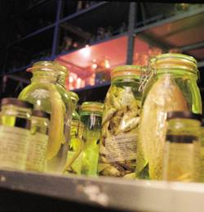
Natural History Collections
World’s natural history
museums house over 3 billion specimens
Specimen data are increasingly becoming databased
Specimen databases are increasingly
becoming accessible via biodiversity
information networks
Accurate geographic coordinates
are essential to utilizing these massive
specimen data sets
(niche modeling, global climate change etc.)
Geographic visualization of specimen data may also aid identification of problems due to misidentifications or misapplied names

Slide 3
What is Georeferencing
As applied to natural history collection data it is the process of assigning geographic coordinates to a textually described collecting event
Traditional approaches laborious and time consuming (3,200 worker hours to georeference TUMNH fish collection)
Automated and collaborative processes have proven to improve efficiency

Slide 4
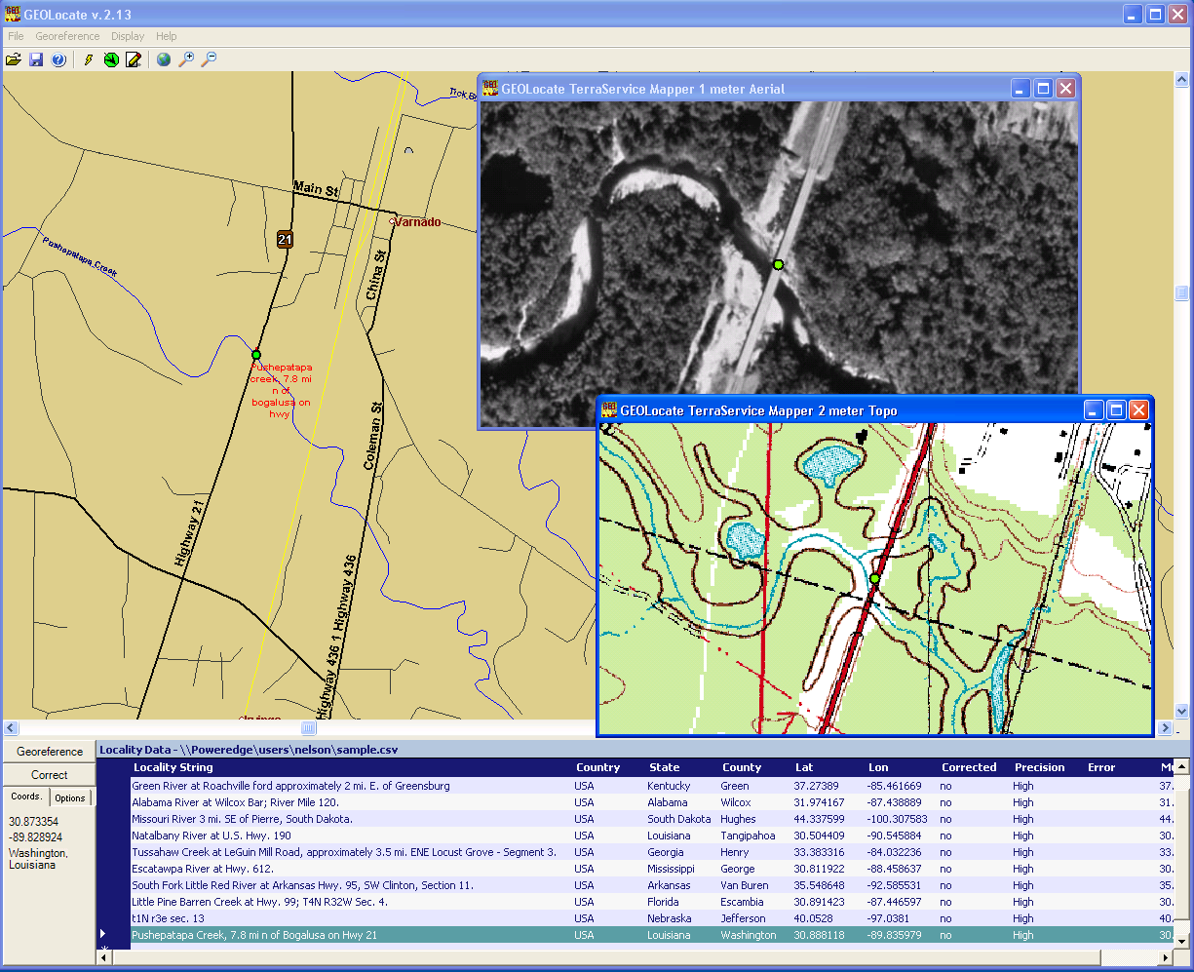
GEOLocate
Desktop application for automated georeferencing of natural history collections data
Initial release in 2002
Locality description analysis, coordinate generation, batch processing, geographic visualization, data correction and error determination

Slide 5
Basic Georeferencing Process
Data Input
  Data Correction
  Manual or file based data entry
  Community network data
Coordinate Generation
  Locality description parsing and analysis
Coordinate Adjustment
  Fine tuning the results on a visual map display
Error Determination
  Assigning a maximum possible extent for a given locality description

Slide 6
Core Components
Locality Input
Locality
Analyzer
Visualization
&
Correction
Gazetteer Data
(NIMA, River Miles,
Hwy Crossings etc)
Map Layer
Data

Slide 7
Gazetteer Data
U.S. Geological Survey’s Geographic Names Information System
National Geospatial-Intelligence Agency’s GEONet Names Service (Global coverage)
U.S. Army Corps of Engineers Waterway Mile Marker Database
U.S. Legal land descriptions (Township Range & Section)
U.S. Bridge Crossings (derived from U.S. Census Tigerline Data)
U.S. Waterbody Network (derived from U.S. Census Tigerline Data)
Spain Waterbody Network
Spain Bridge Crossings
Geosciences Australia Gazetteers
Your Gazetteer Here!

Slide 8
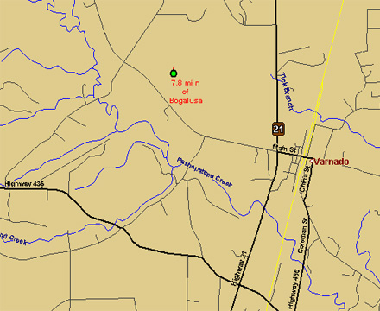
Locality Visualization & Correction
Computed coordinates are displayed on digital maps
Manual verification of each record
Drag and drop adjustment of records

Slide 9
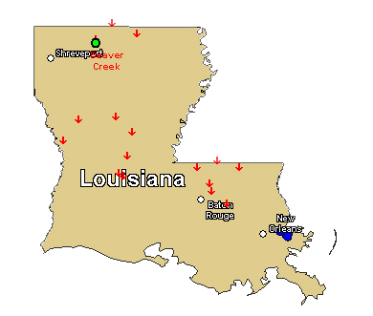
Multiple Result Handling
Caused by duplicate names, multiple names & multiple displacements
Results are ranked and most “accurate” result is recorded and used as primary result
All results are recorded and displayed as red arrows

Slide 10
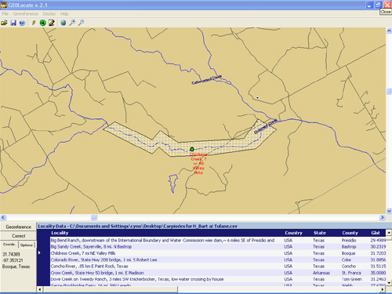
Estimating Error
User-defined maximum extent
described as a polygon that
a given locality description
can represent
Recorded as a comma delimited array of vertices using latitude and longitude

Slide 11
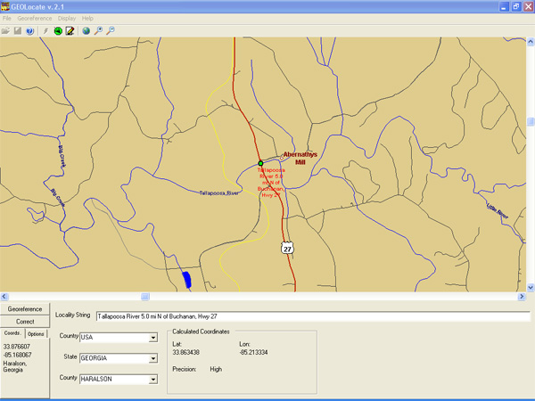
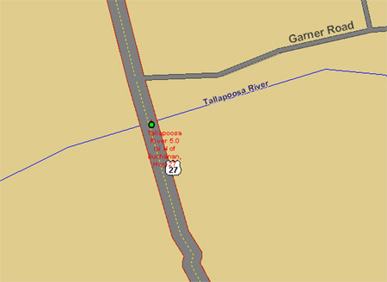
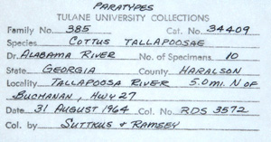
Example

Slide 12
Multilingual Georeferencing
Extensible architecture for adding languages via language libraries
Language libraries are text files that define various locality types in a given language
Current support for:
  Spanish
  Basque
  Catalan
  Galician
  French (In development)
May also be used to define custom locality types in English

Slide 13
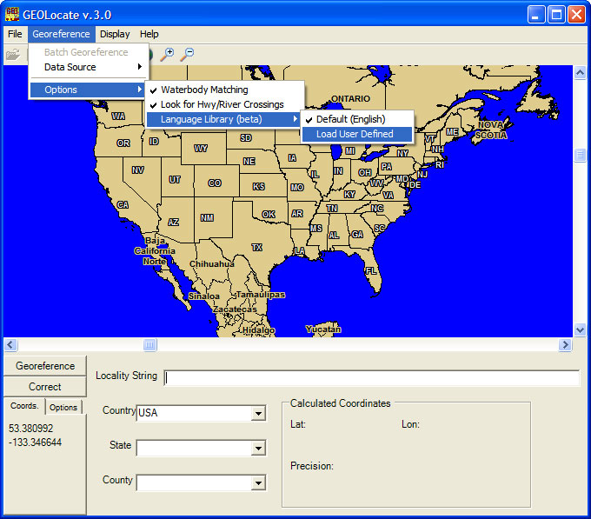

Slide 14
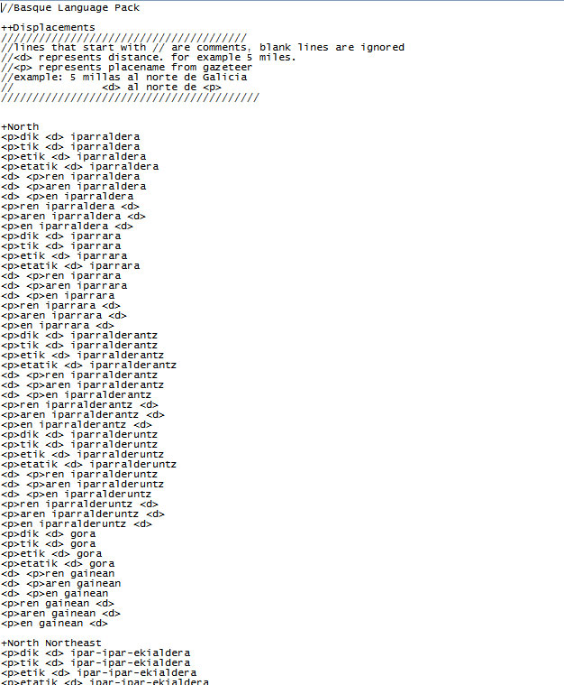
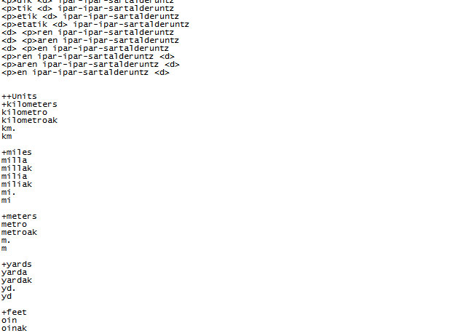

Slide 15
Natural History Data Networks
MANIS, HERPNET, ORNIS, FISHNET I, II, GBIF etc.
Originally based on the Z39.50 protocol
Replaced by the DiGIR protocol
Can be used to significantly improve efficiency of georeferencing by enabling data sharing and collaborative efforts

Slide 16
Collaborative Georeferencing
Distributed community effort increases efficiency
Web based portal used to manage each community
DiGIR used for data input (TAPIR in development)
Similar records from various institutions can be flagged and georeferenced at once
Data returned to individual institutions via portal download as a comma delimited file

Slide 17
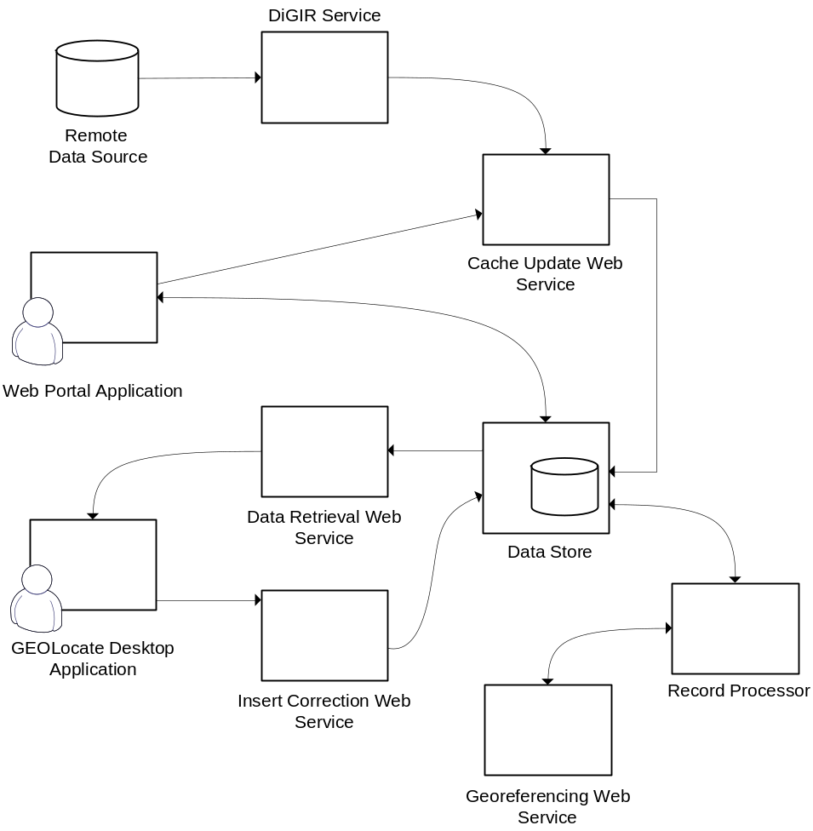
Collaborative Georeferencing

Slide 18
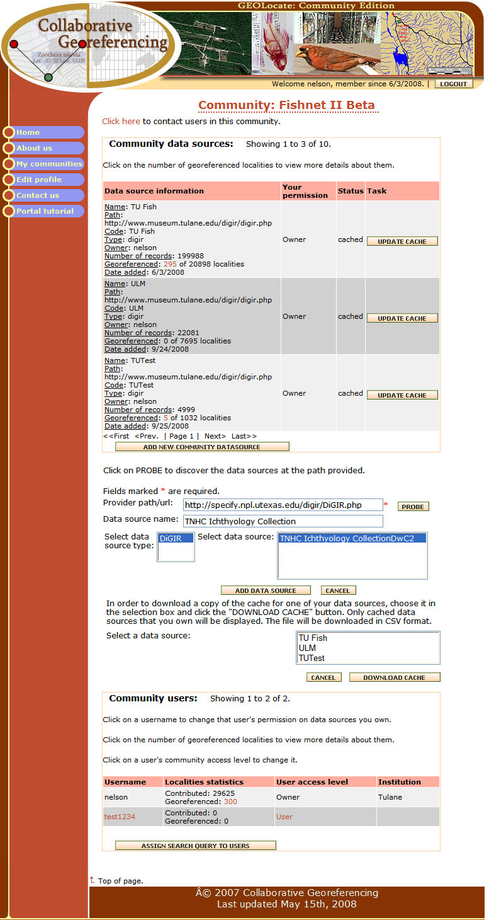

Slide 19
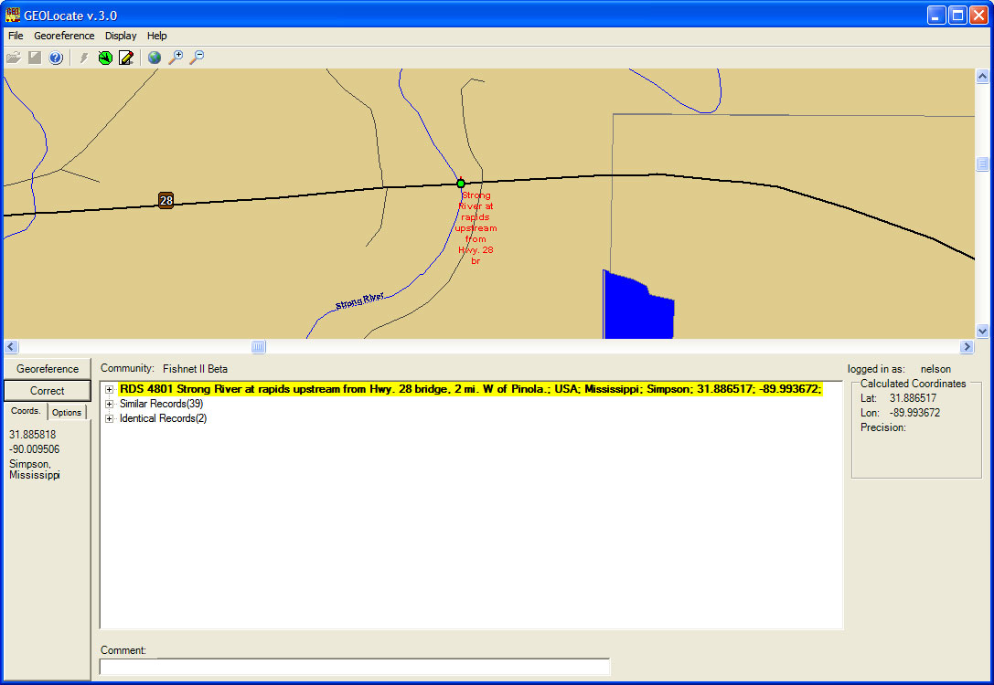

Slide 20
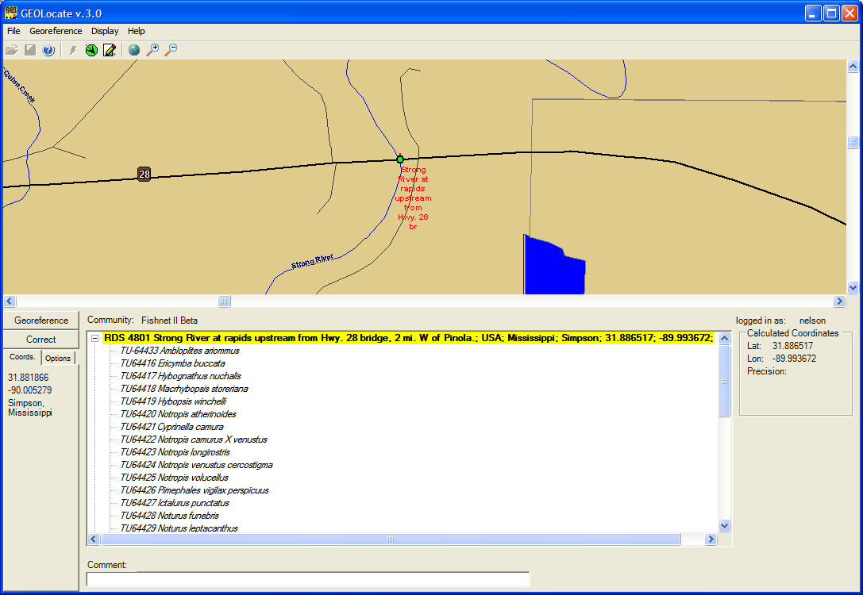

Slide 21
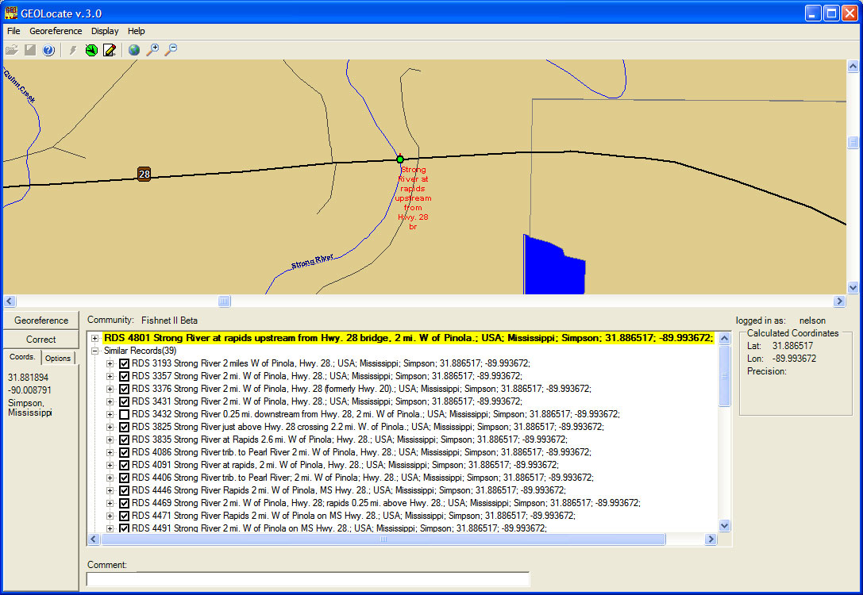

Slide 22
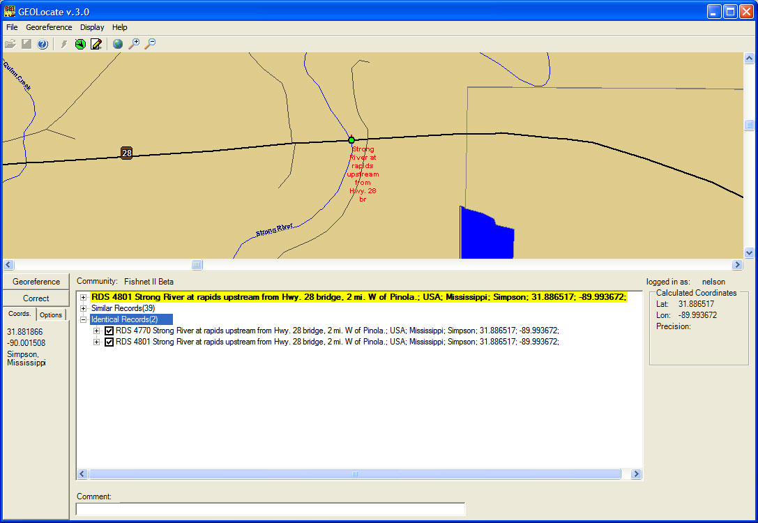

Slide 23
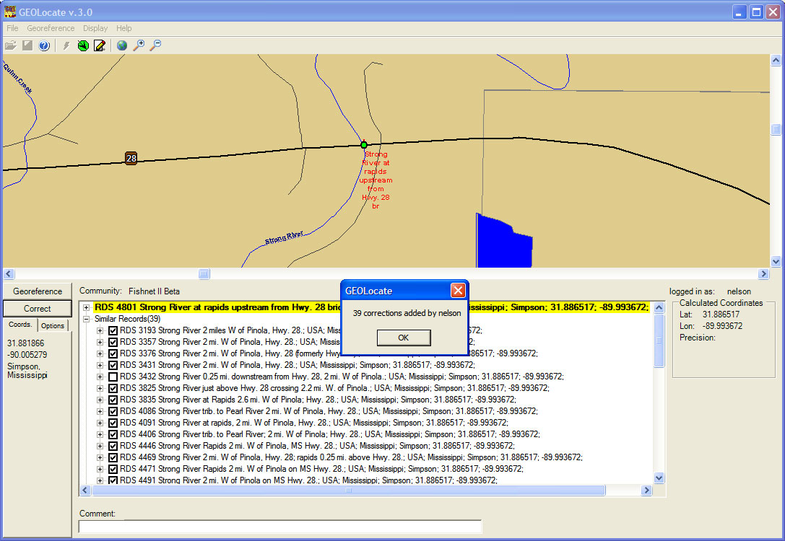

Slide 24
Taxonomic Footprint Validation
Uses point occurrence data from distributed museum databases to validate georeferenced data
Taxa collected for a given locality
Species A
Species B

Slide 25
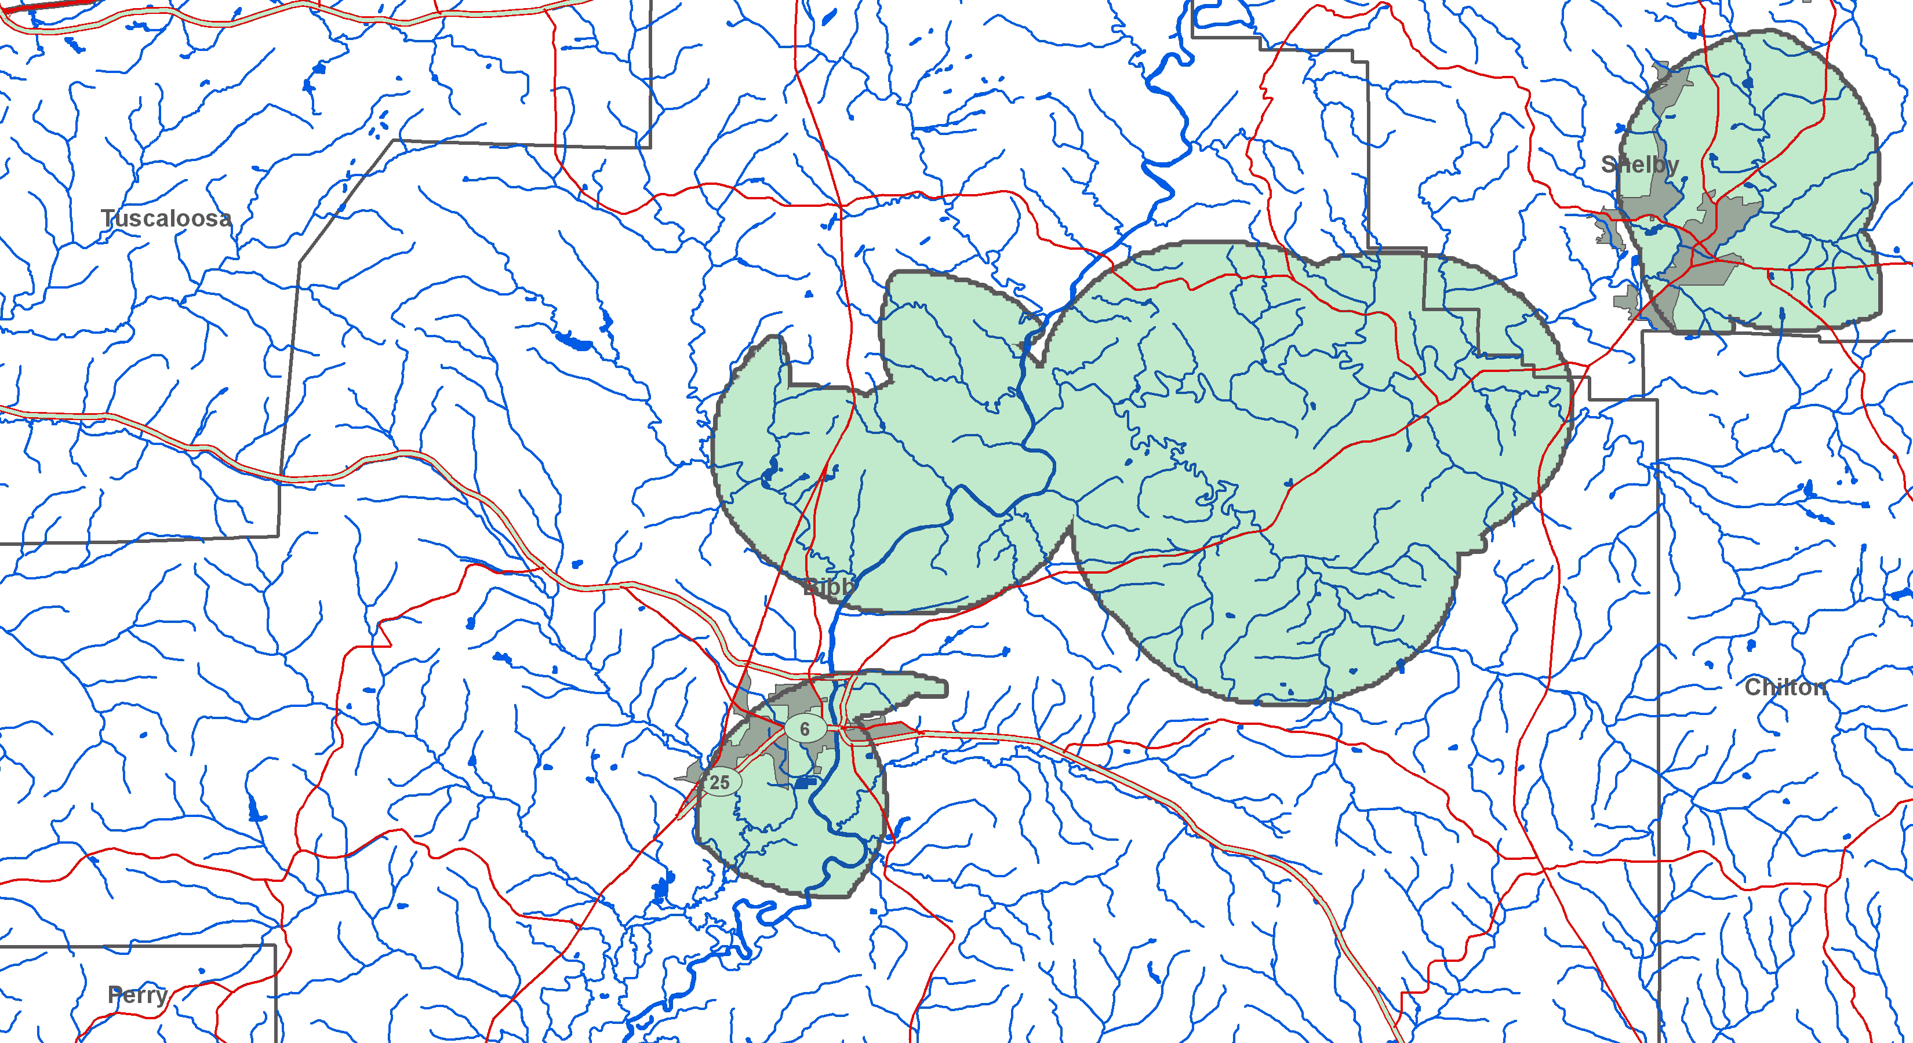
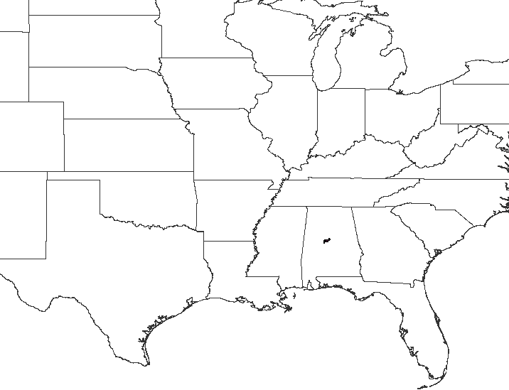
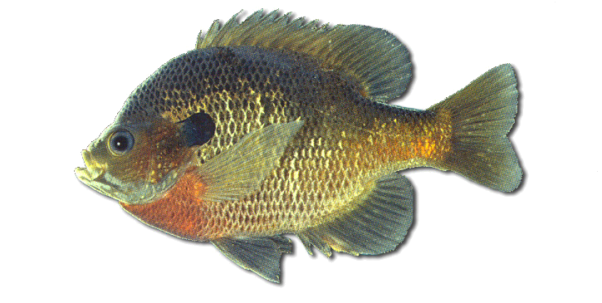
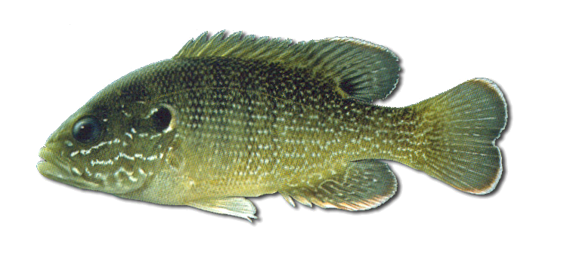
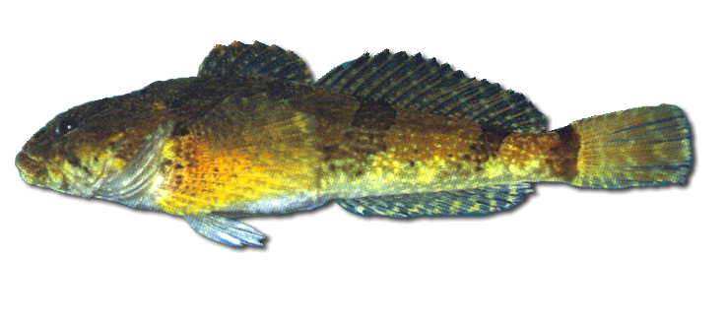
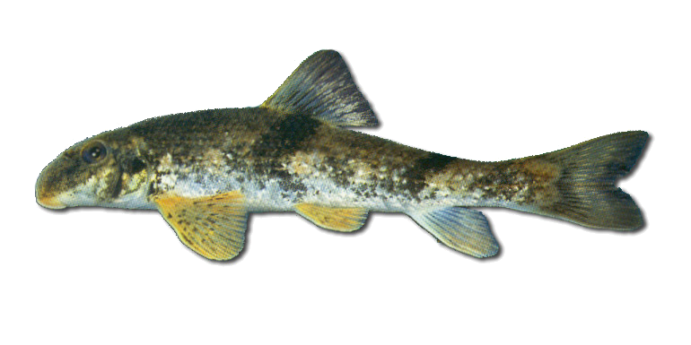
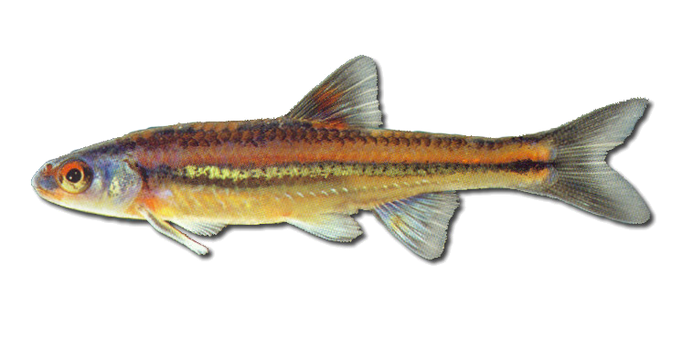
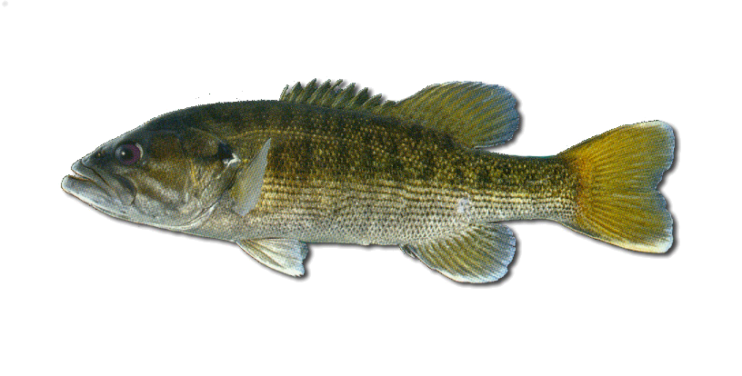
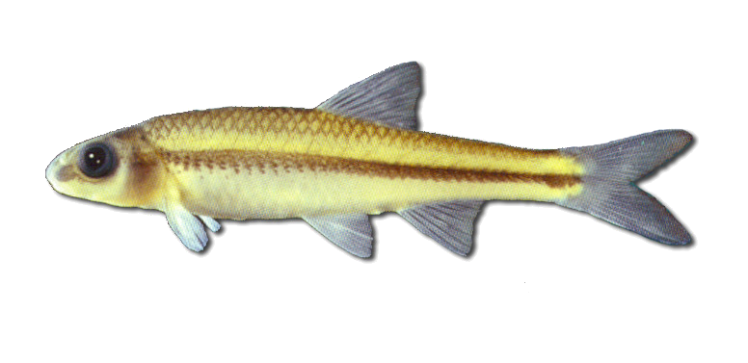
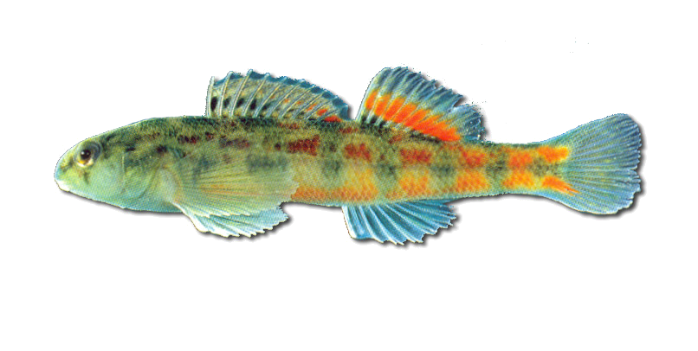
Lepomis macrochirus
Lepomis cyanellus
Cottus carolinae
Hypentelium etowanum
Notropis chrosomus
Micropterus coosae
Notropis volucellus
Etheostoma ramseyi
Footprint for specimens collected at Little Schultz Creek, off Co. Rd. 26 (Schultz Spring Road), approx. 5 mi N of Centreville; Bibb County; White circles indicate results from automated georeferencing. Black circle indicates actual collection locality based on GPS. This sample was conducted using data from UAIC & TUMNH

Slide 26
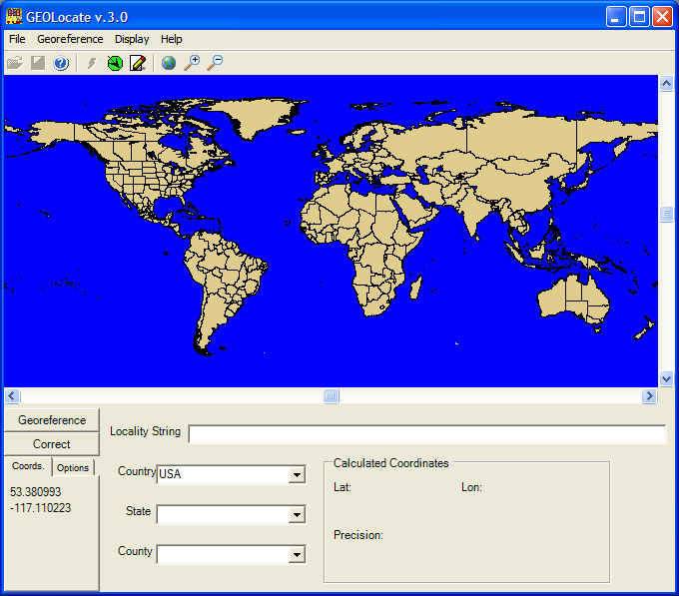
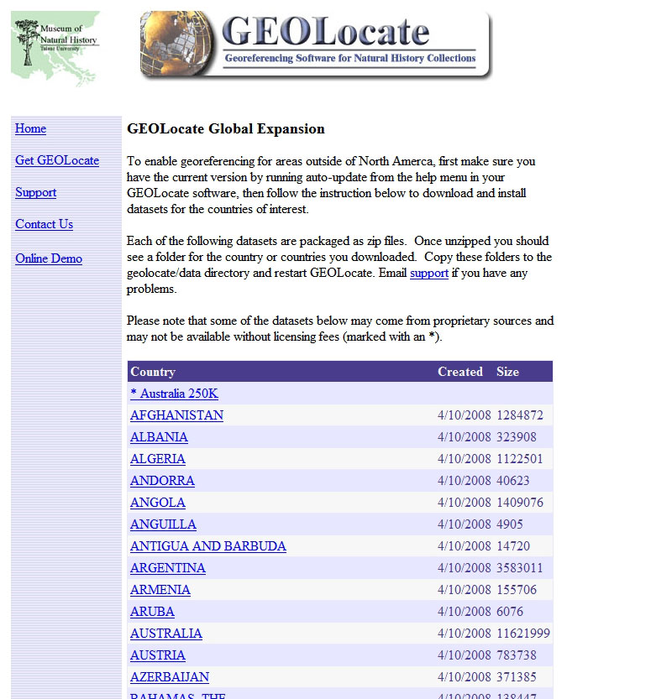
Global Georeferencing
Typically 1:1,000,000
Will work with users to improve resolution (examples: Australia250K & Spain200K)
Advanced features such as waterbody matching bridge crossing detection possible but requires extensive data compilation (example: Spain)

Slide 27
Acknowledgements
Hank Bart
Demin Hu
Mikaela Howie
Bjorn Schmidt
Paul Flemons
Sheridan Hewitt-Smith
National Science Foundation

