Slide 1

Established in 1905, in era of conservation and sustainable
use of natural resources.
First chief was Gifford Pinchot, who summed up mission
as “providing the greatest amount of good for the greatest
amount of people...”
Agency of the U.S. Department of Agriculture. Manages
public lands in national forests and grasslands (191
million acres).

Slide 2
Changing focus
Traditional focus on sustainable use of forest resources.
Has evolved into an agency focused more on protecting
forests as habitat for wildlife and places for human
recreational enjoyment.
Largest forestry research organization in the world.
International leader in forest conservation.
Cooperates with State and local governments, forest
industries, and private landowners to help protect and
manage non-Federal forests.

Slide 3
Research
Forest Service Research and Development (FSR&D) branch enhances understanding of organisms, populations, ecosystems, and ecological processes. Provides results essential for sustaining air, water and soil quality and biological diversity on forests and rangelands.
Research Areas:
        Wildlife Habitat
        Aquatic Habitat
        Watershed Science
        Atmospheric Sciences
        Soil Sciences

Slide 4
Wildlife Habitat Research
360 T&E species are associated with National Forests
and Grasslands. Another 2,500 species are categorized by
Regional Foresters as 'sensitive’.
FSR&D provides land managers with technical information
for sustaining plant and animal populations by protecting,
managing, and restoring high quality habitat.
Particular emphasis is placed on threatened and endangered
species and on declining or vulnerable communities such as
neotropical migratory birds, old-growth forests and riparian
communities.

Slide 5
Aquatic Habitat Research
FSR&D plays a key role in sustaining fisheries on FS lands.
Over 300 native freshwater fishes and over 200 anadromous
fish stocks are at risk in streams draining FS lands.
Only research program in the country with a primary focus
on protecting, managing and restoring fish habitat.
Focus is on native salmonids and imperiled invertebrates
(e.g., mollusks, crayfish).

Slide 6
Watershed Research
Focused on understanding effects of forest and rangeland
management, and related human and natural disturbances,
on the quality of water and watersheds.
Collaborates with the National Science Foundation and
numerous university partners in the nationwide Long Term
Ecological Research (LTER) Network.
Six participating Forest Service experimental watersheds.

Slide 7
Atmospheric Sciences Research
Ozone and other atmospheric contaminants can impair the
growth of trees and forests. Air pollution and rainwater
contamination can also change the biological structure of
forests and rangelands. Solar radiation (e.g., increases in
ultraviolet radiation) can also harm forests.
FSR&D atmospheric science research focuses on effects
of air pollution, weather and climate on ecosystem
function and productivity on public lands.
Examines effects of weather on forest fires.

Slide 8
Roadless Area Conservation
The Roadless Rule protects 58.5 million acres, or 31% of
National Forest System (NFS) lands, about 2% of the total
land base of the United States.
Approximately 386,000 miles of roads are currently
administered on NFS lands. Roadless Rule could prevent
construction of up to 232 miles of new road construction or
reconstruction each year in inventoried roadless areas.
Prohibits new road construction and existing road
reconstruction in inventoried roadless areas on National
Forest System lands.

Slide 9
Roadless Rule Opposition
Prohibits cutting, sale, and removal of timber in inventoried roadless areas.
Opposed by timber industry because it would negatively impact timber production, extraction of oil, gas and other mineral resources, and jobs.

Slide 10
Roadless Rule Impacts
Implementation of the Roadless Rule would decrease the
amount of timber harvested on NFS lands by 2% -- from
3,308 million board feet (MMBF) to 3,234 MMBF, less than
0.5% of total US production.
Prohibiting timber harvest in inventoried roadless areas would
affect only about 461 timber jobs nationwide over the next
5 years.
Currently, total oil and gas production from all National Forest
System lands is about 0.4% of national production. The
Roadless Rule is estimated to directly affect up to 546 jobs
related to coal and phosphate commodities.

Slide 11

Established in 1964 by Wilderness Preservation Act
Forest Service is one of four federal agencies involved
in managing wilderness areas in the U.S.
Wilderness Areas protected by law as places “where
earth and its community of life are untrammeled by
man, where man himself is a visitor who does not
remain” and “leaves no trace”.
4.41% of the continental United States is protected as
Wilderness (106 million acres). FS manages 1/3 of this
land.

Slide 12
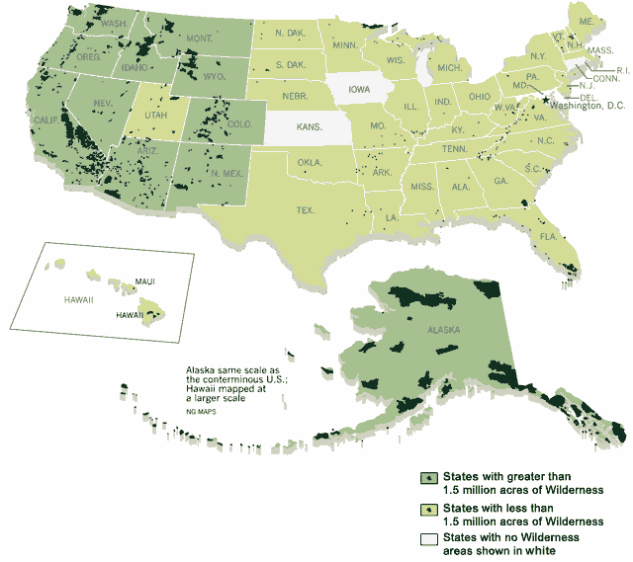
National Wilderness Map

Slide 13
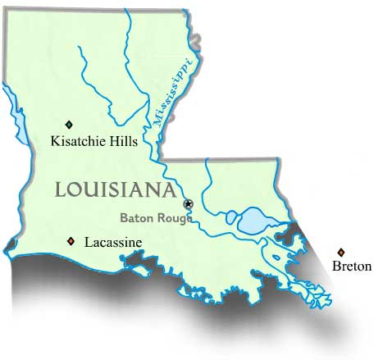
Louisiana Wilderness Areas
Kisarchie Hill
8,679 acres
Lacassine
3,345 acres
Breton
5,000 acres

