Slide 1

U.S. Fish and
Wildlife Service
http://faq.fws.gov/fwsfaq.html
Programs are among the oldest in the world dedicated to
conservation of natural resources
Traces its origins to the U.S. Commission on Fish and
Fisheries in the Department of Commerce and the
Division of Economic Ornithology and Mammalogy in
the Department of Agriculture.
Manages the 93 million-acre National Wildlife Refuge
System with more than 520 National Wildlife Refuges
and thousands of small wetlands and other special
management areas.

Slide 2
U.S. Fish and Wildlife Service
Operates 66 National Fish Hatcheries, 64 fishery resource
offices and 78 ecological services field stations; restores
nationally significant fisheries
Also:
Enforces federal wildlife laws
Protects endangered species
Manages migratory birds
Conserves and restores wildlife habitat
Helps foreign governments with international conservation
efforts
Distributes hundreds of millions of dollars in excise taxes
on fishing and hunting equipment to State fish and wildlife
agencies.

Slide 3
U.S. Fish and Wildlife Service
Assists management of wildlife resources on non-federal
lands (vast majority of fish and wildlife habitat here) through
various partnerships (Partners for Wildlife, Partners for Fish,
Partners in Flight, Sport Fishing and Boating Partnership
Council).

Slide 4
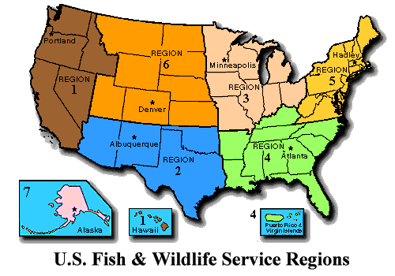
U.S. Fish and Wildlife Service
Employs approximately 7,500 people at facilities across the
U.S.
Is a decentralized organization with headquarters in
Washington, D.C., seven geographic regional offices, and
nearly 700 field units.
FWS programs in
Louisiana fall in
Region 4 (Southeast)

Slide 5
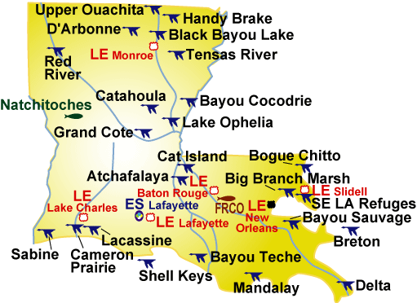
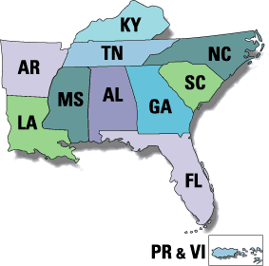
Southeast Region (4)

Slide 6
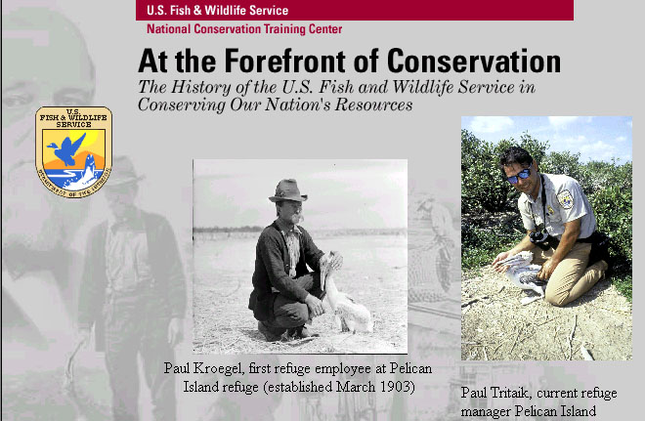
Origins of FWS http://training.fws.gov/history/index.html

Slide 7
U.S. Fish and Fisheries Commission
1871. U.S. Commission on Fish and Fisheries is created
by Congress and charged with studying and recommending
solutions to the decline in food fishes and to promote fish
culture.
Spencer Fullerton Baird is appointed as the first
Commissioner.
A year later, the Commission's Baird Station in northern
California is used to collect, fertilize and ship salmon
eggs by rail to the East Coast.

Slide 8
Bureau of Biological Survey
1885 Division of Economic Ornithology and Mammalogy
established in the Department of Agriculture.
C. Hart Merriam appointed as first Chief
Much of the Division's early work focuses on positive
effects of birds in controlling agricultural pests and
defining the geographical distribution of animals and
plants throughout the country.
Division later expands and is renamed the Bureau of
Biological Survey.

Slide 9
Interstate Protection, Refuges
1900. The Lacey Act becomes the first Federal law
protecting game, prohibiting the interstate shipment of
illegally taken wildlife and importation of species.
1903. The first Federal Bird Reservation is established by
President Theodore Roosevelt on Pelican Island, Florida.
Pelican Island and other early Federal wildlife reservations
are re- designated as "national wildlife refuges" in 1942.
1918. Migratory Bird Treaty Act is passed implementing
convention Between the United States and Canada for
protecting migratory birds, regulating of migratory bird
hunting.

Slide 10
Wildlife funding mechanisms
1934. "Duck Stamp Act," is passed. Requires the purchase
of a stamp by waterfowl hunters. Revenue generated by the
stamp is used to acquire important wetlands. Has resulted
in the protection of approximately 4.5 million acres of
waterfowl habitat.
1937. Federal Aid in Wildlife Restoration Act (a.k.a.
(Pittman-Robertson Act) passed to provide funding for
improving wildlife habitat/management.
1939. Bureaus of Fisheries and Biological Survey combined
and moved to Department of the Interior to create the Fish
and Wildlife Service.

Slide 11
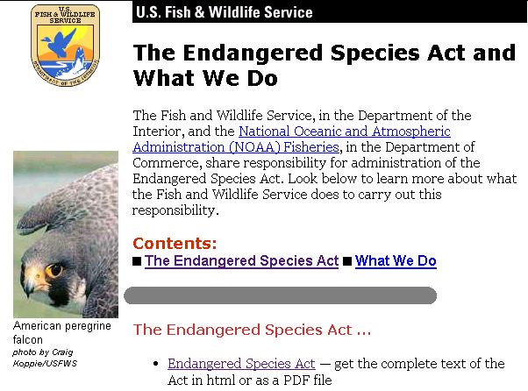

Slide 12
Endangered Species Act of 1973
FINDINGS, PURPOSES, AND POLICY -- SEC. 2.
DEFINITIONS -- SEC. 3.
DETERMINATION OF ENDANGERED AND THREATENED
SPECIES -- SEC. 4.
LAND ACQUISITION -- SEC. 5.
COOPERATION WITH THE STATES -- SEC. 6.
INTERAGENCY COOPERATION -- SEC. 7.
INTERNATIONAL COOPERATION -- SEC. 8.
PROHIBITED ACTS -- SEC. 9.
EXCEPTIONS -- SEC. 10.
PENALTIES AND ENFORCEMENT -- SEC. 11.
ENDANGERED PLANTS -- SEC. 12.
CONFORMING AMENDMENTS -- SEC. 13.
REPEALER -- SEC. 14.
AUTHORIZATION OF APPROPRIATIONS -- SEC. 15.
EFFECTIVE DATE -- SEC. 16.
MARINE MAMMAL PROTECTION ACT OF 1972 -- SEC. 17.

Slide 13
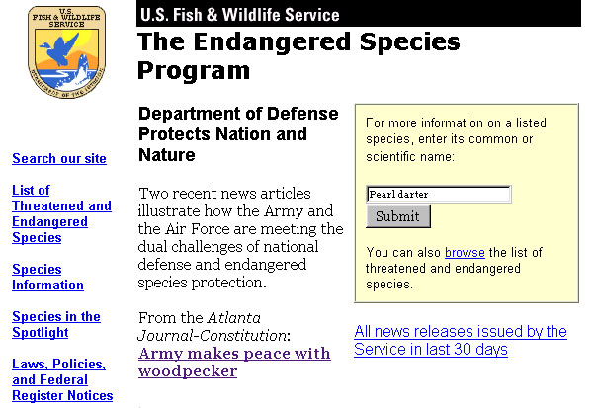
Endangered Species Info

Slide 14
What FWS does for ESA
Candidate Species
Consultations
Grants
HCPs
International
Activities
Landowner Tools
Listing
Permits
Recovery
Recovery Plans
Tribes
Clicking on “consultations”
brings up pages that describe
responsibilities other federal
agenices have for protecting
endangered species under
Section 7 of the ESA, and
consulting they are required
to do with FWS.

Slide 15
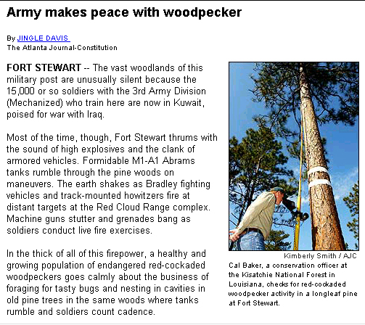
Consultations with other federal agencies
Featured on the main
OES page is a story
from Atlanta Journal
Constitution about
a deal the FWS recently struck with
the Army for
conserving habitat for
the endangered Red-
cockaded woodpecker
on the Fort Stewart
Military Reservation.
The story illustrates
the increasing use of
military lands for
species conservation.

Slide 16
What FWS does for ESA
Candidate Species
Consultations
Grants
HCPs
International
Activities
Landowner Tools
Listing
Permits
Recovery
Recovery Plans
Tribes
Clicking on “HCPs” brings
up pages describing Habitat
Conservation Planning

Slide 17
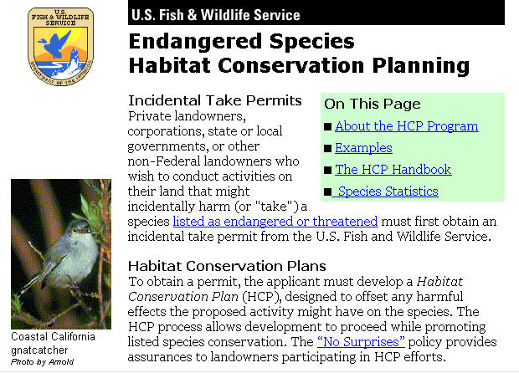
Habitat Conservation Planning

Slide 18
What FWS does for ESA
Candidate Species
Consultations
Grants
HCPs
International
Activities
Landowner Tools
Listing
Permits
Recovery
Recovery Plans
Tribes
Clicking on “International
Activities” brings up pages
that describe the full range
of activities FWS manages
involving protecting wildlife
in other countries, including
regulating importation,
treaties, work with foreign
conservation organizations.

Slide 19
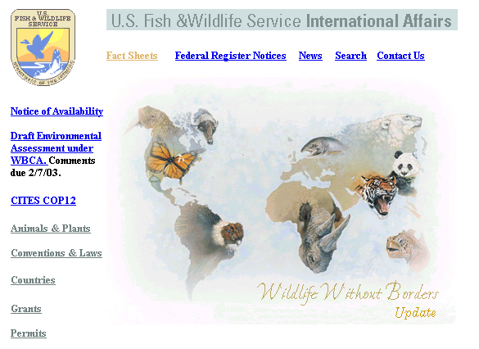

Slide 20
What FWS does for ESA
Candidate Species
Consultations
Grants
HCPs
International
Activities
Landowner Tools
Listing
Permits
Recovery
Recovery Plans
Tribes
Clicking on “Landowner Tools”
brings up pages describing
Section 7 rules and full range
of incentives to land owners
for protecting endangered
species on private lands
(grants, HCPs, SHA, etc.)

Slide 21
