Slide 1
Communities and Diversity

Slide 2
Communities
Community is an assemblage of species populations
that occur together in time and space (interact,
interdependent).
Community is the biological component of an ecosystem.
Communities have emergent properties that appear when
species considered together (diversity, food web, biomass,
productivity, limiting similarity.
Communities and ecosystems are open systems without
discrete boundaries.

Slide 3
Communities and conservation
Concept of community important to conservation biology.
Moving from emphasis on individual species to conserving
whole communities, ecosystems, biodiversity.
To protect a species, must protect its habitat, relationships
to other species.
When we lose species, must understand how this affects
community interrelationships.

Slide 4
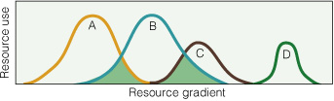
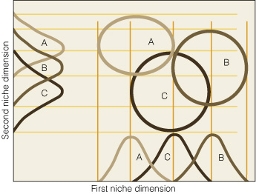
Competition
Theory
Competition theory is
central to community
ecology.
Establishes limits for
similarity among species
and rules for community
assembly.
However, competition is
not the only force
structuring biological
communities...

Slide 5
Concept of community assembly and diversity is broadening
Traditionally held that communities are saturated with species
(at equilibrium) due to competition and other interactions,
as if interactions were a force generating diversity.
But biotic interactions tend to reduce the number of species
in communities. What puts species in a habitat to begin with?
Regional/historical factors such as speciation and dispersal
add species to communities.
Community diversity reflects balance of local/contemporary
and regional/historical influences.

Slide 6
What is diversity?
Two levels:
  number of species in a community; richness
  number of species plus evenness of occurrence
Richness only considers presence/absence.
Broader concept considers importance of each species in
community:
Species Community 1 Community 2
A 96 20
B 1 20
C 1 20
D 1 20
E 1 20

Slide 7
Study of Diversity
In practice, study of communities generally taxonomically
delimited (birds, fish, mammals), but communities are all
encompassing.
Alpha diversity is diversity within a particular habitat.
Beta diversity deals with changes in diversity between
habitats (species replacement along environmental
gradient). Allows us to understand dependence of species
on particular set of environmental conditions.
Gamma diversity deals with diversity change across an
even broader landscapes (different environments).

Slide 8
Species-area relationships
Species diversity increases as a positive function of habitat
area. Large areas include more niches.
Species-area relationship served as basis for theory of
island biogeography:
S = cA^{Z}
Where S = species richness; A = area; c = taxonomic
constant; z = extinction coefficient.

Slide 9
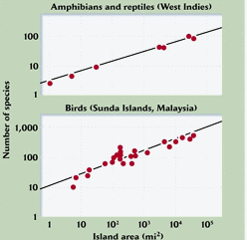
Species-area relationships
Generally depicted
as log-log plot.
One of the most
universal
relationships in
ecology.
Permits predictions
about species loss
with habitat area
loss

Slide 10
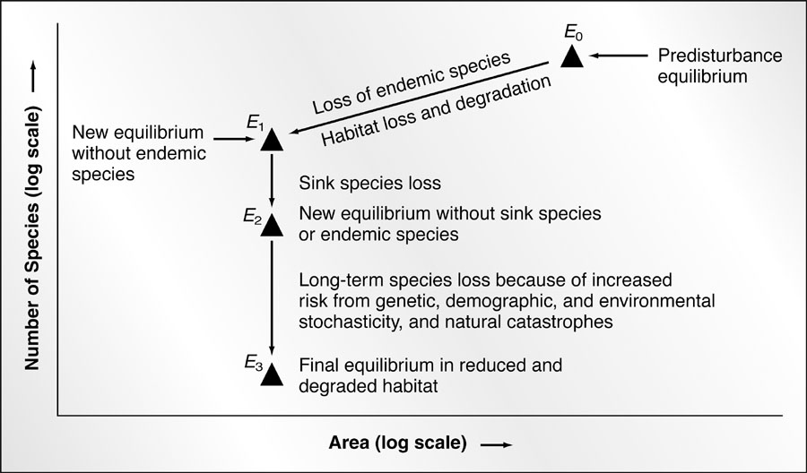
Rosenzweig’s model of species loss with area (habitat) loss

Slide 11
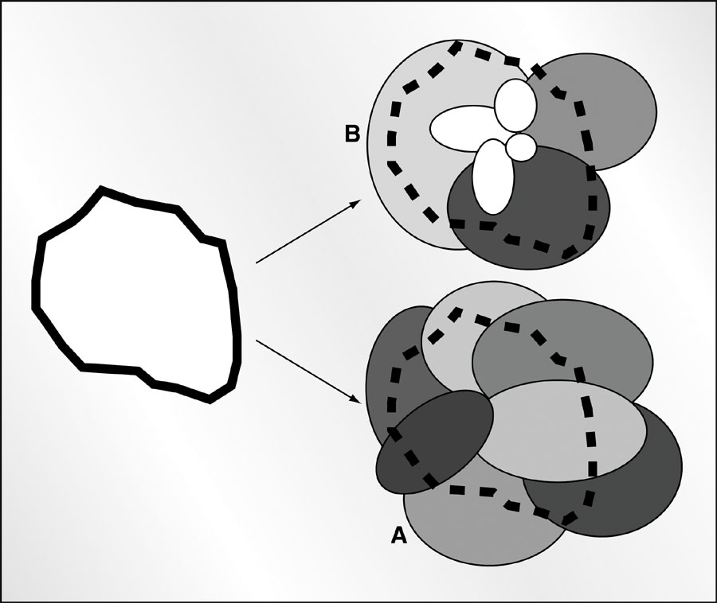
Effect of habitat loss in communities with varying range size
Cookie-cutter model
of species loss.
A. Where ranges large,
cutting out habitat
has little effect on
diversity.
B. Where ranges small,
cutting out habitat
results in reduction of
diversity.

Slide 12
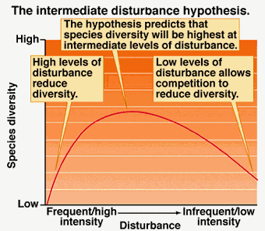
Habitat Heterogeneity, Productivity, and Disturbance
Diversity exhibits a
predictable pattern along
gradients of habitat
heterogeneity, productivity,
and disturbance.
All three trends can be
related to disturbance in
general; diversity is highest
where disturbance levels
are moderate.
(Habitat Heterogeneity)
(Productivity)

Slide 13
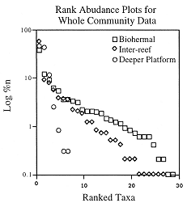
Rarity
Species abundances in natural
communities are typically
left skewed, with few species
represented by large numbers of
individuals and many species
represented by small numbers.
Hard to adequately represent
rare species in community
studies, and essential to
consider this when managing
for diversity.

