Slide 1
Principles of
Conservation Biology

Slide 2
Conservation Biology
Conservation biology is a young (unproven) scientific
discipline.
Major paradigms derived from ecology and genetics.
Endangered species crises of 1960’s and 70’s led to
concerns about genetic diversity and genetic variability
within small, declining populations.
Endangered Species Act sought to protect species and
subspecies. Required techniques to establish validity of
taxonomic descriptions (“innocence lost”, Obrien et al.).

Slide 3
Normative Postulates
Diversity is good
Ecological Complexity is good
Extinction is bad
Evolution is good
Biotic diversity has intrinsic value, regardless of utilitarian value

Slide 4
Molecular genetics
Need to characterize populations genetically and assess
genetic variability led to development of new molecular
techniques.
Protein electrophoresis allowed researchers to infer
differences in presumptive gene loci by examining mobility
of specific proteins (allozymes) on starch gels.
Methods developed in the 1980’s for extracting DNA from
cells, cutting it at specific places and eventually sequencing
it for direct measures of genic variation.

Slide 5
Conservation genetics
Applies principles of genetics to conservation of small,
declining populations.
Small populations at risk of inbreeding and chance loss
of genetic variability due to random genetic drift.
Small populations also at increased risk of extinction due
demographic or environmental factors.
Conservation genetics seeks to establish minimum
viable population size for maintenance of species.

Slide 6
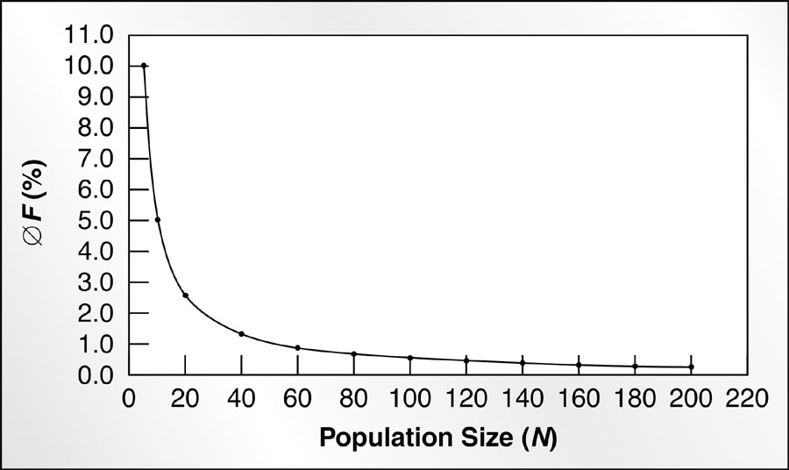
Inbreeding
Breeding in small
populations
increases the
likelihood of
inbreeding and
inbreeding
depression.
Early studies
suggested that
minimum effective population size of 50 needed to
avoid effects of inbreeding.

Slide 7
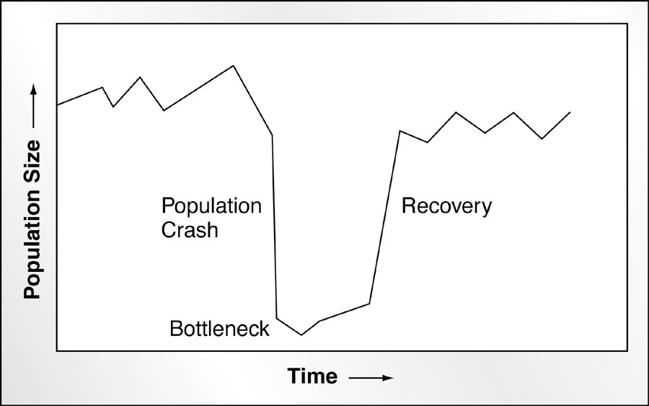
Genetic Drift
Genetic drift is
chance fixation of
an allele in a
populations.
Happens in small
populations
isolated in time or
space.
Results in loss of
genetic variability.

Slide 8
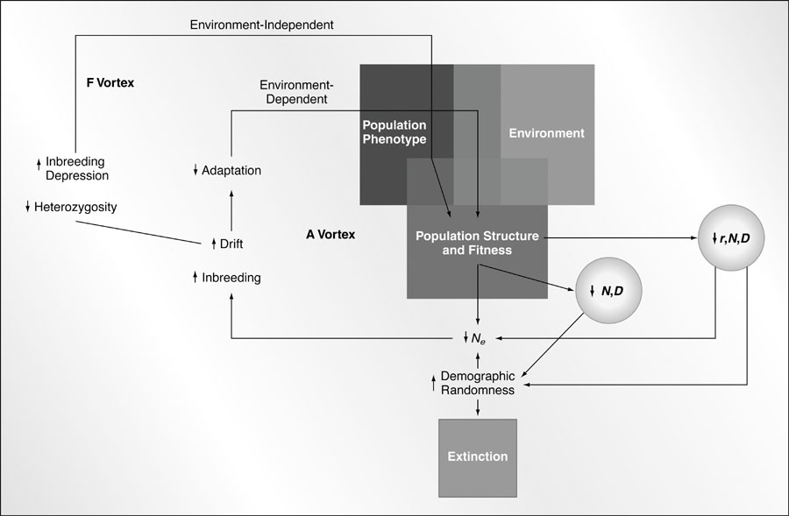
Extinction models

Slide 9
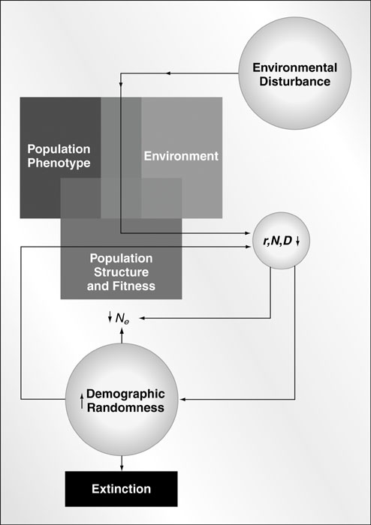
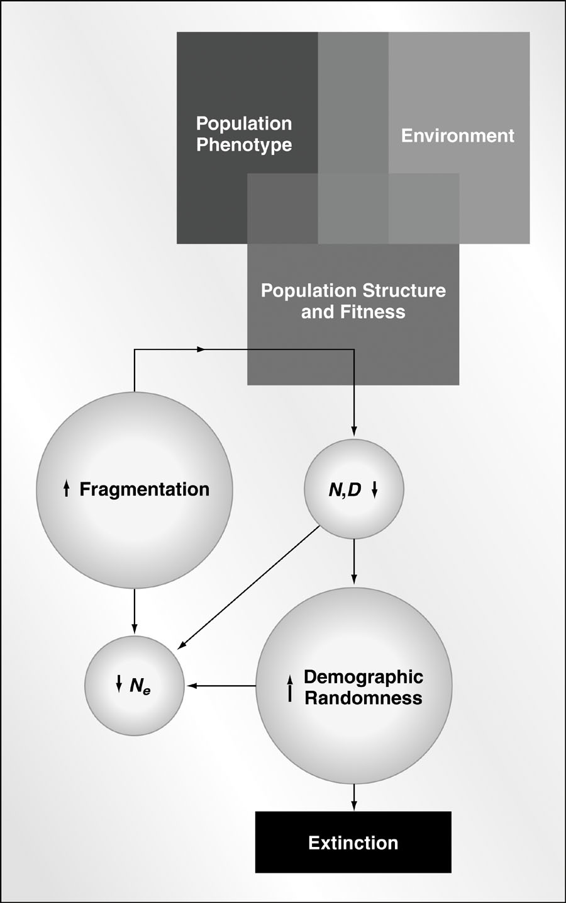
Extinction due to disturbance and population fragmentation

Slide 10
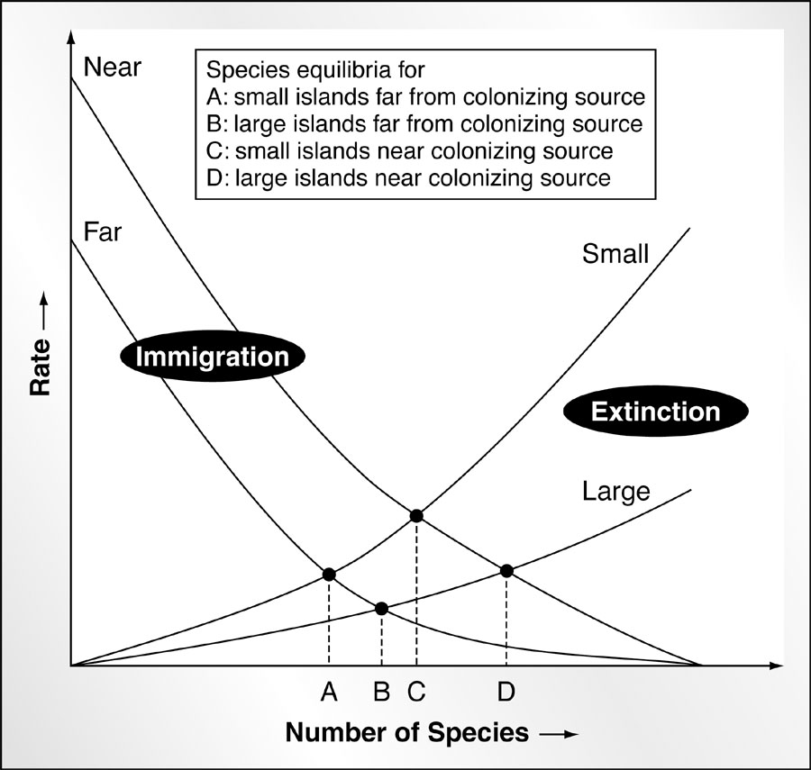
Island biogeography, habitat fragmentation and reserve size
Theory established
to relate diversity
to island size and
distance from
mainland...
Used to predict effects
of habitat fragmentation
and determining size
and optimum design
of nature reserves.

Slide 11
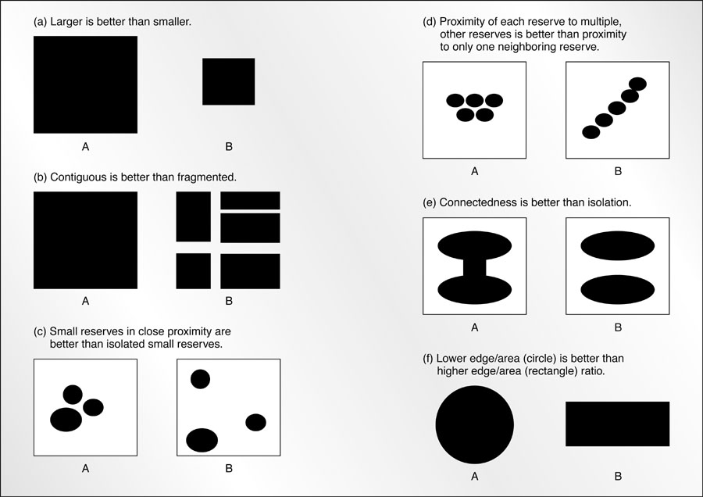
Reserve size and design

Slide 12
Problems with applicability of Island Biogeography
Local population extinction not as frequent as predicted.
Rescue effect of immigration.
Rules of reserve design unsupported by data (more
Species in several small than single large).
No predictions about which species would persist, which
ones lost. Ignores habitat, autecology.
Terrestrial habitats not truly insular.

Slide 13
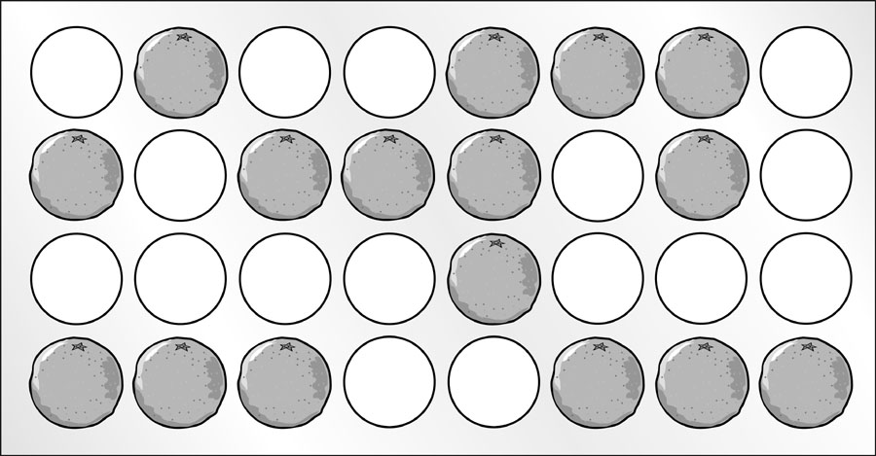
Environmental heterogeneity...
Huffaker’s experiments on mite predator-prey relationships

Slide 14
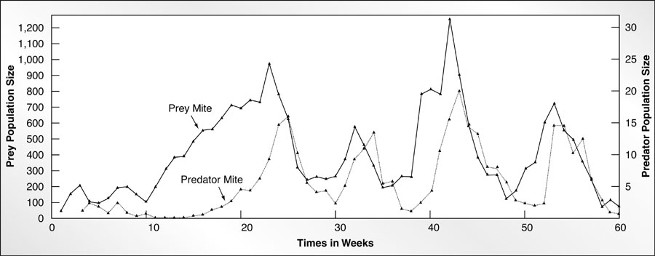
Results in persistence of predator-prey populations
When oranges concentrated, connected, prey and predator
crashed. When oranges dispersed, prey and predator
persisted.

Slide 15
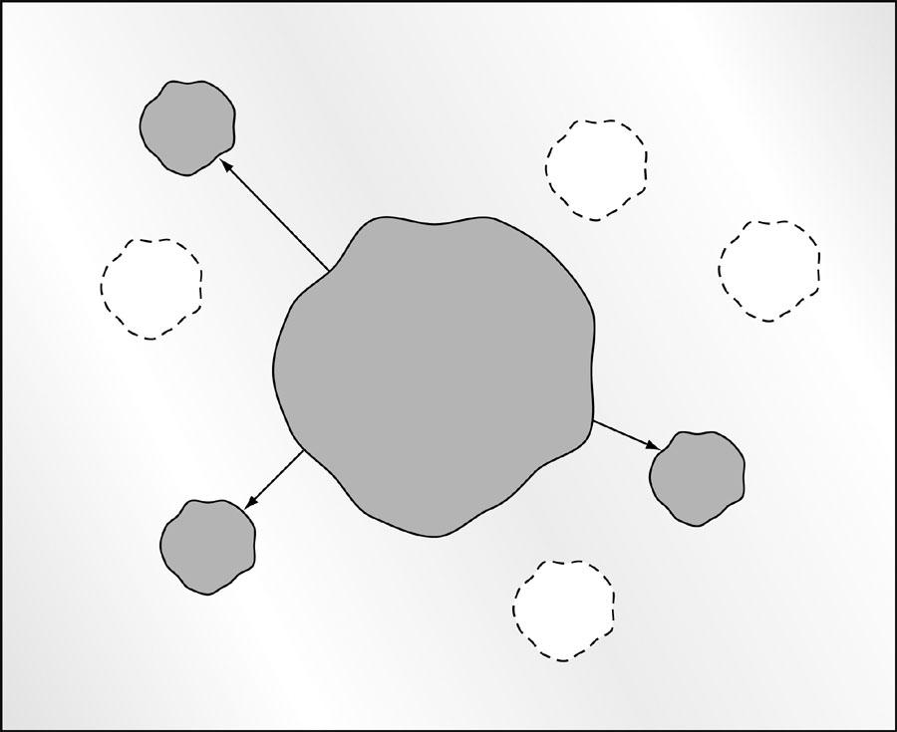
Metapopulations
A collection of
subpopulations
in space and time
maintained by
colonization
Theory revised
to treat some
populations as
sources and
others as sinks.

Slide 16
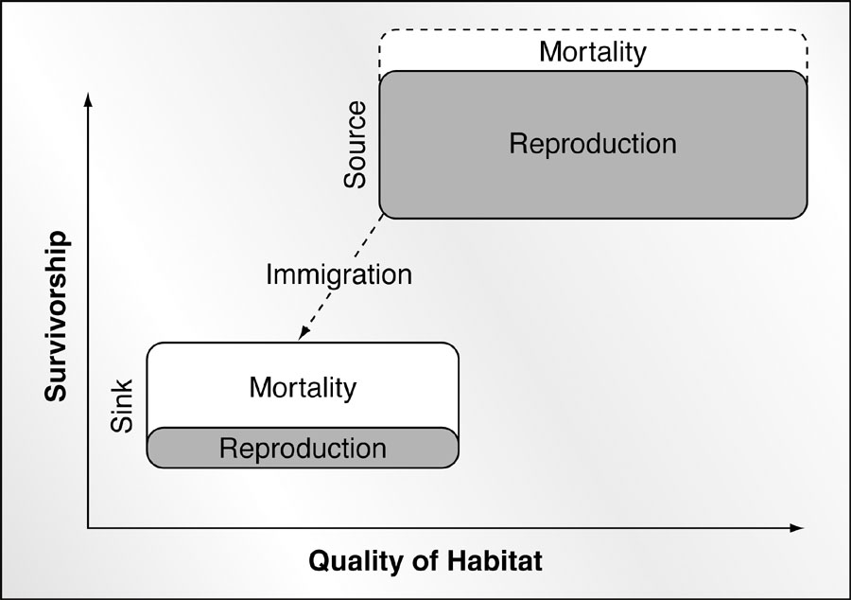
Sources vs. sinks
Source populations
enjoy greater habitat
quality, and thus,
lower mortality and
higher reproductive
success than sink
populations.

Slide 17
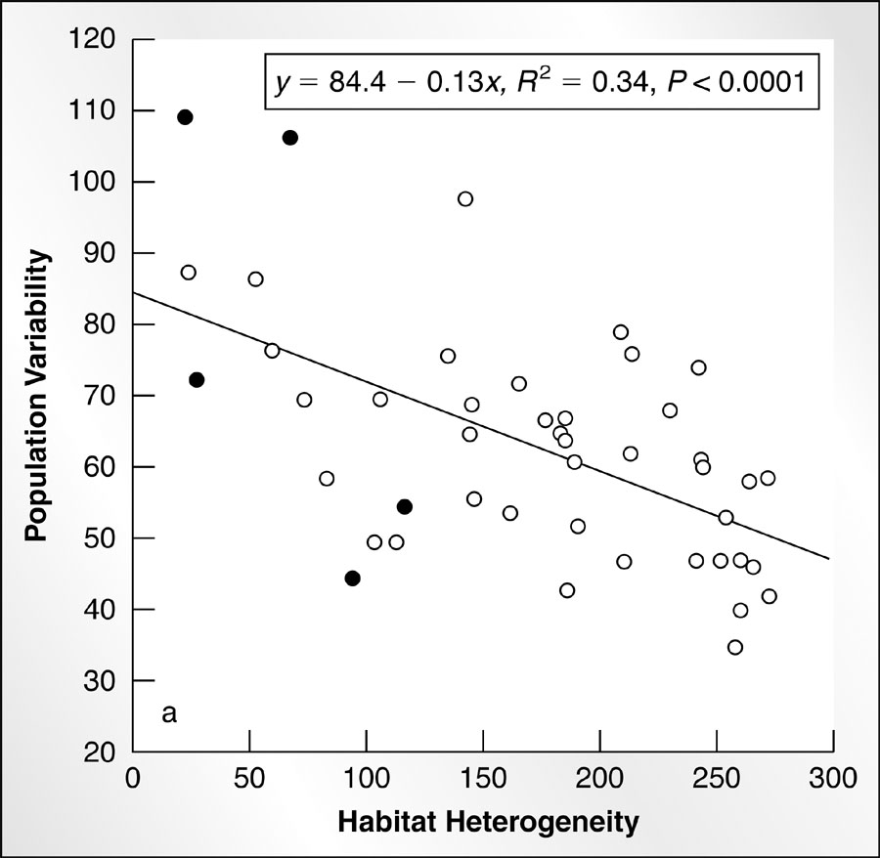
Application of metapopulation concept to conservation
Metapopulation concept
places emphasis on habitat
requirements of species,
(rather than species per se)
and habitat heterogeneity
or patchiness, quality.
Reflects a paradigm shift
from equilibrium to non-
equilibrium view of
communities.

