Slide 1
Basic ecological principles
As applied to individuals, populations and communities

Slide 2
Ecological principles
Ecology is study of interactions of organisms with each other
and with their environment. Poses several questions:
Why does a particular species live where it does?
How is it able to live there?
How does it deal with the physical resources of its
environment?
How does it interact with the other species present?
What gives one species an edge over another species in a
particular habitat?

Slide 3
Liebig’s Law of Minimum
In 1840, Justus von Liebig proposed that the single factor
in shortest supply relative to demand is the critical
determinant of a species’ distribution.
This gave rise to the notion of habitat; that each species has
certain minimal needs of its environment, and that the
availability of these conditions determines the extent of the
species range.

Slide 4
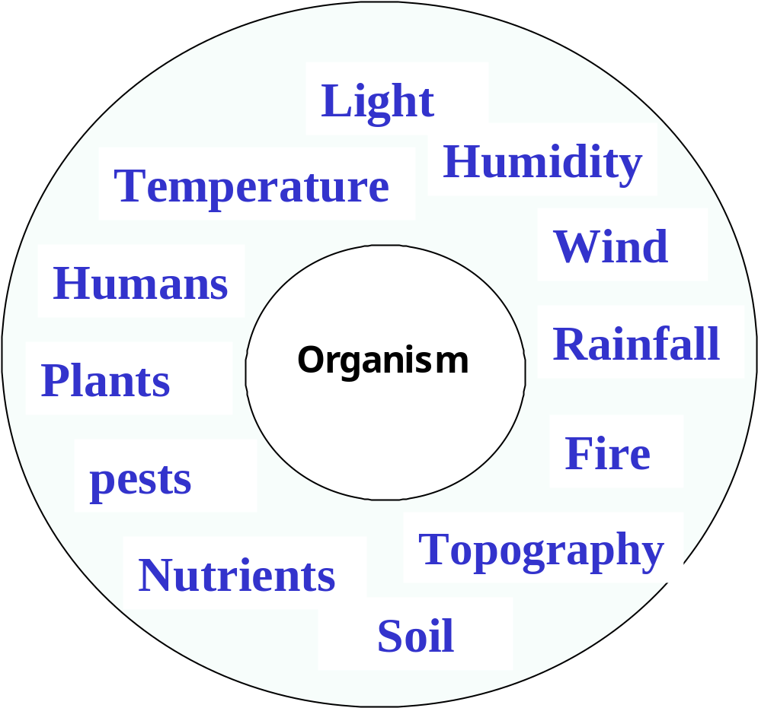
Resource utilization
Organisms have
needs for various
resources from
their
environment
(temperature,
moisture,
nutrients, space).

Slide 5
Cover
Cover is related to habitat; provides shelter from
environmental extremes; protection from predators;
concealment from prey
Requirements vary from species to species, depending
on size and behavior.
Basic cover requirements must be met in order for a
species to populate an area.

Slide 6
Interspersion of resources
Often, most important feature of habitat is the spatial
configuration of resources.
Numbers of organisms limited not so much by quality or
quantity of resources, but by degree of interspersion.
Leopold’s Law of Interspersion wildlife diversity/
abundance is enhanced where resources are highly
Interspersed.
Interspersion highest where two or more habitat types
come together; produces ecotone or edge effect.

Slide 7

Dispersion of organisms
Dispersion refers to the distribution of organisms in a habitat;
related to interspersion of resources or associations of
organisms.
Three basic patterns generally recognized: random; ordered;
clustered or clumped.
Ordered dispersion generally result from territoriality or
avoidence behavior; clumped results from gregariousness.

Slide 8
Tolerance
Victor Shelford expanded Liebig's principal stating that each
environmental factor has both minimum and maximum levels,
called tolerance limits, beyond which a particular species
cannot survive.
A species distribution along an environmental gradient could
be viewed as a bell curve, with peak abundance at the center
of the curve (optimum) and low numbers at the extremes.

Slide 9
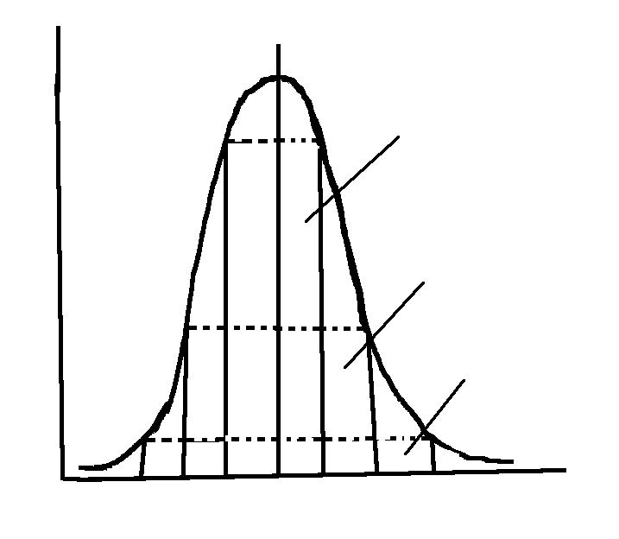
Optimal conditions
Limits of
Reproduction
Numbers or Fitness
Limits of
growth
Limits of
Survival
Resource gradient (temperature)

Slide 10
Tolerance continued
Concept of tolerance is both environmental and genetic;
has fitness component with height of curve representing
both numbers (population fitness) and genetic fitness.
Genetic variants that best suit individuals to local conditions
are promoted through natural selection.
Over the geographic range of a species, local populations
may be differently adapted, contributing to genetic variation.
Migration (gene flow) among populations increases genetic
variability within populations and likelihood populations will
survive in the event of environmental change.

Slide 11
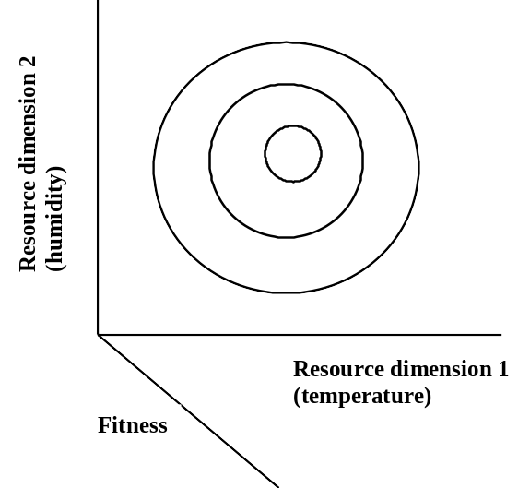
Resource utilization in 2 dimensions

Slide 12
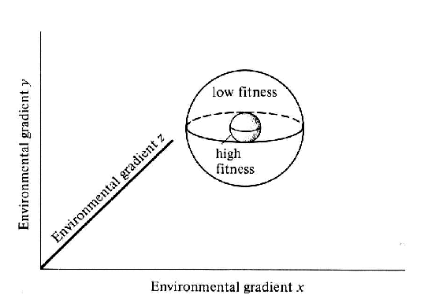
Niche
Niche is the sum total
of all resource needs
of an organism.
Is a multidimensional
hypervolume; sum
total of all tolerance/
resource utilization
curves.
Defines organism’s
role or what it does.

Slide 13
Ecological niche
An organisms place and function in the
environment
    physical location
    trophic role
    limits & tolerances for environmental factors
    relationship to other organisms

Slide 14
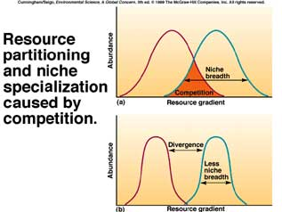
Resource partitioning
Niches of different
species frequently
overlap.
If niches of species
overlap in resource-
limited environment,
results is competition.
Result of competition is
exclusion or divergence
in resource utilization patterns
or resource partitioning

Slide 15
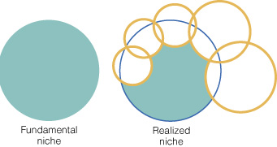
Fundamental and Realized niches
Realized niche is that portion of species hypervolume left
after resource partitioning.

Slide 16
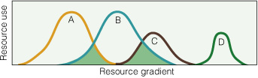
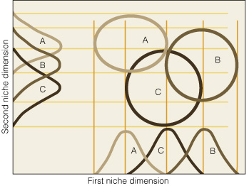
Competition
Theory
Competition theory is
central to community
ecology.
Establishes limits for
similarity among species
and rules for community
assembly.
However, competition is
not the only force
structuring biological
communities...

Slide 17
Other interspecific interactions
Predation
Parasitism
Symbioses (mutualism, commensalism)

Slide 18
Predation
Predator is an organisms that feeds directly upon another
living organism, whether or not it kills the prey to do so.
Technically includes all forms of organisms that feed on
living things (carnivores, herbivores, omnivores, parasites
pathogens).
Exceptions include scavengers, detritivores, and
decomposers (which feed on dead things).

Slide 19
Evolutionary role of predation
Predators play a key role in evolution by:
Preying most successfully on the slowest, weakest,
least fit members of their target population
Reducing competition
Preventing excess population growth
Allowing successful traits to become dominant in
the prey population

Slide 20
Coevolution
Predation plays an important role in coevolution (process
by which species influence evolutionary change in other
species).
Prey species evolve protective or defensive adaptations in
response to predators.
Predators evolve counter-mechanisms to overcome defenses
of their prey.

