Slide 1
Geology, Climate, Ecoregions

Slide 2
Geology, Climate, Ecoregions
What is state of wild lands protection in U.S.?
How did we get in the state we are in?
What is the state of wild lands protection in Louisiana?
What is it about the climate and geology of Louisiana that
makes it vulnerable to loss of wildlands?
What are ecoregions, and what ecoregions occur in the U.S.
and Louisiana?

Slide 3
Public Land in the U.S.
Public lands cover more than 600 million acres in the U.S.
—almost one third of the country!
Include national parks, national seashores, national wildlife refuges, wilderness areas, national forests, monuments, select lakes and seashores, marine sanctuaries, historic and scenic trails and national grasslands.
Most public land is concentrated in the western U.S. Nearly 83%
of Nevada; 68%of Alaska; 64%of Utah; 61% of Idaho; 52% of
Oregon; 49% of Wyoming; and 44% of California is public land
managed by the federal government.

Slide 4
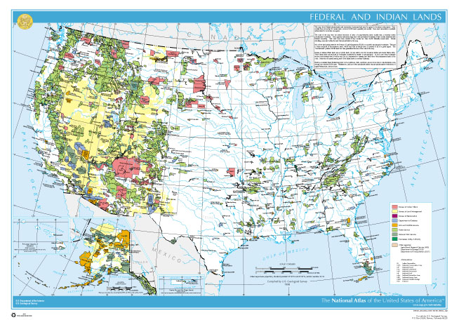
Public Lands of U.S.

Slide 5
Importance of Public Lands
Public lands play an important role in the lives of Americans.
Provide a wealth of natural resources including minerals, coal,
oil, gas and timber; they are a source of clean air and water;
protect ecosystems; offer places for outdoor recreation and
spiritual renewal.
Play a role in our country’s defense.
Certain public lands have been seriously impacted by overuse;
overwhelmed by the periodic influx of visitors; learning the hard way that unregulated recreation of the past few decades can have long-lasting negative impacts on the land.

Slide 6
Climate and Geology
In preserving public lands and organisms that depend on
them, important to understand role climate and geology
play in defining habitat, ecosystems.

Slide 7
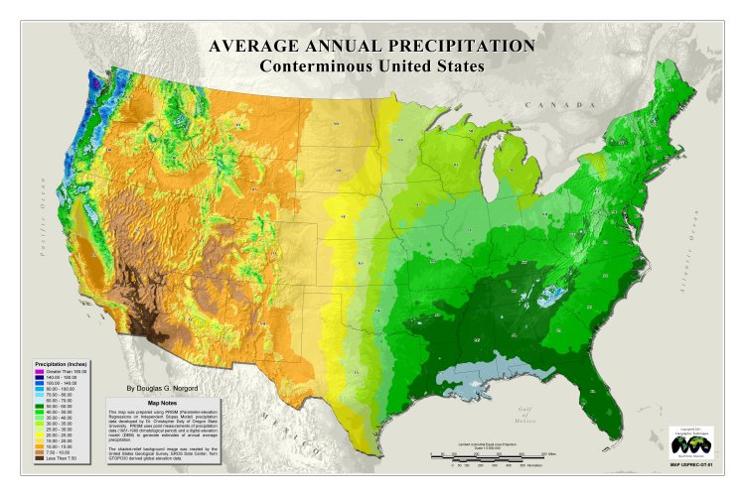
Precipitation Map
Most public land concentrated in arid, mountainous
terrain.

Slide 8
Public Lands of U.S.

Slide 9
Precipitation Map
Most public land concentrated in arid, mountainous
terrain.

Slide 10
Climate change
In addition to present climate considerations, must
consider how climate is changing and how this will
effect reserves.
Most global climate change scenarios predict that
climate will not only become warmer on average, but
also more variable (more extreme).
Reserve locations are fixed; cannot move with shifting
climatic zones.

Slide 11
Louisiana Geology
Surface of Louisiana is underlain by geologically young
sedimentary sequences that were deposited in or adjacent to
rivers and deltas in a coastal plain setting.
Entire suite of fluvial, deltaic, and coastal deposits has
advanced farther into the Gulf through time, and continues
now to fill it with sediment.
Most surface exposures in Louisiana consist of Quaternary
aged sediment (1.8 million years ago to present).

Slide 12
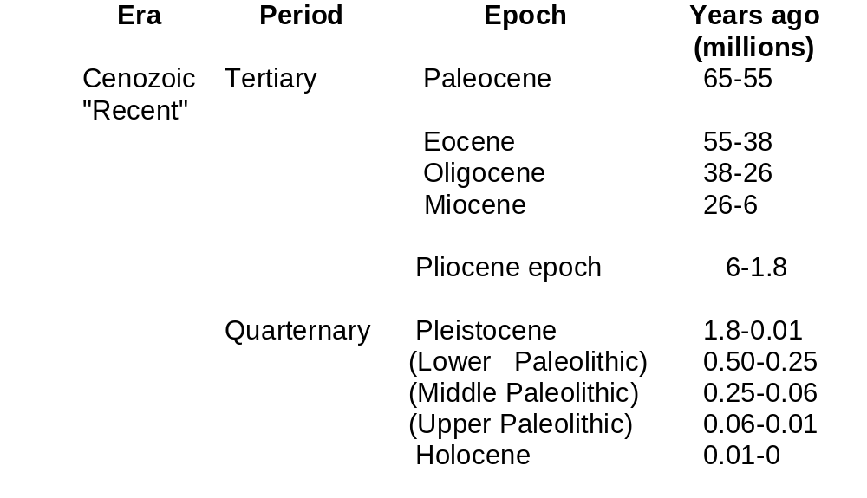
Recent geological time periods

Slide 13
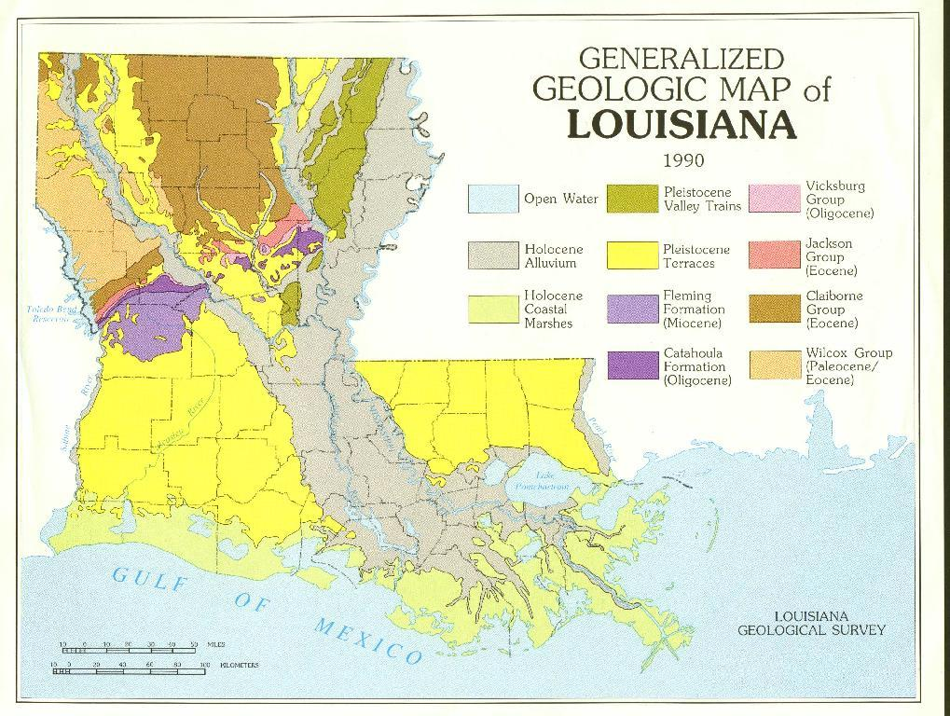

Slide 14
Geology continued
Holocene alluvium of the Mississippi, Red, Ouachita, and
other rivers and smaller tributaries, together
with coastal marsh deposits, occupies about 55% of the
surface.
The alluvium consists of sandy and gravelly channel
deposits mantled by sandy to muddy natural levee deposits,
with organic-rich muddy back-swamp deposits in between;
coastal marsh deposits are chiefly mud and organic matter.

Slide 16
Geology continued
Approximately 25% of the state's surface is raised
Pleistocene terraces, consisting mostly of sand and gravel.
Pleistocene surfaces are remnants of preexisting flood plains.
They were raised as the coastal plain titled in response to
downwarping of the crustal floor of the Gulf of Mexico.
Older (Tertiary) deposits confined to northern portion of the
state; decrease in age coastward.

Slide 18
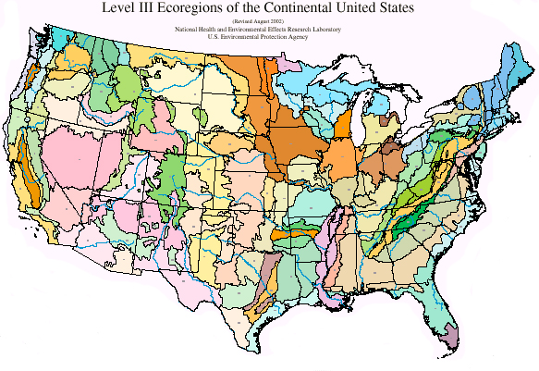
U.S. Ecoregions

Slide 19
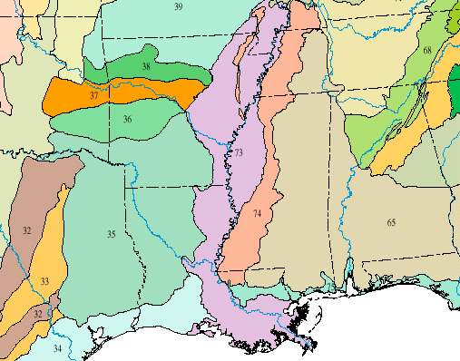


Gulf South Ecoregions

Slide 20
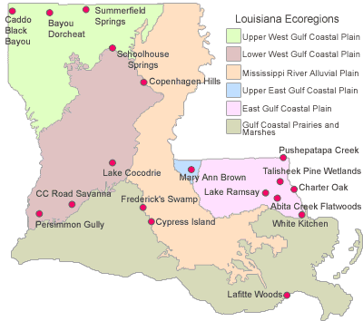
Louisiana Ecoregions (TNC)

Slide 21
How much land is public or in some form conservation in Louisiana ?

Slide 22
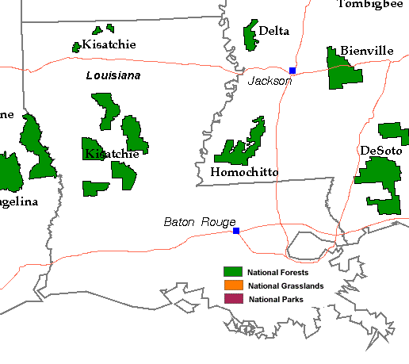
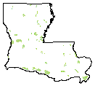
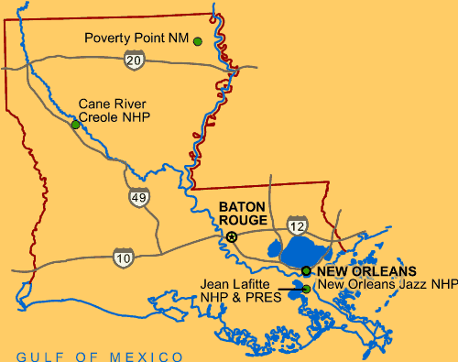
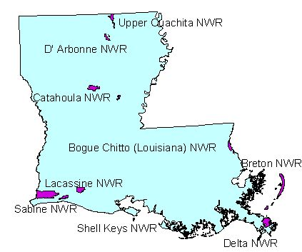
Louisiana Public Lands
Wildlife
management
areas
National Forests
National
Parks
National
Wildlife
Refuges

Slide 23
Louisiana Ecoregions

Slide 24
Status of Land Development in Louisiana
Most of the land area of Louisiana converted to
agriculture long ago; increasing conversion of private
land to forest products culture in more recent times.
Almost all of the wet and mesic coastal prairies have been lost; coastal marsh disappearing at an alarming rate.
Bottomland hardwood forest extensive, but privately owned, declining.
Virtually every stream in the Mississippi Alluvial Plain has
been channelized, levied or otherwise hydraulically altered.

Slide 25
Status of biodiversity in Louisiana
Louisiana does not have a formal biodiversity policy.
No coordinated biodiversity assessment system;
utilizes Natural Heritage database.
State’s endangered species law covers only animal
species; plants not protected.
The state has 27 federally listed threatened and endangered species.

