Slide 1
Origins of resource conservation ethic
Interest in natural resource conservation dates to turn of
last century; 19th Century was “era of over exploitation”
industrial revolution
expanding human population; westward movement
game populations severely depleted by over hunting
extinction of passenger pigeon; Carolina parakeet
common belief that natural resources were non-
replenishable; destine to be permanently exhausted

Slide 2
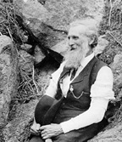
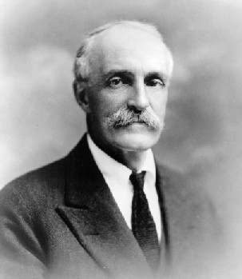
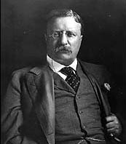
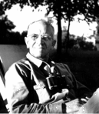
20th Century: Era of resource preservation and conservation
Important figures such as John Muir, Gifford Pinchot, Theodore Roosevelt
and Aldo Leopold established resource preservation movements,
established wildlife refuges and other land set asides, and introduced the
notion that natural resources are renewable; could sustain harvests if
properly managed.

Slide 3
Ethical roots of conservation movement
All living creatures and unspoiled land itself have
intrinsic value.
Organisms in natural ecosystems perform vital
services and good essential to continued human
survival.
Natural world adds value, knowledge and
meaning to the human existence.
Resources should be consumed responsibly,
sustainably, and for the benefit of all.

Slide 4
Ecology and Conservation Biology
Science of ecology established early in 20th century.
Conservation Biology established only in last two decades.
Conservation Biology applies theories of ecology and
population genetics to management and conservation of
natural resources.
It is a young science and many of its precepts are
controversial; however, problems of loss of genetic
variability and biodiversity are such that consequences of
doing nothing outweigh risks of action based on unproven
hypotheses.

