Slide 1
Natural Resource Conservation in theory and practice
EBIO 260/389
Hank Bart, Instructor
hank@museum.tulane.edu
http://www.museum.tulane.edu/conservation

Slide 2
Trust Resources
This course deals with living natural resources: animals, plants and physical habitat they depend on (renewable resources); not fossil fuels, minerals.
Natural resources are trust resources.
What do we mean by trust resources?

Slide 3
Course Overview and Objectives
Q. Who is responsible for conserving natural resources?
A. In the United States, conservation entrusted to agencies of
state and federal government…
Also an increasing number of non-governmental organizations (The
Nature Conservancy, Sierra Club, Audubon Society).
Q. What principles guide these organizations?
A1. Ideally, scientifically-established and ecologically-sound principles.
A2. In reality, governmental agencies hampered by politics and
bureaucratic "red tape" frequently interfere with best practice.

Slide 4
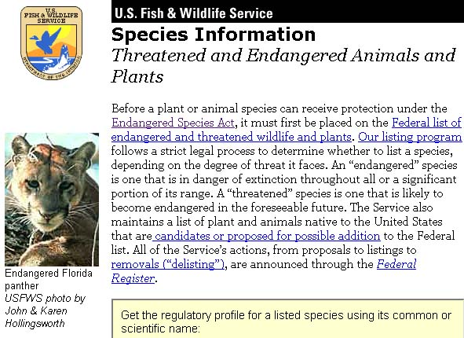
Case in point: US Fish and Wildlife Service’s
Office of Endangered Species
http://endangered.fws.gov/wildlife.html

Slide 5
Course Overview and Objectives
Q. Who is responsible for conserving natural resources?
A. In the United States, conservation entrusted to agencies of
state and federal government
And an increasing number of non-governmental organizations
(The Nature Conservancy, Sierra Club, Audubon Society).
Q. What principles guide these organizations?
A1. Ideally, scientifically-established and ecologically-sound principles.
A2. In reality, governmental agencies hampered by politics and
bureaucratic "red tape" frequently interfere with best practice.
NGO’s work with agencies; serve as "watch-dogs”. But, what obligations
do these organizations have to ensure that the public trust is properly
served?

Slide 6
Course Overview and Objectives continued
This course examines the theory and practice of natural resource
preservation in the United States, and the wide spectrum of agencies
and organizations involved in this endeavor.
Focus will be on activities occurring within the State of Louisiana,
especially the New Orleans vicinity.
We will begin with a discussion of basic principles of ecology and
conservation biology.
Will then review geology, climate, and ecoregions of Louisiana.
We will examine land ownership in Louisiana and extents to which
different habitats/ecoregions are protected.
This will be followed by review of the agencies involved in natural
resource conservation and the environmental laws that guide activities
of these agencies.

Slide 7
Student-Led Exploration
Students in this class are required to participate in student-led learning
activities such as public service or group research.
Students choosing service must complete a minimum of 20 hours of
service with a local natural resource agency/organization. Students who
perform 40 hours of service and enroll in EBIO 289 will receive an
additional credit in the course.
One hour of class per week will be devoted to reflecting on service
activities or group research and discussing how these activities relate to
material presented in lecture.
Students must keep a journal to document service and group research
activities. Journals will be collected and graded at the end of the
semester.
Students will give presentations on their service activities or group
research at the end of the semester.

Slide 8
Grading
Two exams (midterm and final) will be given based on
material presented in lecture. The exams will account for
60% of the final grade (30% each).
Service activities and group research will account for 40% of the final grade as follows: 20% for physical service or research; 25% for journal; 25% for participation in reflection/rap sessions; 30% for
final presentation.

Slide 9
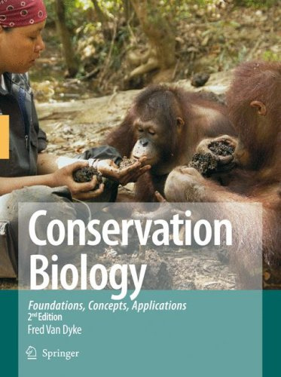
Textbook
Conservation Biology: Foundations, Concepts, Applications
2nd Edition (2008)
Fred Van Dyke
Springer
ISBN: 978-1-4020-6890-4

