Slide 1
Non-Governmental Organizations

Slide 2
Non-governmental organizations http://docs.lib.duke.edu/igo/guides/ngo/
World Bank defines NGOs as "private organizations that
pursue activities to relieve suffering, promote the interests
of the poor, protect the environment, provide basic social
services, or undertake community development"
Typically value-based organizations which depend, in whole
or in part, on grants,charitable donations and voluntary service.
Not directly affiliated with any national government, but often
have a significant impact on the social, economic and political
activity of the country or region involved.
Number in 10’s of thousands and cover all parts of the globe.

Slide 3
Types of NGOs
World Bank recognizes two main categories of NGOs:
i) Operational NGOs - whose primary purpose is the
design and implementation of development-related projects.
ii) Advocacy NGOs - whose primary purpose is to defend
or promote a specific cause and who seek to influence the
policies and practices of government or development
interests.
Conservation interests are mainly covered by advocacy NGOs

Slide 4

Some environmentally focused NGOs take a radical
approach and address a mix on environmental and social
issues.

Slide 5
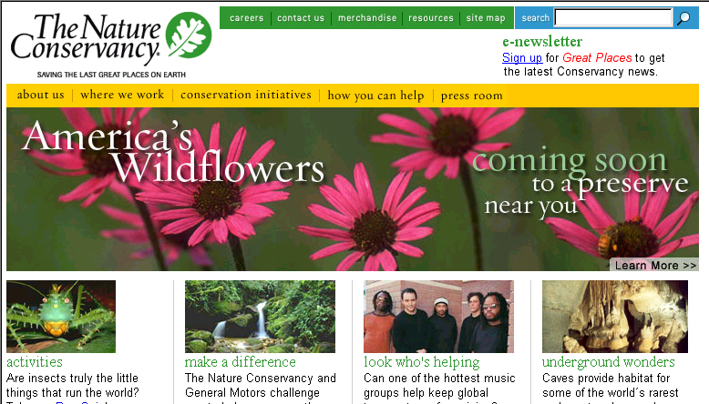
Others work with government, local and development interests;
have popular appeal and are more effective at achieving
conservation goals.

Slide 6
Top 5 U.S. Conservation-oriented,
Non-Governmental Organization's
Wilderness Society Concerned with preserving wilderness
and wildlife, and protecting America's prime forests, parks,
rivers, deserts and shorelands.
National Audubon Society Fights for the protection of wildlife
and its habitat, forests, and endangered species.
Environmental Defense Fund Brings together science, economics,
and law to create solutions to environmental problems.
Sierra Club Dedicated to exploring and protecting the earth's
wildlandsand promoting the responsible use of the earth's
resources.
The Nature Conservancy Protects land where endangered species
and threatened ecosystems exist.

Slide 7

“Deliver to future generations an unspoiled legacy of wild
places, with all the precious values they hold: Biological
diversity; clean air and water; towering forests, rushing
rivers, and sage-sweet, silent deserts.”
Brings together scientific expertise, analysis and bold
advocacy at the highest levels to save, protect and
restore America's wilderness areas.

Slide 8
Wilderness Society
Protecting the last great American wilderness area,
the Arctic Wildlife Refuge, from oil and gas drilling;
Staving off logging and road building on 58 million
acres of roadless lands;
Curbing the abuse of our lands by off-road vehicle
users;
Protecting wild places within the lower 48 states
from rampant oil development.

Slide 9
Wilderness Society cont’d
Identifies, inventories and protect America's most fragile
wild places.
Helped pass the Wilderness Act of 1964. Former
President, Howard Zahniser, wrote the Act.
Devotes expertise and leadership to coalition efforts,
creating a broad base of support for conservation
campaigns and reaching out to diverse communities.
75% of funding it receives used directly for conservation.

Slide 10
National Audubon Society
At end of 19th Century, birds were being slaughtered by the
millions. Their plumes were used for decorating hats, their
nests were robbed for eggs, and many species were hunted
for food. No laws on books to control hunting of birds or other
animals. Entire species such as the passenger pigeon,
Carolina parakeet, and great auk were exterminated.
George Bird Grinnell, editor of Forest and Stream, was one
of the first to speak out against the mindless slaughter. In
1886 he encouraged his readers to join him in forming the
country's first bird preservation organization, named the
Audubon Society after John James Audubon.

Slide 11
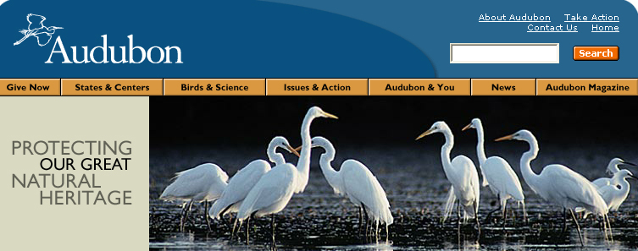
Organizes Christmas Bird Count (since 1900)
Aided development of National Refuge System.
Maintains bird sanctuaries (largest in LA).
Publishes Audubon Magazine.
500 Chapters around US and Latin America.
Lobbies congress for environmental protection.
Sponsors research

Slide 12
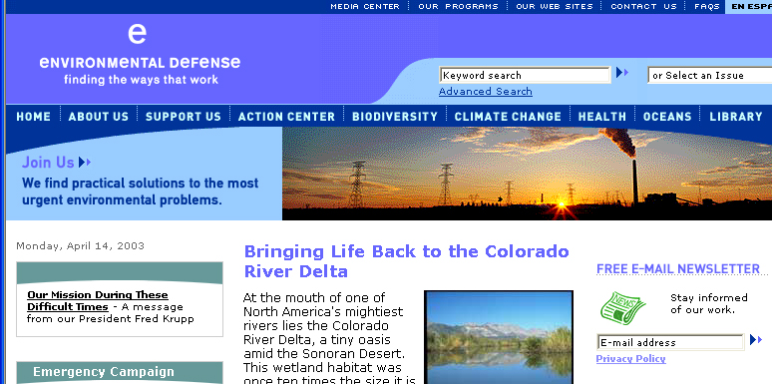
Environmental Defense Fund
Established in 1967 during fight to ban DDT. Dedicated to
protecting rights of people (especially poor, disadvantaged)
to clean air, water, diverse and healthy ecosystems.

Slide 13
Environmental Defense Fund cont’d
300,000 members
Links science, economics and law to create innovative and
cost-effective solutions to society's most urgent environmental
problems.
Also has programs on biodiversity, ecosystem restoration,
environmental health, global warming, oceans.
Maintains 750,000-member Action Network for alerting
online community of activists to send emails and faxes on
timely issues to legislators and other policymakers.

Slide 14


Sierra Club
America's largest and most effective grassroots environmental
organization. Established 1892 (second oldest).
Over 700,000 members.
Motto: “Explore, enjoy and protect the wild places of the earth”
Influences public, private and corporate policies and actions
through Club programs at the local, state, national and
international levels.

Slide 15
Sierra Club
Maintains field offices and chapters all over U.S., Canada
“Beyond the Borders” Program covers projects in Mexico,
Africa
Task Forces and Regional Conservation Committees
Foundation for grant making
Conservation honors and awards
Congressional lobbying

