Slide 1
National Park Service

Slide 2
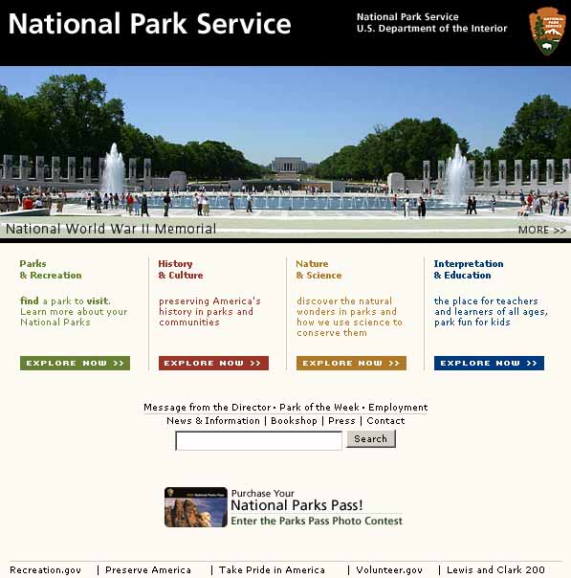
National Park Service
"...to promote and
regulate the use of the
national parks...
to conserve the
scenery and the
natural and historic
objects and the wild life
therein…
to provide for their
enjoyment in such
manner and by such
means as will leave
them unimpaired for the
enjoyment of future
generations."

Slide 3

Origin of national park concept generally credited to artist George Catlin, who, on a trip to the Dakotas in 1832, wrote about impact of America's
westward expansion on Indian civilization, wildlife, and wilderness:
They might be preserved, he wrote, “by some great protecting policy of government...in a magnificent park.... A nation's park, containing man and beast, in all the wild and freshness of their nature's beauty!”

Slide 4
Catlin's vision was partly realized in 1864, when Congress
donated Yosemite Valley to California for preservation as a
state park. Eight years later, in 1872, Congress reserved the
spectacular Yellowstone country in the Wyoming and Montana
territories “as a public park and “pleasuring-ground” for the
benefit and enjoyment of the people.”
With no state government in place yet to receive and manage
it, Yellowstone remained in the custody of the U.S. Department
of the Interior as the world's first national park.

Slide 5
NPS Mission
"...to promote and
regulate the use of the
national parks...
to conserve the
scenery and the
natural and historic
objects and the wild life
therein…
to provide for their
enjoyment in such
manner and by such
means as will leave
them unimpaired for the
enjoyment of future
generations."

Slide 6
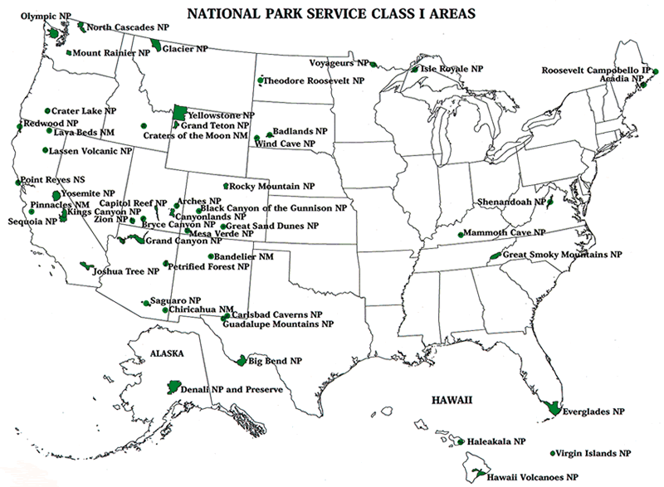
?

Slide 7
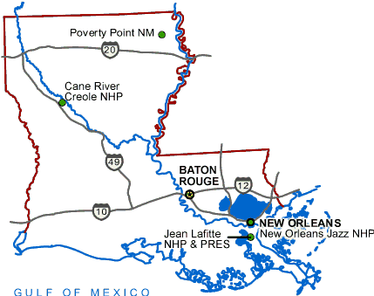
Louisiana National Parks
Poverty Point National Monument Epps, LA (National Monument)
Cane River National
Heritage Area
Natchitoches, LA
Cane River Creole
National Historical Park
Natchez, LA
Jean Lafitte National
Historical Park and Preserve
New Orleans, LA
New Orleans Jazz
National Historical Park
New Orleans, LA

Slide 8
NPS Mission

Slide 9
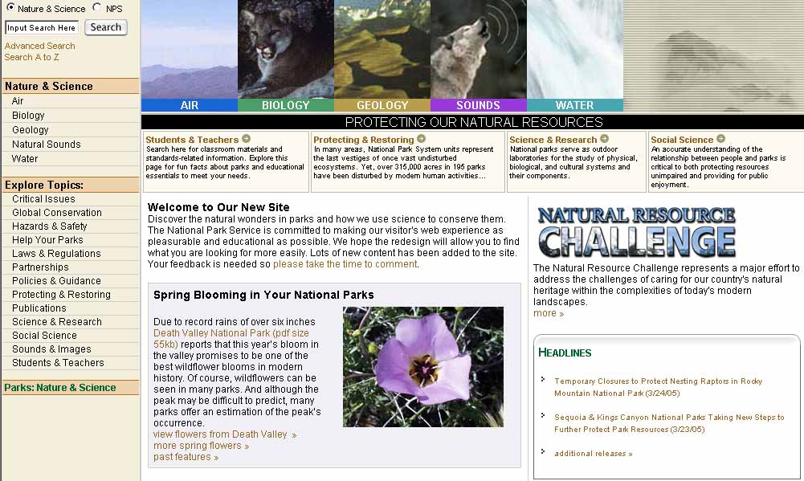

Slide 10
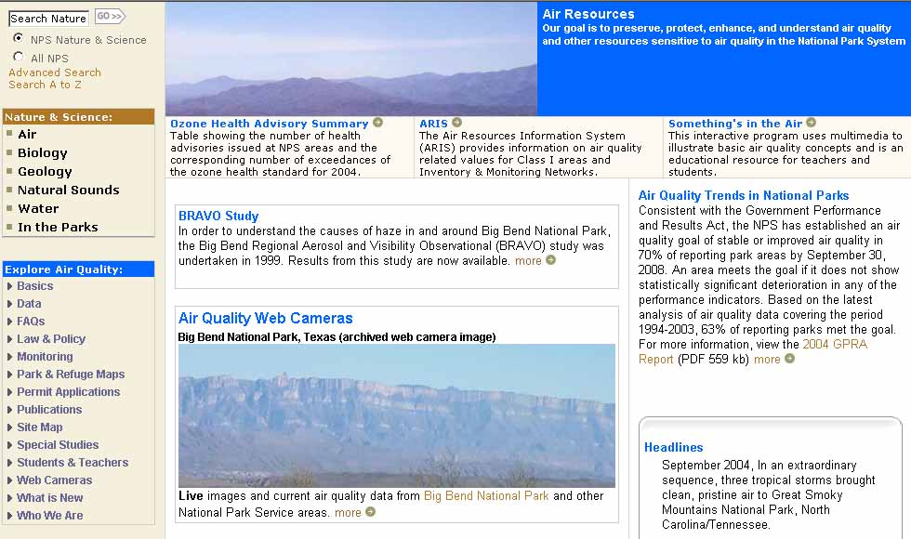

Slide 11
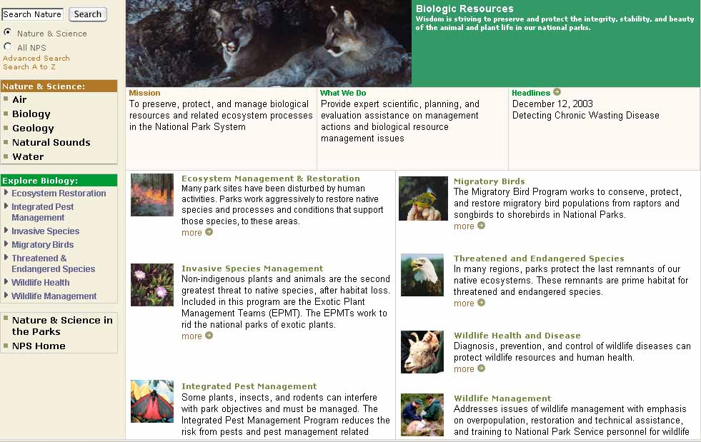

Slide 13
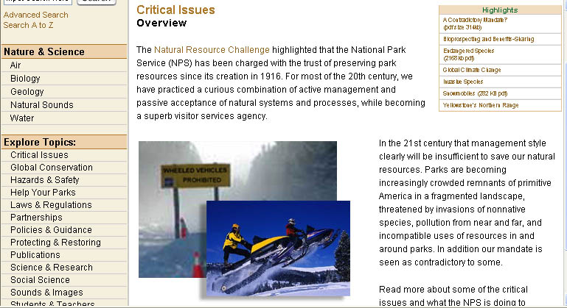
Natural Resource Challenges

Slide 14
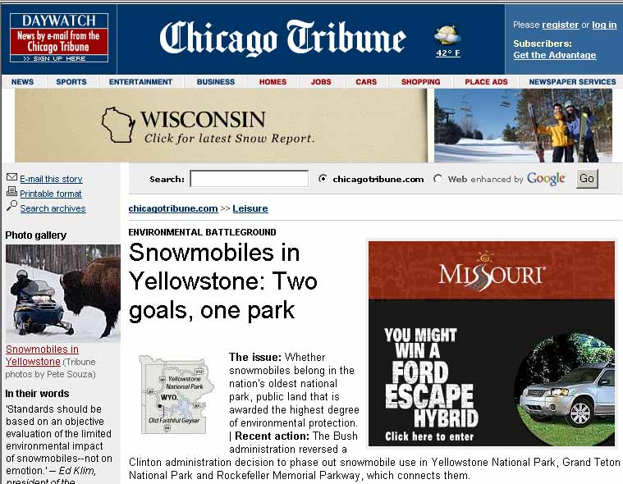
Public Pressure on Parks
Public use of National
Parks is very high.
Bumper-to-bumper
traffic in peak season.
Damage, pollution
caused by ATVs,
dirt bikes, snow
mobiles.
People get too close/
familiar with wildlife.
Park Service under
political pressure to
permit all uses.

