Slide 1
Overview of Conservation Organizations

Slide 2
Federal Conservation Agencies
Department of Agriculture
Forest Service
Natural Resources Conservation Service
Department of Commerce
National Marine Fisheries Service
Department of the Interior
Bureau of Land Management
Fish and Wildlife Service
Geological Survey
Minerals Management Service
National Park Service

Slide 3
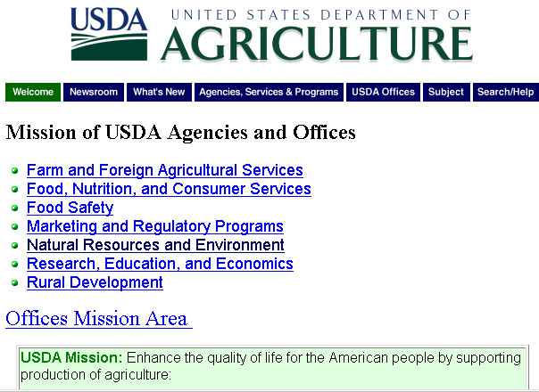

Slide 4

Natural Resources and Environment (NRE) Mission Area
The goal of the Natural Resources and Environment mission
area is to ensure the health of the land through sustainable
management. To achieve this goal, NRE agencies work to:
prevent damage to natural resources and the environment;
restore the resource base and environment to a healthy and
sustainable condition where it is impaired; and promote good
land management to conserve resource health and ensure the
maximum return from investment in conservation. NRE is
composed of the Forest Service (FS) and the Natural Resources
Conservation Service (NRCS). Both agencies also assist with
rural development and help communities with natural resource
concerns, such as erosion control, watershed protection, and
forestry.

Slide 5

U.S. DEPARTMENT OF COMMERCE
Bureau of Economic Analysis
Bureau of Industry and Security
Census Bureau
Economic Development Administration
Economics and Statistics Administration
International Trade Administration
Minority Business Development Agency
National Institute of Standards and Technology
National Oceanic & Atmospheric Administration
National Telecommunications & Information Administration
Office of Civil Rights
Patent and Trademark Office
Technology Administration

Slide 6

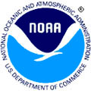

National Oceanographic and Atmospheric Administration
Charting and Navigation
Climate
Coasts
Fisheries
Oceans
Research
Satellites
Weather

Slide 7

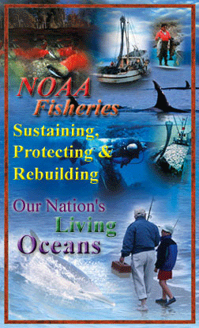
National Marine Fisheries Service
Fisheries Management and Conservation
Marine Mammal Conservation
Sea Turtle Protection and Conservation
Marine Habitat Protection
Marine Biodiversity

Slide 8
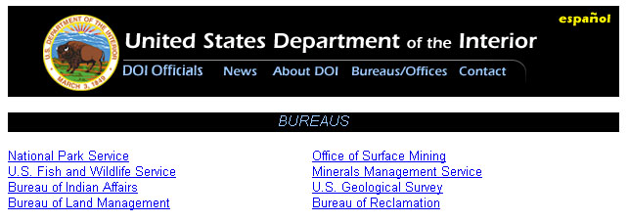
The Department of the Interior (DOI) is the nation’s principal
conservation agency. Mission is to protect America’s
treasures for future generations, provide access to our nation’s
natural and cultural heritage, offer recreation opportunities,
honor trust responsibilities to American Indians and Alaska
Natives and our responsibilities to island communities, conduct
scientific research, provide wise stewardship of energy and
mineral resources, foster sound use of land and water resources,
and conserve and protect fish and wildlife.

Slide 9
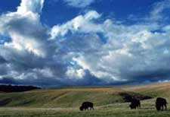
Dept. of Interior’s
Land Management
DOI manages 507 million acres of
surface land, or about one-fifth of
the land in the United States,
including:
262 million acres by Bureau of Land Management
95 million acres by the Fish and Wildlife Service
84 million acres by the National Park Service
8.6 million acres by the Bureau of Reclamation
associated with reclamation projects
56 million acres by the Bureau of Indian Affairs

Slide 10
U.S. Geological Survey
Monitor, analyze, interpret, and disseminate information on
earthquakes, volcanoes, and the geology and topography of
the United States.
Monitor and assess water quality, stream flow and ground water
at thousands of sites across the nation
Produce more than 100,000 different maps
Estimate world and United States energy and mineral supplies
Conduct a wide range of research on biology, geology, and water
to provide land and resource managers information they need to
make sound decisions, and to help mitigate the effects of
natural hazards.

Slide 11
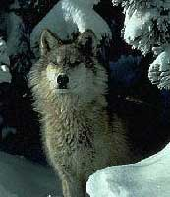
Fish and Wildlife
Service
Improves habitats for migratory
birds, certain marine animals,
freshwater and anadromous fish,
as well as providing public enjoyment of these resources
Protects 1,851 endangered or threatened species.
Prevents and controls spread of invasive species

Slide 12
Top 5 Non-Governmental Organization's
Environmental Defense Fund Brings together science, economics,
and law to create solutions to environmental problems.
National Audubon Society Fights for the protection of wildlife and its
habitat, forests, and endangered species.
The Nature Conservancy Protects land where endangered species
and threatened ecosystems exist.
Sierra Club Dedicated to exploring and protecting the earth's wildlands
and promoting the responsible use of the earth's resources.
Wilderness Society Concerned with preserving wilderness and wildlife,
and protecting America's prime forests, parks, rivers, deserts and shorelands.

