Slide 1
Population Ecology

Slide 2
Populations
Population is a group of individuals with a high
probability of exchanging genes (close proximity;
when reproducing).
Populations have group characteristics (density,
birth and death rates, age structure, sex ratio,
demography).
Age specificity: rate of life functions varying by age;
i.e., age-specific birth rate/death rate

Slide 3
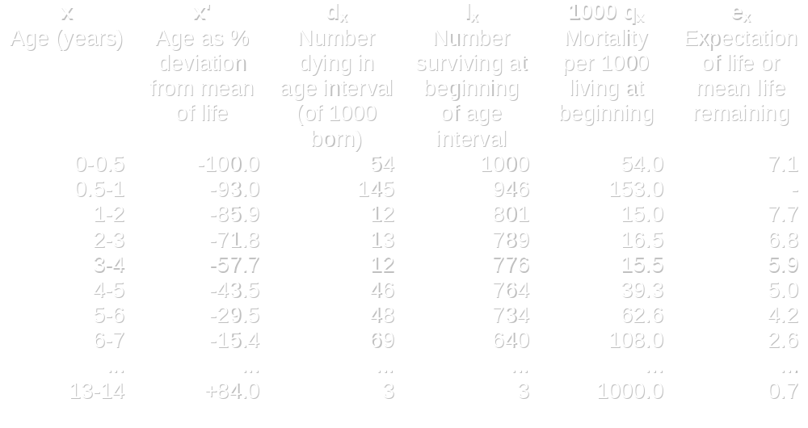
Life Tables

Slide 4
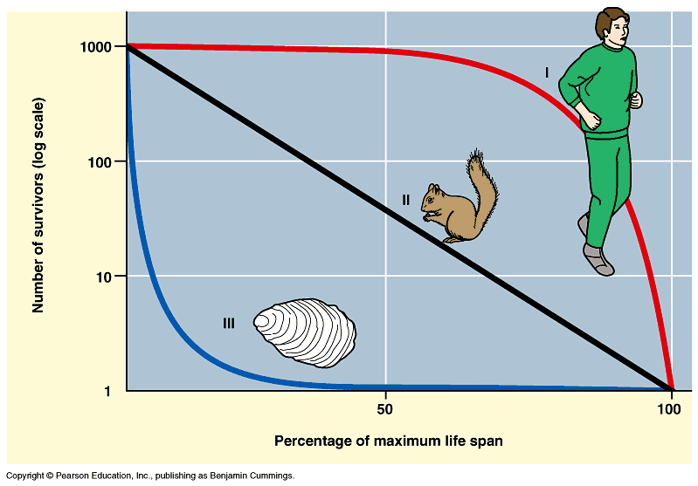
Survivorship curves

Slide 5
Population growth
Population growth rate = intrinsic rate of
increase (Malthusian parameter)
In closed population, determined by
birth and death rates:
r = b - d
where :
    b = births (natality)
    d = deaths (mortality)

Slide 6
Population growth cont’d
Population growth in open population determined
by births, deaths, and movements of individuals
into and out of populations:
r = (b + I) - (d + E )
  where :
    b = births (natality) I = immigration
    d = deaths (mortality) E = emigration

Slide 7
Exponential Growth
dN/dt = rN
Change in population size (N) over
time period (t)
Unchecked population with unlimited
resources grows exponentially

Slide 8
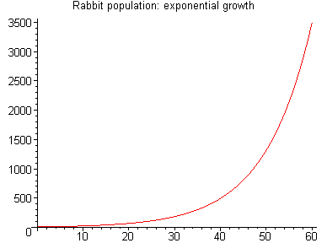
Exponential Growth
http://www.mapleapps.com/categories/mathematics/desolving/html/images/growth15.gif

Slide 9
Logistic growth
Eventually, resources become limiting and/or
negative interactions among members of the
population start to occur.
So equation has to be modified to describe
carrying capacity (K) of environment at which
point no net growth in population occurs
  dN/dt = rN(K-N)
  K
  as N gets close to K, growth slows and dN/dt → 0

Slide 10
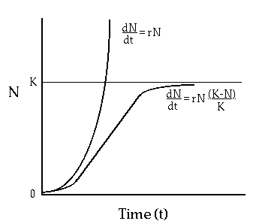
Logistic growth
http://nimbus.ocis.temple.edu/~rsanders/LogGrwthCrv.gif

Slide 11
Factors contributing to carrying capacity
Limits can be related to number of individuals in the
population - density dependent factors
    e.g. resource competition
Or some factor external to population - density
independent
    e.g. frost, flood, fire, locust plague

Slide 12
Life history strategies
Recognition of different kinds of factors limiting populations (extrinsic vs. intrinsic) led to belief that populations could evolve different life history strategies.
Two different strategies recognized (r vs K),
emphasizing basic differences in population
growth curves.

Slide 13
R strategists
tend to live in harsh, variable, frequently
disturbed environments
limited by environmental (density independent)
factors
large allocation to reproduction
high population growth rates
short-lived
generalists, broad niches, opportunistic
“r” region of logistic curve

Slide 14
K strategists
tend to live in stable, predictable environments
limited by density dependent & biotic factors
longer-lived
higher allocation to growth, competitive ability
specialists, narrow niche
“K” region of logistic curve

