Slide 1

Mission
to preserve the plants, animals and natural communities that represent the diversity of life on Earth by protecting the lands and waters they need to survive

Slide 2
Approach
Strategic, science-based planning process, called
Conservation by Design, which helps TNC identify the
highest-priority places—landscapes and seascapes that,
if conserved, promise to ensure biodiversity over the long
term.

Slide 3

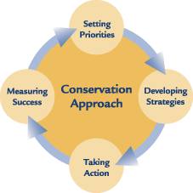
The Nature Conservancy employs an
integrated conservation process
comprising of four fundamental
components:
1. Setting priorities through ecoregional planning and global habitat
assessments;
2. Developing strategies at multiple scales to address ecoregional priorities
and global threats;
3. Taking direct conservation action;
4. Measuring conservation success.

Slide 4
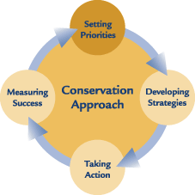
1. Setting priorities
Through global major habitat type assessments and
ecoregional planning.
Scientific assessments of Earth’s 30+ major habitat types to establish top
priorities for conservation at a global scale.
Assessments examine biodiversity richness and threats to biodiversity and
ecosystems.
TNC also designs portfolios of conservation areas within and across
ecoregions.
Ecoregional portfolios represent the full distribution and diversity of native
species, natural communities and ecosystems.

Slide 5
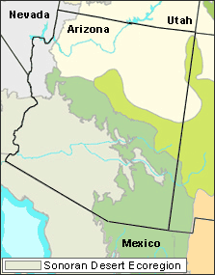
Ecoregion-based planning
Designing ecoregion-based portfolios is
complex, iterative process based on five
steps:
Identifying the species, communities and
ecosystems in an ecoregion;
Setting specific goals for the number and
distribution of these conservation targets
to be captured in the portfolio;
Assembling information and relevant data
on the location and quality of conservation
targets;
Designing a network of conservation areas that
most effectively meets the goals; and Identifying
the highest priority conservation areas, wide-ranging targets and pervasive threats
for conservation action.

Slide 6
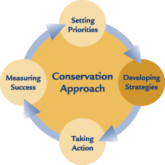
2. Developing Strategies
TNC develops and implements conservation
strategies at two basic geographic scales:
Single-Area Strategies
Employs 5-S Framework for Conservation Project
Management
Multi-Area Strategies
Priorities that affect multiple conservation areas

Slide 7
5-S planning approach
Systems
Focal conservation targets and their key ecological attributes.
Stresses
Most serious types of destruction or degradation affecting conservation
targets or key ecological attributes.
Sources of stress
Causes or agents of destruction or degradation.
Strategies
Full array of actions necessary to abate the threats or enhance viability of
conservation targets.
Success measures
Monitoring process for assessing progress in abating threats and improving
the biodiversity health of a conservation area.

Slide 8
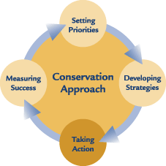
3. Taking Action
Types of action TNC takes include:
Fee acquisition of land and waters
Joint land- and water-management agreements
Repository for mitigation lands and other land grants
Environmental education
Public policy

Slide 9
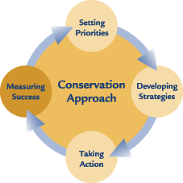
4. Measuring Success
The Nature Conservancy defines conservation success
as the combination of three outcomes:
Maintenance of viable biodiversity,
Abatement of critical threats
Effective protection and management of places where action
is taken with partners.

