Slide 1
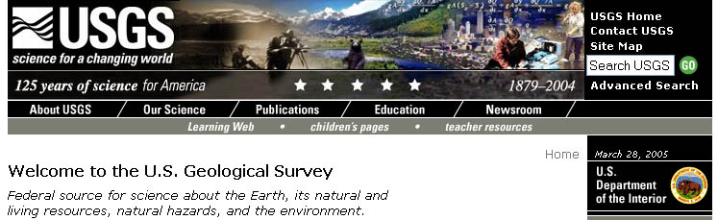
Monitor, analyze, interpret, and disseminate information on earthquakes, volcanoes, and the geology and topography of the United States.
Monitor and assess water quality, stream flow and ground water at thousands of sites across the nation
Produce more than 100,000 different maps
Estimate world and United States energy and mineral supplies
Conduct a wide range of research on biology, geology, and water to provide land and resource managers information they need to make sound decisions, and to help mitigate the effects of natural hazards.

Slide 2
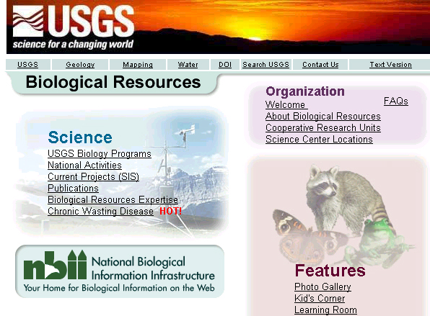
U.S. Geological Survey
Biological Resources Division

Slide 3
USGS/BRD: Checkered Past
1885 - Ornithological Office established in the Entomology
Division, U.S. Department of Agriculture.
1886 - Mission extended to mammals. Division of
Economic Ornithology and Mammalogy created.
1896 - Name changed to the Division of Biological Survey. 1905 - Division elevated to the Bureau of Biological Survey (BBS).
1939 - BBS becomes part of the U.S. Fish and Wildlife
Service at the Department of the Interior.
1993 - Formation of the National Biological Service (NBS).
1996 - NBS becomes part of USGS as the BRD

Slide 4
USGS/BRD Mission
BRD is a research focused agency; whereas USFWS is more
practice oriented.
BRD works cooperatively with Federal and State agencies
to share information necessary to develop a comprehensive
picture of the Nation's biological resources.
Majority of BRD programs and resources directed towards
needs of Interior resource management bureaus, such as
development of annual waterfowl regulations, research on
better land protection strategies for national parks, and
investigations on optimal water control practices (for
reservoirs) for enhancement of fisheries.

Slide 5
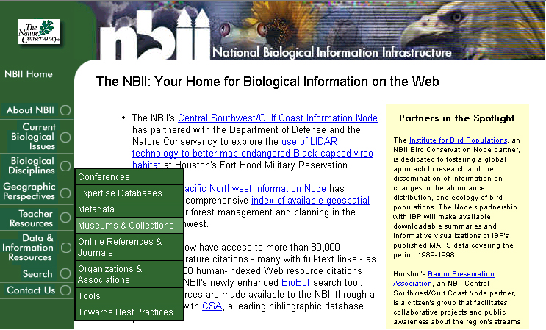
National Biological Information Infrastructure
Network of distributed databases on biological resources used by
Federal and State agencies, researchers,universities and museums,
consultants, private companies, landowners, and the public

Slide 6
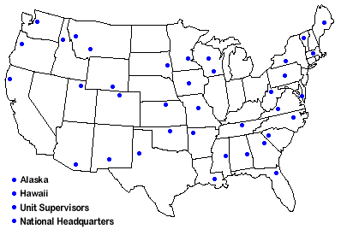
Cooperative Research Units
39 CRU’s
around
the U.S.
Conduct
research
on renewable
resources.
Participate
in graduate
education.
Provide
technical
assistance on natural resource issues, and various forms of continuing
education for natural resource professionals.

Slide 7
Other National Activities
Biomonitoring of Environmental Status and Trends (BEST)
A program designed to identify and understand the effects of
environmental contaminants on biological resources.
Bird Banding Laboratory (BBL)
The North American Bird Banding Program is jointly
administered by the USGS Biological Resources
Division and the Canadian Wildlife Service to study the
movement, survival, and behavior of birds.
Gap Analysis Program (GAP)
A geographic approach for assessing the current protection
of biological diversity over large geographic areas.

Slide 8
National Activities cont’d
Global Change Research Program
Contributes to an understanding of the processes and impacts
of global climate change.
Geospatial Technology Program
Provides national coordination for the use and application
of geographic information systems, remote sensing
technologies, satellite positioning systems, telemetry, and
thematic mapping technology.
Integrated Taxonomic Information System (ITIS)
A standard reference on nomenclature and taxonomy of plants
and animals.

Slide 9
National Activities cont’d
Land Use History of North America (LUHNA)
A multi-year project to prepare a scientifically based
"history" of land use change across North America,
from prehistoric times to the present.
National Water-Quality Assessment Program (NAWQA)
Designed to describe the status and trends in the quality
of the Nation's ground- and surface-water resources.
USGS-NPS Vegetation Mapping Program
Cooperative effort to classify, describe, and map vegetation
communities in more than 250 national park units across
the United States.

Slide 10
National Activities cont’d
North American Breeding Bird Survey
A source of population trend and distribution information
for most species of North American birds.
Nonindigenous Aquatic Species Program
A national information resource for accurate and spatially
referenced biogeographic accounts of nonindigenous
aquatic species.
NPFlora and NPFauna databases
Databases of vertebrate and vascular plant occurrences in
the National Parks.

