Slide 1
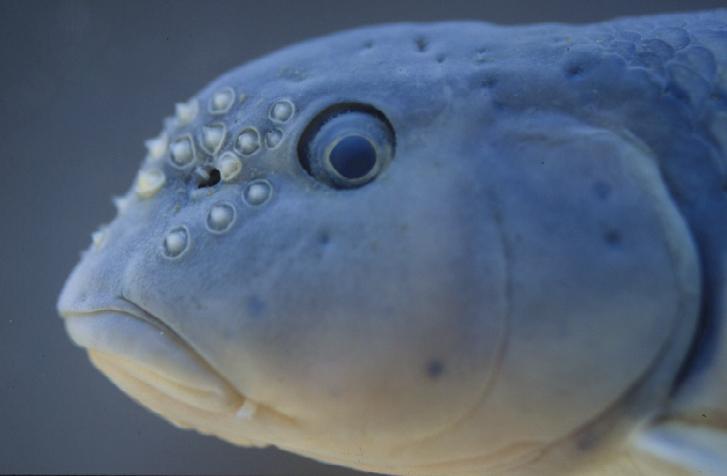
Ichthyology: ZOO 456/556
Dr. Kyle Piller

Slide 2
What is a fish?
Ichthyology: the study of fishes

Slide 3
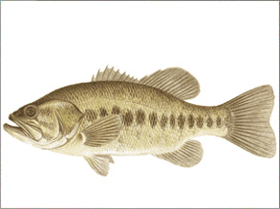
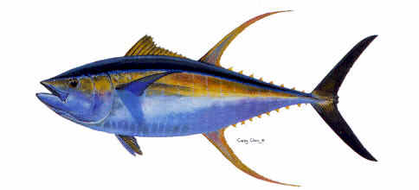
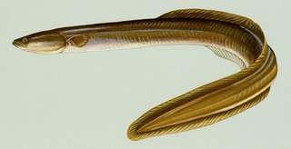
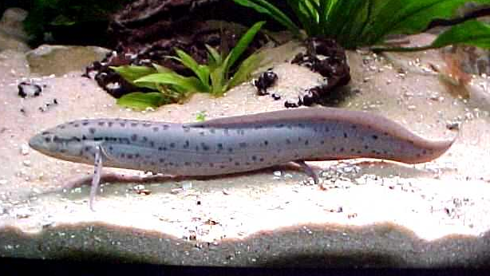
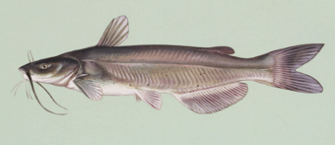
Anatomical definition: A fish is an aquatic vertebrate that respires using gills, is ectothermic, has fins, and has skin that is usually with scales

Slide 4
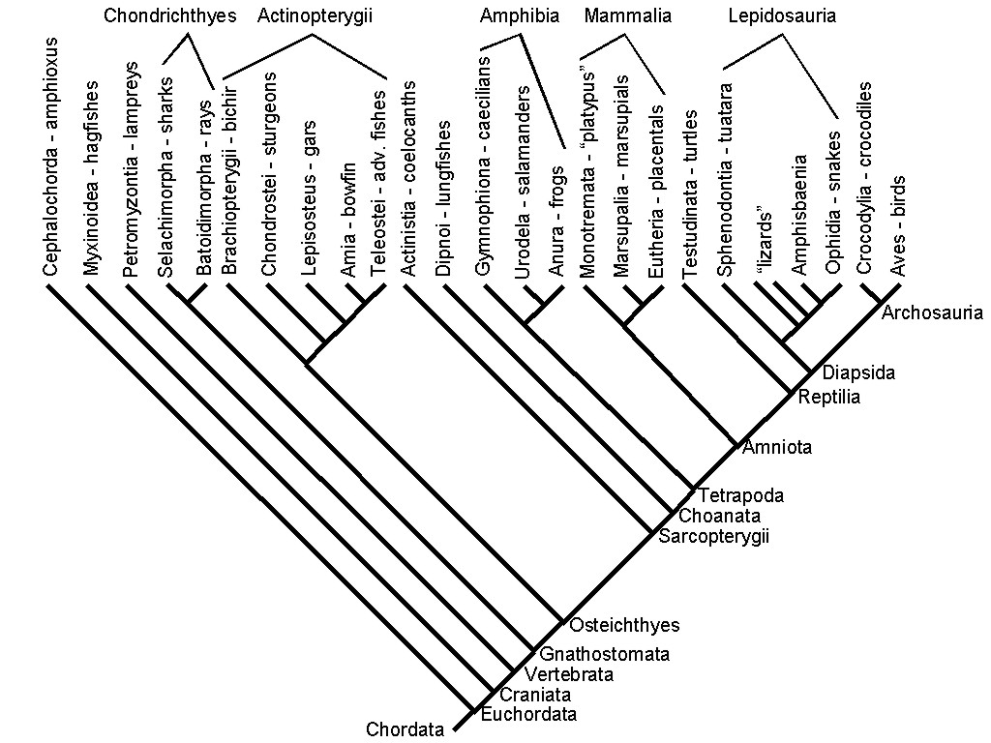
Phylogenetic definition: fish are vertebrates (craniates) that occupy a phylogenetic position between cephalochordates (lancelets) and amphibians.
“Paraphyletic”

Slide 5
Three groups of living fishes recognized:
Agnathans - jawless fishes
Chondrichthyans - cartilaginous fishes
Teleostomes (Osteichthyans) - bony fishes

Slide 6
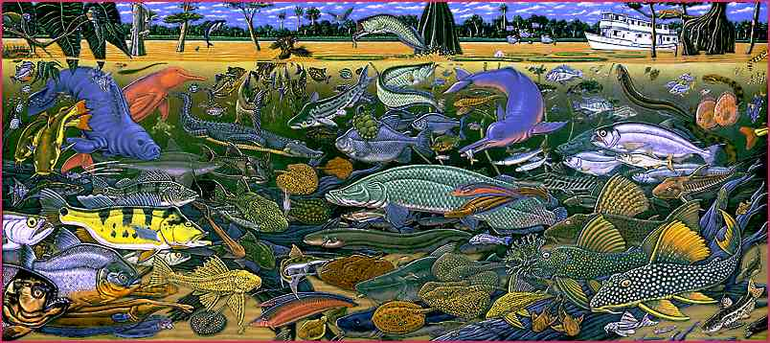
“Fishy Facts”
>25,000 species
  Half of all vertebrates
(Image by Ray Troll)

Slide 7
“Fishy Facts”
FW SW
Available habitat 0.01% 96%
Diversity of fishes 41% 58%

Slide 8
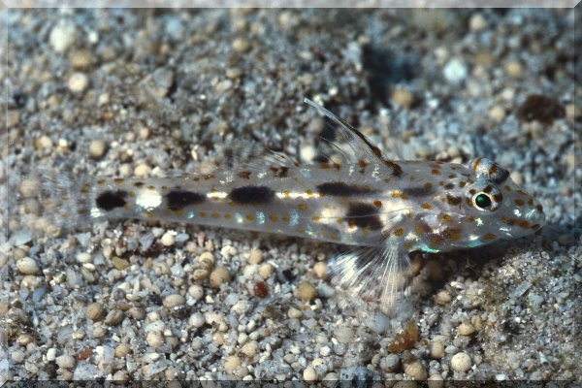
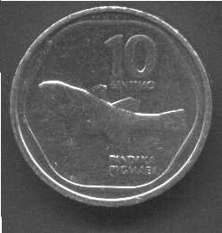
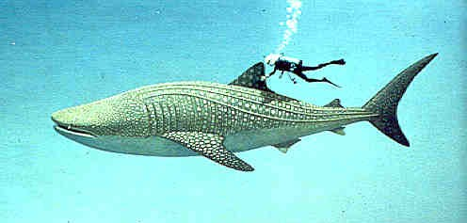
“Fishy Facts”

Slide 9


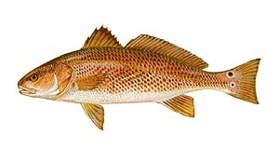
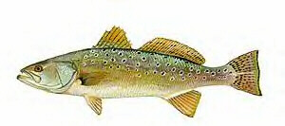
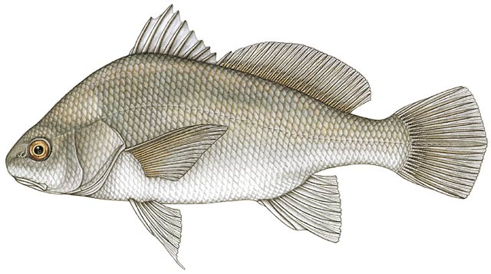
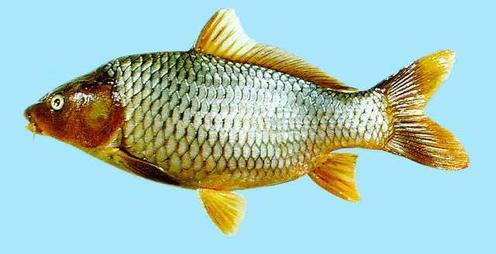
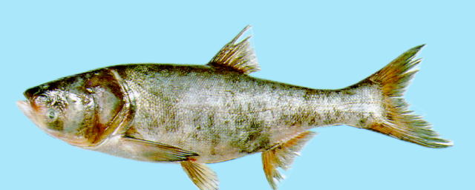
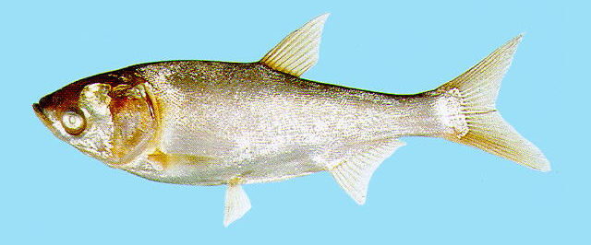

Slide 10
History of Ichthyology

Slide 11

Aristotle
(384-322 BC)

Slide 12

Peter Artedi
(1705-1735)

Slide 13
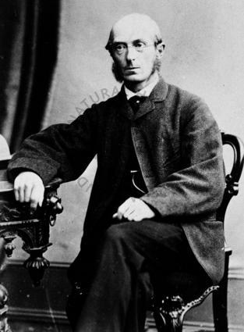
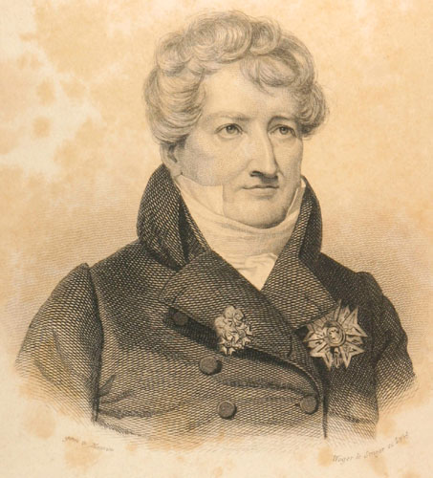

George Cuvier and
Achille Valenciennes
Histoire Naturelle de Poissons
(1828-1849)
Albert Gunther
Fishes of the British Museum (1870)

Slide 14

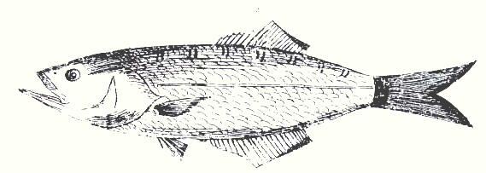
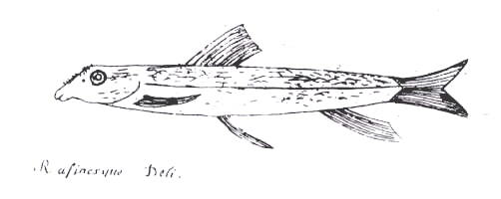
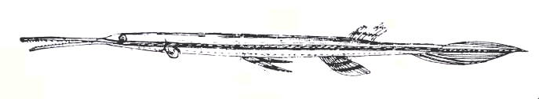
Constantine Samuel Rafinesque
(1738-1840)
Ichthyologia Ohiensis (1820)

Slide 15
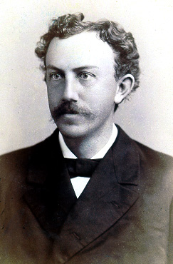
David Starr Jordan
(1851-1931)
Fishes of North and Middle America (1896-1900)
Manual of vertebrates of the northern United States (1876)

Slide 16
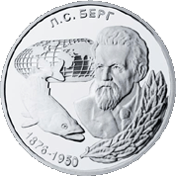

Leo Berg
(1876-1950)
A classification of fishes both recent and fossil fishes (1947)

Slide 17
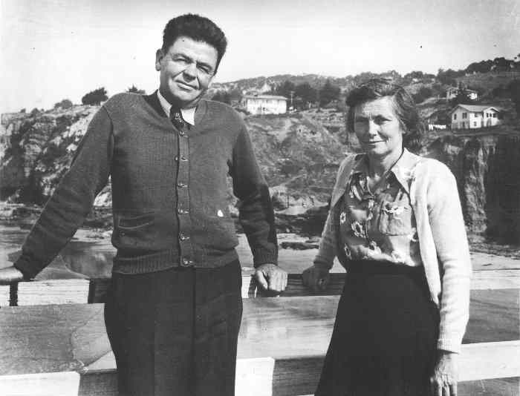
Carl Hubbs
(1894-1977)
Over 700 publications on fishes!
Fishes of the Great Lakes Region (1947)

Slide 18


Joe Nelson
(Extant)

Slide 19
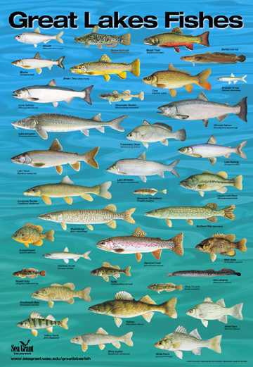

Slide 20
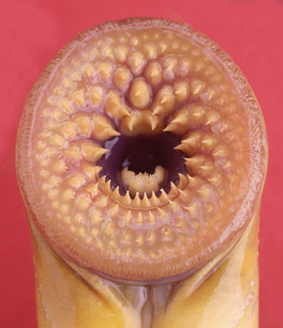
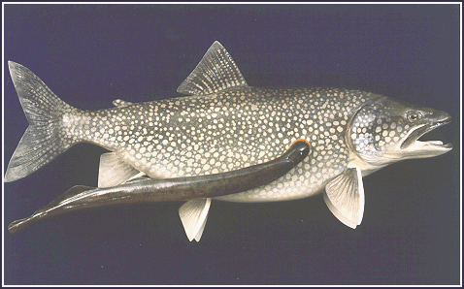
Next Time……
Jawless Fishes & Lab #1

