Slide 1
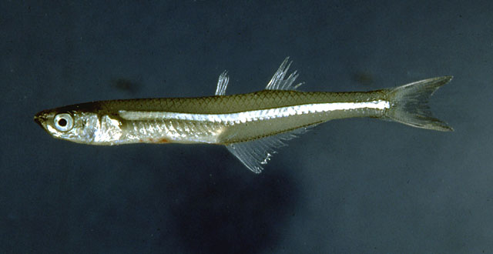
Basal Acanthopterygians

Slide 2
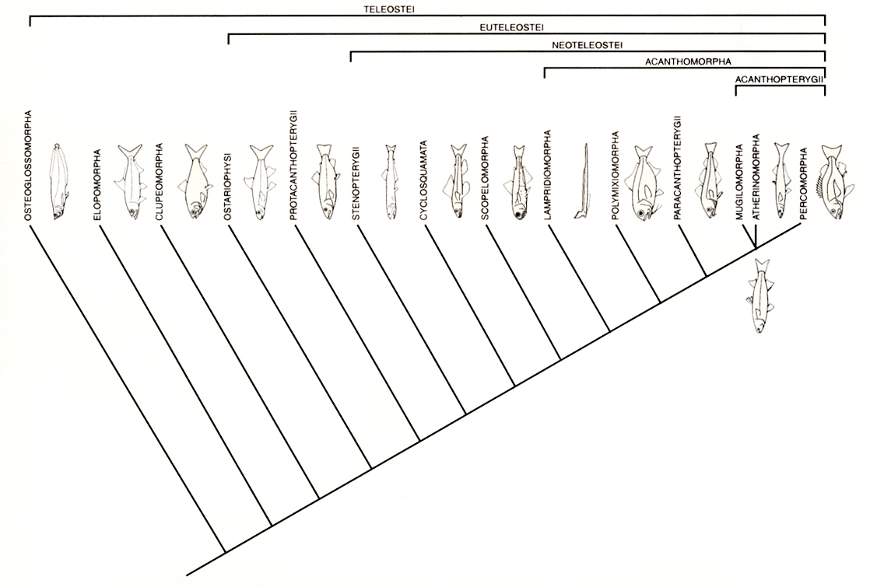

Slide 3
Superoder Acanthopterygii
Spiny-finned fishes - perches, basses, tunas, flounders, etc.
13,500 species
Marine, freshwater, and anadromous
  (23% strictly freshwater)
Dominate shallow water marine habitats
Dominate in warmer freshwater lakes

Slide 4
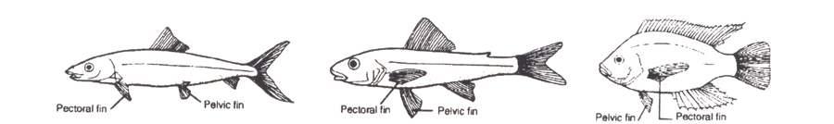
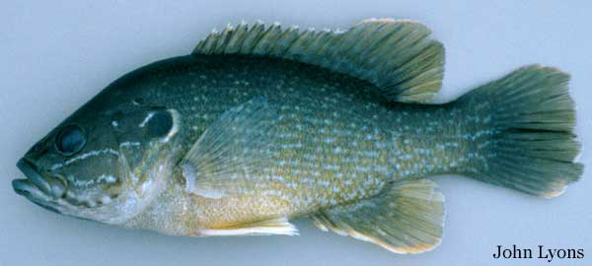
Superorder Acanthopterygii
Pelvic fins thoracic or jugular
Vertically aligned, midlateral pectorals

Slide 5
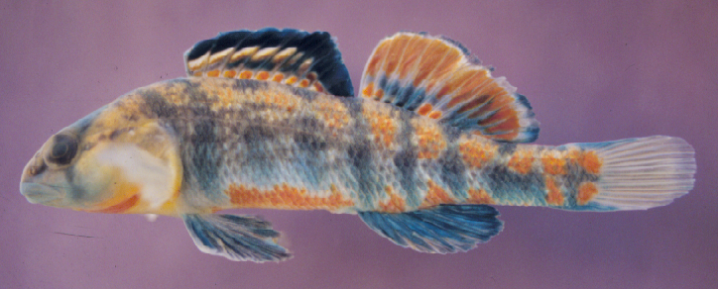
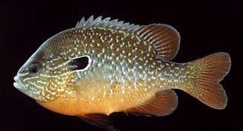
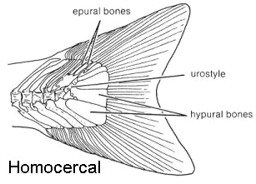
Superorder Acanthopterygii
Two dorsal fins
  Spiny (anterior)
  Soft (posterior)
No adipose fin
Homocercal tail

Slide 6
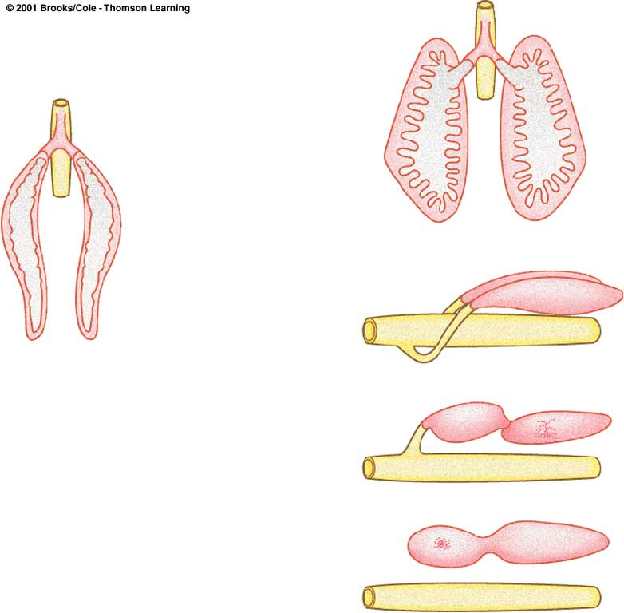
Superorder Acanthopterygii
Swim bladder physoclistous or absent

Slide 7
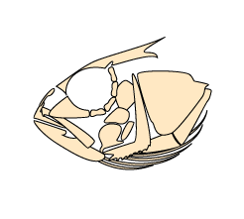
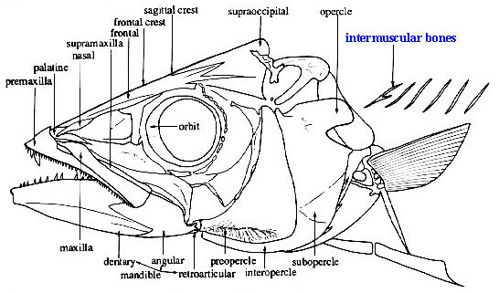
Superorder Acanthopterygii
Premaxilla and maxilla protractile
Maxillae toothless, excluded from gape

Slide 8
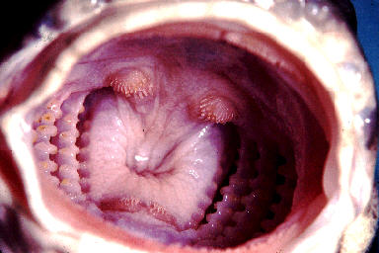
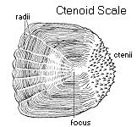
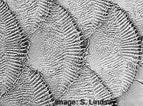
Superorder Acanthopterygii
Highly modified pharyngeal
mill (dorsal and ventral tooth pads)
Ctenoid scales
(most)

Slide 9
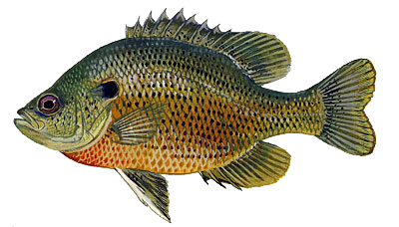
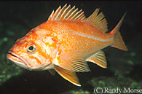
Acanthopterygii adaptations
Spiny rayed fins (first dorsal, anal, pelvics) increase effective body diameter, making swallowing difficult for a gape-limited predator, especially one attacking from the rear.

Slide 10
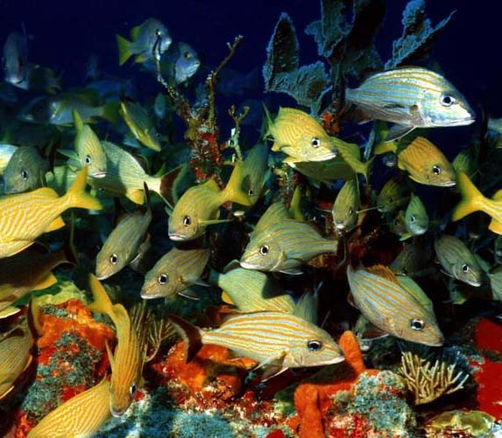
Acanthopterygii adaptations
Paired fin placement improves maneuverability:
Mid lateral pectorals used for propulsion
Thoracic pelvics used for breaking
Fin placement adapts
acathopterygians for life
around structures
Most successful in shallow
marine environments such
as coral reefs

Slide 11
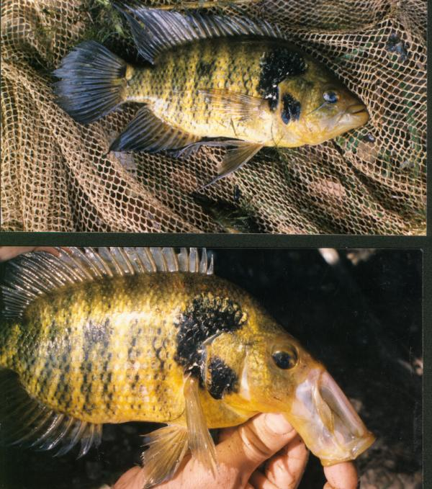
Acanthopterygii adaptations
Feeding specializations
  protrusible jaws allow
  feeding specializations
  such as suction feeding

Slide 12
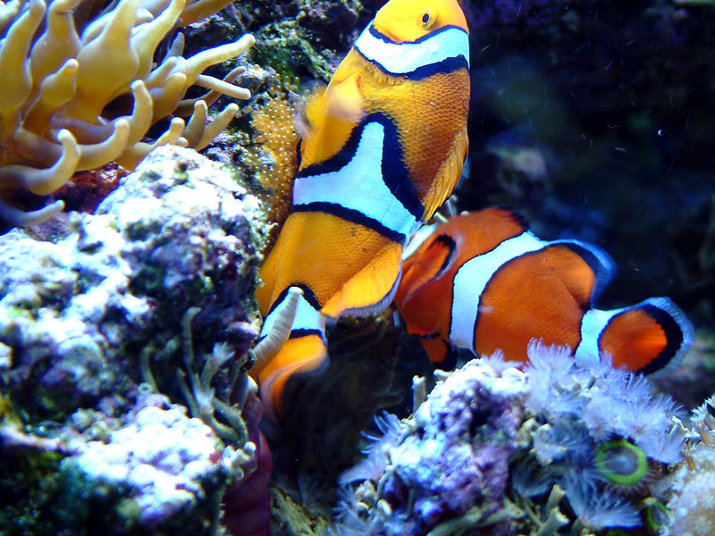
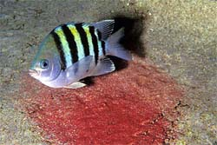
Acanthopterygii adaptations
Reproductive specializations
  territoriality
  elaborate courtship
  parental care

Slide 13
Superorder Acanthopterygii
Subdivision Teleostei
Infradivision Euteleostei
Superorder Acanthopterygii (14 orders, 250 families)
Series Mugilomorpha
Order Mugiliformes
Series Atherinomorpha
Order Cyprinodontiformes
Order Atheriniformes
Order Beloniformes
Series Percomorpha

Slide 14
Superorder Acanthopterygii
Subdivision Teleostei
Infradivision Euteleostei
Superorder Acanthopterygii
Series Mugilomorpha
Order Mugiliformes
Series Atherinomorpha
Order Cyprinodontiformes
Order Atheriniformes
Order Beloniformes
Series Percomorpha
Basal acanthopterygians

Slide 15
Superorder Acanthopterygii
Subdivision Teleostei
Infradivision Euteleostei
Superorder Acanthopterygii
Series Mugilomorpha
Order Mugiliformes
Series Atherinomorpha
Order Cyprinodontiformes
Order Atheriniformes
Order Beloniformes
Series Percomorpha

Slide 16
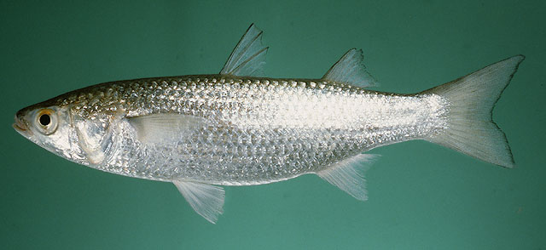
Series Mugilomorpha
Marine, anadromous, some FW (77 species)
Two dorsals (spinous and soft)
Pectorals fins set high on body and vertical
Thoracic pelvics
Cycloid scales (or intermediate)
Detritivores/planktivores

Slide 17
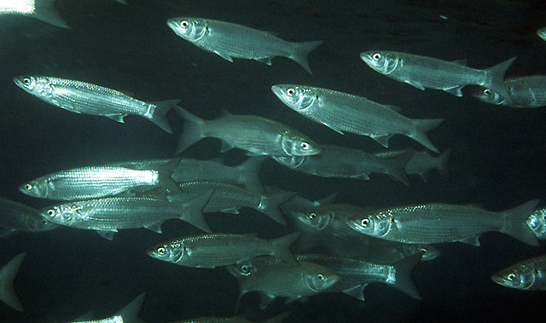
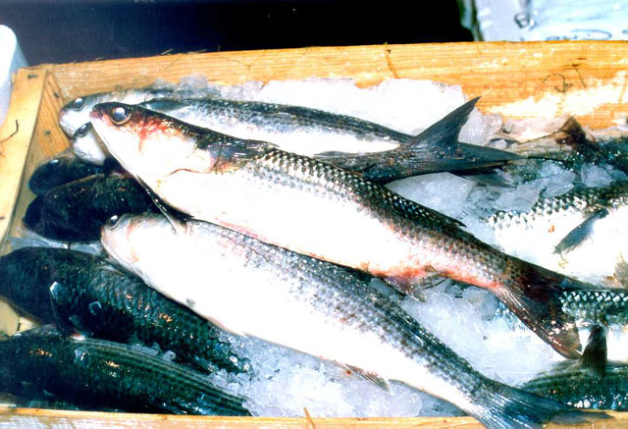
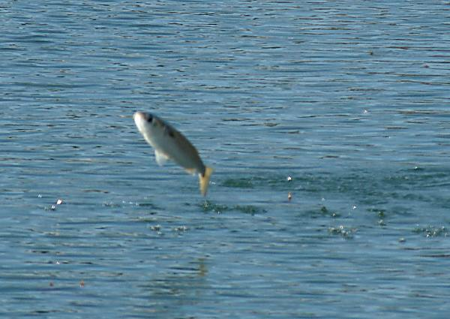
Order Mugiliformes
Family Mugilidae
(mullets)

Slide 18
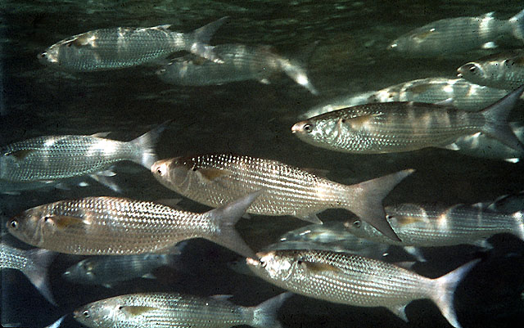
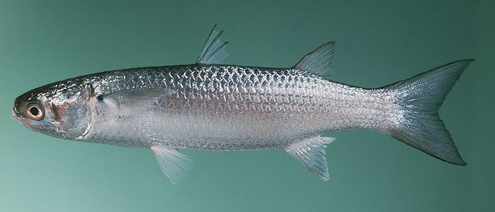
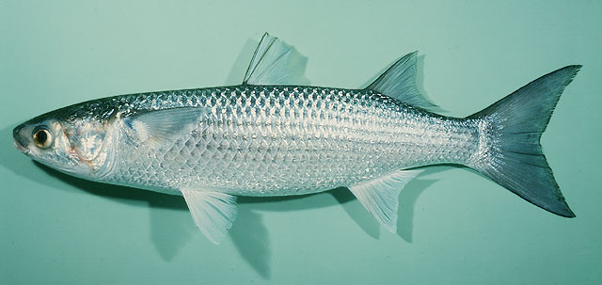

Slide 19
Superorder Acanthopterygii
Subdivision Teleostei
Infradivision Euteleostei
Superorder Acanthopterygii
Series Mugilomorpha
Order Mugiliformes
Series Atherinomorpha
Order Cyprinodontiformes
Order Atheriniformes
Order Beloniformes
Series Percomorpha

Slide 20
Series Atherinomorpha
Generally small, surface-oriented fishes
Large eyes, flattened heads, upturned mouths
Dorsal fins set far back on the body
Primarily marine, but many FW (“peripheral marine”)
Physoclistic swimbladder
Scales usually cycloid
No spines on opercular bones
3 orders

Slide 21
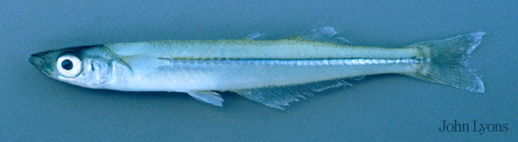
Order Atheriniformes
230+ species
Freshwater and shallow water marine
Slender, elongate body
Planktivores

Slide 22
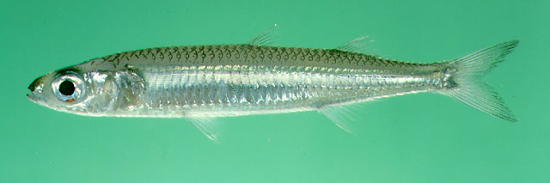
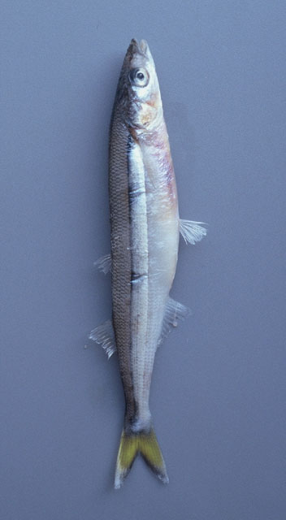
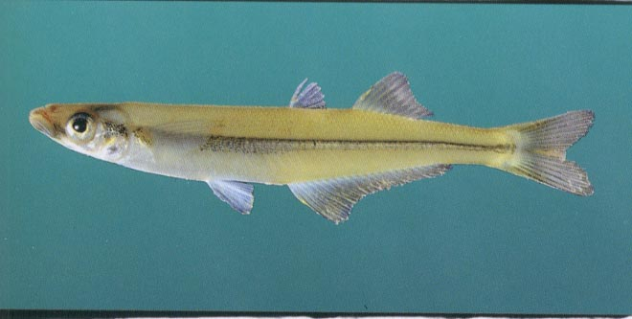
Order Atheriniformes
Family Atherinopsidae
Family Atherinidae
(silversides)

Slide 23
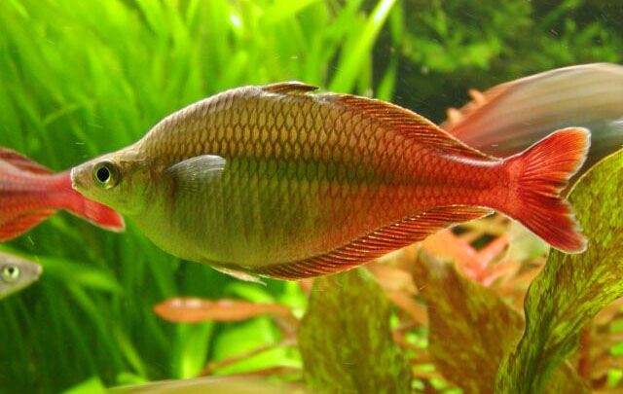
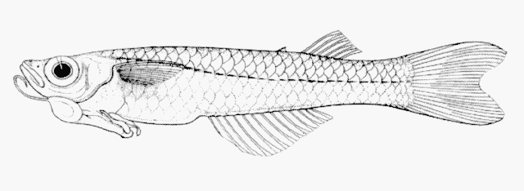
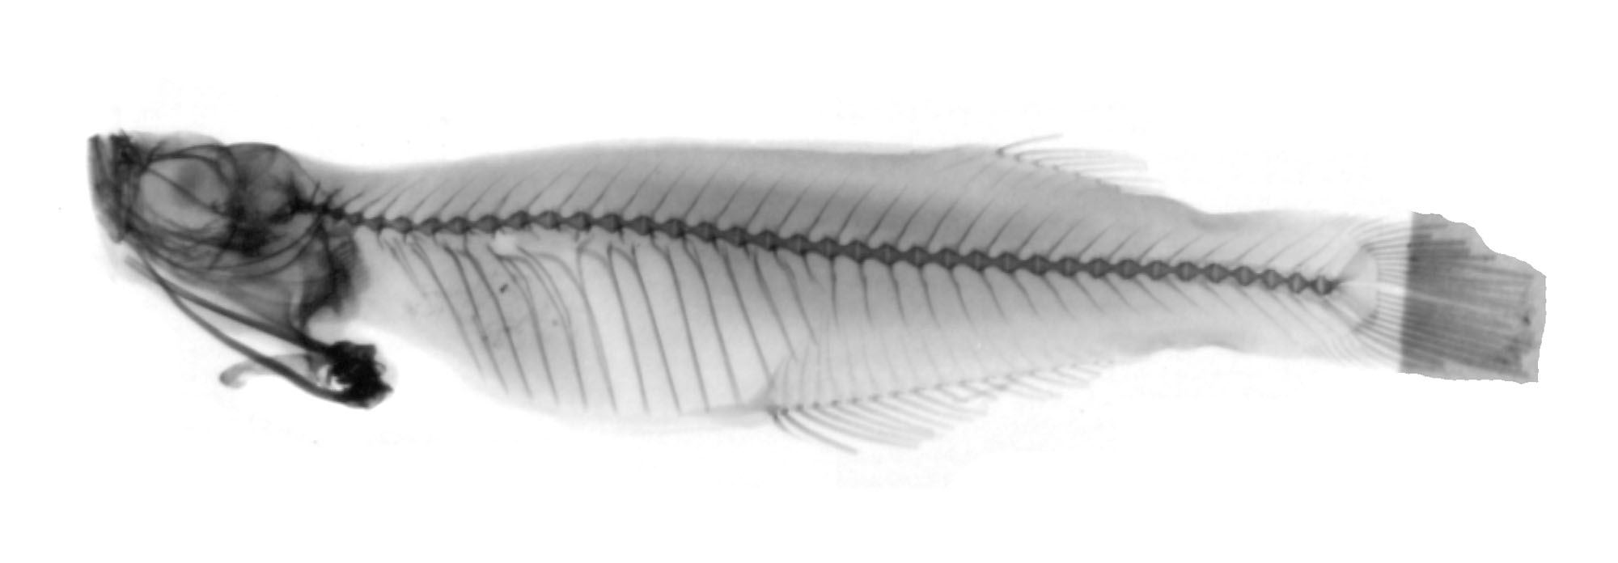
Order Atheriniformes
Family Melanotaeniidae
(rainbow fishes)
Family Phallostethidae
(priapium fishes)

Slide 24
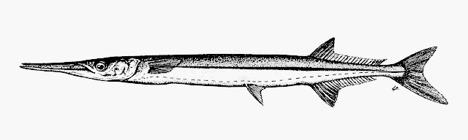
Order Beloniformes
Silvery marine fishes (191 species)
Epipelagic fishes
Roughly equal dorsal and anal fins located far back on the body,
Low-running lateral line
Abdominal pelvic fins

Slide 25
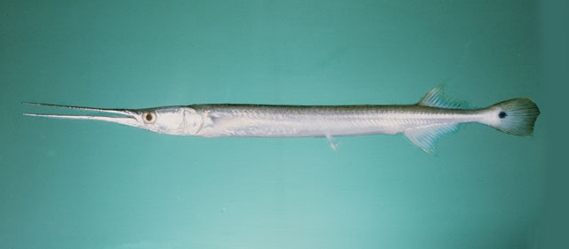
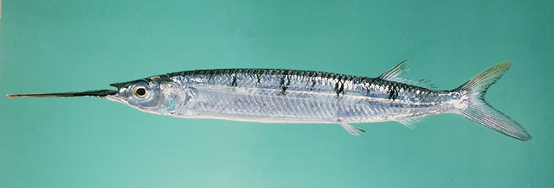
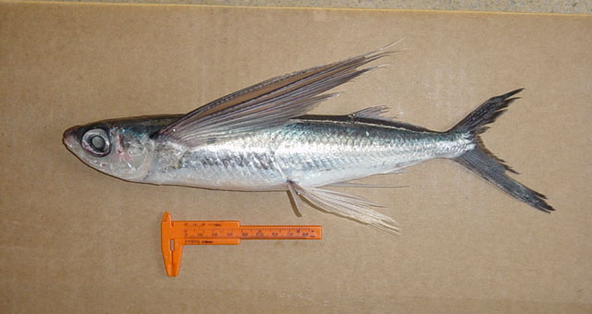
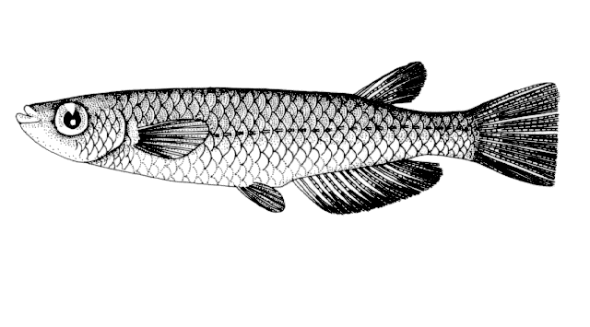
Order Beloniformes
Family Belonidae
Family Hemirhamphidae
Family Adrianichthyidae
Family Exocoetidae

Slide 26
Order Cyprinodontiformes
Most are FW, others are estaurine
Wide range of salinities and temperatures
  42C
  160ppt salinities
Small (<15cm)
807 species
Single dorsal fin, no fin spines

Slide 27
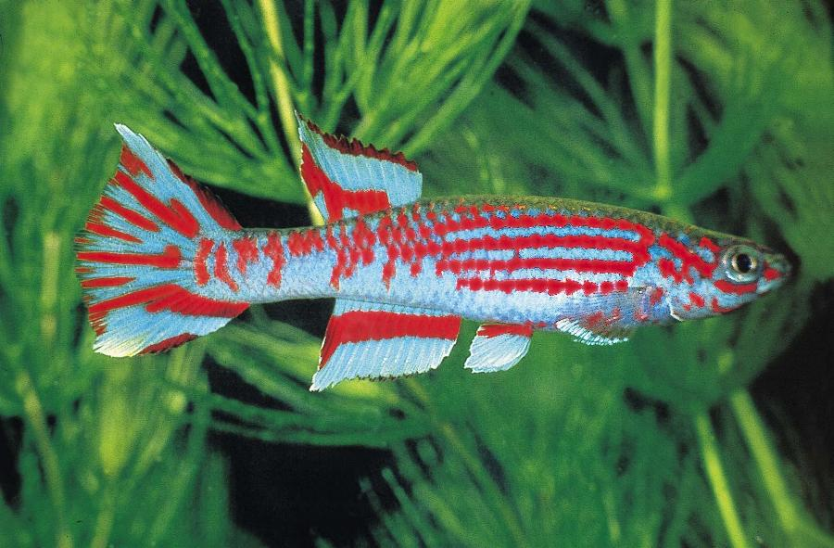
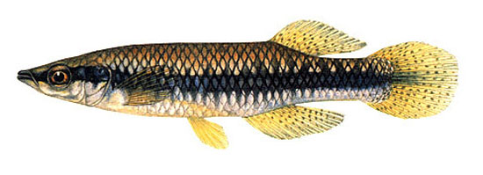
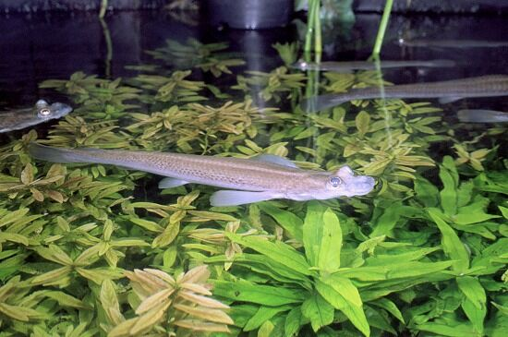
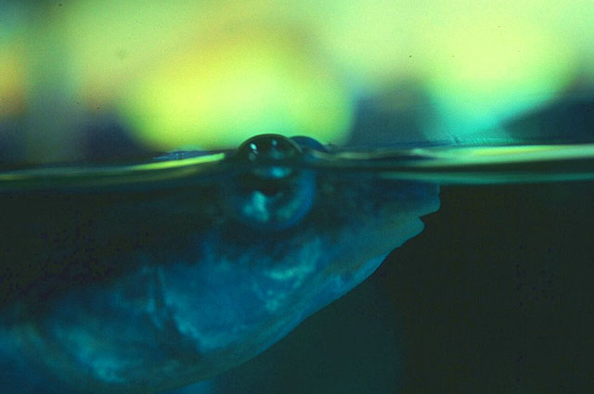
Order Cyprinodontiformes
Family Aplocheilidae
Family Fundulidae
Family Anablepidae

Slide 28
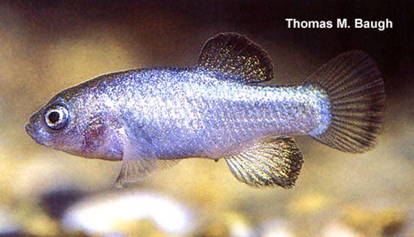
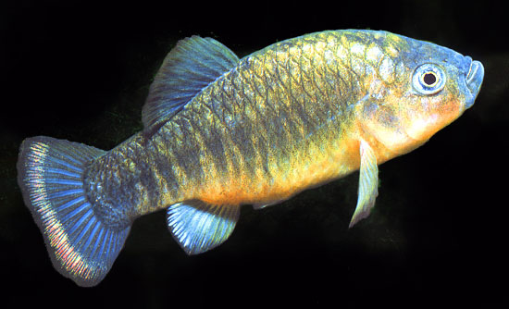
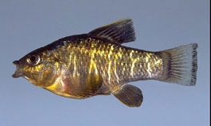
Order Cyprinodontiformes
Family Cyprinodontidae
(pupfishes)

Slide 29
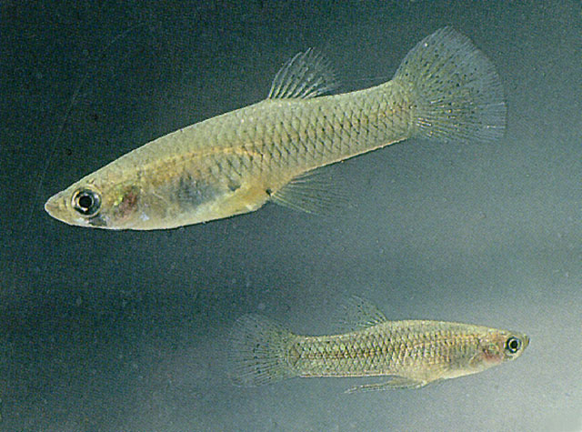
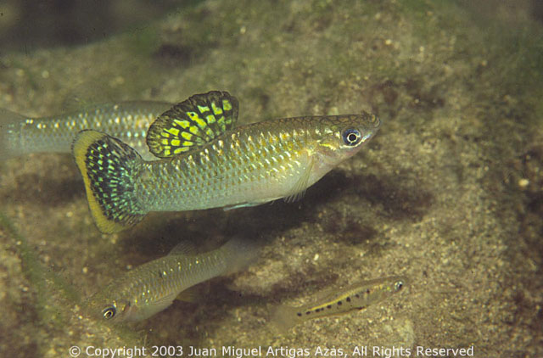
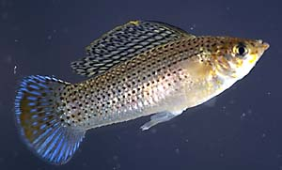
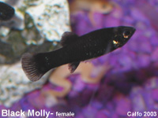
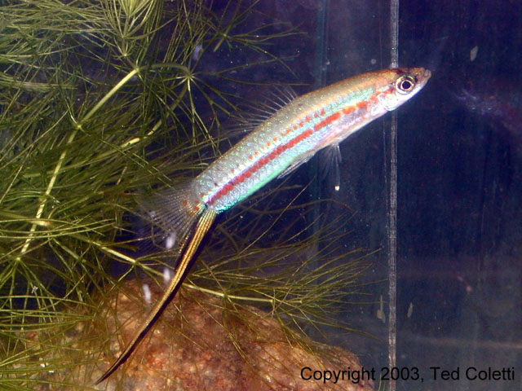
Order Cyprinodontiformes
Family Poecilidae (live bearers)

Slide 30



Poeciliidae
Males have a intromitten organ
called a gonopodium; females
retain, maternally nourish eggs.
Give birth to “live” young.

Slide 31


Order Cyprinodontiformes
Family Goodeidae (splitfins)
Another group of livebearers
endemic to Central Mexico.
Anal fin of males less
modified. Embryos absorb
maternal nourishment
through trophotaenia

