Slide 1
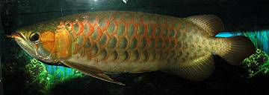
Early Teleosts

Slide 2
Division Teleostei
Class Actinopterygii (ray-finned fishes)
Subclass Chondrostei (sturgeon, paddlefish, etc)
Subclass Neopterygii
Division Unnamed (gars, bowfin)
Division Teleostei (teleosts)
Subdivision Osteoglossomorpha
Order Osteoglossiformes
Subdivision Elopomorpha
Order Elopiformes (tarpons, ladyfishes)
Order Albuliformes (bonefishes, spiny eels)
Order Anguilliformes (eels)
Order Saccopharyngiformes (gulpers)
Subdivision Clupeomorpha
Order Clupeiformes (herrings, anchovies)
Subdivision Euteleostei

Slide 3
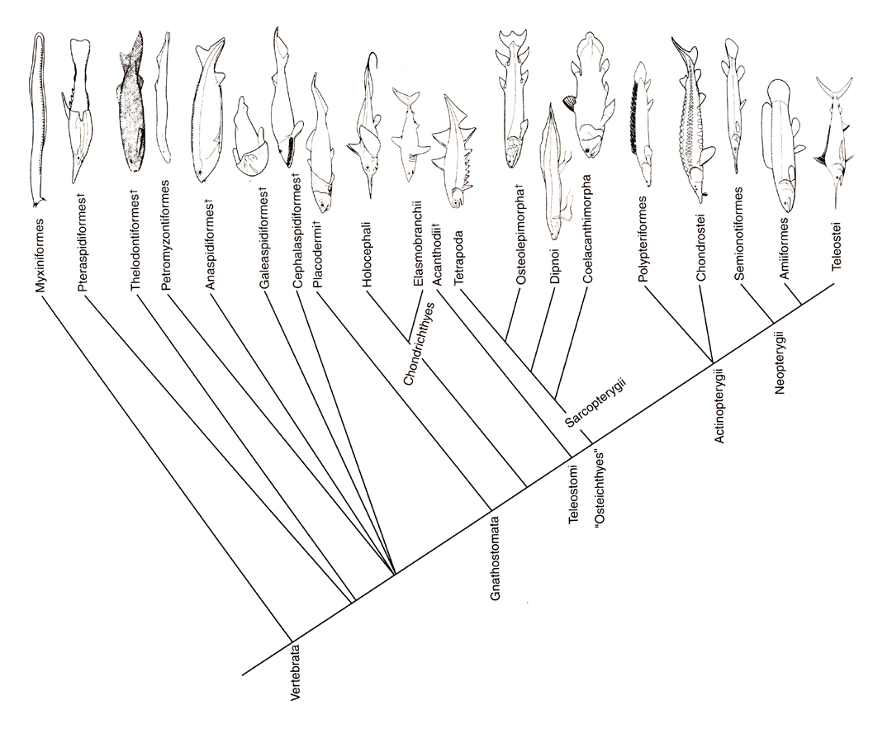

Slide 4
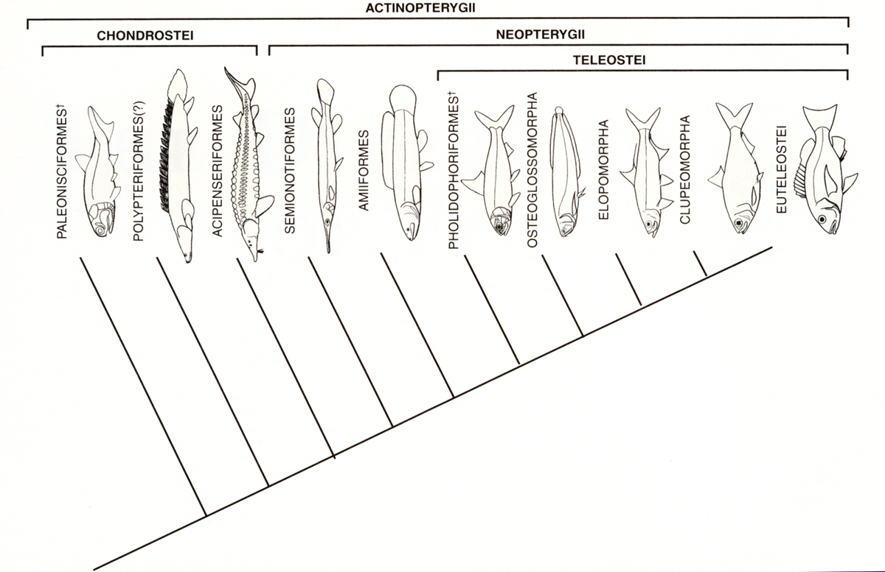

Slide 5
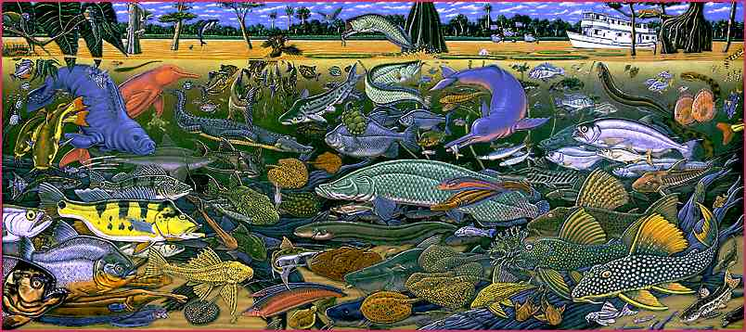
Division Teleostei
38 recognized orders, 425 families, 4,070 genera, and >20,000 species

Slide 6
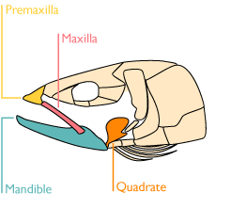
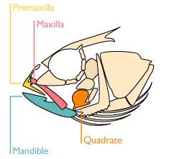
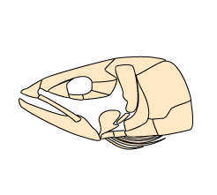
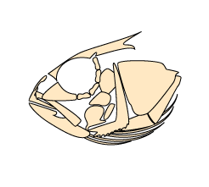
Division Teleostei
Changes in the upper jaw (mobile premaxilla)

Slide 7
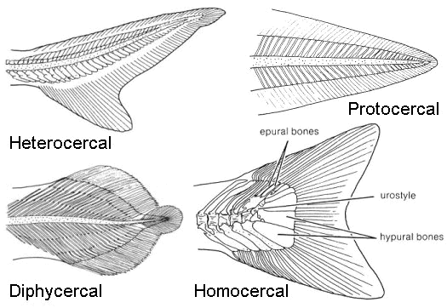
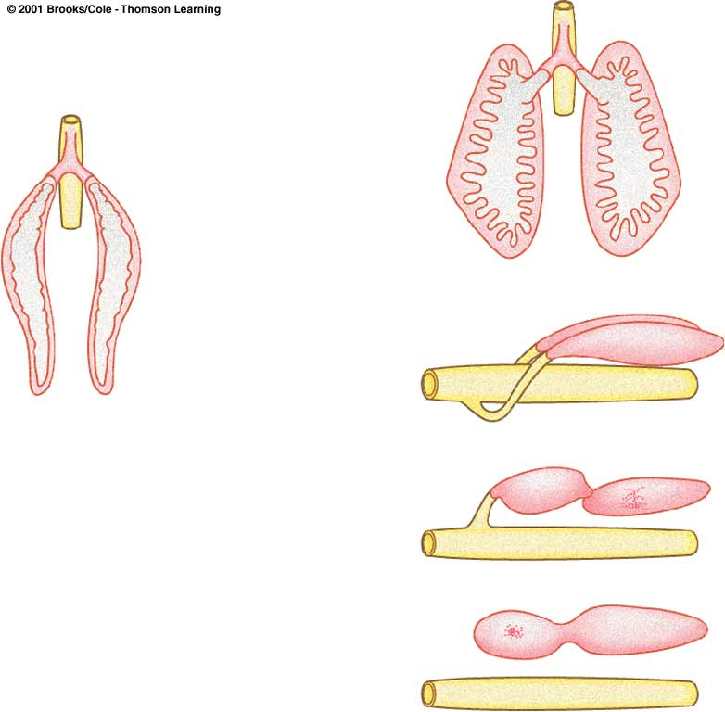
Division Teleostei
Symmetrical (homocercal) caudal fin
Phystomus to physoclistic gasbladder

Slide 8
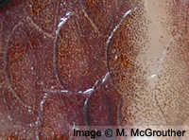
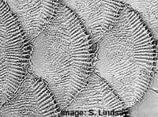
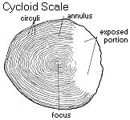
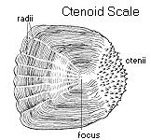
Bony ridge scales

Slide 9
Four subdivisions of Teleosts
Class Actinopterygii (ray-finned fishes)
Subclass Chondrostei (sturgeon, paddlefish, etc)
Subclass Neopterygii
Division Unnamed (gars, bowfin)
Division Teleostei (Teleosts)
Subdivision Osteoglossomorpha
Order Osteoglossiformes
Subdivision Elopomorpha
Order Elopiformes (tarpons, ladyfishes)
Order Albuliformes (bonefishes, spiny eels)
Order Anguilliformes (eels)
Order Saccopharyngiformes (gulpers)
Subdivision Clupeomorpha
Order Clupeiformes (herrings, anchovies)
Subdivision Euteleostei

Slide 10
Division Teleostei
Class Actinopterygii (ray-finned fishes)
Subclass Chondrostei (sturgeon, paddlefish, etc)
Subclass Neopterygii
Division Unnamed (gars, bowfin)
Division Teleostei (Teleosts)
Subdivision Osteoglossomorpha
Order Osteoglossiformes
Subdivision Elopomorpha
Order Elopiformes (tarpons, ladyfishes)
Order Albuliformes (bonefishes, spiny eels)
Order Anguilliformes (eels)
Order Saccopharyngiformes (gulpers)
Subdivision Clupeomorpha
Order Clupeiformes (herrings, anchovies)
Subdivision Euteleostei

Slide 11
Subdivision Osteoglossomorpha
Most basal (primitive) of the four subdivisions of teleostean fishes.

Slide 12
Subdivision Osteoglossomorpha
Characters uniting members of the group
  Teeth on the tongue and on the roof of the mouth (forms biting apparatus),
  Caudal fin with 16 or fewer branched rays
  Intermuscular bones absent
  Cycloid scales
  Swimbladder adapted for air-breathing in many
Six families and 200+ species of freshwater fishes (Africa, South America, and Asia).

Slide 13
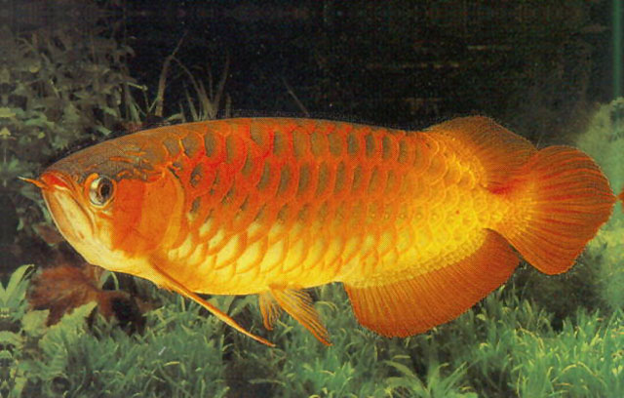
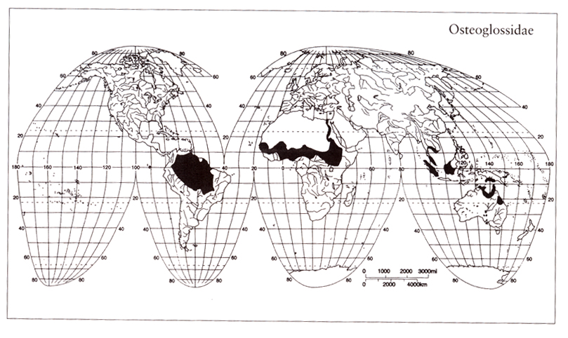

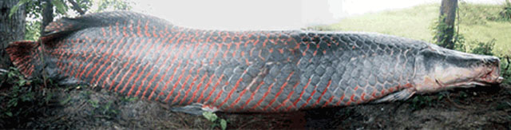
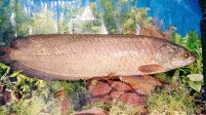
Family Osteoglossidae
Oldest and most widespread family in the order; 6 species
in tropics of Africa, South America, Asia and Austrailia.

Slide 14
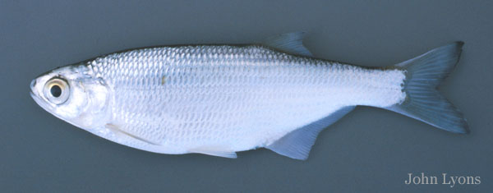
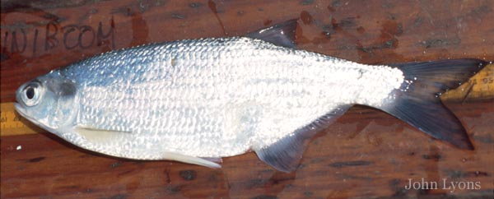
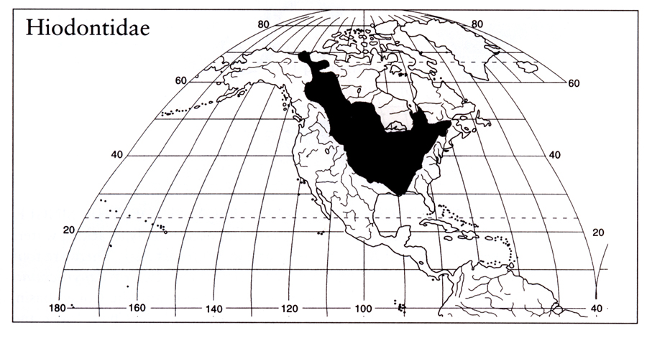
Family Hiodontidae
Named for their bright gold or silver eyes adapted for night vision. The
group includes 2 species common in of large rivers of North America.

Slide 15
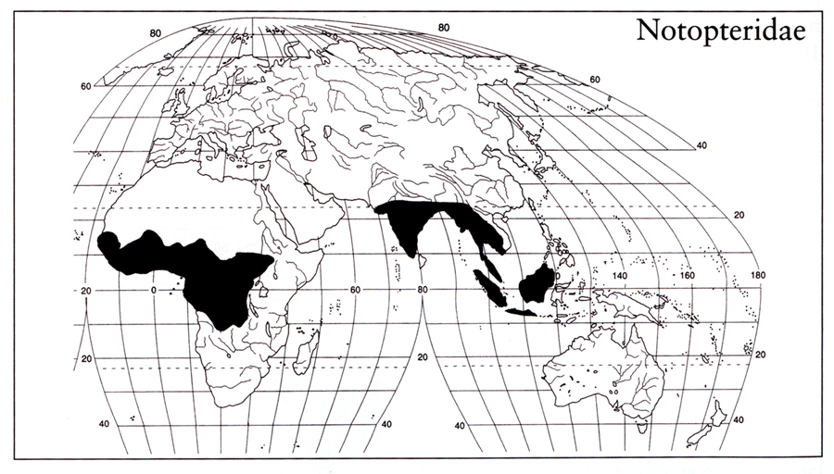

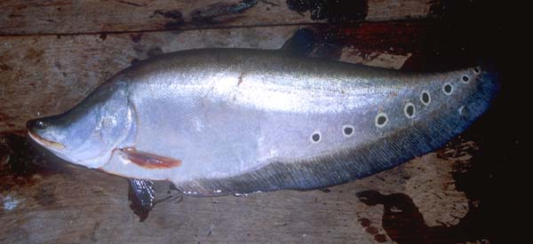

Family Notopteridae
Comprises 6 species of “knifefishes”
from tropical Asia and Africa. Long,
strongly compressed, tapered bodies,
long anal fins, and reduced or absent
dorsal and pelvic fins. Live among
vegetation in backwaters subject to
stagnation (swimbladder adapted for
air breathing).

Slide 16
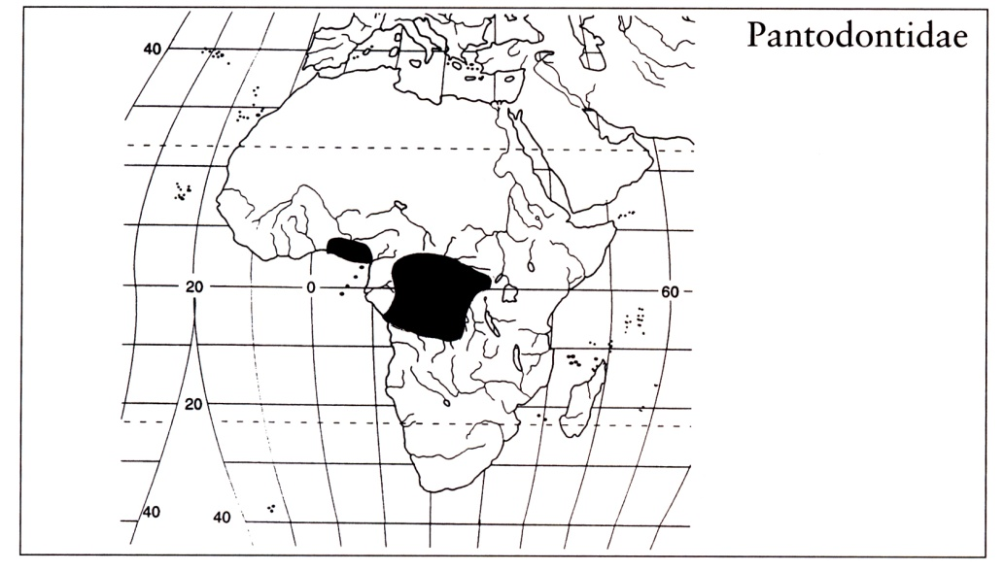
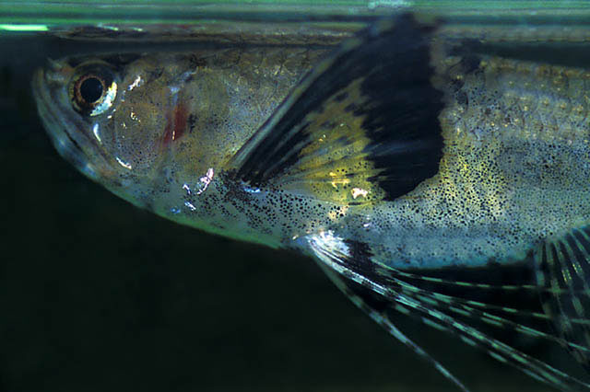
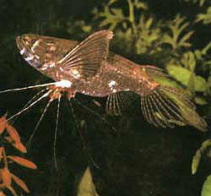
Family Pantodontidae
Only the small, butterfly fish of
central Africa. It lives near the
surface and uses its elongate
pectorals for gliding and support
in shallow water.

Slide 17
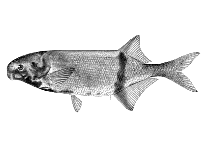

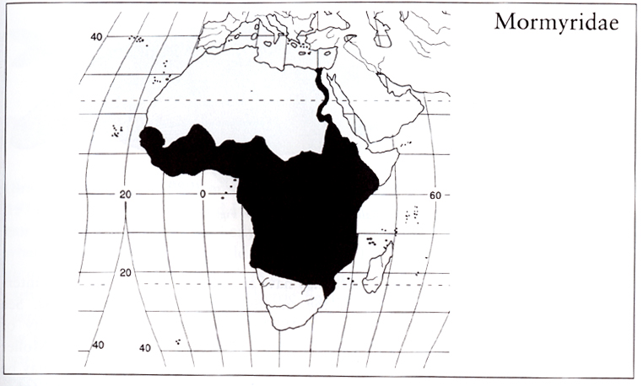
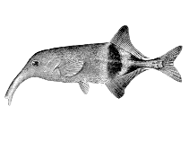

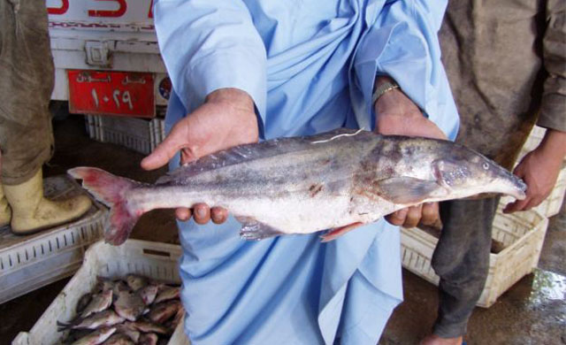
Family Mormyridae
Elephantfishes, a diverse group
adapted for nocturnal existence in
lakes and rivers of tropical Africa.
Well-developed electric organs used
for navigation and communication.
Many have proboscis-like snouts on
lower jaws for probing bottom
sediments.

Slide 18
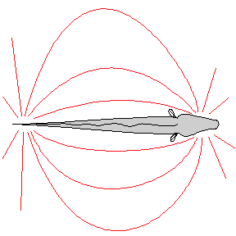
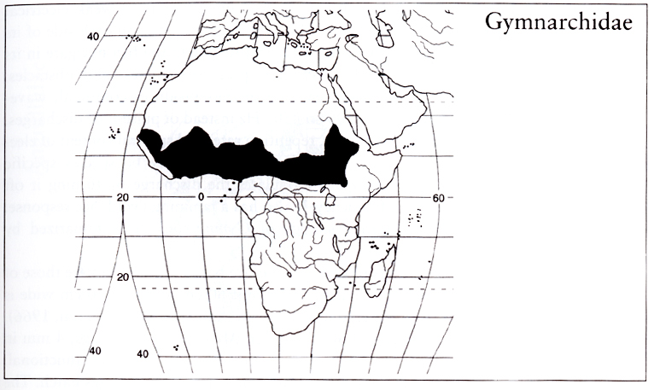
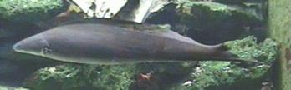
Family Gymnarchidae
Single species (Gymnarchus niloticus)
related to mormyrids. Long
eel-like body, large electric organ,
long dorsal fin, and no anal,
caudal or pelvic fins.

Slide 19
Division Teleostei
Class Actinopterygii (ray-finned fishes)
Subclass Chondrostei (sturgeon, paddlefish, etc)
Subclass Neopterygii
Division Unnamed (gars, bowfin)
Division Teleostei (Teleosts)
Subdivision Osteoglossomorpha
Order Osteoglossiformes
Subdivision Elopomorpha
Order Elopiformes (tarpons, ladyfishes)
Order Albuliformes (bonefishes, spiny eels)
Order Anguilliformes (eels)
Order Saccopharyngiformes (gulpers)
Subdivision Clupeomorpha
Order Clupeiformes (herrings, anchovies)
Subdivision Euteleostei

Slide 20
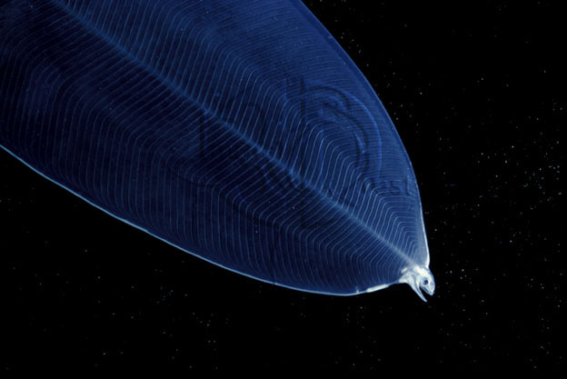
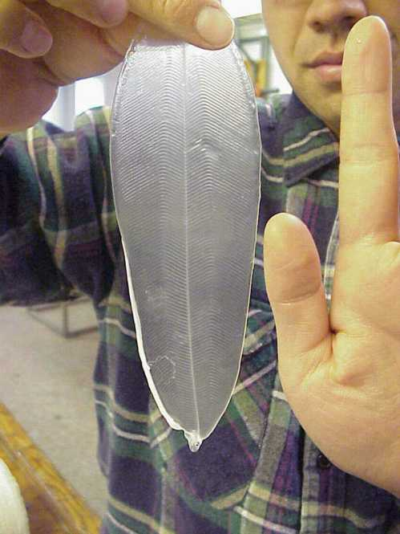
Subdivision Elopomorpha
Unusual mix of species united be transparent, planktonic, leptocephalus larvae
Mostly marine, fossils dating back to the Jurassic
4 orders, 25 families and about 630 species

Slide 21
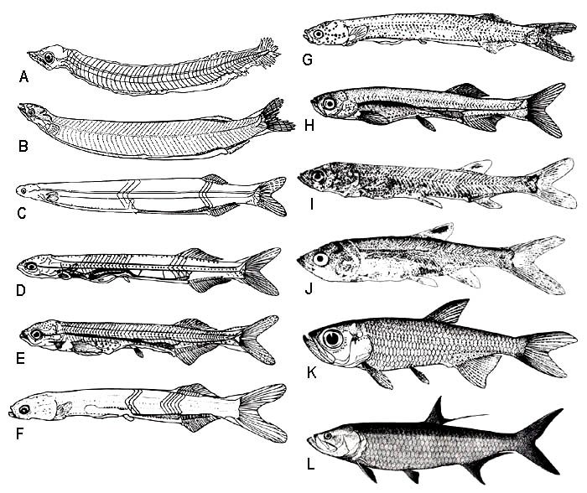
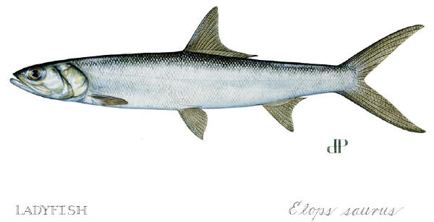
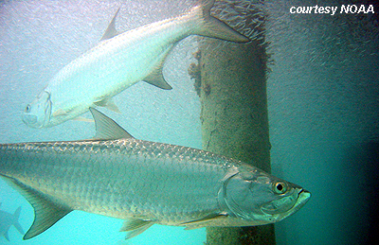
Order Elopiformes
Pelagic fishes that superficially
resemble herrings (body more
elongate and slender and gular
plate present). Two families and
7 species of primarily marine,
including some of the most
prized sport fishes (tarpon).

Slide 22
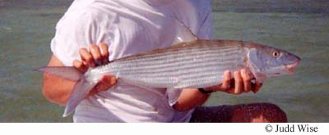
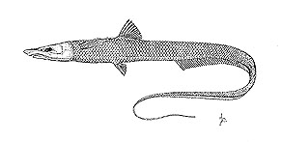
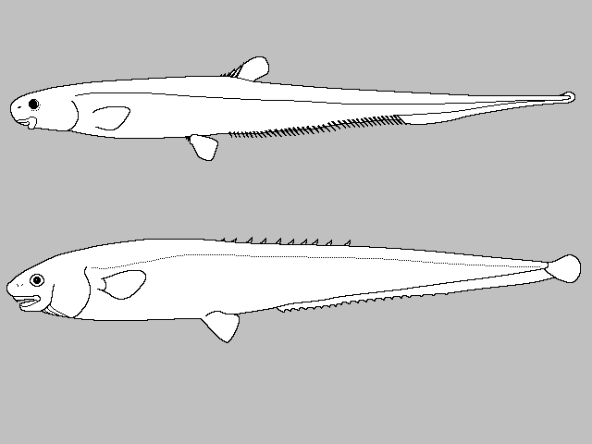
Order Albuliformes
Halosaurs
Comprises near shore and deep sea
bonefishes (suborder Albuloidei), and
deepwater halosaurs and spiny eels
(suborder Notacanthoidei).
Bonefishes are prized sport fish.
Halosaurs and spiny eels are deep-
water, chimeriform shaped fishes
(elongate anal fin continuous with
the tail). Depth range of 100-5000 m.
Spiny eels

Slide 23
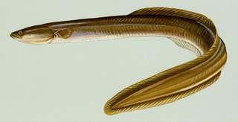
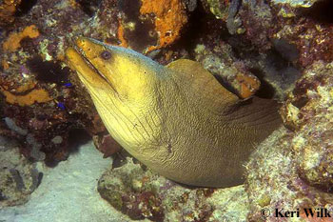
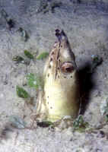
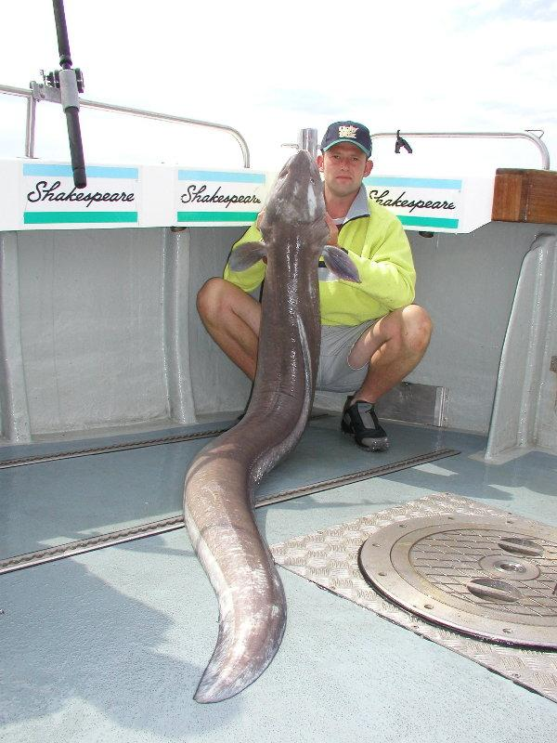
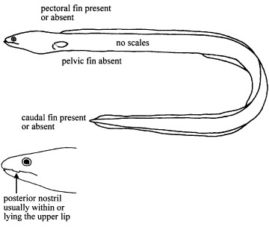
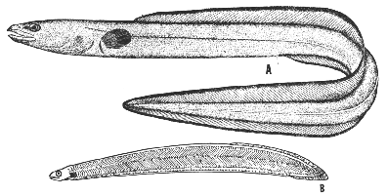
Order Anguilliformes
“True eels”. 15 Families
No pelvic fin, reduced or
absent pectoral.

Slide 24
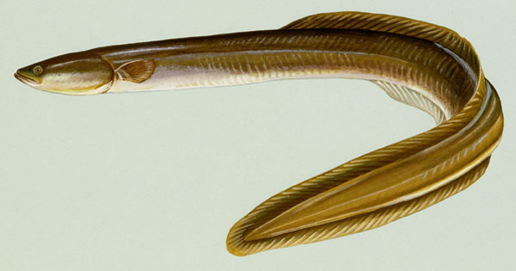
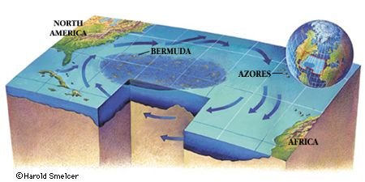
Family Anguillidae
Most eel families in Suborder
Anguilloidei (typical eels). Gill
openings far back on head
and covered by a small
operculum.
Best known are freshwater
eels of the family Anguillidae.
Are catadromous, i.e.,
they develop and mature
in freshwater and
estuarine habitats, and
migrate offshore for
spawning.

Slide 25
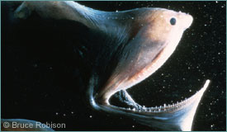


Order Saccopharyngiformes
Deepwater or Gulper eels
Elongate jaws, distensible stomach
Lack pectoral and pelvic fins, scales and swimbladder.

Slide 26
Division Teleostei
Class Actinopterygii (ray-finned fishes)
Subclass Chondrostei (sturgeon, paddlefish, etc)
Subclass Neopterygii
Division Unnamed (gars, bowfin)
Division Teleostei (Teleosts)
Subdivision Osteoglossomorpha
Order Osteoglossiformes
Subdivision Elopomorpha
Order Elopiformes (tarpons, ladyfishes)
Order Albuliformes (bonefishes, spiny eels)
Order Anguilliformes (eels)
Order Saccopharyngiformes (gulpers)
Subdivision Clupeomorpha
Order Clupeiformes (herrings, anchovies)
Subdivision Euteleostei

Slide 27



Subdivision Clupeomorpha
Silvery scales, compressed, keeled body
Fine gillrakers
Extension of the swimbladder which connects to the inner ear.

Slide 28



Order Clupeiformes
4 families, 357 species
Shad, herrings, anchovies, sardines
Gas bladder extends into braincase
(otophysic:ear-to-gas-bladder)

Slide 29

Teleost Phylogeny
From Forey et al. 1996,
Li and Wilson, 1996.
Otocephala

