Slide 1
What is a fish?
Ichthyology: the study of fishes

Slide 2
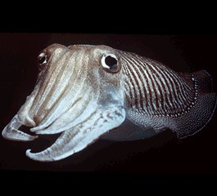
Is this a fish?

Slide 3
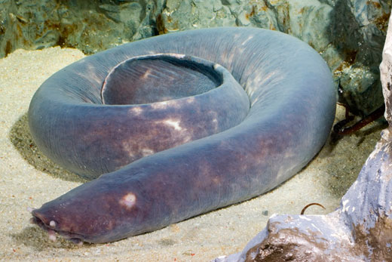
Is this a fish?

Slide 4
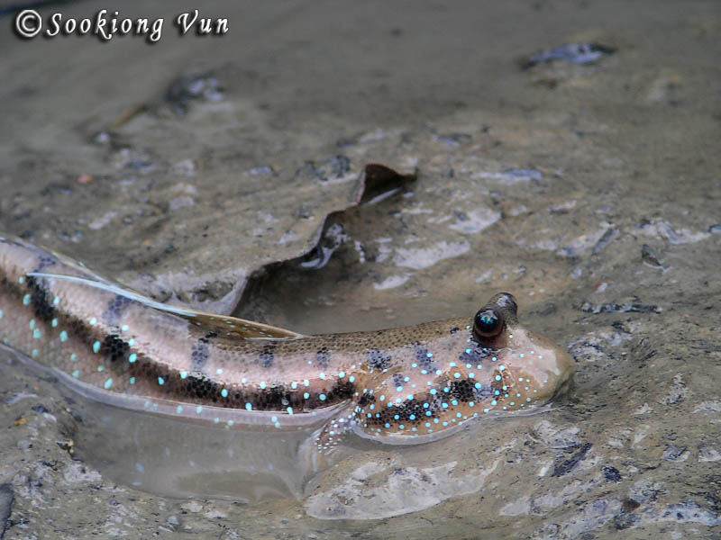
Is this a fish?

Slide 5
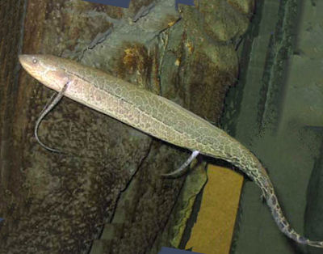
Is this a fish?

Slide 6
How do you define a fish?

Slide 7
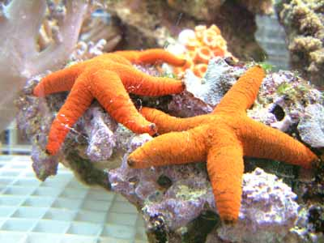
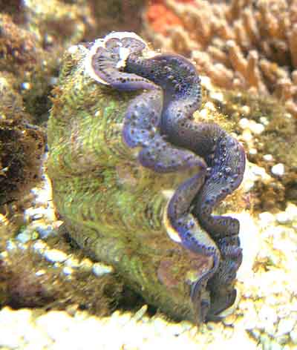
Many things are called fish
Term “fish” applied to everything caught in net, or by hook, or even
dredged from the bottom in some instances.

Slide 8
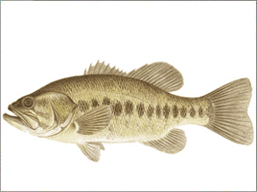
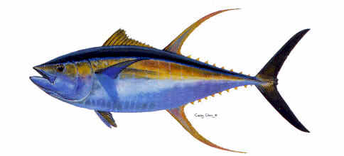
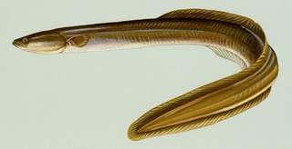
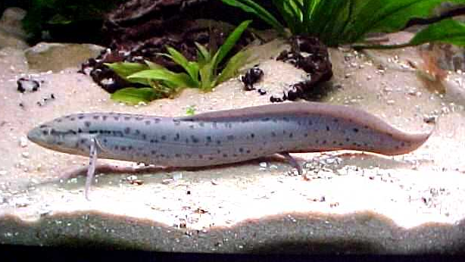
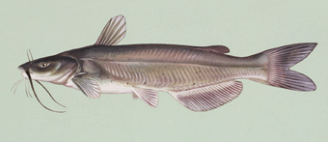
Anatomical Definition
A fish is an aquatic vertebrate
that respires using gills, is
ectothermic, has fins, and
usually has scales in its skin.

Slide 9
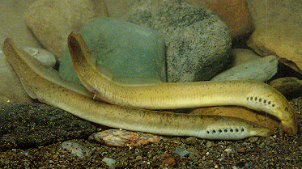
Do all fish have vertebrae?
No. Jawless fishes lack vertebral centra

Slide 10
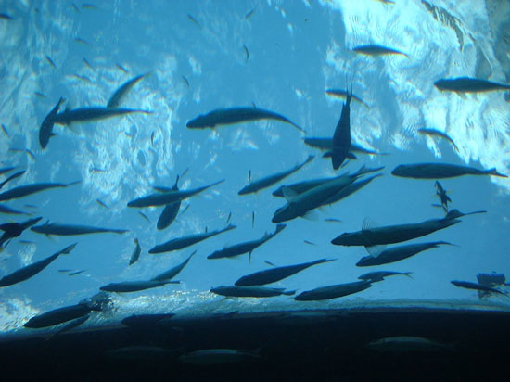
Life Aquatic
Fish live in water and
basic design reflects
constraints imposed by
an aquatic medium.
Water is 800 times more
dense than air; it provides
so much support that little
energy needed to
counteract the force of
gravity.
Most fish are neutrally
buoyant in water.

Slide 11

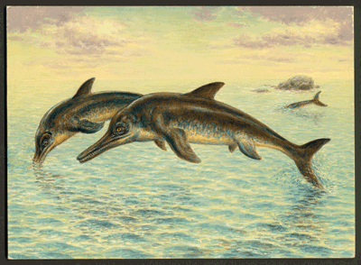
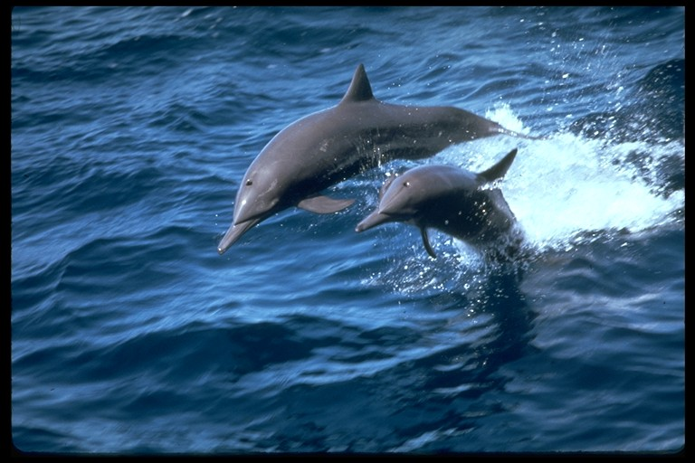
Water makes morphology fish like
Water is virtually incompressible;
literally has to be pushed out of
the way in swimming (air compresses,
makes room).
Most fish are streamlined or fusiform in
shape; allows them to slice through water;
have structural features designed to reduce
drag and turbulence (e.g., fins, scales).
Movement accomplished by pushing fins
and body against the water column for
propulsion.
Other groups that have reinvaded seas have
converged on fish-like morphology.

Slide 12
Phylogenetic definition
Fish are craniates that occupy a phylogenetic position between
cephalochordates (lancelets) and amphibians.
Jawless
fishes
Cartilaginous
fishes
Bony
fishes
Reptiles
Birds
Mammals
Lancelets
Amphibians

Slide 13
Phylogenetic definition
Group “Fishes” is
unnatural, paraphyletic
Jawless
fishes
Cartilaginous
fishes
Bony
fishes
Reptiles
Birds
Mammals
Lancelets
Amphibians

Slide 14
Phylogenetic definition
Gnathostomes
Jawless
fishes
Cartilaginous
fishes
Bony
fishes
Reptiles
Birds
Mammals
Lancelets
Amphibians
Bony skeleton
Jaws, vertebrae

Slide 15
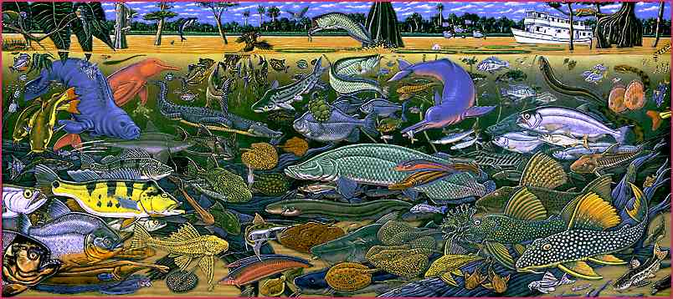
“Fish Facts”
>25,000 species
  Half of all vertebrates
(Image by Ray Troll)

Slide 16
Diversity
Vertical distribution exceeds 15,000 m, from 5 km above sea level to 11 km
below.
FW SW
Available habitat 0.01% 96%
Diversity of fishes 41% 58%

Slide 17
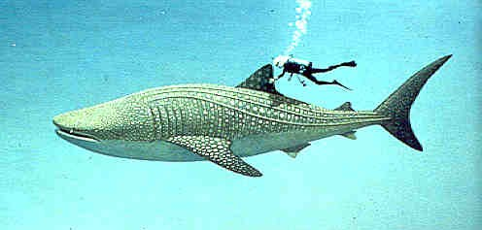
Largest Fish

Slide 18
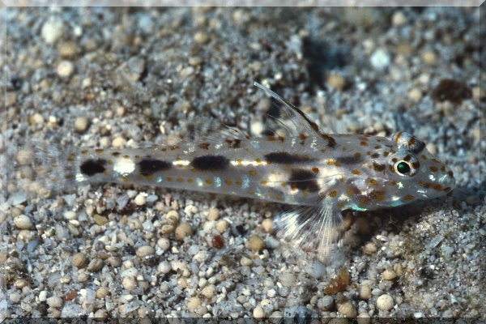
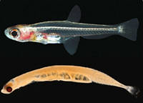
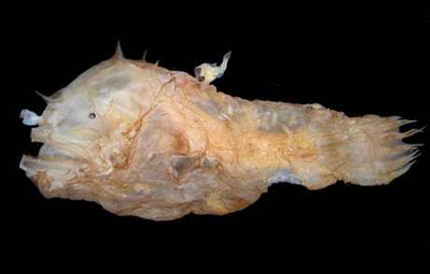
Smallest Fish?
Dwarf pygmy goby Pandaka pygmaea from Philippines
breeds at less that 15 mm.
The cyprinid Paedocypris progenetica from Indonesia
reaches maximum size of 10.3 mm with females reaching
maturity at 7.9 mm.
Stout Infantfish Schindleria brevipingui from Australia
matures at 8.4 mm standard length.
Males of the deepsea anglerfish Photocorynus
spiniceps are parasitic on the much larger female
and mature at 6.2 mm

Slide 19


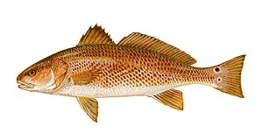
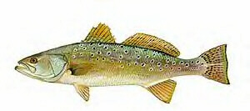
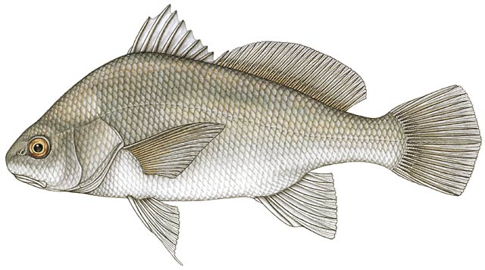
Food and Game Fishes
Important source of food and pleasure (recreational fishing or diving)

Slide 20
What we will do…
Learn major groups of fishes (families and higher).
Mid-semester exam and practical.
Local field trips and weekend trip to Florida
Group exercise on fish taxonomy and keying
Comprehensive final

Slide 21
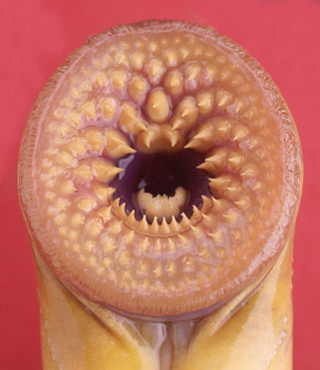
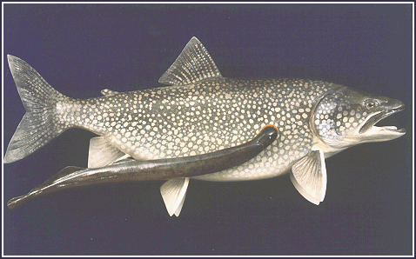
Next Time……
Jawless Fishes

