Slide 1
Migrations

Slide 2
Migration
Term migration refers to active movements of groups of organisms to fulfill some specific life history purpose.
Most of the migrations seen in fishes are for breeding, feeding and wintering purposes.

Slide 3
George S. Meyers Definition
Diadromous - migrations between salt and freshwater in three patterns:
  Anadromous - fishes that spend most of adult lives in sea and migrate to fresh water to breed.
  Catadromous - fishes that spend most of their lives in fresh water and migrate to the sea tobreed.
  Amphidromous - diadromous migration during a definite stage for reasons other than breeding.
Potamodromous - migration wholly within freshwater.
Oceanodromous - migration wholly within the sea.

Slide 4
Diadromy
Diadromous migrations emphasize the adaptive differences between marine and freshwater environments.
The migrations sometimes cover very large distances and can be completed only once in a lifetime.

Slide 5
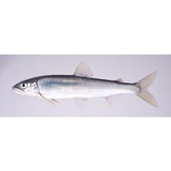
Anadromy
Anadromous migrations typically involve long periods of time at sea followed by ascent of rivers only for spawning (e.g., striped bass, american shad).
However, many variations, including short periods in seawater and relatively long periods in fresh water (e.g., Ayu of Japan).
Most examples of anadromy involve marine derived fishes that invade freshwater.

Slide 6
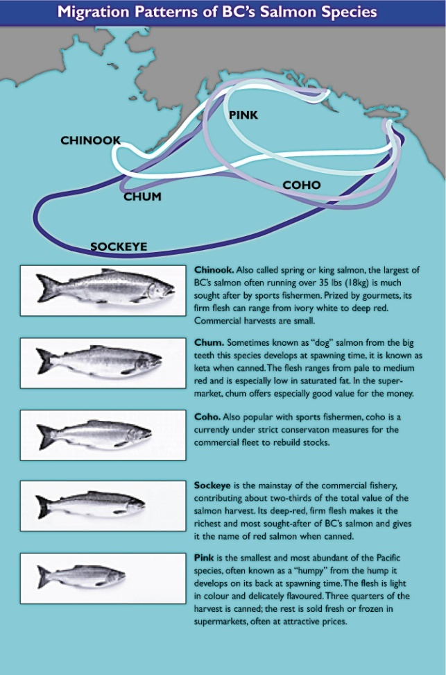
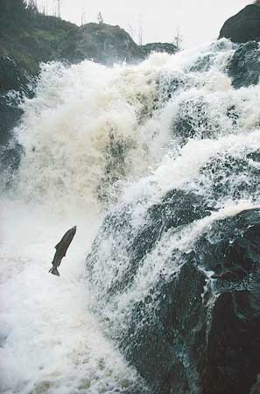
Salmon migrations
Most remarkable anadromous migrations are seen in salmon.
Salmonids are predominantly freshwater fishes and the pattern of breeding in freshwater is no doubt primitive.

Slide 7
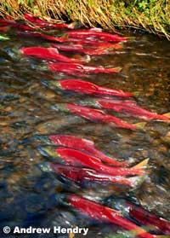
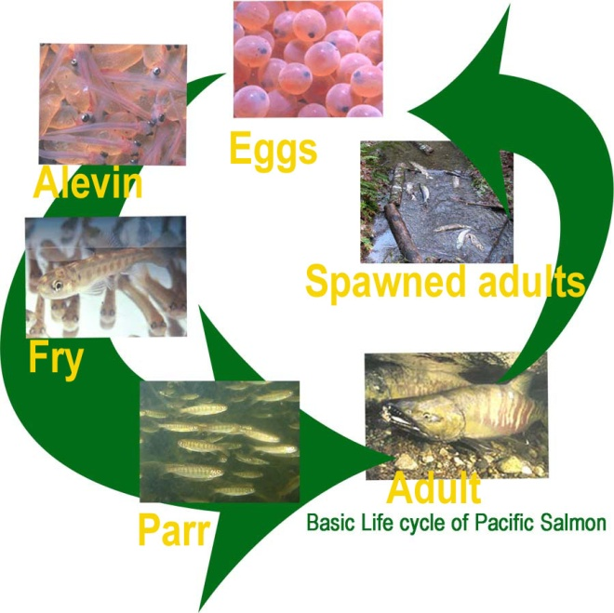
Salmon migrations
Shallow, high gradient streams where salmonids spawn are ideal for spawning and early development of the eggs and larvae. But food limited and thus typically cannot support growth to large size and high fecundity.
In contrast the sea is food rich; it is therefore a better growth environment. But also rich in predators.

Slide 8
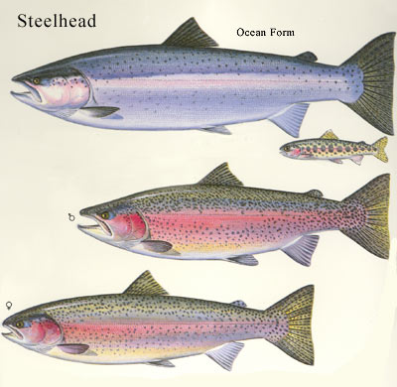
Salmon vs. Trout
Trout that remain in freshwater (rainbow trout) are smaller on average and have much lower fecundities than those that migrate to sea.
Sea-run trout (steelhead) are larger, silvery sided and counter-shaded.
Onchorhychus mykiss
Salmo gairdneri

Slide 9

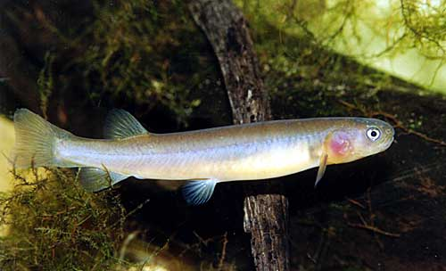
Catadromy
Catadromous migrations are less common, but examples also include short and long range movements.
Prickly sculpin migrates from sandy freshwater habitats to rocky estuaries a short distance downstream.
Galaxias is also known to migrate short distances from rivers to estuaries to breed.

Slide 10
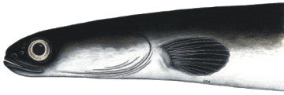
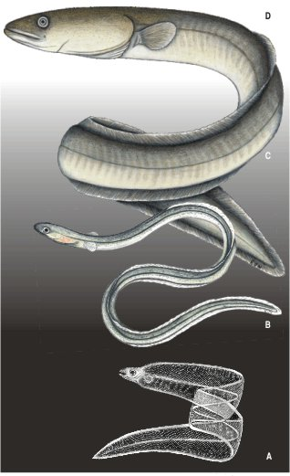
Catadromy
Most remarkable catadromous migration is that of the eels Anguilla anguilla and A. rostrata.
Females ascend rivers at a postlarval "elver" stage. After maturity they migrate to estuaries to join males.
Adults adapt to salt water as they migrate, developing large eye and silvery body.
Disappear from the moment they enter the sea ;next seen as leptocephalus larvae over the Sargasso sea.
The larvae drift back to coastal rivers in ocean currents. Some believe the two species of freshwater eels to be the same biological species.

Slide 11
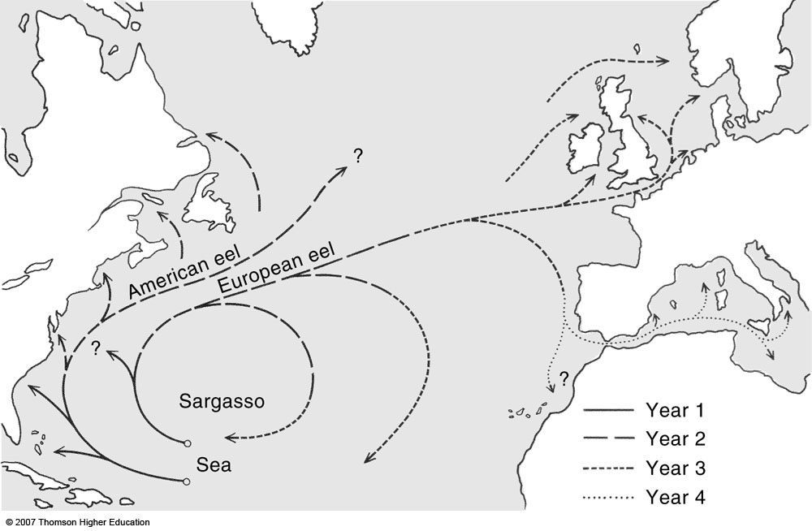
Freshwater eel migration

Slide 12
Amphidromy
Amphidromous migrations are movements between salt and freshwater for reasons other than breeding.
Many euryhaline marine species make temporary excursions into freshwater for feeding or resting.
Freshwater fishes are generally intolerant of seawater, so movements in the opposite direction are uncommon. Where they occur they involve salt tolerant peripheral marine species or marine invaders.

Slide 13
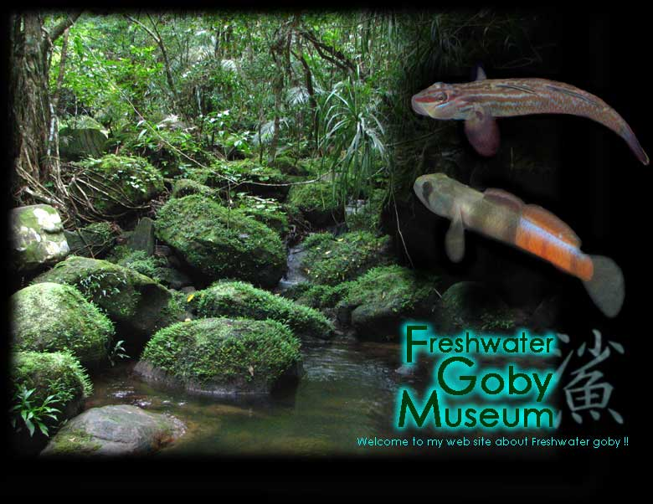
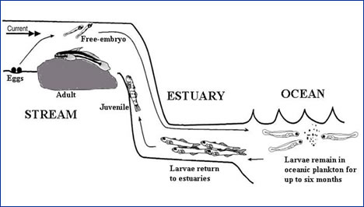
Amphidromy
Larvae of riverine gobies (a marine derived group) live and spawn in fresh water, "migrate" offshore for early development and return to the rivers at a later juvenile stage.
The primitive reproductive strategy of gobies involves living and breeding in inshore areas with larval development occurring offshore.

Slide 14
Potamodromy
Potamodromous migrations are movements entirely within freshwater.
Included here are seasonal movements of riverine fishes into small streams for breeding purposes followed by passive downstream drift of the developing larvae.
many examples among stream fishes.
Also included are offshore to inshore migrations of lacustrine fishes.

Slide 15
Oceanodromy
Oceanodromous migrations (within salt water) include daily vertical migrations of mesopelagic fishes between nocturnal feeding grounds and daily resting areas.
Also included are the long range movements of epipelagic fishes such as albacores and tunas between feeding and wintering areas.

