Slide 1


AToL PIs Meeting 2008

Slide 2
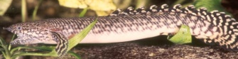
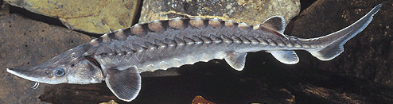
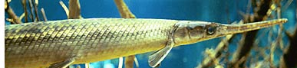
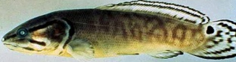

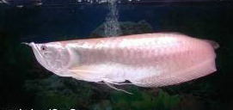
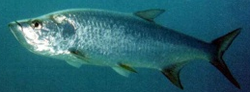
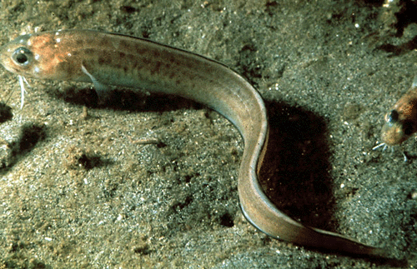
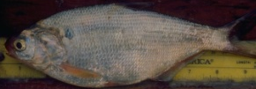
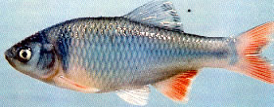
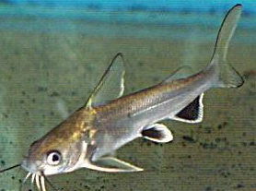
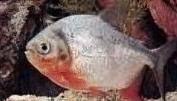
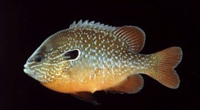
What are euteleosts?
Polypteriformes
Acipenseriformes
Lepisosteiformes
Amiiformes
Osteoglossomorpha
Elopomorpha
Clupeiformes
Teleostei
Ostariophysi
Euteleostei
The crown group of ray-finned fishes

Slide 3
Euteleostei
Comprises some 346 families, 2,935 genera, and 17,419 species at present count (Nelson 2006).
Approx. 2/3 of ray-finned fishes and 1/3 of vertebrate species.
Includes most of the economically important fishes, including salmons, cods, basses, tunas, and flatfishes.
Includes important model species pufferfishes, stickleback, medaka, Fundulus, cichlids, etc.

Slide 4
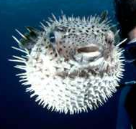
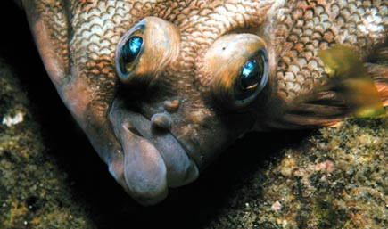
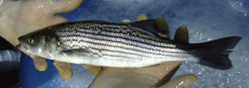
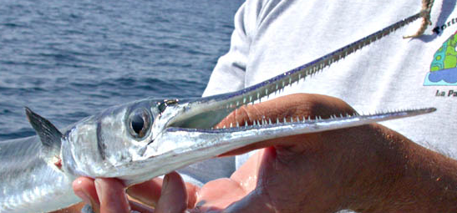
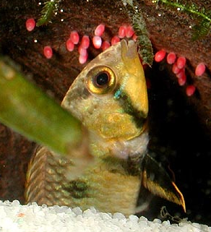
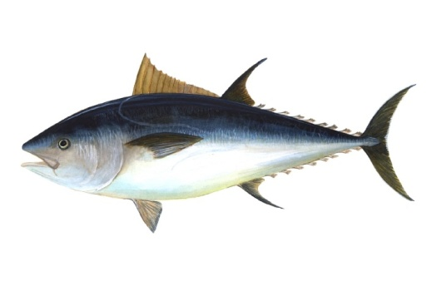
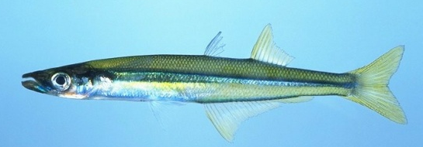
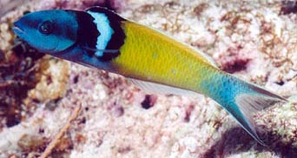
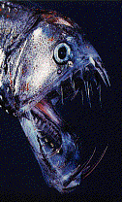
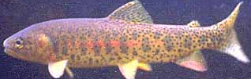

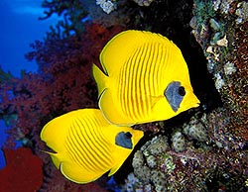
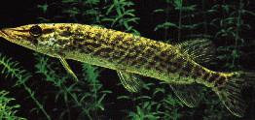
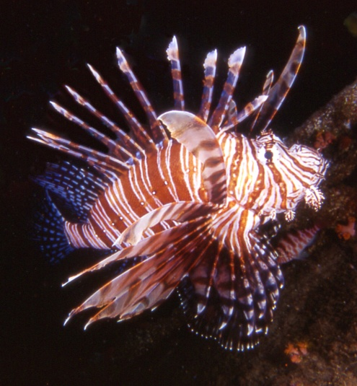
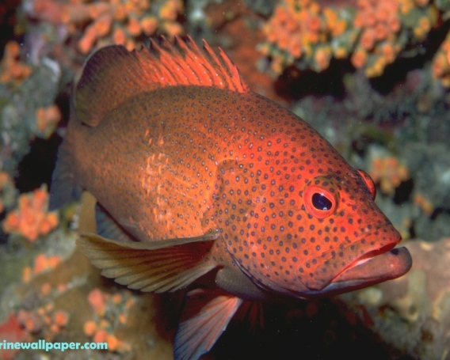
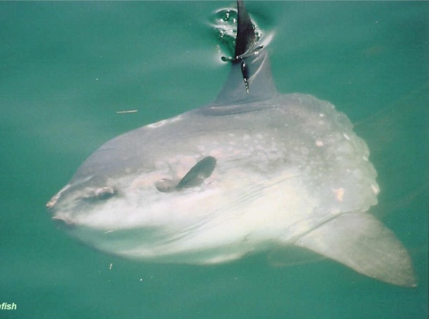
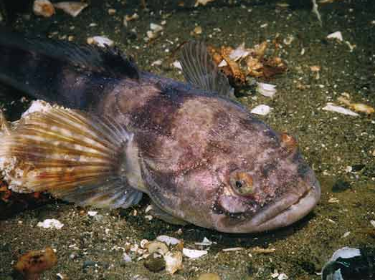
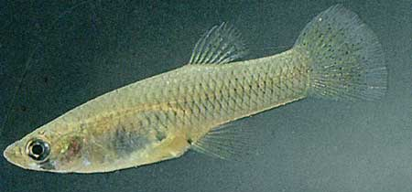
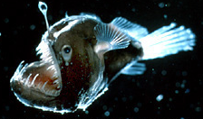
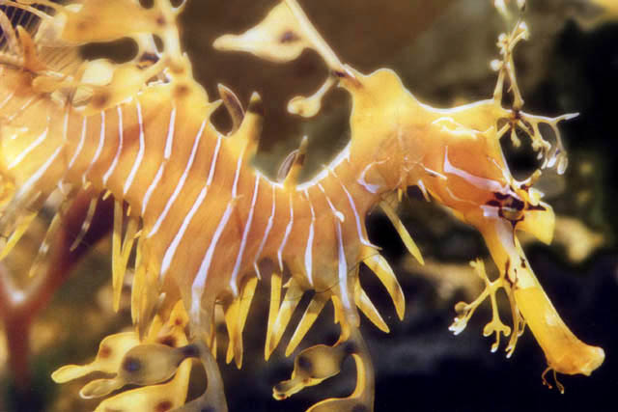
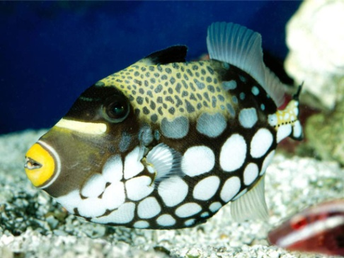
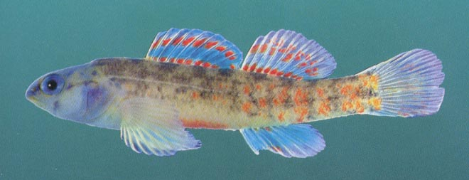

Slide 5
Euteleostei
Tetraodontiformes
Pleuronectiformes
Perciformes
Scorpaeniformes
Synbranchiformes
Gasterosteiformes
Our knowledge of relationships among euteleostean groups ranges from well corroborated to essentially unknown.
Zeiformes
Beryciformes
Stephanoberyciformes
Cyprinodontiformes
Beloniformes
Atheriniformes
Mugiliformes
Lophiiformes
Batrachoidiformes
Ophidiiformes
Gadiformes
Percopsiformes
Ateleopodiformes
Polymixiiformes
Lampridiformes
Myctophiformes
Aulopiformes
Stomiiformes
Argentiniformes
Osmeriformes
Esociformes
Modified from J. Nelson 2006
Salmoniformes

Slide 6
Basal euteleosts
Tetraodontiformes
Pleuronectiformes
Perciformes
Scorpaeniformes
Synbranchiformes
Relationships of the basal euteleosts, the Protacanthopterygii, are controversial.
The monophyly and relationships of basal neopterygian clades Stomiiformes, Aulopiformes, and Myctophiformes to the crown group Acanthomorpha seem well established.
Gasterosteiformes
Zeiformes
Beryciformes
Stephanoberyciformes
Cyprinodontiformes
Beloniformes
Atheriniformes
Mugiliformes
Lophiiformes
Batrachoidiformes
Ophidiiformes
Gadiformes
Percopsiformes
Ateleopodiformes
Polymixiiformes
Lampridiformes
Neopterygii
Myctophiformes
Aulopiformes
Stomiiformes
Argentiniformes
Osmeriformes
Protacanthopterygii
Esociformes
Salmoniformes

Slide 7
Basal acanthomorphs
Tetraodontiformes
Pleuronectiformes
Perciformes
Scorpaeniformes
Synbranchiformes
Gasterosteiformes
Zeiformes
Acanthomorpha includes 15,000+ species
Relationships among basal acanthomorphs, including the Paracanthopterygii, are problematic.
Beryciformes
Stephanoberyciformes
Cyprinodontiformes
Beloniformes
Atheriniformes
Mugiliformes
Acanthomorpha
Lophiiformes
Batrachoidiformes
Ophidiiformes
Paraca-nthopts
Gadiformes
Percopsiformes
Ateleopodiformes
Polymixiiformes
Lampridiformes
Myctophiformes
Aulopiformes
Stomiiformes
Argentiniformes
Osmeriformes
Esociformes
Salmoniformes

Slide 8
Percomorpha
Tetraodontiformes
Pleuronectiformes
Perciformes
Scorpaeniformes
Synbranchiformes
Gasterosteiformes
Percomorpha, as presently recognized, includes 13,000+ species, including the majority of economically important fishes
Yet relationships within the Percomorpha are essentially unknown.
Percomorpha
Zeiformes
Beryciformes
Stephanoberyciformes
Cyprinodontiformes
Beloniformes
Atheriniformes
Mugiliformes
Lophiiformes
Batrachoidiformes
Ophidiiformes
Gadiformes
Percopsiformes
Ateleopodiformes
Polymixiiformes
Lampridiformes
Myctophiformes
Aulopiformes
Stomiiformes
Argentiniformes
Osmeriformes
Esociformes
Salmoniformes

Slide 9
Percomorpha
Tetraodontiformes
Pleuronectiformes
Perciformes
Scorpaeniformes
Relationships among the Scorpaeniformes, Pleuonectiformes, Tetraodontiformes, and 18 unresolved suborders of the Perciformes appear to be complex.
Even if monophyletic, Pleuronectiformes, Scorpaeniformes and Tetraodontiformes may be closely related to, or contained within, one or more perciform suborders.
Synbranchiformes
Gasterosteiformes
Zeiformes
Beryciformes
Stephanoberyciformes
Cyprinodontiformes
Beloniformes
Atheriniformes
Mugiliformes
Lophiiformes
Batrachoidiformes
Ophidiiformes
Gadiformes
Percopsiformes
Ateleopodiformes
Polymixiiformes
Lampridiformes
Myctophiformes
Aulopiformes
Stomiiformes
Argentiniformes
Osmeriformes
Esociformes
Salmoniformes

Slide 10
Perciformes
Tetraodontiformes
Pleuronectiformes
Perciformes, the largest order of vertebrates, is currently merely a convenient receptacle for fishes with no clear affinities to other orders.
The result is some ±18 suborders of fishes with unknown affinities.
There is evidence for the monophyly of some of these suborders.
However, the largest suborder, Percoidei, can be viewed as a polytomy of 70 branches, with many of the families of unknown phylogenetic integrity.
Perciformes
Scorpaeniformes
Synbranchiformes
Gasterosteiformes
Zeiformes
Beryciformes
Stephanoberyciformes
Cyprinodontiformes
Beloniformes
Atheriniformes
Mugiliformes
Lophiiformes
Batrachoidiformes
Ophidiiformes
Gadiformes
Percopsiformes
Ateleopodiformes
Polymixiiformes
Lampridiformes
Myctophiformes
Aulopiformes
Stomiiformes
Argentiniformes
Osmeriformes
Esociformes
Salmoniformes

Slide 11
Tetraodontiformes
18 suborders unresolved
Pleuronectiformes
G. Nelson:
“The bush at the top”
Perciformes
Percoidei: 70 families unresolved
Percomorpha
Scorpaeniformes
Synbranchiformes
Gasterosteiformes
E. Wiley:
“Perciformes is a phylogenetic imbroglio”.
Zeiformes
Beryciformes
Stephanoberyciformes
Cyprinodontiformes
Beloniformes
Atheriniformes
Mugiliformes
Lophiiformes
Phylogeny of the euteleosts remains The major unresolved problem in vertebrate phylogeny
Batrachoidiformes
Ophidiiformes
Gadiformes
Percopsiformes
Ateleopodiformes
Polymixiiformes
Lampridiformes
Myctophiformes
Aulopiformes
Stomiiformes
Argentiniformes
Osmeriformes
Esociformes
Salmoniformes

Slide 12
Specific objectives of EToL
Basic research
Identify a set of at least 20 nuclear DNA markers for actinoptergyian (and possibly sarcopterygian) phylogenetic studies. Make available a user-friendly bioinformatic tool to search for phylogenetically useful genes.
Sequence a minimum of 1,500 euteleost species (and outgroups) for ≥20 single-copy nuclear protein-coding gene segments, yielding a matrix of approximately 20 kilobases (kb) of sequence per species.
  Reprentatives of all euteleost families and ~40% of genera
  Taxon selection is proportional to within-group diversity and emphasizes groups where phylogenetic relationships are particularly obscure.

Slide 13
Score up to 450 phylogenetically informative morphological characters for 300 representative euteleostean species and outgroups.
Integrate adult morphology and ontogeny through a comparative developmental study of at least 50 (of the 300) representative species.
Perform partitioned and combined phylogenetic analyses, ultimately combining all characters into a combined morphological and molecular matrix for overall analysis.
Resolve euteleost phylogeny to the family level.

Slide 14
Dissemination of results
Maintain a dedicated web site (http://fishtree.org) to disseminate information about the project, our latest findings, and the outreach and broader impact contributions.
Contribute to GenBank, Morphbank, TreeBase, etc.
Developing pages for the Tree of Life Web Project that will summarize our present state of knowledge of euteleost relationships and diversity.
Use the Deepfin (www.deepfin.org) RCN to coordinate character selection with other large-scale fish systematics projects (e.g. the ongoing Cypriniformes ToL, All Catfish project, etc.). We will share genes and morphological characters to enhance data combinability from independent projects.

Slide 15
Education
Produce an activity book on discovering the tree of life for elementary and middle school education. The book will have national distribution and use fish as a model for understanding evolution and the common ancestry of life (“tree thinking”).

Slide 16
The EToL Team
Richard Broughton University of Oklahoma PI
Kent Carpenter Old Dominion University Co-PI
Judy Diamond University of Nebraska-Lincoln Co-PI
Terry Grande Loyola University Chicago Co-PI
Nancy Holcroft University of Kansas Co-PI
Chenhong Li University of Nebraska-Lincoln Co-PI
Andres López University of Florida Co-PI
Gouqing Lu University of Nebraska-Omaha Co-PI
Guillermo Orti University of Nebraska-Lincoln Co-PI
W. Leo Smith Field Museum of Natural History Co-PI
E. O. Wiley University of Kansas Co-PI
Wendy Gram University of Oklahoma Collaborator
Daniel Hough University of Oklahoma Collaborator
G. David Johnson Smithsonian Institution Collaborator
Teresa MacDonald University of Kansas Collaborator
Henry Neeman University of Oklahoma Collaborator
Judy Scotchmoor U.C. Berkeley Collaborator
Amy Spiegel University of Nebraska-Lincoln Collaborator

Slide 17

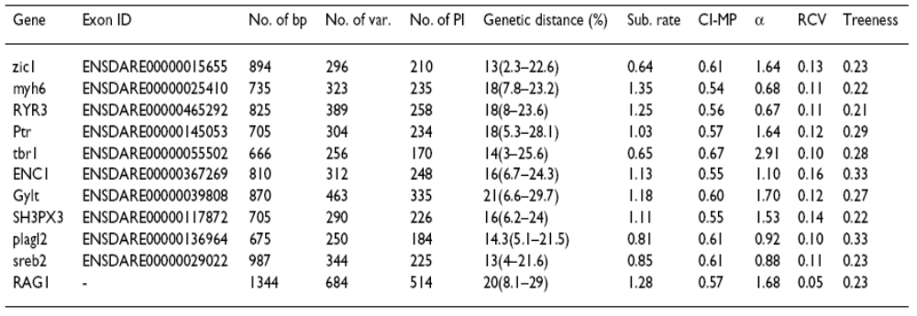

Slide 18
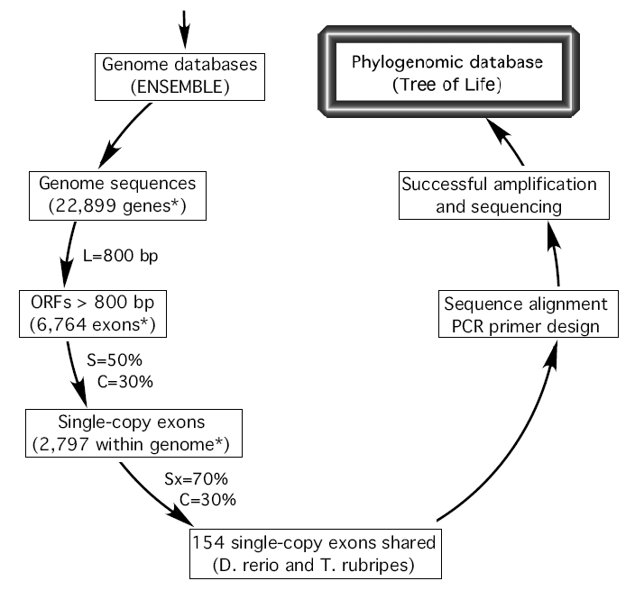
Bioinformatics pipeline for marker development

Slide 19
Where we are
95% of specimens have been acquired and vouchered – KU, Field Museum
~ 500 DNAs isolated
11 genes amplified from subsets of DNAs (in different labs)
Morphological characters are being surveyed for phylogenetic utility
Exploring systems for databasing, information retrieval, sharing

Slide 20
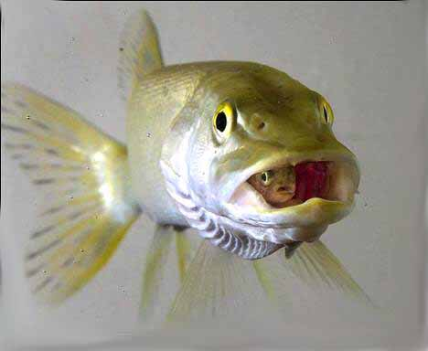

Slide 21


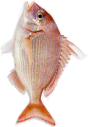

Second International Barcode of Life Conference
18–20 September 2007 in Taipei
Evolutionary History of Fishes: An Overview
Based on >1000 Whole Mitochondrial
Genome Sequences
Masaki Miya¹ and Mutsumi Nishida²
¹ Natural History Museum and Institute, Chiba
² Ocean Research Institute, University of Tokyo
Notes:
• Thank you chairman.
• Today, I am going to talk briefly about how we have tackled the problems of fish phylogenies with a large number of mitochondrial genome sequences.

Slide 22

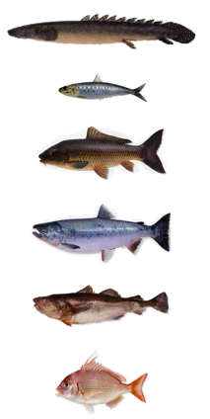
The knowns and unknowns
common ancestor
extant ray-finned fish
27,580 spp.
The late Silurian
420 Mya
???
When
Where
How
ray-fiinned fishes have
diversified during these
420 Myr
4289 genera
453 families
44 orders
Paleozoic
Mesozoic
Cenozoic
Notes:
• (#1) We are pretty much sure that the origin of the actinopterygians dates back to the late Silurian about 420 Mya.
• (#2) We are also sure that the current diversity of actinopterygians attains at least 27,580 species.
• (#3) But we are not sure when, where, and how these actinopterygians have diversified during these 420 Myr, BECAUSE their fossil record is fragmentary and incomplete and can tell us little about patterns of diversification and also BECAUSE there has been no study that address this issue using a SINGLE dataset.
• So our objective was to provide an overview on patterns and process of evolutionary history of actinopterygians, which cannot be inferred from fossil record alone.

Slide 23
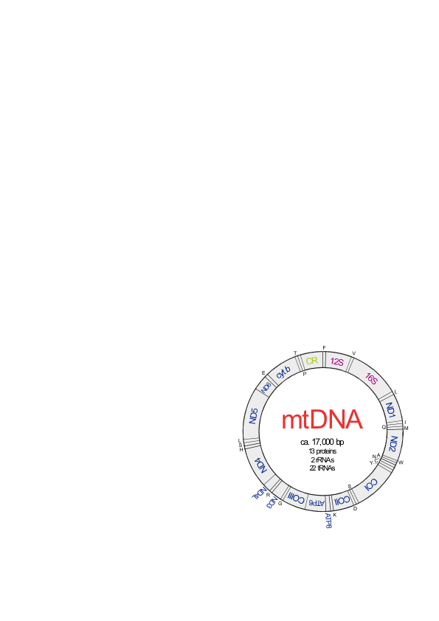
Evolutionary Mitogenomics of Fishes (EMFish)
common ancestor
extant ray-finned fish
27,580 spp.
The late Silurian
420 Mya
16,500 bp x 327 spp.
Phylogenetic analysis
Divergence time estimation
Macroevolutionary analysis
4289 genera
453 families
44 orders
Paleozoic
Mesozoic
Cenozoic
Notes:
• This is the resulting tree from those analyze, but you can’t see anything from this figure.
• (#1) Anyway, what I have been doing now is to conduct phylogenetic analyses of a large dataset comprising whole mitogenome sequences from 327 species…
• … estimate divergence time…
• … and the resulting TIME SCALE allow us to estimate rates of diversification across all actinopterygians and for a specific clade of interests…
• … which together allow us to gain a big picture of evolutionary history of the actinopterygians at an ORDINAL level.

Slide 24
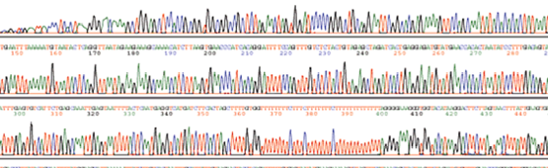
Development of the new method
1. Long PCRs
2. Full-nested short PCRs
Long PCR product #1
Long PCR product #2
3. Direct cycle sequencing
Miya & Nishida (1999) Mar. Biotechnol. 1: 416–426
Notes:
• This method consists of three steps.
• (#1) First mitogenome is amplified in two or three fragments using a long PCR technique.
• (#2) Then these long PCR products are used as templates for subsequent short PCRs using (#3) many fish-versatile primers.
• (#4) The short PCR products are used as templates for direct cycle sequencings.
• The process is very simple and easy, which takes only a few days for completion in most fish mitogenomes.

Slide 25



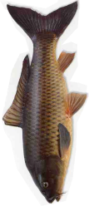
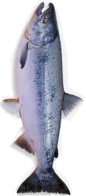






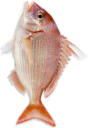



Four separate analyses: An overview
10 spp.
Basal Actinopterygii
34 spp.
• Inoue et al. (2003)
Mol. Phyl. Evol. 26: 110–120
• Inoue et al. (2004)
Mol. Phyl. Evol. 32: 274–286
217 spp.
Otocephala
801 spp.
• Saitoh et al. (2003) J. Mol. Evol. 56: 464–472
• Ishiguro et al. (2005) J. Fish Biol. 67: 561–569
• Lavoué et al. (2005). Mol. Phyl. Evol. 37: 165–177
• Saitoh et al. (2006) J. Mol. Evol. 63: 826–841
• Lavoué et al. (2007). Mol. Phyl. Evol. 43:1096–1105
6864 spp.
322 spp.
321 spp.
Basal Euteleostei
219 spp.
• Ishiguro et al. (2003) Mol. Phyl. Evol. 27: 476–481
272 spp.
Higher Teleostei
535 spp.
• Miya et al. (2001) Mol. Biol. Evol. 18: 1993–2009
• Miya et al. (2003) Mol. Phyl. Evol. 26: 121–138
• Miya et al. (2005) Biol. J. Linn. Soc. 85: 289–306
• Mabuchi et al. (2007) BMC Evol. Biol. 7: 10
• Kawahara et al. (2007) Mol. Phyl. Evol. (in press)
209 spp.
13,866 spp.
Notes:
• We have conducted four separate analyses that overlapped each other, making a big picture of actinopterygian phylogenies.
• From the bottom to top, we covered basal actinopterygians, otocephalans, basal euteleosts, and higher teleosts.
• These studies, however, are still a mosaic of hypotheses from different levels of phylogenies and I have decided to perform bigger analyses with a large number of the sequences.

