Slide 1
Conflicts Between Fish Phylogeny and Fossil Record

Slide 2
Importance of fossils
Fossils provide only clues we have about early history of organisms.
Reveal details about early anatomy and origin of modern anatomical features.
Useful for calibrating ages of groups in phylogenetic trees.

Slide 3
Problems with fossils
Fossil record is incomplete.
Fossil preservation is environment dependent.
When independent data used to calibrate phylogenies, group ages always older than oldest fossil.
Oldest fossil almost never from the group believed most primitive.
Great examples of this among fishes.

Slide 4
Jawless Fishes
Earliest group of fishes believed to have originated in the late Cambrian period (600 mya).
Oldest fossil jawless fish dates to Ordovician (500 mya).

Slide 5
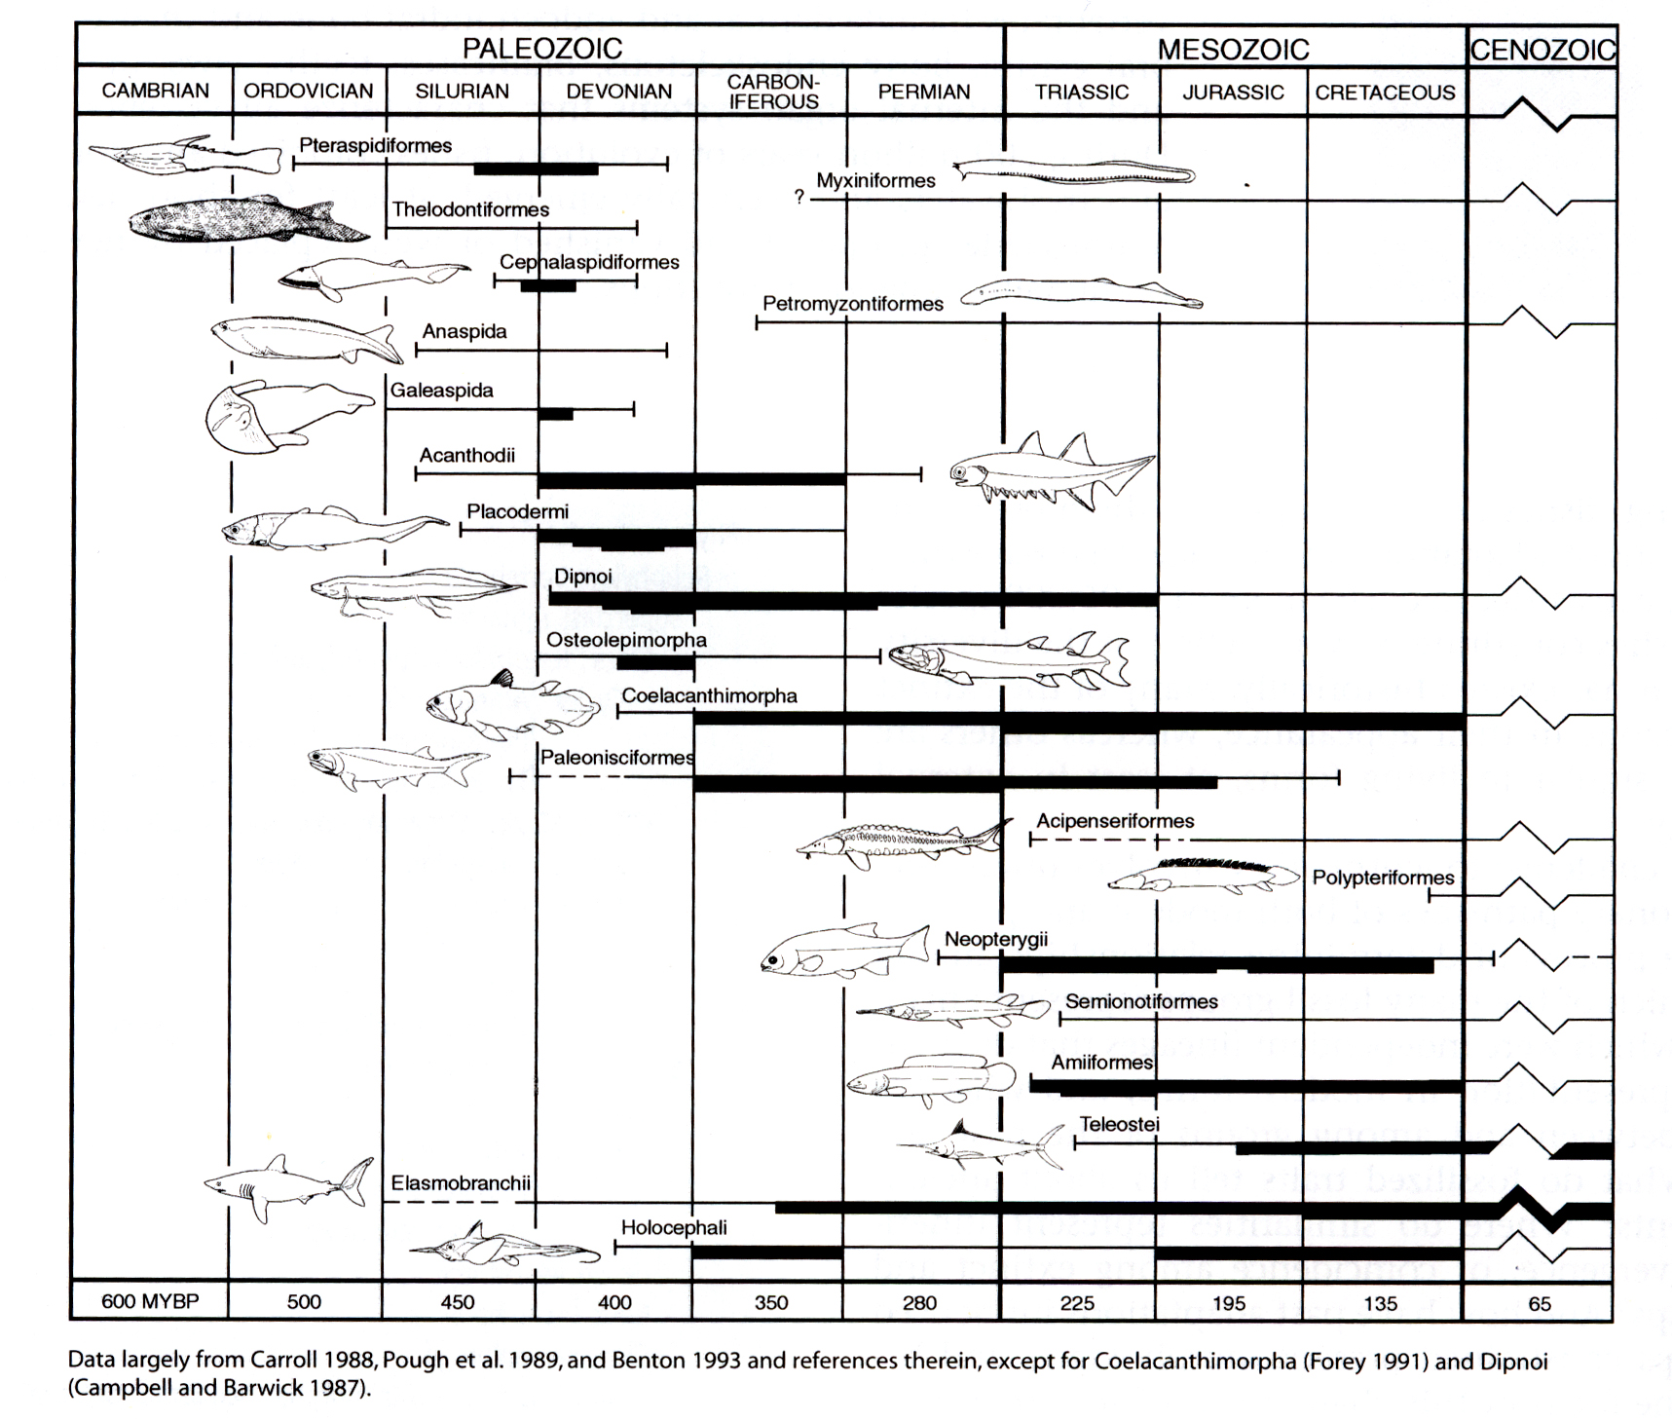

Slide 6
Jawless Fishes
Earliest group of fishes believed to have originated in late Cambrian period (600 mya).
Oldest fossil jawless fish dates to Ordovician (500 mya).
Hagfishes considered oldest fishes in phylogenetic sense, but fossil record only extends back to late carboniferous.
Similar problem with lampreys.

Slide 7
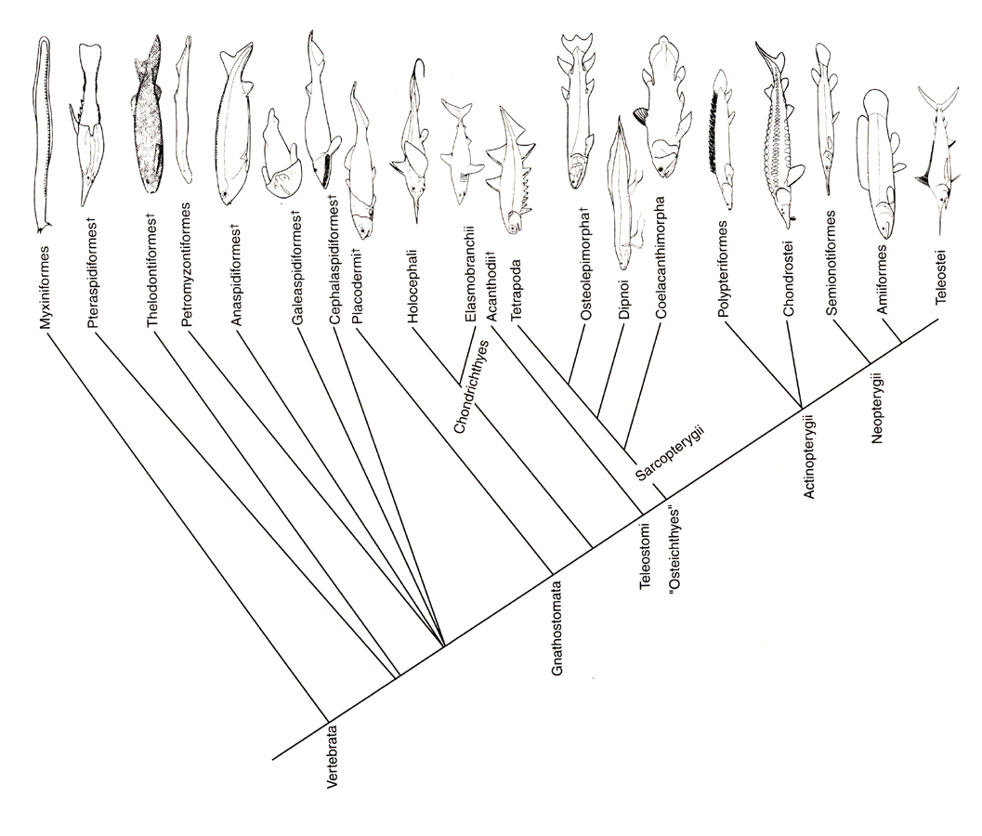

Slide 9
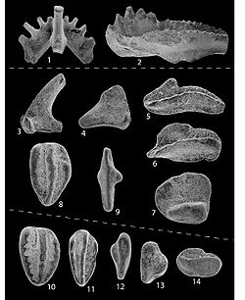
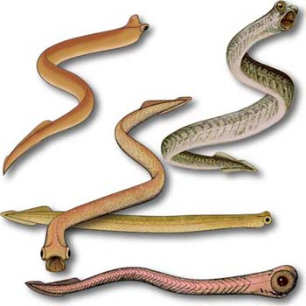
Conodonts
Term assigned to teeth, long known in fossil record.
Trace fossils found later, purported to be from eel-like bearers of the teeth.
Unclear what the organism is.
Most experts consider them chordates; some consider them jawless fishes.
Could be ancestors to living jawless fishes, but little support for this.

Slide 10
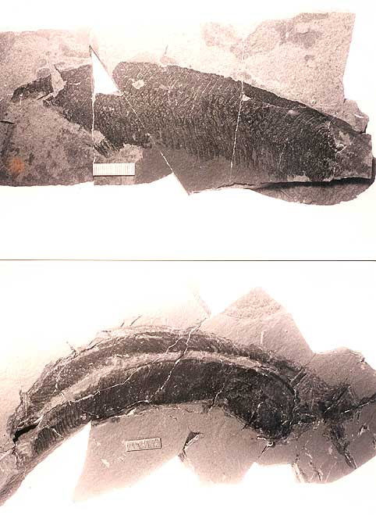
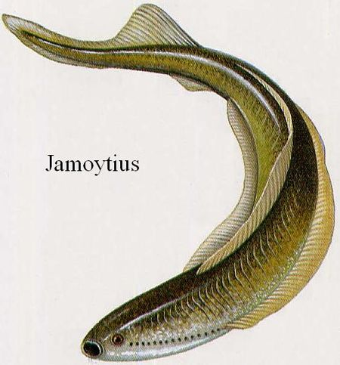
Jamoytius (Anaspidiformes)
Some believe this to be lineage that gave
rise to lampreys.

Slide 11
Gnathostomes
Placoderms considered the oldest jawed craniates, phylogenetically.

Slide 13
Gnathostomes
Placoderms considered the oldest jawed craniates phylogenetically.
Oldest fossil placoderm is from mid-Silurian (450 mya)
Oldest fossil gnathostomes (teeth) are Chondrichthyans (Ordovician).

Slide 14
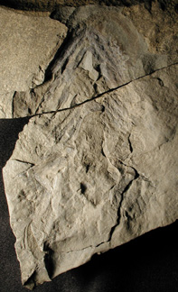
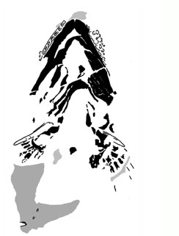
Doliodus problematicus
Oldest known, reasonably complete, shark fossil in the world.
Found in Devonian aged rocks.
Teeth and dermal denticles from this and other sharks known from late Ordovician (418 mya).

Slide 16
Gnathostomes
Placoderms considered the oldest jawed craniates phylogenetically.
Oldest fossil placoderm is from mid-Silurian (450 mya)
Oldest fossil gnathostomes (teeth) are Chondrichthyans (Ordovician)
Chondrichthyans older than Placoderms and Acanthodians?

Slide 17
Teleostomes
Acanthodians (once considered oldest gnathostomes) now believed to be sister group to bony fishes and tetrapods, phylogenetically.
If true, basal divergence of teleostomes occurred earlier than previously thought.

Slide 18
Minimum age for origin of
Teleostomes is Silurian
Grade Teleostomi (†Acanthodii + Sarcopterygii + Actinopterygii)

