Slide 1
Molecular evidence of interspecific hybridization in Subfamily Ictiobinae
(Teleostomi: Catostomidae)
Henry L. Bart, Jr.¹ Mark D. Clements¹, Rebecca E. Blanton¹, Kyle R. Piller², John Lyons³, David L. Hurley⁴
¹ Museum of Natural History and Ecology and Evolutionary Biology,
Tulane University
² Wisconsin Department of Natural Resources and University of
Wisconsin
³ Department of Cell and Molecular Biology, Tulane University

Slide 2
Subfamily Ictiobinae
4 genera (2 extinct)
oldest catostomids (Paleocene)
large, long-dorsal fin, inhabit large rivers and lakes
most basal and pliesiomorphic suckers
7 or 8 currently recognized extant species: 3 Carpiodes; 4 or 5 Ictiobus

Slide 3
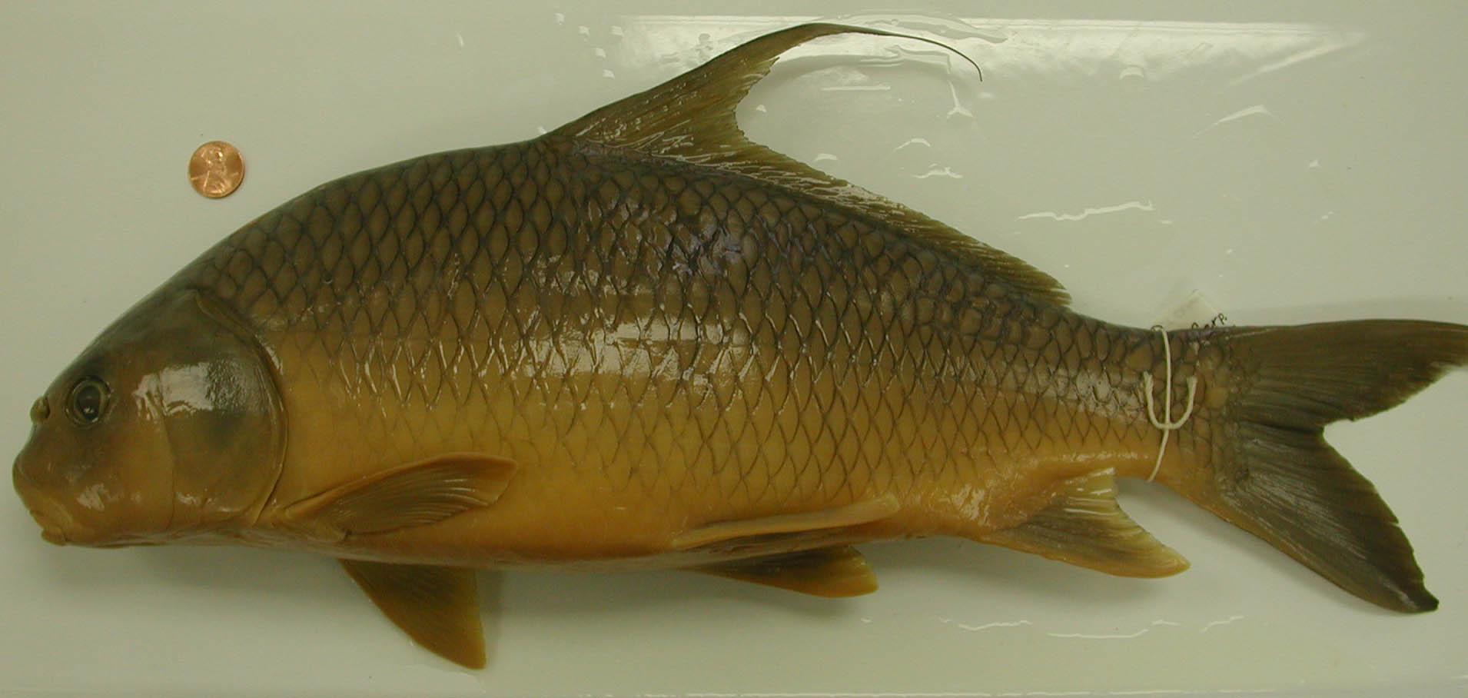
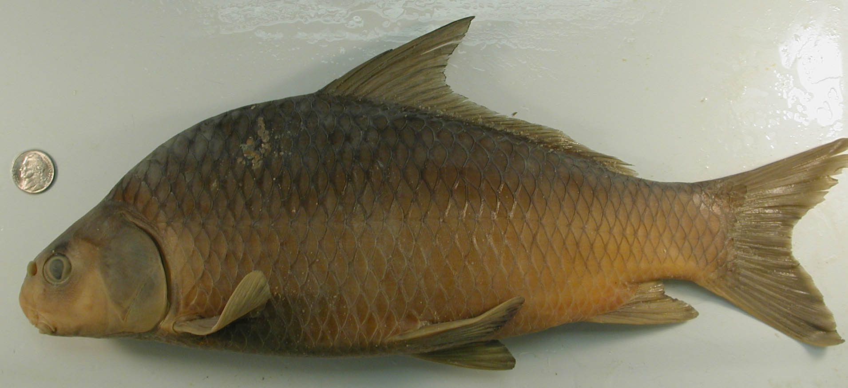
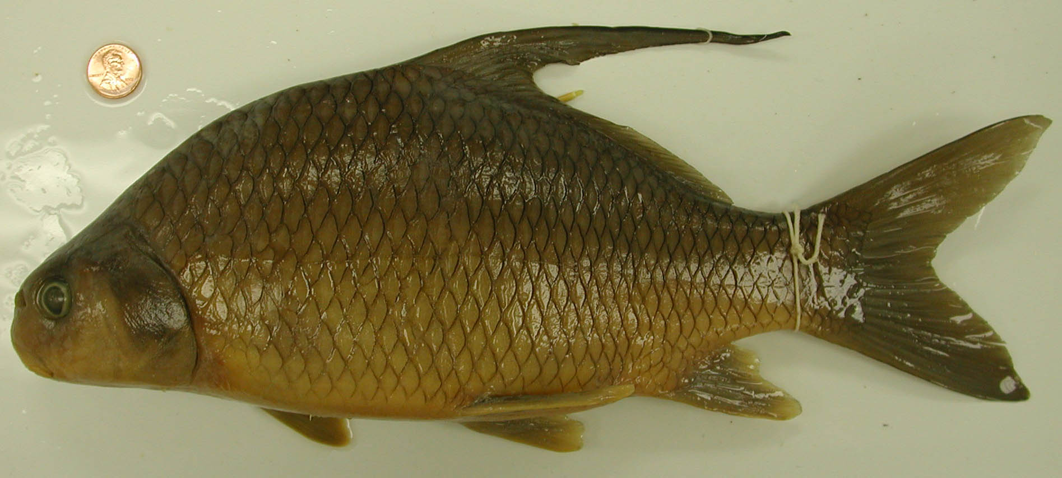
Carpiodes
Carpiodes cyprinus
LeSueur, 1817
Long quill, short
head, elongate body
Carpiodes carpio
Rafinesque, 1820
Short quill, short
head, elongate body
Carpiodes velifer
Rafinesque, 1820
Long quill, short
head, short, deep
body

Slide 4
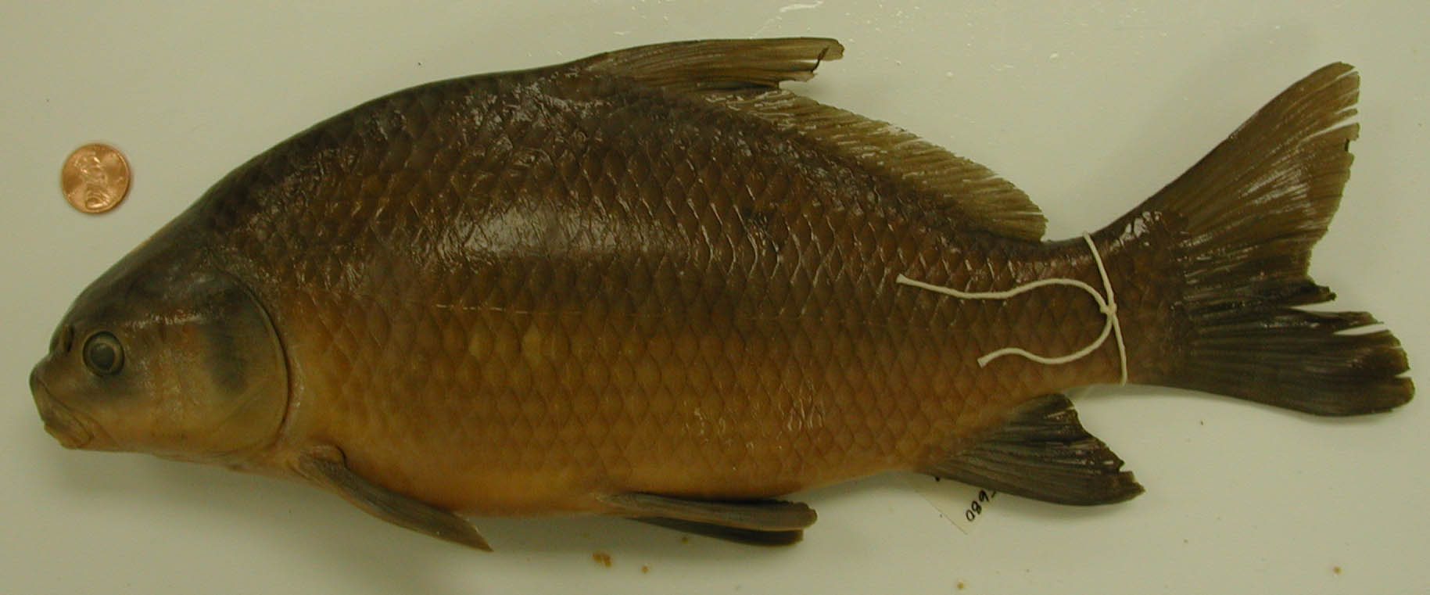
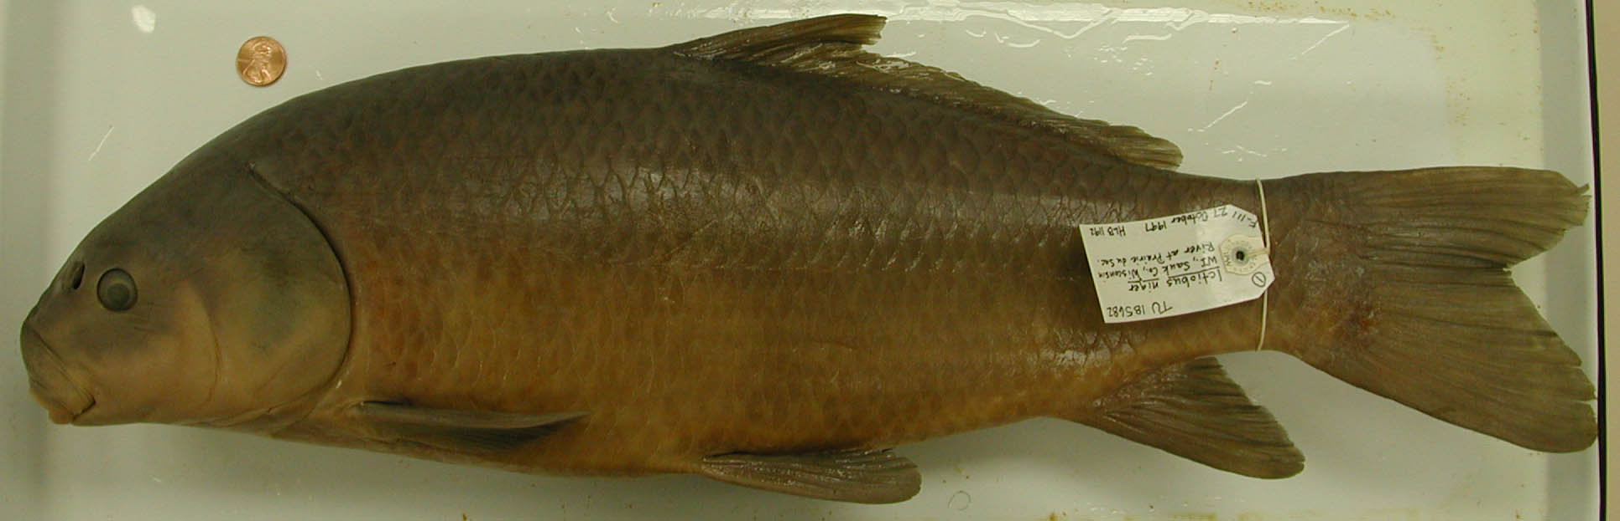
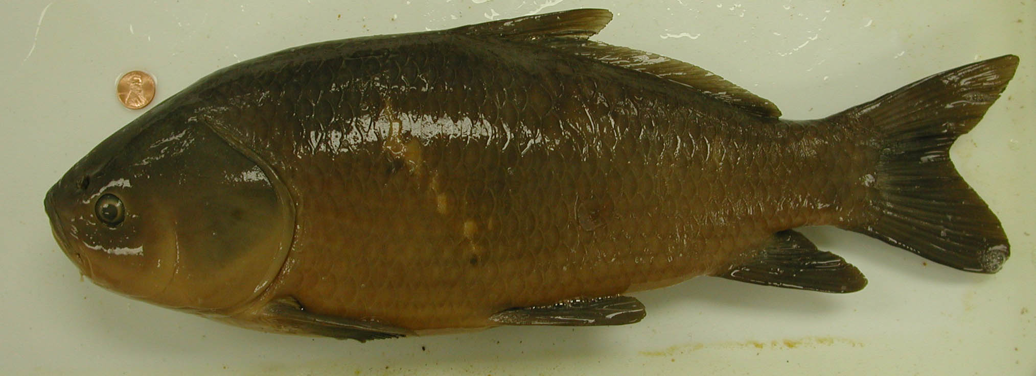
Ictiobus
Ictiobus bubalus
Rafinesque, 1820
Small head, deep
body, subterminal
mouth
Ictiobus niger
Rafinesque, 1820
Large head, shallow
body, subterminal
mouth
Ictiobus cyprinellus
Valenciennes, 1844
Terminal mouth

Slide 5
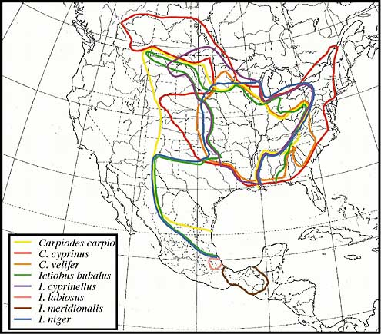
DISTRIBUTION
North America east
of continental divide
Southern-most
Catostomids
Highly overlapping
ranges (except
southern Mexíco)

Slide 6
Shape analysis
Digitized 14 landmarks for
samples of the six species
(3 Carpiodes, 3 Ictiobus)
co-occuring in the Wisconsin
River.
Thin-plate spline methods
used to derive size-free
shape variables for
multivariate analysis.

Slide 7
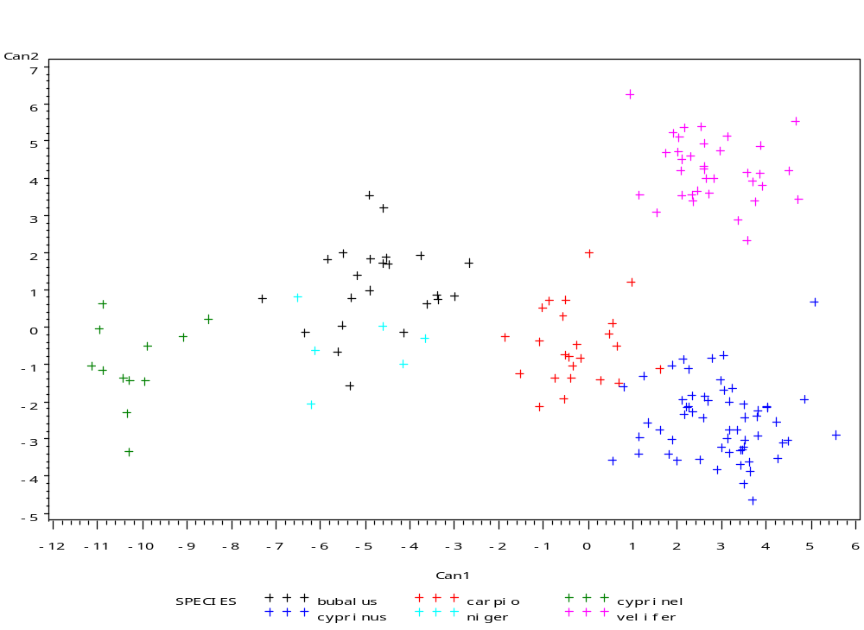
Canonical discriminant analysis of landmark data
C. velifer
I. bubalus
C. carpio
C. cyprinus
I. niger
I. cyprinellus

Slide 8
I. cyprinellus
C. carpio
Bayesian tree
Cytochrome b

Slide 9
This study
Sequenced and/or screened (using Single-Stranded
Conformational Polymorphism analysis) the mitochodrial
cytochrome b gene (1140 bp) and Intron B (300 bp) of one
of two paralogous copies of the nuclear growth hormone
(GH) gene for samples of 10 specimens each of Ictiobus
bubalus, I. cyprinellus, I. niger, Carpiodes carpio,
C. cyprinus, and C. velifer from syntopic populations in
the Wisconsin River.
Cyt b results for Wisconsin River compared with cyt b data
from other populations of Carpiodes and Ictiobus.

Slide 10
Cyt b Results for Carpiodes
Upper Mississippi C. cyprinus morphotypes cluster with
Ohio River and Hudson Bay C. cyprinus and two C. carpio
(Mississippi Basin specimens differing by 0-4 substitutions).
Latter interpreted as C. cyprinus x carpio hybrids.
Specimens with C. carpio morphotype cluster with C. velifer
to differing degrees with some specimens having identical
sequence and others differing by as much as 0.8% (10
substitutions).
No evidence of hybrids between C. cyprinus and C. velifer

Slide 11
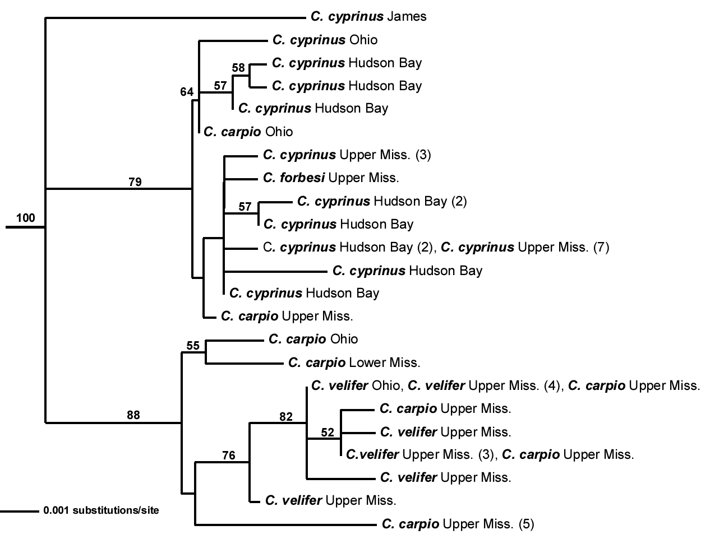
C. “cyprinus”
C. carpio/velifer

Slide 12
Cyt b Results for Ictiobus
Lower cyt b sequence divergence overall in Ictiobus than in
Carpiodes (Mean of 0.4% versus 0.8% in Carpiodes).
Specimens representing different morphotypes of Ictiobus
within the Wisconsin River (as well as populations as distant
as the Rio Usumacinta in Mexico, found to have very similar
cyt b haplotypes.
Specimens with I. bubalus morphotype tend to cluster together
and share (with some I. cyprinellus and I. niger) a
non-conservative first position substitution.

Slide 13
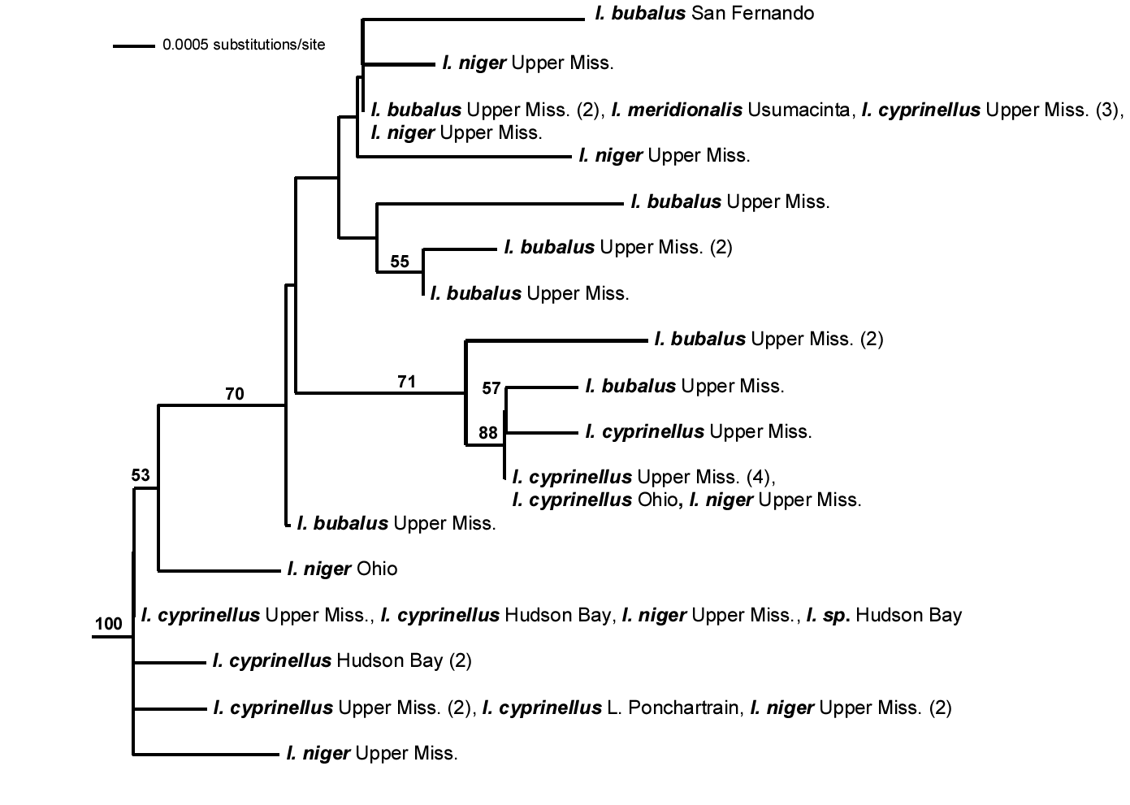

Slide 14
Cyt b Results for Ictiobus cont’d
Certain specimens of I. niger and I. cyprinellus, including
isolated I. cyprinellus from the Hudson Bay drainage,
occur at the bottom of the tree and show the highest
cyt b divergences (as much as 0.8%) from specimens in
the other cluster.

Slide 16
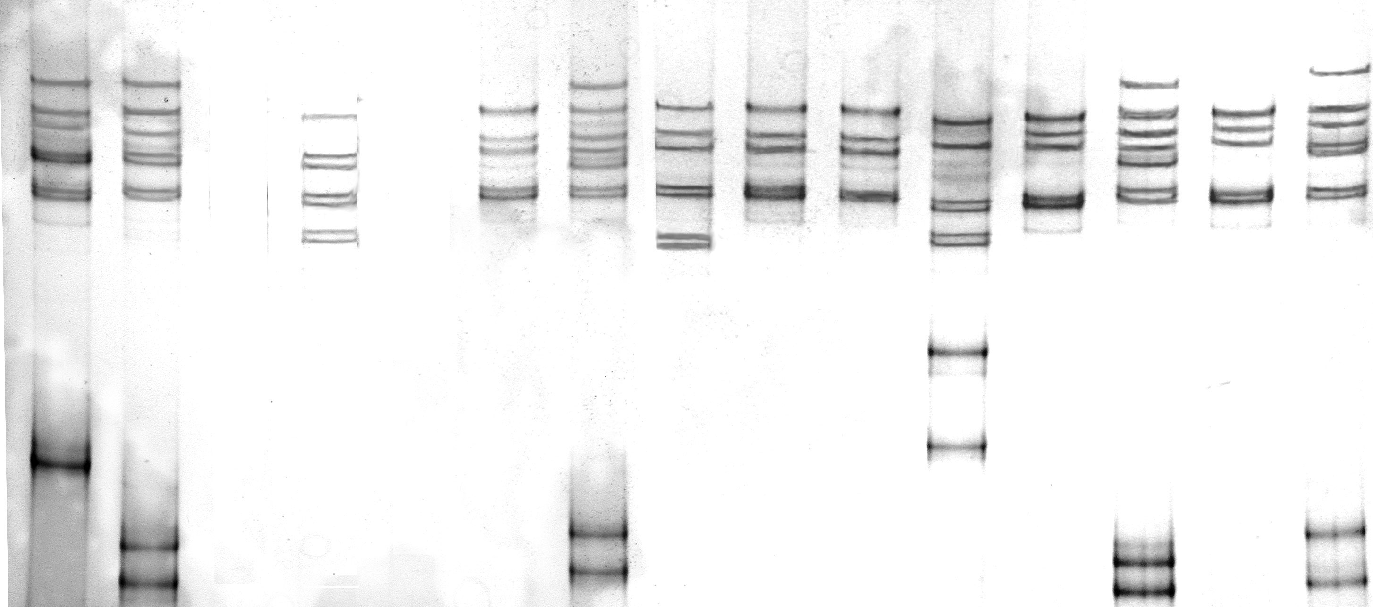
Interpreting SSCP gels
AF
AB
EF
CC
AC
CD
CC
CC
?
BB
AH
BB
AB
Ictiobus bubalus
I. cyprinellus
I. niger

Slide 17
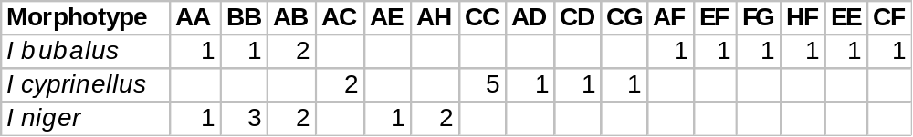
GH Intron SSCP summary
I. cyprinellus (n=10) shows 4 alleles (A,C,D,G) with common allele C
I. niger (n=9) shows 4 alleles (A,B,E,H) with common alleles A and B
I. bubalus (n=10) shows 6 alleles (A,B,C,E,F,G) with common alleles
E and F. Individuals with AA, AB, BB genotypes may be misidentified.
Allele A is 3% divergent from alleles B and C and has a 6 bp indel.
Alleles B and C are 1% divergent and have a 2 bp indel.

Slide 18
GH Intron SSCP results for Carpiodes
SSCP results for Carpiodes are preliminary (not able to
unambiguously identify genotypes at this stage).
Ten individuals of C. velifer exhibited three SSCP patterns
not seen in either of the other two Carpiodes.
Ten individuals of C. cyprinus showed five SSCP patterns
not seen in C. velifer
Two individuals of C. carpio (both of which were suspected
to be C. carpio x cyprinus hybrids) show an SSCP pattern
that is shared with two C. cyprinus individuals.
C. velifer and C. cyprinus GH I, Intron B sequences are 1.5%
divergent with 4 bp indel.

Slide 19
Conclusions
Sharing of cyt b haplotypes and GH Intron alleles among
distinct morphotypes of Ictiobus suggests that all three
species of Ictiobus are hybridizing in the Mississippi River
Basin.
Common alleles may represent ancestral genotypes. More
sequencing of GH introns needed to assess extent of
introgression in Ictiobus.
Hybridization not as extensive in Carpiodes and favors
certain combinations of species (C. carpio x cyprinus,
C. carpio x velifer) .

Slide 20
Conclusions cont’d
Hybridization in both groups may be a recent phenomenon.
Hybrids of all three species of Ictiobus have been
produced in the laboratory.
Fossils evidence suggests species of Ictiobus have been
diverging for 1-5 my.
Dams and other river modifications may disrupt reproductive
isolating mechanisms.

Slide 21
Acknowledgements
Research part of an ongoing taxonomic revision
of the Subfamily Ictiobinae supported by NSF
grant DEB 0237013 to HLB, RDS, and DLH.
Special thanks to Patrick Nelson of University of
Manitoba for tissues of Carpiodes cyprinus and
Ictiobus cyprinellus from Hudson Bay Drainage.

