Slide 1
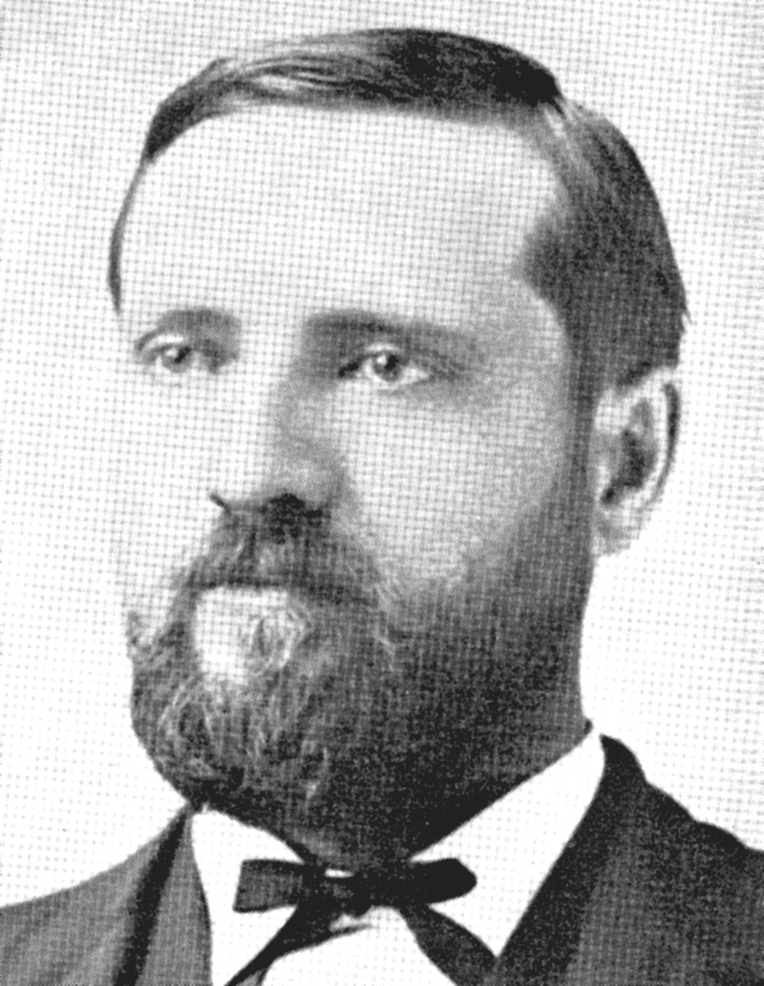
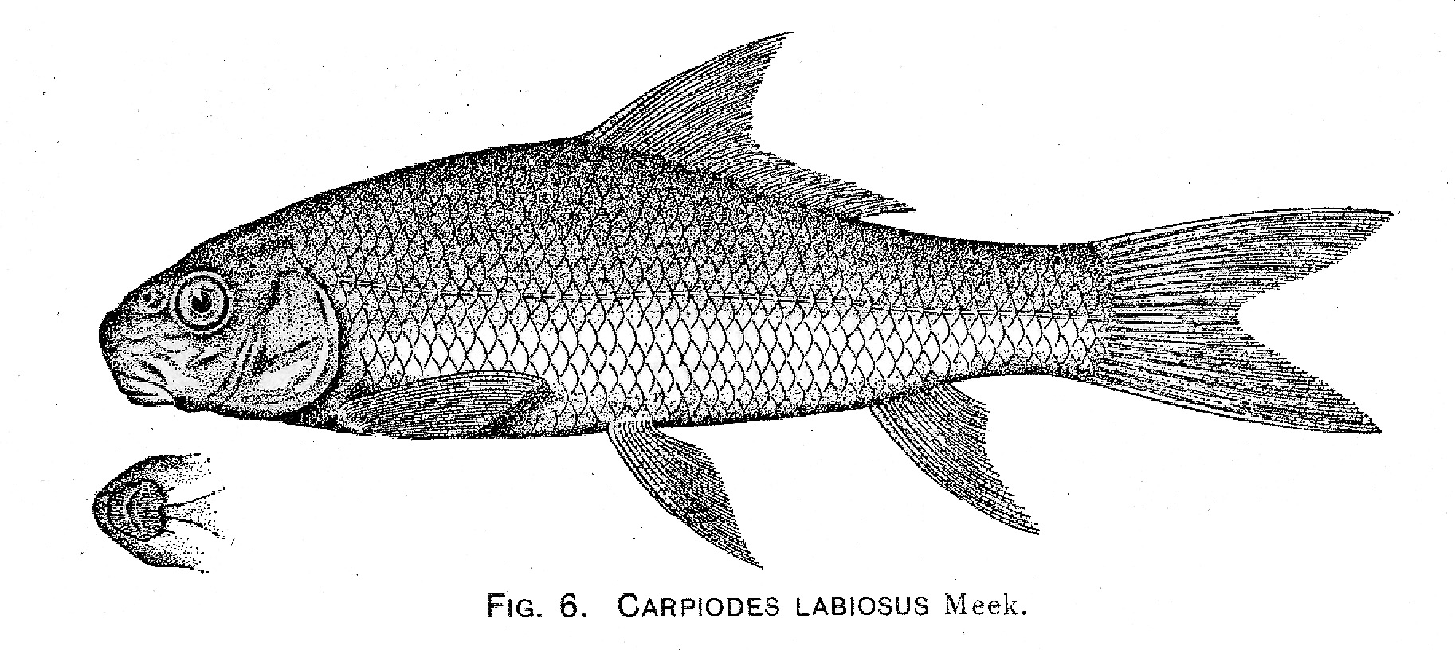
“This species is easily distinguished by being more slender
than any other member of the genus and having thick
papillose lips like the species of Catostomus.”
Meek (1904) The Freshwater Fishes of Mexico North of the Isthmus of Tehuantepec

Slide 2
Phylogenetic relationships of suckers of subfamily Ictiobinae, as inferred from cytochrome b sequence data
Bart, H. L. Jr^{.1;} Piller, K.R^{.1;} Hurley, D.L².; Lyons, J^{.3;} Mercado-Silva, N^{.3;} Díaz-Pardo, C.E.⁴
1 Tulane Museum of Natural History, Belle Chasse, LA 70037
2 Dept. of Cell and Molecular Biology, Tulane University, New Orleans, LA 70118
3 University of Wisconsin, Zoological Museum, Madison, WI 53706
4 Dept. Zoologia, Instituto Politécnico Nacional, Mexico, DF 11340

Slide 3
Subfamily Ictiobinae
4 genera (2 extinct)
oldest catostomids (Paleocene)
large, long-finned, inhabitants of large rivers and lakes
most basal and pliesiomorphic suckers
7 or 8 currently recognized extant species: 3 Carpiodes; 4 or 5 Ictiobus

Slide 4
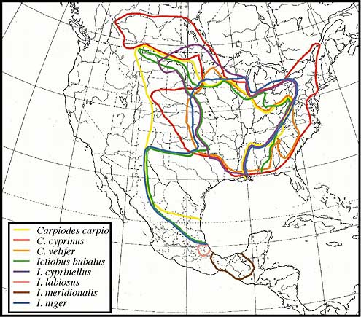
Distribution
North America east of continental divide
Southern-most Catostomids
Highly overlapping ranges (except southern Mexíco)

Slide 5
Study Populations
Carpiodes velifer (Kentucky R., Ohio R., Dr., KY)
Carpiodes velifer (Wisconsin R., Upper Miss. R. Dr., WI)
Carpiodes cyprinus (Wisconsin R., Upper Miss. R. Dr., WI)
Carpiodes cyprinus (Wisconsin R., Upper Miss. R., Dr., WI)
Carpiodes carpio (Kentucky R., Ohio R. Dr., KY)
Ictiobus niger (Kentucky R., Ohio R. Dr., KY)
Ictiobus niger (Wisconsin R., Upper Miss. R. Dr., WI)
Ictiobus bubalus (Wisconsin R., Upper Miss. R. Dr., WI)
Ictiobus bubalus (Amite R., Lake Pontch. Dr., LA)
Ictiobus cyprinellus (Amite R., Lake Pontch. Dr., LA)
Ictiobus labiosus (Rio Pánuco, Mexico)
Myxocyprinus asiaticus (GenBank AF036176)

Slide 6
Methods
1. GNOME DNA Isolation Kit (Bio 101)
2. PCR: 94°/1min, 55°/1min, 72°/1:15min for 30 cycles
3. PCR Rapid Purification Kit (Gibco)
GLU 322F 648F 907F
GLU
Cyt-b
THR
907R 644R 304R THR

Slide 7
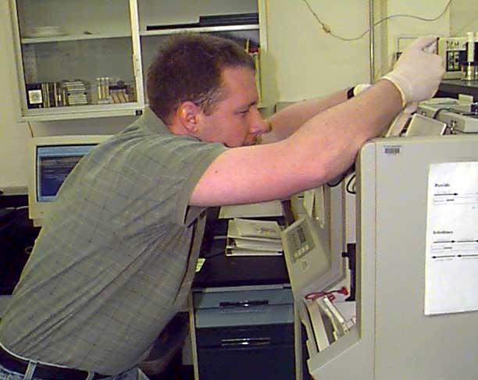
Methods (cont’d)
4. Sequenced using ABI 373 Automated Sequencer
5. Aligned data analyzed using PAUP*4.0

Slide 8
MP: Heuristic Search
351 steps
92
C. velifer (Wisconsin R.)
C. velifer (Kentucky R.)
100
99
C. cyprinus (Wisconsin R.)
C. cyprinus (Wisconsin R.)
55
C. carpio (Kentucky R.)
I. cyprinellus (Amite R.)
100
I. niger (Kentucky R.)
100
I. niger (Wisconsin R.)
98
96
I. bubalus (Amite R.)
100
I. bubalus (Wisconsin R.)
I. labiosus (Rio Pánuco)
M. asiaticus

Slide 9
Smith (1992)
Cyt-b
C. cyprinus
C. cyprinus
C. velifer
C. carpio
C. carpio
C. velifer
I. labiosus
I. bubalus
I. cyprinellus
I. niger
I. bubalus
I. cyprinellus
I. niger
I. labiosus
Amyzon
M. asiaticus

Slide 10
C. cyprinus (Wisconsin R.)
Partial Cyt-b
C. cyprinus (Wisconsin R.)
C. cyprinus (Illinois R.)
C. “forbesi”- like (Wisconsin R.)
C. cyprinus (Wisconsin R.)
C. cyprinus (Rock R.)
C. cyprinus (Kentucky R.)
C. cyprinus (James R.)
C. cyprinus (Savannah R.)
C. carpio (Kentucky R.)

Slide 11
Partial Cyt-b tree (380 bp) from Guelph Meeting
C. cyprinus (Kentucky R.)
C. cyprinus (Amite R.)
C. cyprinus (James R.)
C. cyprinus (Wisc. R.)
C. “forbesi” (Wisc. R.)
C. velifer (Amite R.)
C. velifer (Wisc. R.)
M. asiaticus

Slide 12
92
C. velifer (Wisconsin R.)
351 steps
C. velifer (Kentucky R.)
100
99
C. cyprinus (Wisconsin R.)
55
C. cyprinus (Wisconsin R.)
C. carpio (Kentucky R.)
I. cyprinellus (Amite R.)
100
I. niger (Kentucky R.)
100
96
I. niger (Wisconsin R.)
98
I. bubalus (Amite R.)
100
I. bubalus (Wisconsin R.)
I. labiosus (Rio Pánuco)
M. asiaticus

Slide 13
Smith (1992)
C. carpio
C. velifer
C. cyprinus
I. labiosus
I. cyprinellus
I. bubalus
I. niger
†Amyzon

Slide 14
Conclusions
Unweighted parsimony analysis of complete Cyt-b data for 7 of 8 extant “species” produced one tree with very high bootstrap support for all but one node
monophyly of Carpiodes and Ictiobus supported
Carpiodes cyprinus sister to C. carpio

Slide 15
Conclusions (cont’d)
More complete Cyt-b dataset provides no support for existence of two quillback forms in upper Mississippi River
Ictiobus labiosus sister to Mississippi River valley Ictiobus; most divergent of included forms; likely not a recent peripheral isolate
more sampling of southwestern U.S. and Mexícan Ictiobus needed

