Slide 1
Patterns of variation in introns of the growth hormone gene in species of Ictiobus (Cypriniformes: Catostomidae)
Henry L. Bart, Jr.¹, Mark D. Clements¹, Rebecca E. Blanton¹, David L. Hurley²
1 -Tulane University Museum of Natural History, Belle Chasse, LA 70037, and Department of Ecology and Evolutionary Biology,
Tulane University, New Orleans, LA 70118
2- Department of Biochemistry, Tulane University
School of Medicine, New Orleans, LA 70112

Slide 2
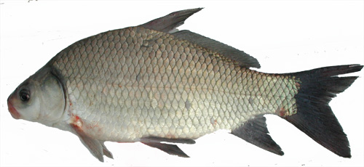


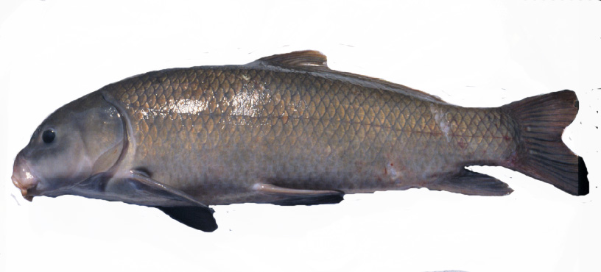
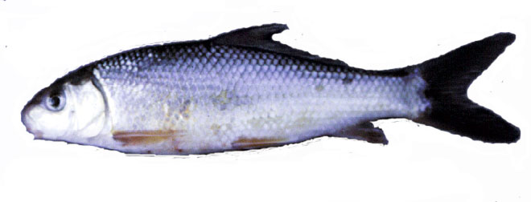
Genus Ictiobus Rafinesque, Buffalofishes
Ictiobus bubalus Smallmouth buffalo
Small head, deep body, small subterminal mouth
Ictiobus cyprinellus Bigmouth buffalo
Large terminal mouth
I. meridionalis Boquin
Small head, slender body, small subterminal mouth
Ictiobus niger Black buffalo
Large head, shallow, elongate body, large subterminal mouth
Ictiobus labiosus Fleshylip matalote
Slender body, thick fleshy lips

Slide 3
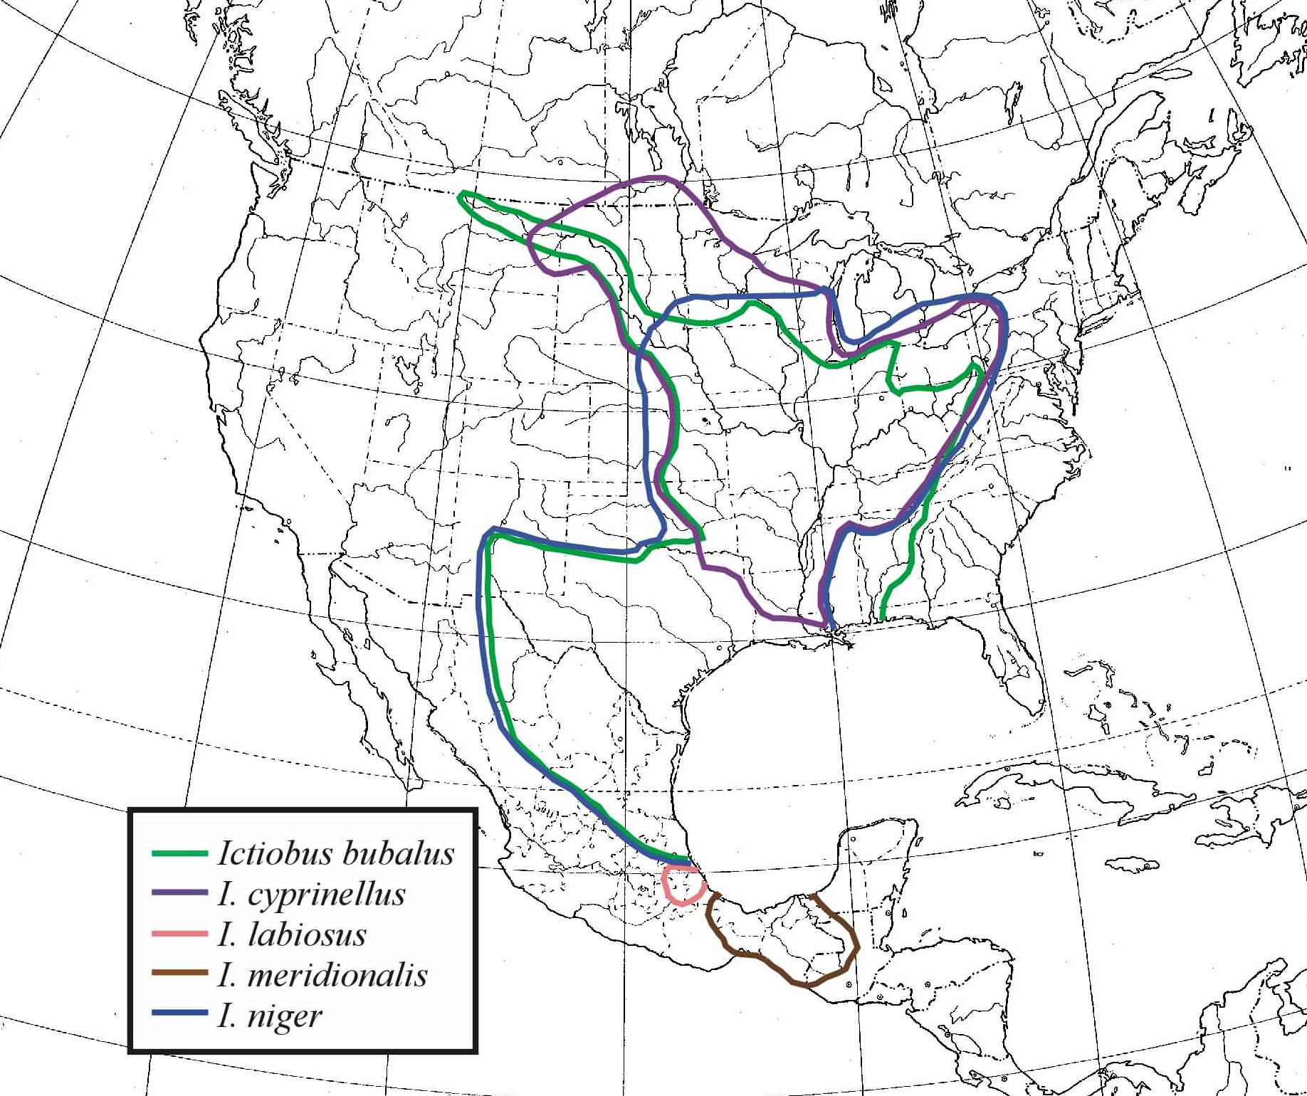

Slide 4
Fossil Record
mya
Period
Epoch
0
Quaternary
Pleistocene
I. cf cyprinellus
I. cf bubalus
†I. aguilerai ms.
I. niger
2
Pliocene
Ictiobus sp.
10
Neogene
(Tertiary)
Miocene
20

Slide 5
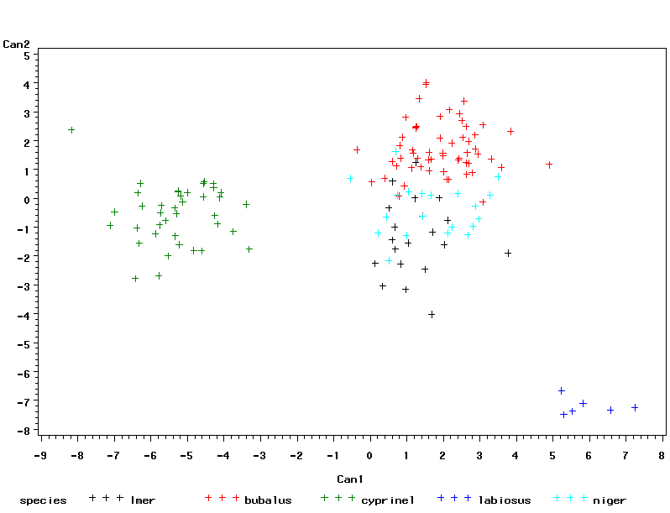
Body shape variation in Ictiobus
I. bubalus
I. meridionalis
I. niger
I. cyprinellus
I. labiosus

Slide 6
Carpiodes cf cyprinus Apalachicola River (outgroup)
Ictiobus labiosus
98
I. bubalus Eastern Gulf
96
I. niger Eastern Gulf
I. bubalus, I. niger Upper Miss.
I. bubalus Lower Miss.
I. meridionalis Southern Gulf
I. bubalus Lower Miss.
BOX A
I. bubalus (2) Great Lakes,
Middle Miss.; I. cyprinellus (13)
Upper, Middle, Lower Miss.,
Great Lakes; I. meridionalis (2);
I. niger (6) Great Lakes, Upper
Miss.
I. bubalus Atlantic Slope
99
I. meridionalis Southern Gulf (2)
BOX A
I. bubalus Upper Miss. (2)
I. cyprinellus Upper Miss.
I. cyprinellus Great Lakes
I. niger Great Lakes
I. ? Great Lakes
I. bubalus Eastern Gulf
96
I. bubalus Upper Miss. (2)
I. bubalus Upper, Middle Miss.
BOX B
I. bubalus (4) Eastern Gulf, Great
Lakes, Lower Miss; I. cyprinellus
(5) Great Lakes, Middle, Upper
Miss.; I. meridionalis; I. niger (4)
Great Lakes, Middle, Upper Miss.;
I. ? Great Lakes
99
I. bubalus Upper Miss.
98
I. bubalus Upper Miss.
BOX B
I. bubalus Western Gulf
100
I. bubalus Upper Miss.
81
95
I. niger Upper Miss.
I. bubalus Western Gulf
I. niger Upper Miss.
I. bubalus, I. niger Upper Miss.
I. bubalus Lower Miss.
100
I. niger Upper Miss.
Bayesian
majority-rule
consensus tree
36 cyt b haplotypes
92 Ictiobus specimens
I. niger Upper Miss.
I. ? Great Lakes
I. bubalus Upper Miss.
I. cyprinellus Hudson Bay
I. cyprinellus Hudson Bay
I. cyprinellus Lower Miss
BOX C
I. cyprinellus (3) Eastern Gulf,
Upper Miss.; I. niger (3) Middle,
Upper Miss.
BOX C
I. niger Middle Miss.
I. niger Upper Miss.

Slide 7
Mixed model Bayesian consensus tree
Cyt b and Control Region data
Carpiodes sp. cf cyprinus
Ictiobus bubalus Eastern Gulf
I. niger Eastern Gulf
I. bubalus Atlantic Slope*
I. bubalus Great Lakes
I. cyprinellus Lower Mississippi
I. cyprinellus Great Lakes
I cyprinellus Upper Mississippi
I. niger Upper Mississippi
I. meridionalis Southern Gulf (Mexico)
I. meridionalis Southern Gulf (Mexico)
I. bubalus Eastern Gulf
I. bubalus Western Gulf
I. bubalus Western Gulf (Mexico)
I. bubalus Lower Mississippi
I. bubalus Eastern Gulf
I. bubalus Upper Mississippi
I. bubalus Lower Mississippi
I. cyprinellus Eastern Gulf
I. niger Upper Mississippi
I. niger Upper Mississippi
I. cyprinellus Hudson Bay
10 changes

Slide 8
Previous conclusions
Exception for I. labiosus, can’t distinguish among Ictiobus species based on mitochondrial DNA.
Mitochondrial genome introgressed in recent past (most likely in Mississippi River Basin)
Recent colonization of other areas of distribution, including extreme southern Gulf of Mexico.
If morphological differences among species genetically programmed, and morphotypes represent long divergent lineages, should see signal in the nuclear genome.

Slide 9
This Study
Exon 1
5’ UTR
3’ UTR
Exon 2
Exon 3
Exon 4
Exon 5
Intron A
Intron B
Intron C
Intron D
Sequenced and/or screened (Single-Stranded Conformational
Polymorphisms) Intron B (230 bp) of one of two paralogous
copies of the nuclear growth hormone gene (GH) for 94 specimens of
Ictiobus representing multiple populations of all currently recognized
species.
Examined patterns of GH intron sequence variation and frequencies
of GH intron alleles among Ictiobus morphotypes and different
geographic areas across Ictiobus distribution.

Slide 10
Hudson Bay
1
Upper
Miss
?
Great Lakes
3
3
Middle Miss.
(Ohio)
Lower
Miss
Western
Gulf
3
2
Eastern Gulf
1
Lake Pontchartrain
(3)
Ictiobus
labiosus
Southern Gulf
2

Slide 11
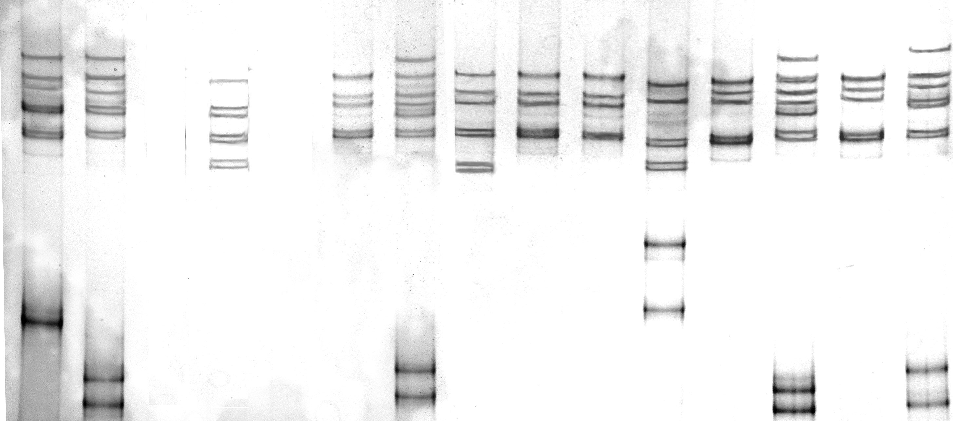
Interpreting SSCP gels
AF
AB
EF
CC
AC
CD
CC
CC
??
BB
AH
BB
AB
Ictiobus bubalus
I. cyprinellus
I. niger

Slide 12
Intron allele network
Allele 1
I. labiosus
(3 alleles)
13 nt difference,
including 5 nt
indel
Allele A
Allele 2
Allele I
Allele K
Allele 3
Other Ictiobus
(12 alleles)
Allele D
24 nt differences,
including 19 nt indel
Allele L
Allele E
Allele H
Allele G
Allele B
Allele C
Allele F
3 nt difference, including 1 nt indel
Allele J

Slide 13
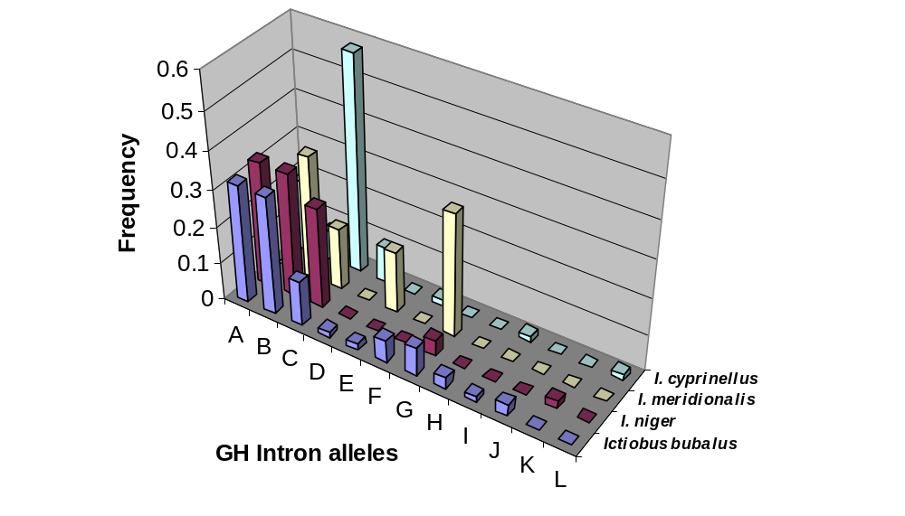
Allele frequencies by species
(morphotype)

Slide 14
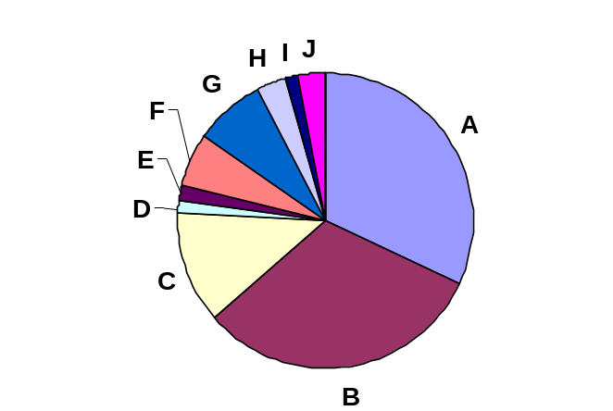
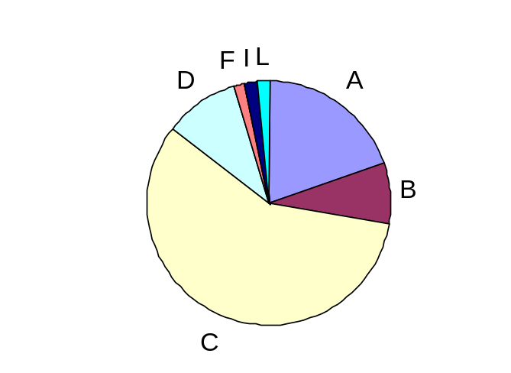
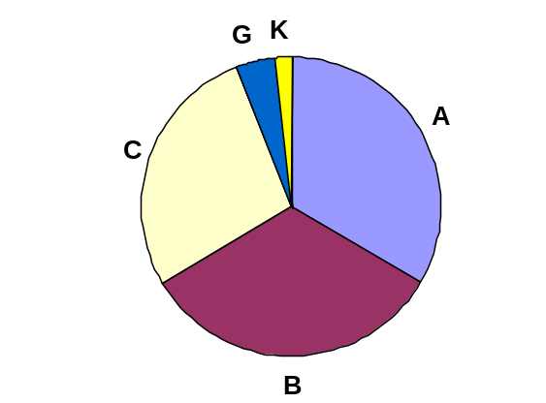
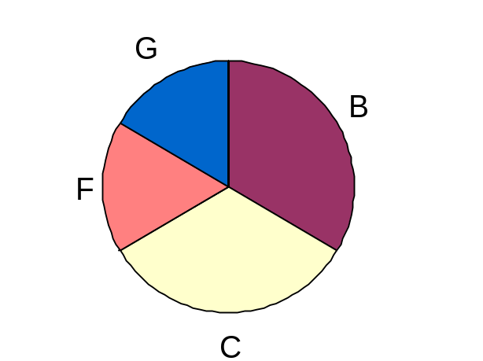
Allele frequencies by species
Ictiobus bubalus
I. cyprinellus
I. niger
I. meridionalis

Slide 15

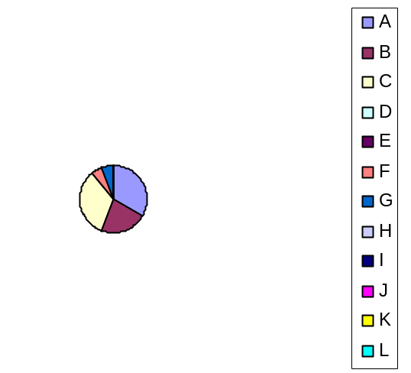
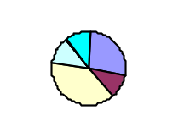
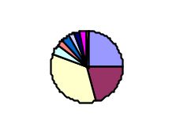
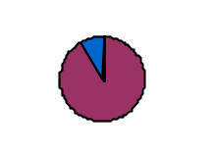
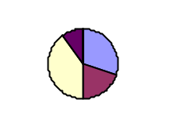
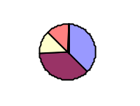
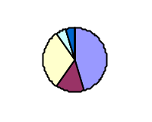
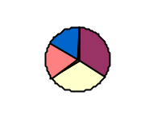

Slide 16
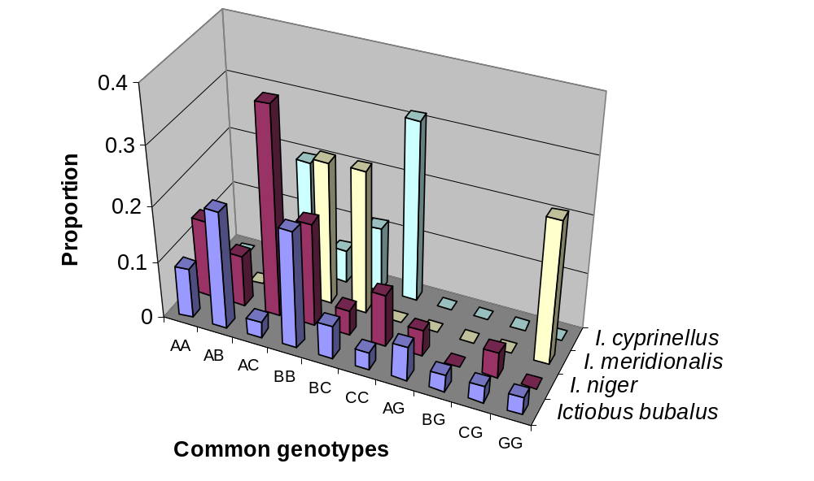
Common genotypes

Slide 17
Allele relationships
I. labiosus Allele 1
I. labiosus Allele 2
I. labiosus Allele 3
Allele A ; I. bubalus, I. niger, I. cyprinellus
Allele K; I. niger
Allele I; I. bubalus, I. cyprinellus
Allele E; I. bubalus
Allele G; I. bubalus, I. meridionalis, I. niger
Allele H; I. bubalus
Allele F; I. bubalus, I. cyprinellus, I. meridionalis
Allele C; I. bubalus, I. cyprinellus, I. meridionalis, I. niger
Allele B; I. bubalus, I. cyprinellus, I. meridionalis, I. niger
Allele J; I. bubalus
Allele L; I. cyprinellus
0.01
Allele D; I. bubalus, I. cyprinellus

Slide 18
Discussion and Conclusions
Sharing of GH intron alleles among Ictiobus morphotypes and across broad geographic areas suggests extensive interspecific hybridization in past and recent colonization of present range.
Three most common alleles have been diverging for some time, but don’t correspond to morphotypes (except Allele C in I. cyprinellus).
Sorting of alleles occurring (Eastern Gulf), but genes still flowing.
Unclear what is programming morphological differences or constraining morphological variation to a limited number of morphotypes.
Little support for recognizing Ictiobus morphotypes as species based on GH intron data.

Slide 19
Acknowledgements
FINANCIAL ASSISTANCE: NSF DEB 0237013 to HLB,
R.D. Suttkus, and D.L.Hurley.
FIELD ASSISTANCE: Mike Taylor, Steve McIninch,
Mike Doosey, Pat Ceas, Dave Etnier, Bob Jenkins,
Steve Powers, Matt Thomas, Jason Tipton, John Lyons,
Norman Mercado, Scott Harpold, Phil Cochran, Tom Turner,
Steve Platania, Salvador Contreras, Lourdes Lozano,
Armando Contreras, Ma. Elena Garcia, Salvador Contreras,
Jr., Nelson Rios,Jason Bettinger, Patrick Nelson.
LAB ASSISTANCE: Larry Minor, Liesl Schmidt, Justin Mann.
SPECIAL THANKS: Jim Grady, University of New Orleans

