Slide 1
Shape variation in fishes of Subfamily Ictiobinae
Directed Undergraduate Research
Faculty Mentor: Henry L. Bart, Jr.
Tulane University Museum of Natural History
Belle Chasse, LA 70037

Slide 2
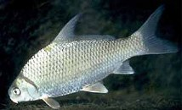
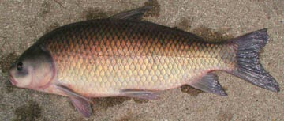
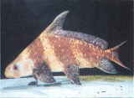
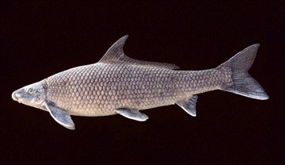
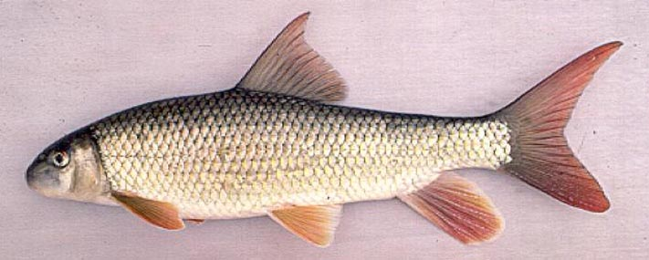
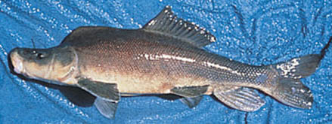
Subfamily Ictiobinae: one of three subfamilies
of suckers (Family Catostomidae)
Ictiobinae
Cycleptinae
Catostominae

Slide 3
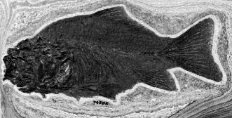
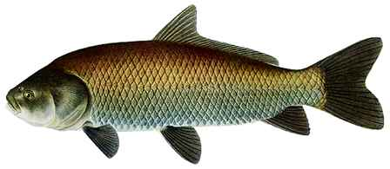
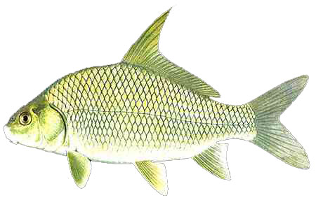
Subfamily
Ictiobinae
†Amyzon
Paleocene to
Oligocene, only
west of continental
divide
3 or 4 genera
Oldest catostomids
Most basal and
pliesiomorphic
suckers
Inhabit large rivers
and lakes
Important food fish
Ictiobus
Buffalofishes
Four or five living
species. Fossils
dating to lower Pliocene (5 mya), east of Rockies
Carpiodes
Carpsuckers
Three living species.
Fossils to Pleistocene

Slide 4
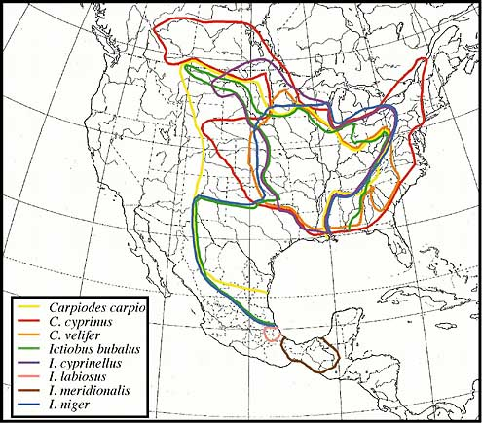
ICTIOBINE DISTRIBUTIONS
Currently recognized
species have highly
overlapping distributions,
especially in Mississippi
River Basin.
Some areas unstudied
(Gulf coastal rivers east
and west of Mississippi
River and lower
Atlantic coastal rivers).
Study of populations in
these areas may reveal
additional undescribed
species.

Slide 5
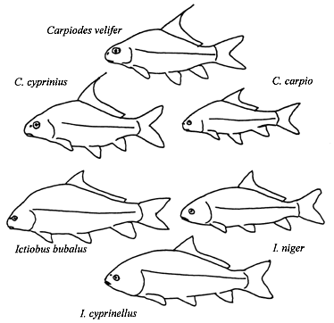
Shape variation in ictiobines
Currently recognized ictiobine species are easily
distinguished on the basis of shape.

Slide 6
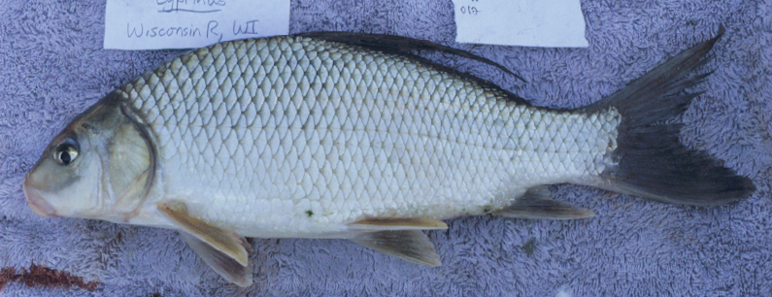
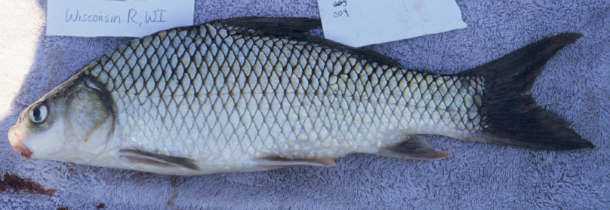
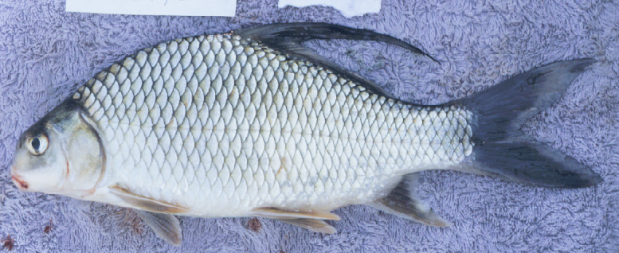
Carpiodes
Carpiodes cyprinus
Long quill, long
head, snout,
elongate body
Carpiodes carpio
Short quill, small
head, elongate body
Carpiodes velifer
Long quill, short
head, short, deep
body

Slide 7
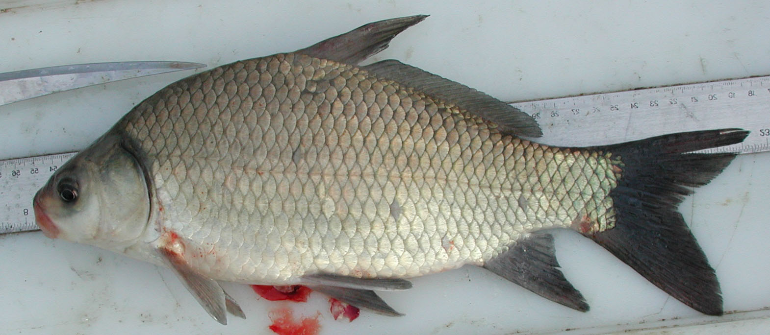
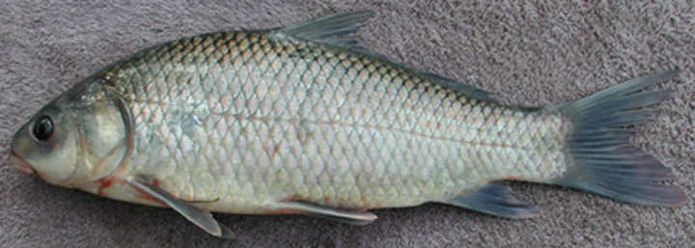
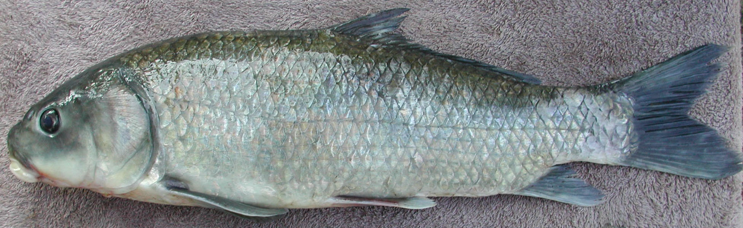
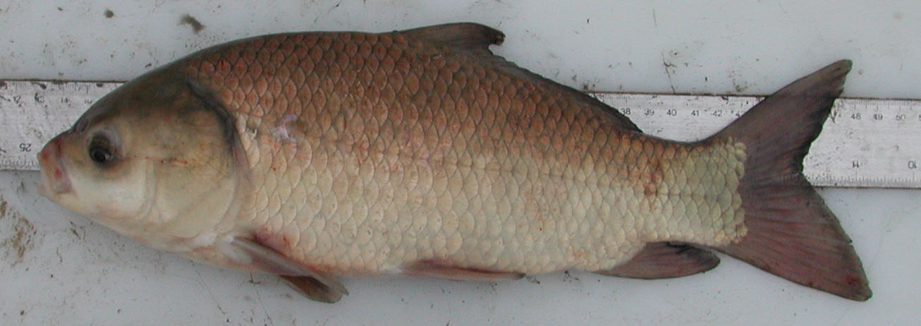
Ictiobus
Ictiobus bubalus
(I. meridionalis)
Small head, deep
body, subterminal
mouth
Ictiobus niger
Large head, shallow,
elongate body,
subterminal mouth
Ictiobus cyprinellus
Terminal mouth

Slide 8

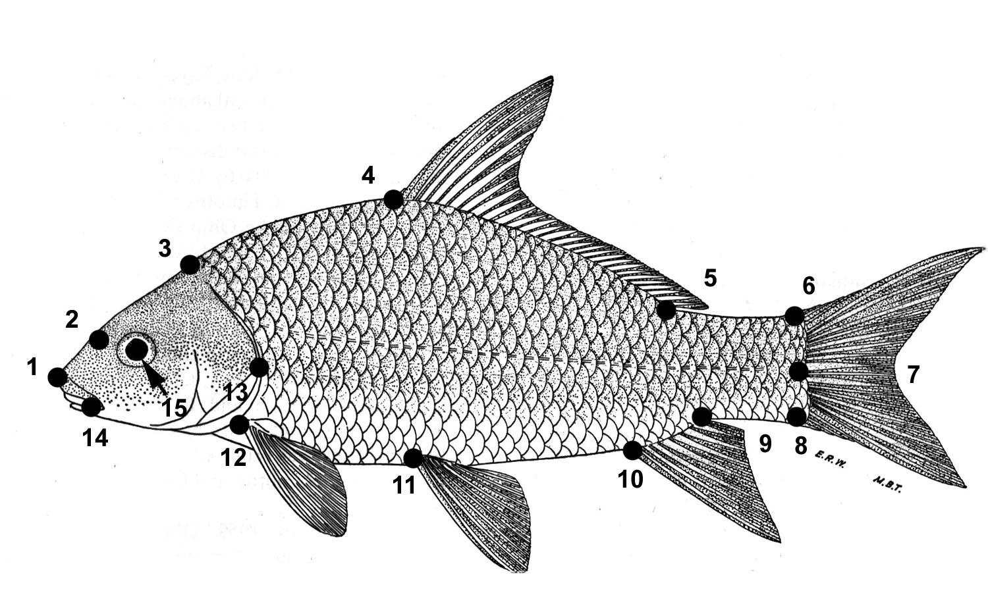
You will be using geometric morphometrics to examine shape variation in ictiobines. The method involves digitizing 15 homologous landmarks along the body outlines of specimens from throughout the geographic ranges of each species…
…using thin-plate spline methods to derive size-free shape variables for multivariate analysis.

Slide 9
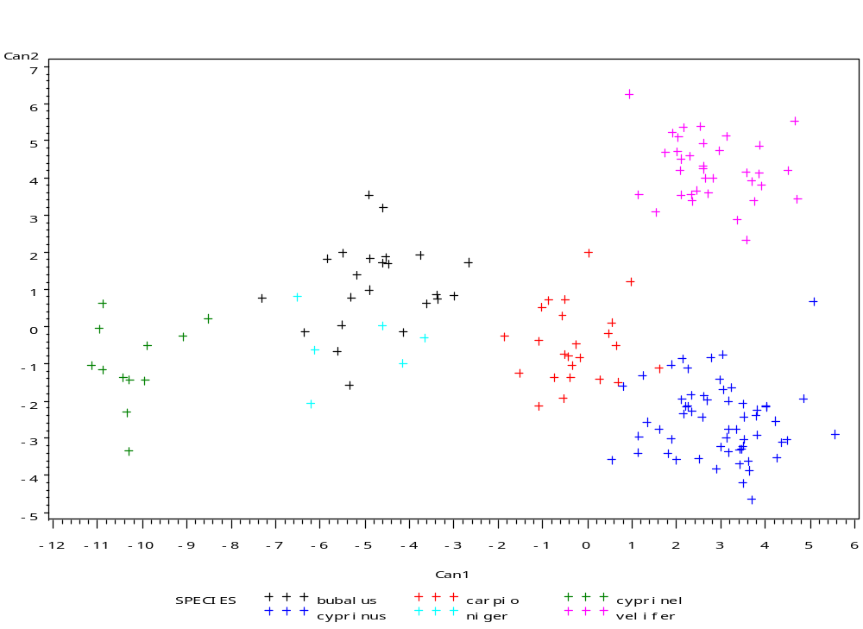
Preliminary analyses results reveal significant variation in
shape among species within a system…
C. velifer
I. bubalus
C. carpio
C. cyprinus
I. niger
I. cyprinellus

Slide 10
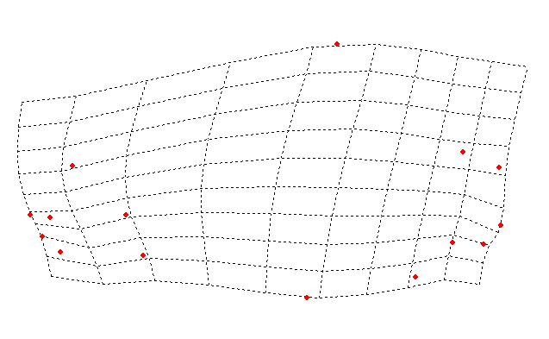
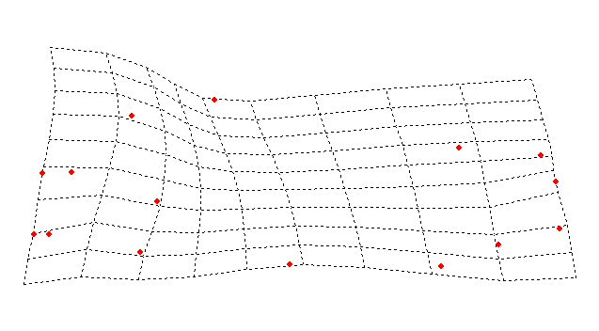
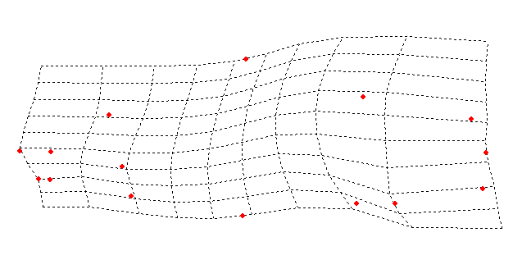
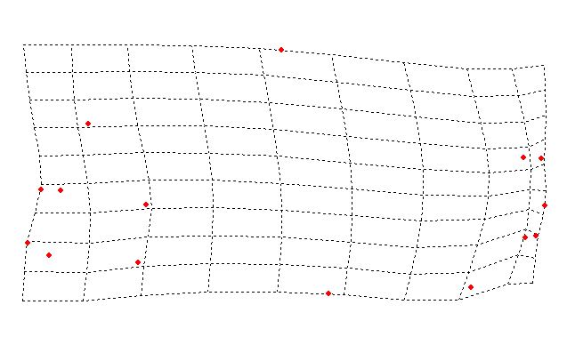
…and among populations within “species”
(C. velifer complex)
5
Lower Atlantic Slope
+ Can 2
4
East Gulf
3
Pearl
2
Mobile
1
CV2
0
-1
-2
Upper Mississippi
- Can 2
-3
Escambia/Choctawatchee
-4
-3
-2
-1
0
1
2
3
4
5
- Can 1
CV1
+ Can 1

Slide 11
Directed Undergraduate Research
In this project, you will gather and analyze data on shape
variation within and/or among certain ictiobine species.
All of the work will be performed on computers using images
of specimens and geometric morphometric techniques.
You will be given instructions on how to access and digitize
landmarks on the images, scale the images, and save the
resulting landmark data.
You will be assisted with data analysis and interpretation.
You will be assigned readings and required to write a paper
based on your findings.

